Slide 1
TutorialBank: Using a Manually-Collected Corpus for Prerequisite Chains, Survey Extraction and Resource Recommendation
Alexander R. Fabbri, Irene Li, Prawat Trairatvorakul, Yijiao He, Wei Tai Ting, Robert Tung, Caitlin Westerfield, Dragomir R. Radev PhD

Slide 2
What is Tutorial Bank?
Collection of 5,600 resources on Natural Language Processing (NLP) as well as the related fields of Artificial Intelligence(AI), Machine Learning (ML) and Information Retrieval (IR)
Notable emphasis on resources rather than academic papers
Search engine and command-line tool for annotations

Slide 3
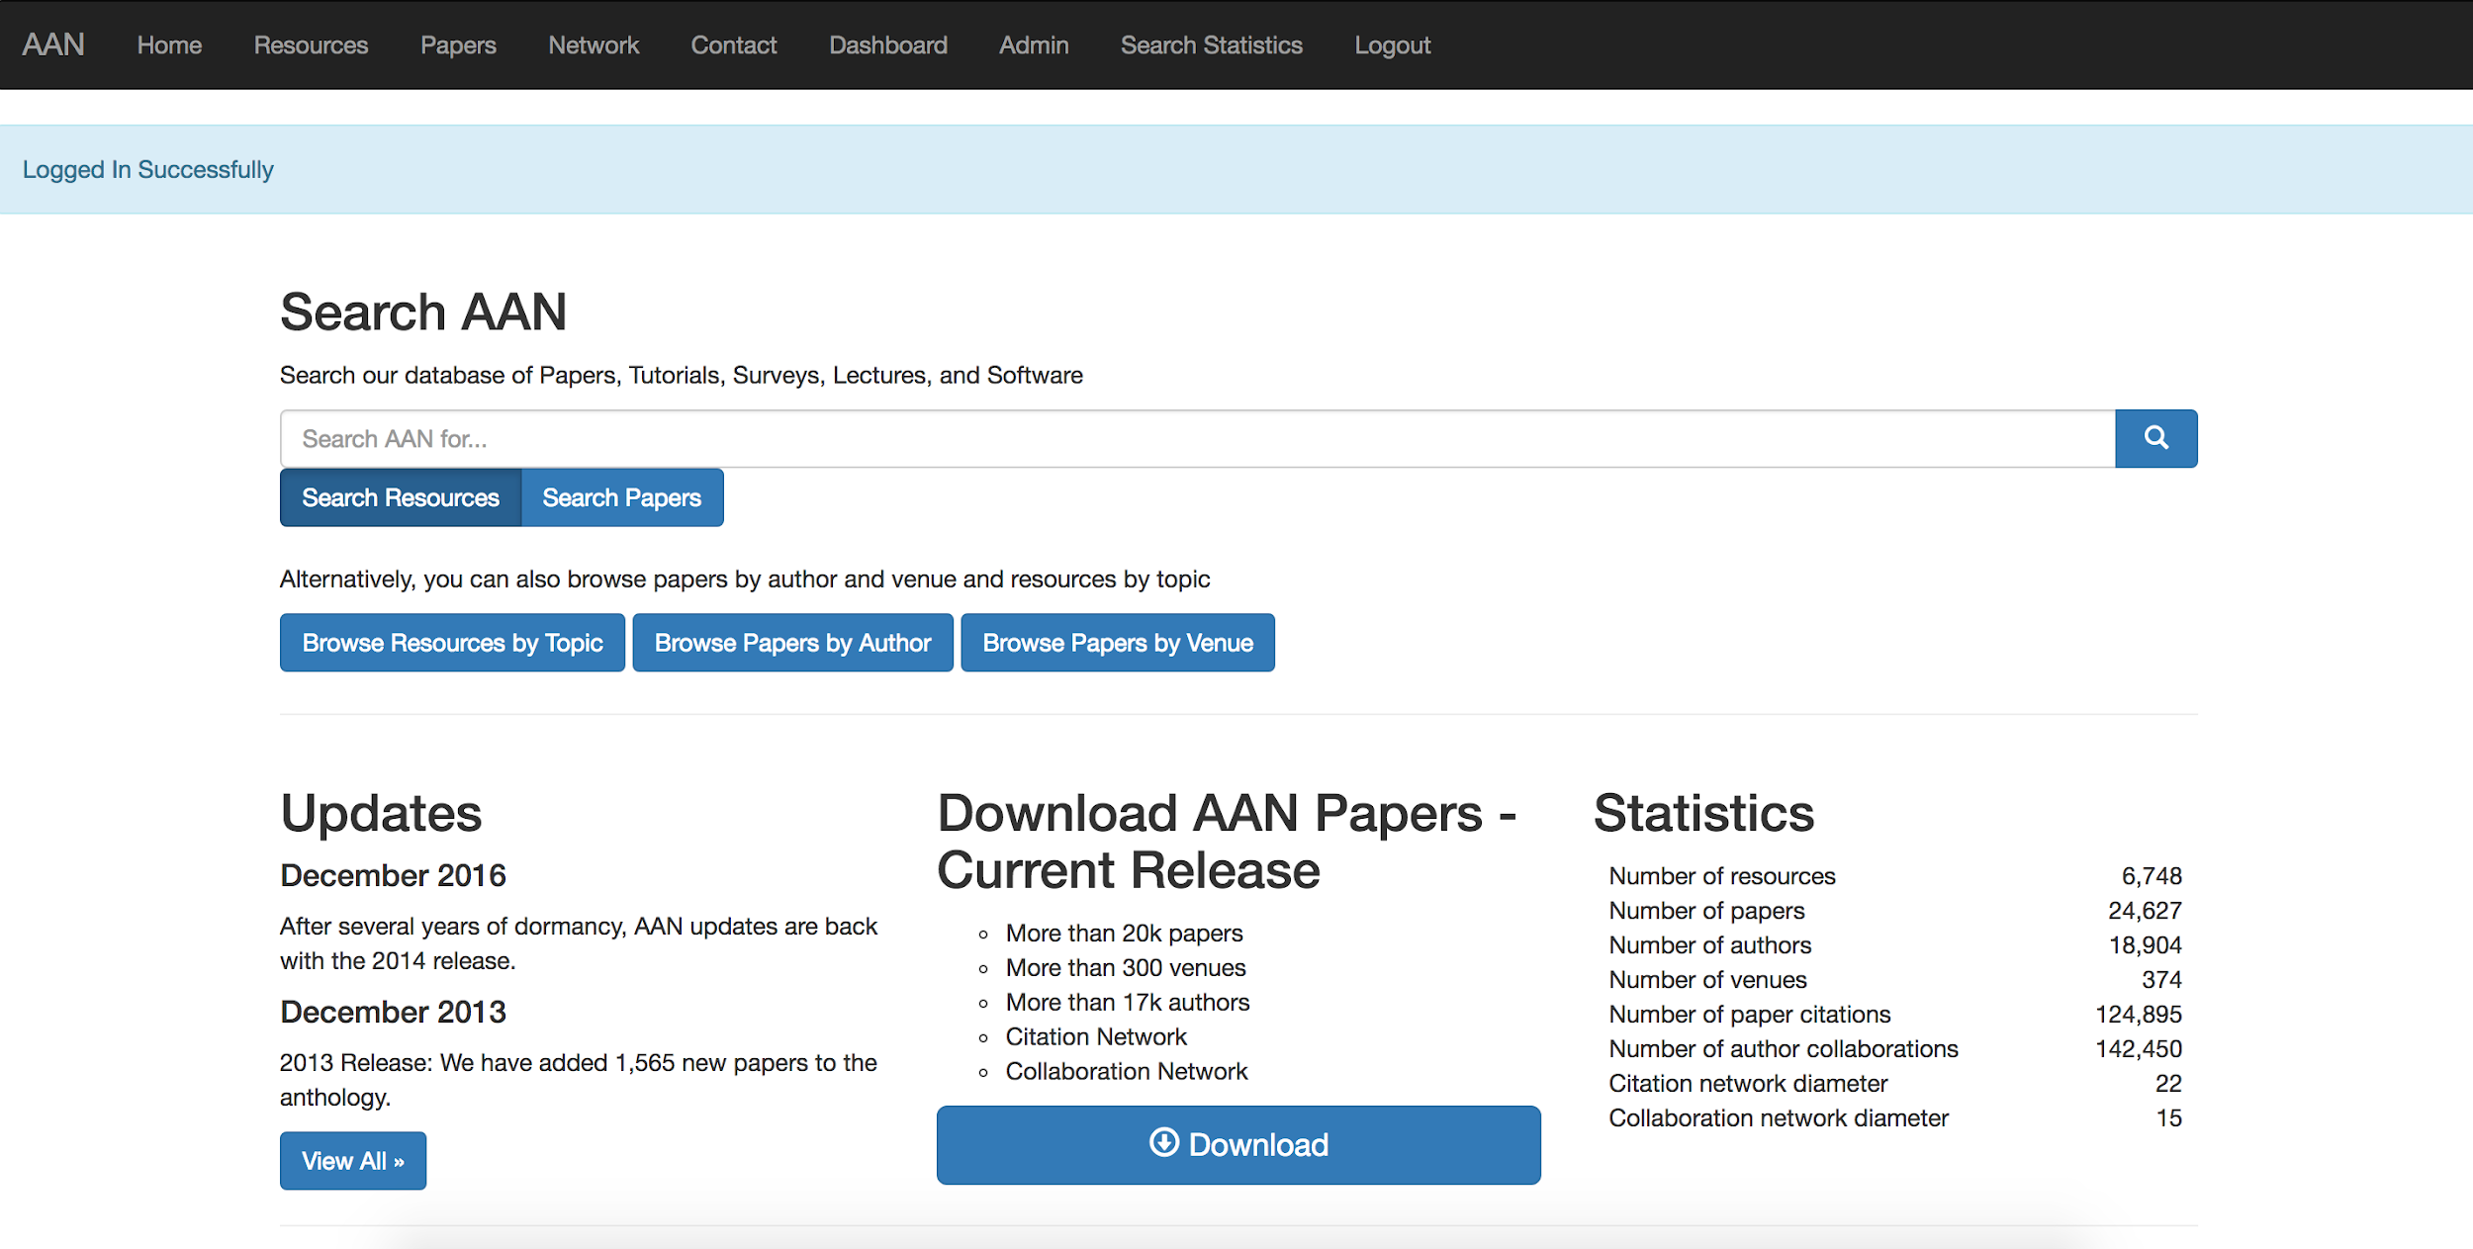
AAN

Slide 4
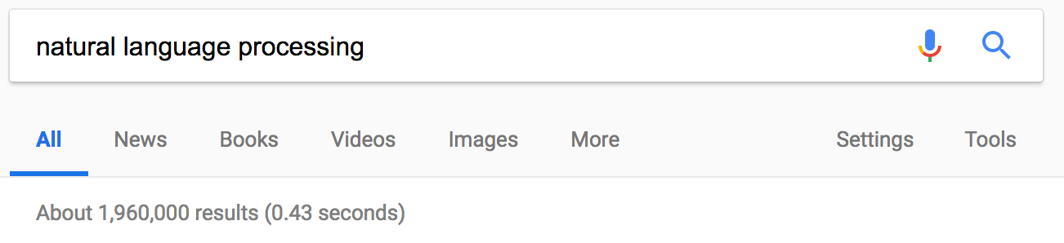
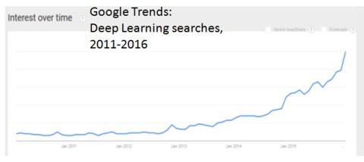
Why Create TutorialBank?
Growth of NLP and related fields
https://www.kdnuggets.com/images/deep-learning-google-trends.jpg

Slide 5
How did we create TutorialBank?
Collection of resources over years
Annotation!
More Annotation!

Slide 6
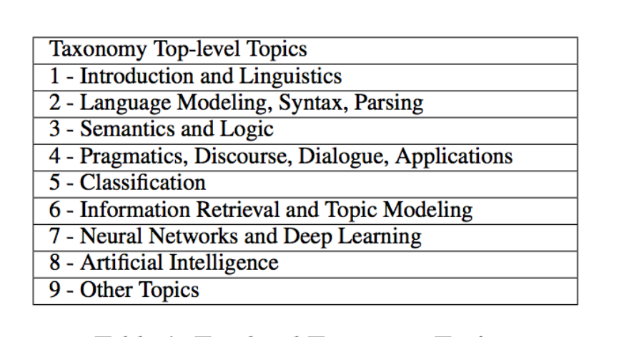
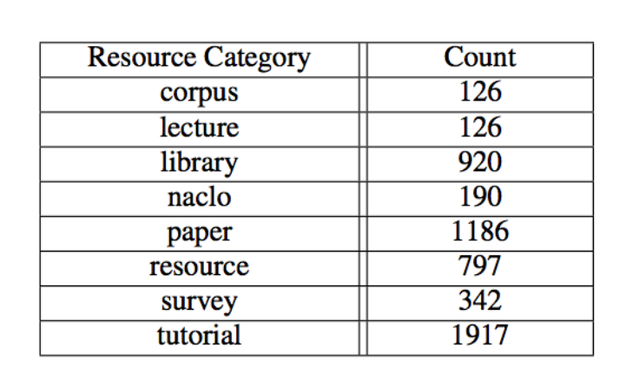
Taxonomy and Pedagogical Function Annotations
The top-level of our taxonomy of 300+ topics and meta-data about the types of resources

Slide 7
Reading List and Content Card Annotation
Reading lists created for 182 of 200 hand-picked topics
3.94 resources per reading list on average for the 182 topics
313 resources split into content cards which we annotated for usefulness in survey extraction

Slide 8
Prerequisite Chain Annotations
Labeled prerequisite annotations for 208 topics
Will understanding topic X help you understand Topic Y?
Our network consists of 794 unidirectional edges and 33 bidirectional edges

Slide 9
Conclusion and
Future Work
TutorialBank is notably larger than similar datasets and unique in its use as an educational tool
We have done initial experiments in topic modeling, survey generation and prerequisite chain discovery (presentations to follow)
Future Work
Refine annotation
Expand taxonomy and coverage
Research in individual areas

