Slide 1
Resource Recommendation for AAN
Robert Tung
Alexander R. Fabbri, Irene Li
Advisor: Professor Dragomir Radev

Slide 2
Outline

Slide 3
Outline
Problem Description
Quick Background
Methods
Results
Future Research
Appendix

Slide 4
Problem Description

Slide 5
Problem Description
User inputs title and abstract of new project
Related previous literature often simple queries
Recommend resources from AAN corpus
Related previous literature largely uses papers
Notes:
The user of this work may input the title and abstract of some new project, and the work in this paper will recommend resources from the AAN corpus to help the user prepare for said project.
There currently exists extensive literature in the realm of recommending scientific papers to others, such as that of Tang and McCalla’s paper “On the Pedagogically Guided Paper Recommendation for an Evolving Web-Based Learning System” in which they base a system on user's learned behaviors and pedagogical functions of papers among other factors.
However, much less literature exists regarding resources such as those in AAN, including tutorials and corpora among other types listed later in this paper. Additionally, recommending scientific papers specifically may make the recommendations largely inaccessible to a beginner in the relevant topics. For this reason, we focus more generally on recommending resources (e.g. tutorials, links, presentations, etc.).

Slide 6
Quick Background

Slide 7
Quick Background (cont’d.)
Pedagogical Value of Resources
Corpus, Lecture, Library, NACLO, Paper, Resource, Survey, Tutorial
Pre-requisite Chains
Reading List Generation
LDA
Doc2Vec
Notes:
Sheng et. al determine pedagogical value of resources in “An Investigation into the Pedagogical Features of Documents”.
A separate but inter-related AAN project deals with pre-requisite chains, which seek to find a graph representation of the topics in a corpus, and the dependency relationships between them. Pre-requisite chains not used in this project’s results but very related in determining the topic structure. See Pan et. al’s “Prerequisite Relation Learning for Concepts in MOOCs”.
Jardine does this on technical papers with ThemedPageRank, and Gordon et. al generates a concept graph and then traverses it to recommend resources for each topic node.
LDA, or Latent Dirichlet Allocation, is an NLP technique that allows for documents to be explained by multiple unobserved topics. It assumes that each document is a mixture of these topics, and that the document is generated probabilistically.
Doc2Vec is an extension of Word2Vec, which creates representations of arbitrarily-sized documents.

Slide 8
Methods

Slide 9
Methods: Baseline Implementation with LDA and Doc2Vec
LDA
Ran unsupervised on 60 topics
Doc2Vec
Ran for 10 epochs
Used each to recommend resources for 10 random papers
From a corpus of ~1500 resources
LDA classifies topic and recommends from the topic
Doc2Vec finds most similar documents
5 annotators score results
Notes:
We began by constructing a baseline implementation of resource recommendation using only each of LDA and Doc2Vec. For this part, we tested on a set of 1,480 files with a vocabulary size 191,446 and a token count of 9,134,452. For each file, tokens were stripped for stop words and stemmed. Additionally, any word with overall counts of less than five across the entire corpus were dropped.
LDA specifically was applied in an unsupervised manner, and used $60$ topics over $300$ iterations as displayed in Figure 2.
Our Doc2Vec model used a hidden dimension size of $300$, a window size of $10$, and a constant learning rate of $0.025$. The model was trained for $10$ epochs \cite{aan}.

Slide 10
Methods: Deep Learning Approach
Built a network for each project / resource pair
Uses topic embedding of each, document embedding of title and text of each, and similarity scores
Assumes document and topic embedding models constan
Neural network on next slide...

Slide 11
Overall Inputs
Our specific inputs
Concatenate
Hidden Layer
Concatenate
Output
LDA topic distr.
Doc 1
Topic Distributions
LDA topic distr.
Doc 2
Similarity Scores
LDA cosine sim.
Doc2Vec cosine
sim.
Score of whether resource 2 is helpful for resource 1
Doc2Vec embedding:
Title of Doc 1
Doc2Vec embedding:
Abstract of Doc 1
Embeddings
Doc2Vec embedding:
Title of Doc 2
Doc2Vec embedding:
Text of Doc 2
Neural Network Architecture
Notes:
Note that this neural network takes in features regarding a \textbf{pair} of resources, and returns a score representing whether resource $2$ is helpful for resource / project $1$. Note also that each time the network is trained and tested, it assumes a constant LDA model, Doc2Vec model, and corpus from which these models are created. Changing these models would inherently change the embeddings and similarity representations, and thus require retraining the network as well.
The inputs that the neural network takes in are: the topic embedding of each, an array of similarity scores from different metrics, and the embedding of the title and text of each resource.
All the above dense layers use $tanh$ as the activation function.
For our training and testing metrics, we use LDA to perform the topic embedding of each, Doc2Vec for the embeddings, and the cosine similarities of the LDA and Doc2Vec representations for the similarity scores. However, note that the neural network code in this project can be reused with any topic embedding metric, any similarity scores, and any embeddings of the title and texts of the resources, by just changing the preprocessing code.

Slide 12
Results

Slide 13
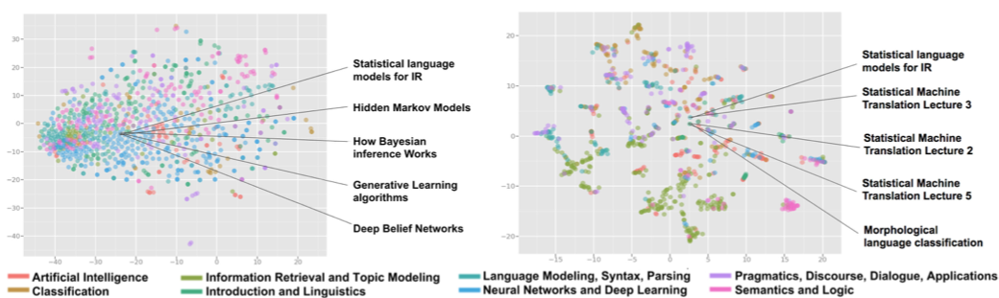
Results: Baseline Implementation with LDA and Doc2Vec
Doc2Vec on left, LDA on right. Resources seem clustered well

Slide 14
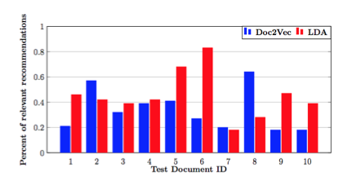
Results: Recommendation with Baseline Implementation
Both can be improved but LDA better overall (0.45 avg vs 0.34)
LDA better on cases 5 and 6 (well-defined topics)
Doc2Vec better on cases 2 and 8 (mix of topics)

Slide 15
Results: Deep Learning Approach
Tested on human-annotated corpus
Used annotations from 10 projects as before
Weighted score based on human annotations (1 positive, -1 negative). 0 for all other pairs.
Evaluated based on whether output was same sign as human annotation
73.79% accuracy on 5 epochs, 74.76% accuracy on 10 epochs.
Much better than baseline 51.46% accuracy

Slide 16
Future Research

Slide 17
Future Research
Other topic and document embeddings
Network Architecture
Other Approaches
Other Evaluation Metrics
Notes:
A future project could determine if LDA and Doc2Vec are indeed the best for topic and document embeddings. Pre-requisite chains may be used.
The network may improve performance with a different structure.
Other approaches may be taken such as query modeling.
Other evaluation metrics may more accurately fit the problem.

Slide 18
Appendix

Slide 19
Appendix
All code for this project can be found at: https://github.com/IreneZihuiLi/aan_rec
All data sets are extracted from the AAN corpus.

Slide 20
Thanks!
Professor Dragomir Radev
Alex Fabbri
Irene Li
Everyone in LILY Lab
Professor John Wettlaufer

