Slide 1
How should I learn:
prerequisite chain learning and
the introduction of LectureBank
Irene Li, Alexander R. Fabbri, Robert R. Tung, and Dragomir Radev 27, Apr, 2018 LILY Workshop

Slide 2
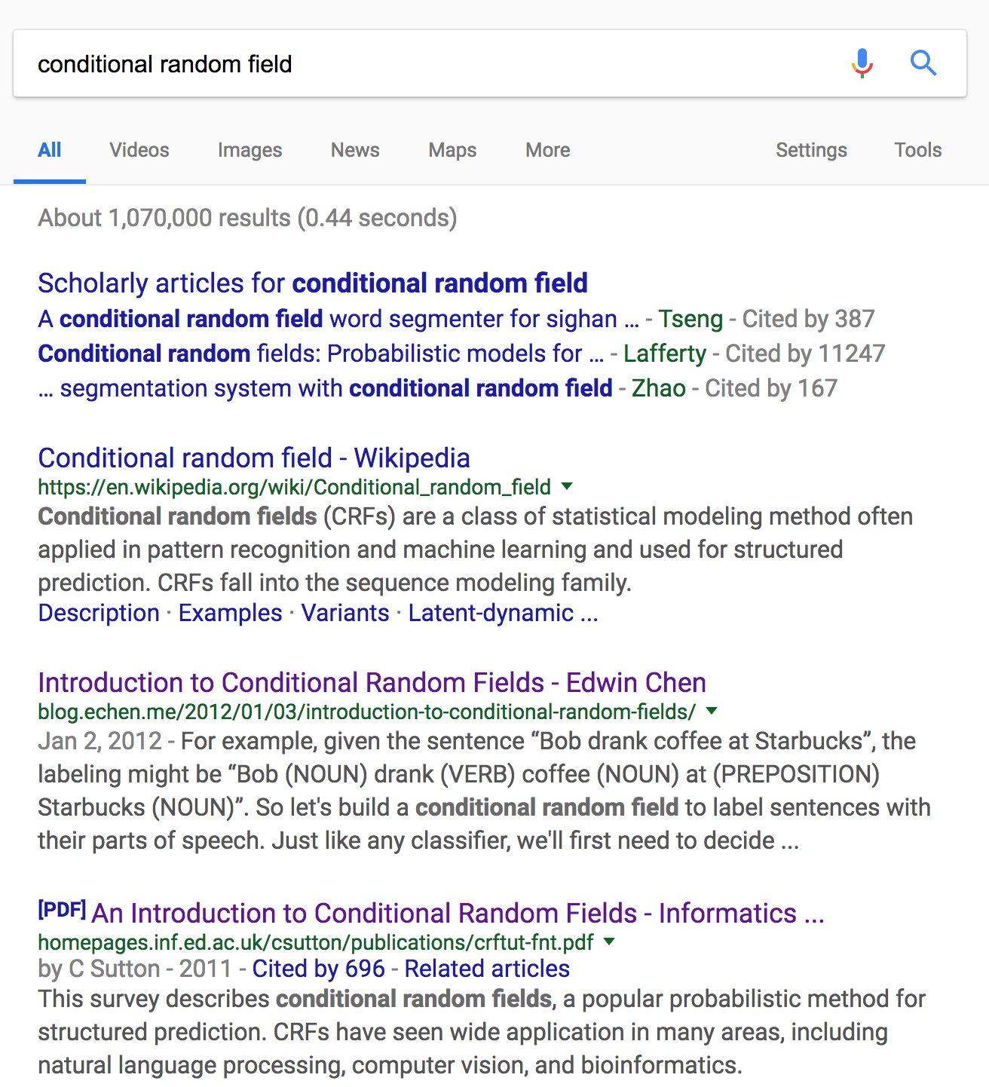
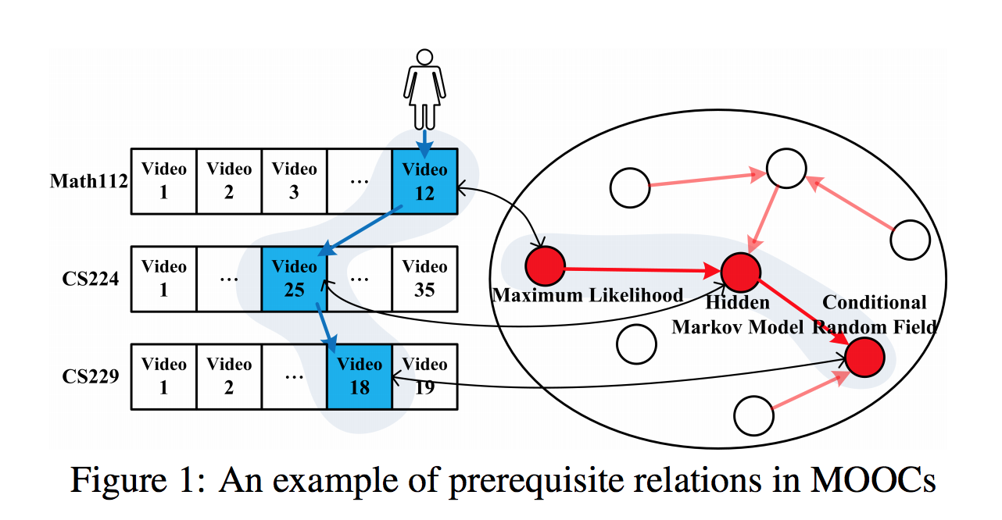
Introduction
Learn a new concept as a student.
Conditional Random Field
Figure: Prerequisite Relation Learning for Concepts in MOOCs

Slide 3
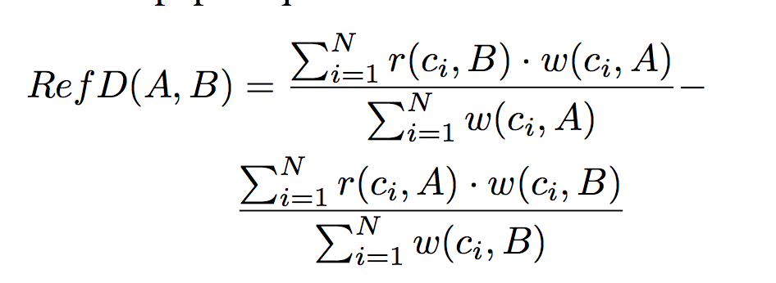
Related Works
RefD (Reference Distance )
models the relationship of two concepts by considering how differently they refer to each other, such as asymmetry and irreflexivity.
Where w(ci,A) weights the importance of ci to A; r(ci,A) is an indicator showing whether ci refers to A, which could be links in Wikipedia, mentions in books or citations.
Liang, Chen, et al. "Measuring prerequisite relations among concepts." Proceedings of the 2015 Conference on Empirical Methods in Natural Language Processing. 2015.

Slide 4
Approach
Step 1: concept representation
Clustering methods, LDA topic modelling.
Topic Labelling: find out which topic is it (keyword rank or TF-IDF)
Step 2: prerequisite relationship learning
Binary Classifiers: NB, LR, SVM, etc
Graph Convolutional Network (GCN): exciting
TutorialBank: rich contents. Word embeddings and document embeddings.
LectureBank: key words and phrases. Graph-based method.

Slide 5
Preliminary Results
Gensim doc2vec on TutorialBank. Concatenate two concept vectors directly.
210 pairs (7/3, train/test)
Method | Precision | Recall | F1
Logistic Regression | 0.720 | 0.758 | 0.739
Naive Bayesian | 0.593 | 0.5634 | 0.613
SVM | 0.624 | 0.569 | 0.596
Notes:
Two vectors: K-L Div
Language models: NLTK distribution (similarity metric) ←---TODO List
NewAAN
Slide-taxonomy (not in our taxonomy)
Use the current AAN as training data + Drago’s lectures: classify
Info from Adjacency slide + same presentation.
Pre-req: orders. Harmonic functions (every slide is a node, define similarity, spectral method) Label propagation
AAN
Lectures. AAN
Introduction semi-supervised learning

Slide 6
LectureBank
Lecture Notes from 26 courses
Total number of slides 527
Total number of tokens: 997074
Total sentence number: 354218
Total page number: 21344, average token per page : 46.7145

Slide 7
Concept Extraction and annotations
Annotate prerequisite relations of concept pairs (~25%): sparse!
LectureBank Concepts + TutorialBank concepts (~210 concepts)
LectureBank concepts extraction: header section -> preprocess -> re-ranking-> list of concepts
Up to now:
998 concepts in total (210 from TutorialBank): a lot!
To annotate 25% of the pairs: ~166550 (?)

Slide 8
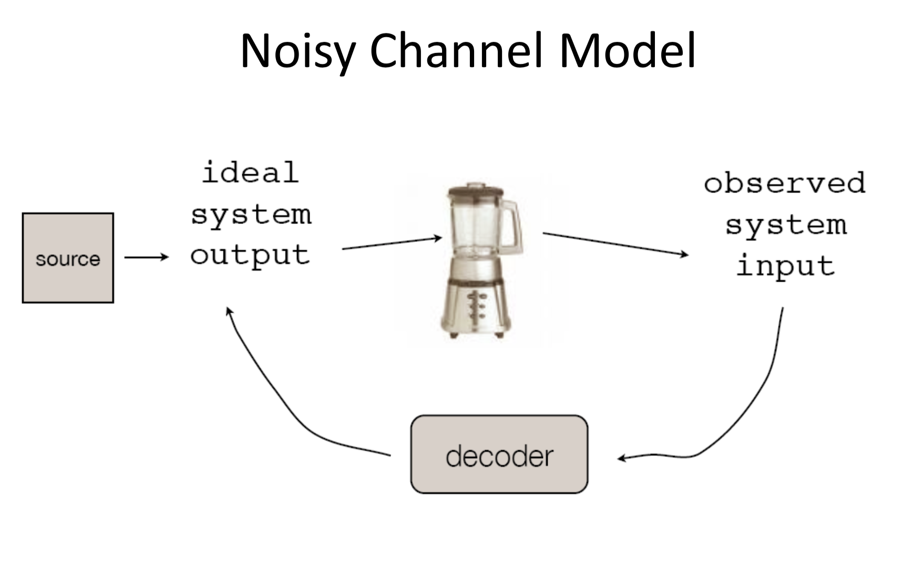
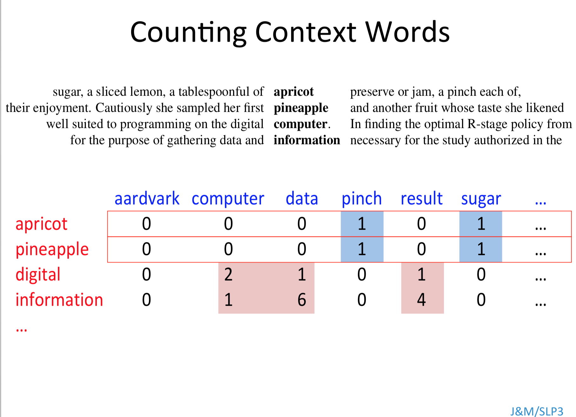
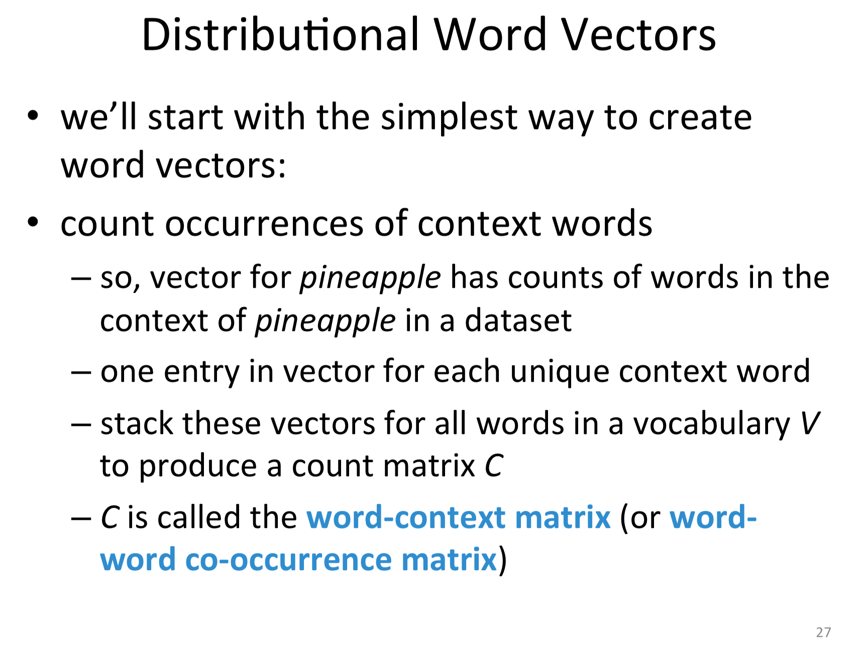
Graph-based approach on LectureBank
Find out the topic of each slide page ? Harmonic Functions, Label Propagation
Other topic..
Word vectors
close
Word vectors
far
?
close
?
far
close

Slide 9
References
Schlichtkrull, Michael, et al. "Modeling Relational Data with Graph Convolutional Networks." arXiv preprint arXiv:1703.06103 (2017).
Moody, Christopher E. "Mixing dirichlet topic models and word embeddings to make lda2vec." arXiv preprint arXiv:1605.02019 (2016).
Pan, Liangming, et al. "Prerequisite relation learning for concepts in MOOCs." Proceedings of the 55th Annual Meeting of the Association for Computational Linguistics (Volume 1: Long Papers). Vol. 1. 2017.
Zhu, Xiaojin, Zoubin Ghahramani, and John D. Lafferty. "Semi-supervised learning using gaussian fields and harmonic functions." Proceedings of the 20th International conference on Machine learning (ICML-03). 2003.

Slide 10
Thanks
irene.li@yale.edu
ireneli.eu

