Slide 1

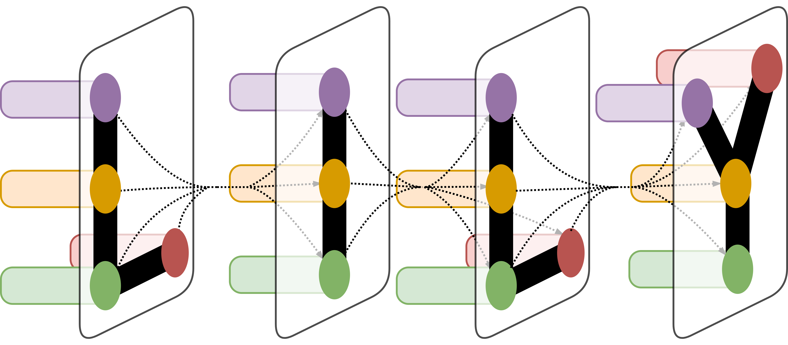
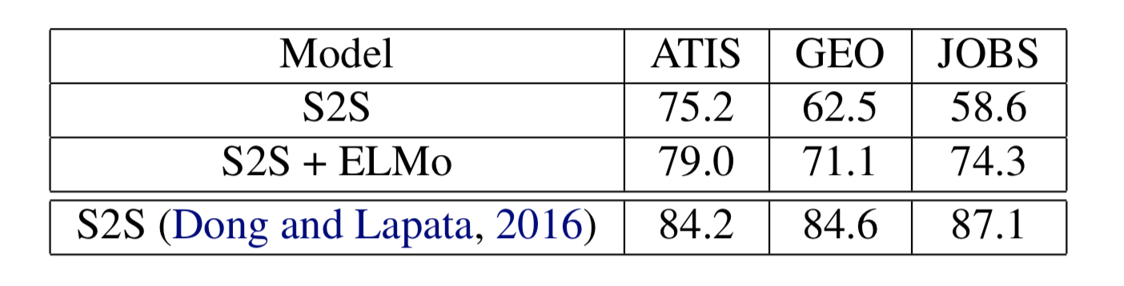
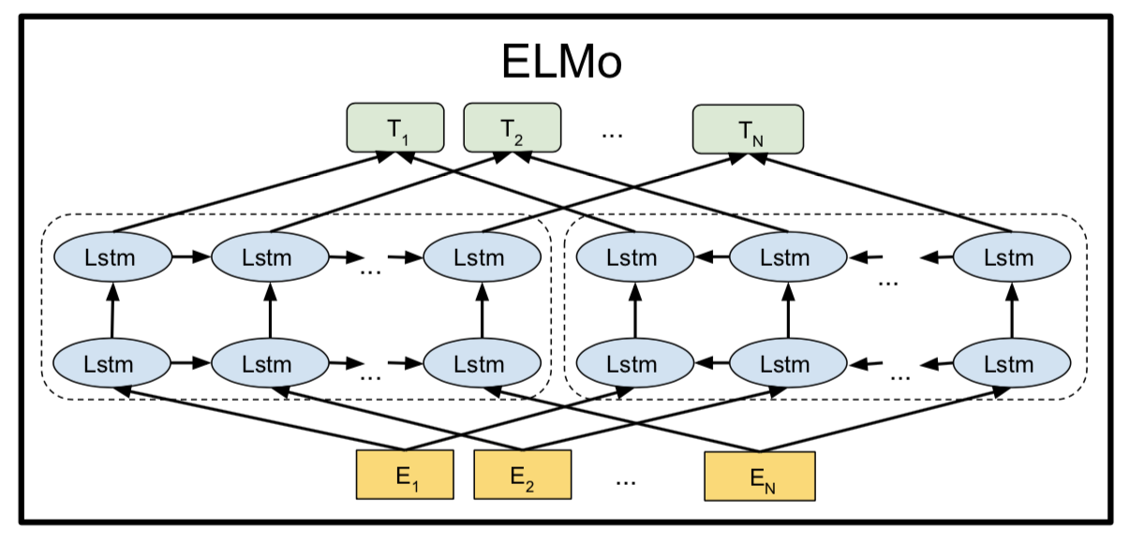
Unsupervised Pretraining for Semantic Parsing
Jack Koch¹
¹Department of Applied Mathematics, Yale University, New Haven, CT
LILY Lab
Introduction
Semantic parsing is the process of mapping natural language sentences to formal meaning representations. Techniques in semantic parsing can be performed on various natural languages as well as task-specific representations of meaning. As in many areas in machine learning, semantic parsing can be learned in either supervised or semi-supervised settings, in which a natural language query is paired with either its equivalent logical form or its denotation. This project represents an attempt to combine recent advances in natural language processing involving the use of language models that have been pretrained on large amounts of data in an unsupervised manner (unsupervised pretraining) with the well-established use of sequence-to-sequence models on semantic parsing tasks.
Results
My results give strong empirical evidence in favor of the effectiveness of utilizing pretrained models for semantic parsing. Although none of my models were able to match the baseline reported by Dong and Lapata (2016), the models with ELMo strongly outperformed my own baseline, which is the more relevant comparison, as differences in implementations and training are controlled for. The ELMo models see absolute gains in performance of 3.8%, 8.6%, and 15.7% on ATIS, GEO, and JOBS, respectively. This supports the trend reported in the literature of pretraining being most important for smaller datasets, as ATIS is the largest dataset, while JOBS is the smallest. These results show that incorporating features that have been pretrained as a language model into a sequence-to-sequence model is a simple way to significantly increase performance; the baseline models were tuned on the validation set to optimize performance, but the ELMo models used exactly the same architecture and training settings with the addition of ELMo features, no further tuning, and noticeably improved performance across the board.
Table 1. Sequence-level accuracies of sequence-to-sequence models, with and without ELMo
Materials and Methods
My baseline is a sequence-to-sequence LSTM network with an attention mechanism. This architecture has already been successfully used in semantic parsing. All experiments utilize the same sequence-to-sequence architecture: a bidirectional encoder with 200-dimensional hidden units and 100-dimensional embeddings, a bilinear attention mechanism, 100-dimensional embeddings for the decoder, and a beam search of 5 for decoding.
My sequence-to-sequence with ELMo model is the exact same architecture described above except for one difference: 1024-dimensional pretrained ELMo features are combined with 100-dimensional GLoVe embeddings to provide 1124-dimensional inputs to the LSTM encoder. The decoder maintains its randomly initialized, 100-dimensional embedding layer.
Figure 1 shows how forwards and backwards LSTM language models are independently trained and weighted and combined to yield the ELMo representation.
Conclusion
In this project, I have demonstrated the effectiveness of incorporating pretrained features into sequence transduction models. The use of language models which have been pretrained in an unsupervised manner in order to improve performance on downstream supervised tasks has been an increasingly popular trend in NLP and used to achieve state-of-the-art results on a diverse set of language understanding tasks. This project extends this trend to the realm of language generation by using ELMo to achieve large increases in performance on semantic parsing datasets.
Figure 1. A visualization of the ELMo biLM used to calculate pretrained representations.
Acknowledgement
Many thanks to Dragomir Radev, Alex Fabbri, and the rest of the LILY lab for their support!

