Slide 1

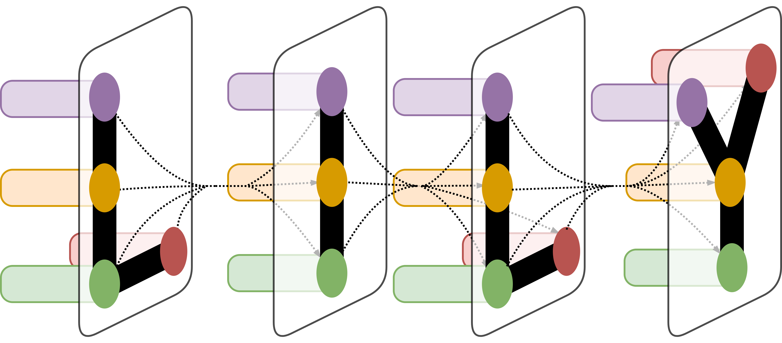
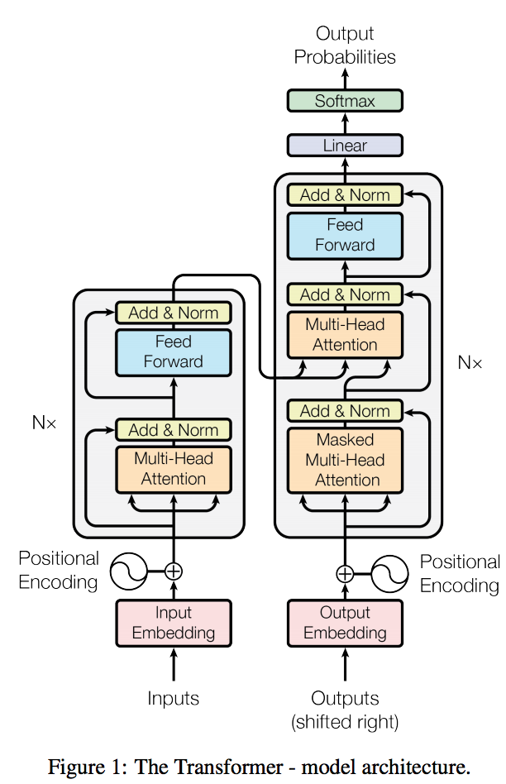
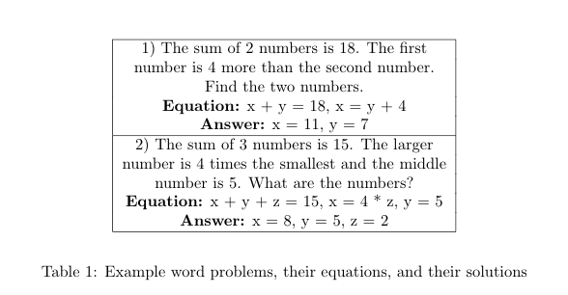
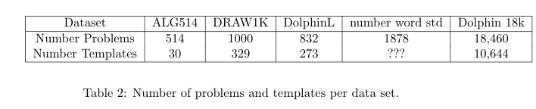
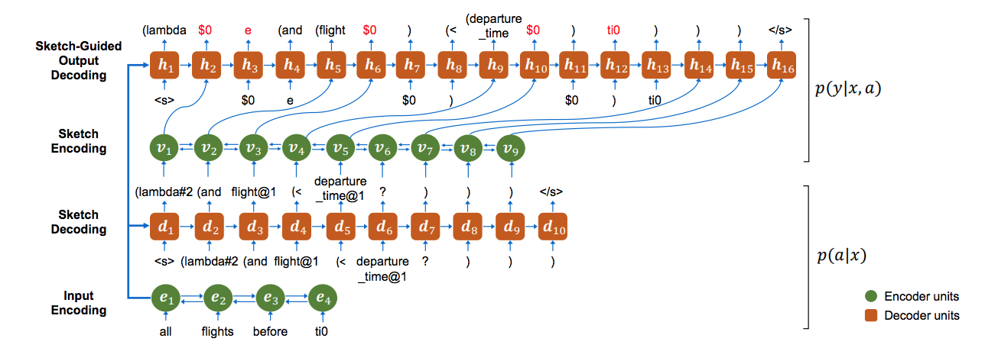
Automatically Solving Mathematical Word Problems
Daniel Keller
LILY Lab
Abstract
Neural Models
This report reviews the current work that is being done in the field of solving mathematical word problems. Following this review, the paper presents the data sets used for the task, the baselines constructed for evaluation, and proposes a new model to try to solve the task at hand. Taking advantage of the larger data sets recently available to the public, the model attempts to use a sequence to sequence system to encode natural language word problems into an intermediate logical form, and then use that intermediate logical form to construct a final equation. The model then uses an alignment model with copying to finalize the equation, at which point a final answer is computed using the equation constructed. Ideally, the paper hopes to show that learning intermediary sketches of word problems helps models deal with new equation templates that have not been seen before.
Approach
With the construction and release of the Dolphin 18k dataset by Huang et al., the math word problem task finally had a data set that was capable of supporting deep learning models. This led to an influx of neural models trying to solve the math word problem task.
Most of these models used sequence to sequence models, treating the math word problem like a generation problem. Feeding the natural language word problem text into the network, the models would then try to generate the equation. This treated math word problem like machine translation.
While most of the neural models proposed treat math word problems as a generative problem, Robaidek et al. wanted to test if the task was better suited as a classification problem. While Robaidek et al. do not compare their models to any of the other published model, they construct several generative based models and classification models and compare them to similarity based baselines. They find that the classification models outperform the simplified generative models.
I want to approach the problem using the information I've gleaned from the currently existing papers and the current state of the art in semantic parsing. In addition the papers discussed above, I plan on testing coarse2fine semantic parsing and transformers, techniques published by Dong et al. and Vaswani et al., respectively.
The coarse2fine model is a generalized approach to turning input (in this case, natural language word problems) into their sketch derivatives. Ideally, I will be able to test using various sketch intermediates, whether these are one of the various semantic intermediate representations proposed by other papers or the generic equation template. Then, coarse2fine takes the intermediate step and outputs a final response. In this case, the final response would be the properly aligned equation ready to be solved by the computer.
Another model I will try will treat the problem as a classification problem. Instead of using BiLSTMs, I want to try to use transformers (with the word problem as input) to classify which template corresponds to a given word problem.
Introduction
Solving mathematical word problems is an extremely challenging semantic parsing problem. While the task has been of interest to computer scientists for quite some time, little progress has been made. Recently, smaller sized datasets seemed to lead to the construction of promising template based and feature based models.
Template based models tried to learn features for each "template type" of problem, where a template is a certain equation form (e.g. a mathematical expresssion with variable slots and number slots, such as n1 * x + n2 = n3 versus (x - n1) / (x-n2) = n3) that different word problems attach to. Additionally, many template based models try to learn intermediary languages to help identify which template may exist.
With all of this information, these template based models then treat mathematical word problem solving as a classification task followed by an alignment task. If one can classify which type of template a word problem corresponds to and then fill in the subsequent number slots with the information provided from the word problem, one can then use normal computer mathematical processing to compute the solution to the unknown variables.
Conclusion
Problem Statement
Unfortunately, due to a large workload this semester, I am still in the process of writing code in order to test my hypothesis.
However, through my literature review, I have identified that mathematical word problem solving is a challenging semantic parsing problem; however, recently released large-scale datasets open up the possibility of new neural models. Since this happened very recent, there are very few published models, and there is significant space in this field to make a mark.
Given a mathematical word problem written in natural language, identify the underlying math problem being asked and solve it. Math word problems can be of various lengths, include superfluous information, and require common sense knowledge (e.g. how many days are in a week) to answer.
See Table 1 for an explanation.
Figure 2: The diagram for coarse2fine semantic parsing
Acknowledgement
This is a body of text that will repeat over and over until it fills up the page. It requires little thought but says a great deal about layout design.

