Slide 1

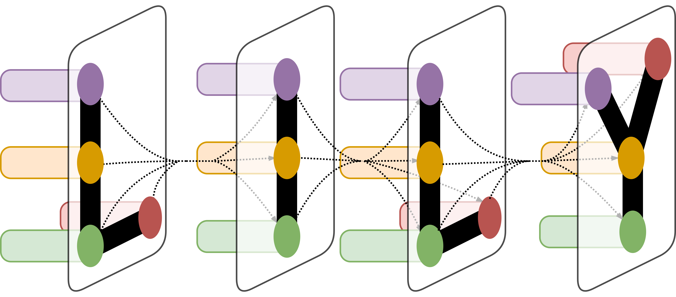
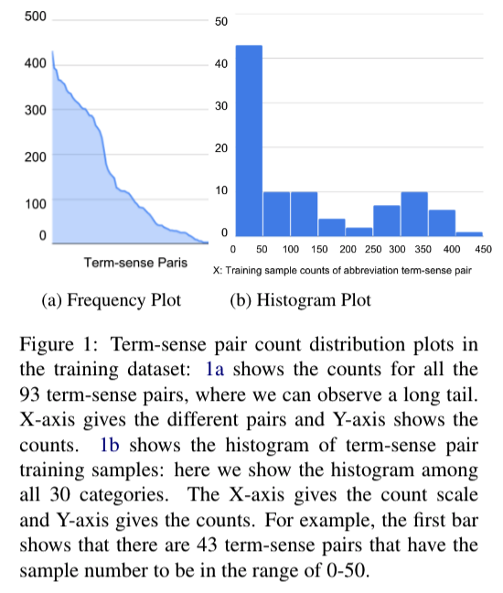
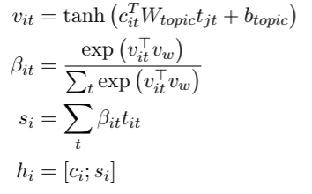
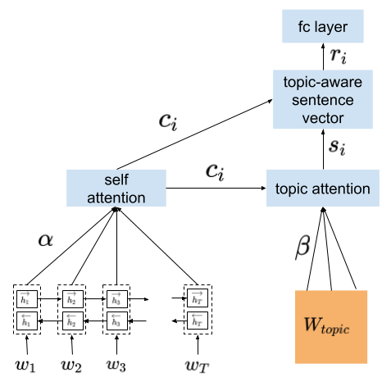
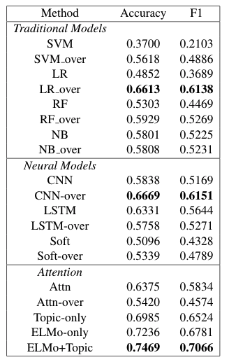
A Neural Topic-Attention Model for Few-shot Learning on Clinical Notes
Irene Li,¹ Muhammed Yavuz Nuzumlalı,¹ and Michihiro Yasunaga, ¹ Cesar Caraballo, ² Shiwani Mahajan², Harlan Krumholz² and Dragomir Radev¹
¹ Department of Computer Science at Yale, New Haven, CT and ² Department of Research, Yale School of Medicine, New Haven, CT
LILY Lab
Introduction
Clinical notes text processing are attracting more and more attention nowadays. However, many existing methods would fail due to the challenges like limited annotated training data and out of vocabulary. While the annotated clinical notes are always scarce, and expensive to get various annotated clinical notes among NLP tasks, and it is quite common that the datasets are extremely unbalanced. Few-shot learning approaches become a promising method to tackle these issues. In this paper, we propose a neural topic-attention model to enhance the ability to learn sentence representations by applying the method to a special classification task in the medical domain, namely medical term abbreviation disambiguation. Our model consists of a Bi-LSTM (Bidirectional-Long Short Term Memory) layer, a sentence attention module and a CNN (Convolutional Neural Network)-based topic attention module. We show that by bringing topic information into the sentence representation would improve the overall classification performance on small-scale unbalanced training datasets. We train our model on about 30 different abbreviation datasets extracted from a public abbreviation disambiguation dataset and test on manually-created balanced datasets. The training and testing datasets could be made public shortly with certain applications needed.
Figure 1. Histogram of Term-Sense Pair
Figure 3. Topic Attention Model Illustration.
Model and Results
We applied a Bi-LSTM based model to do classification. As shown in Figure 1, we first apply the Bi-LSTM layer to encode the input sentences, then apply an attention model on top of the word level. After we get the content vector, it will be the input to the topic attention module. We pre-train an LDA model to get the top words for each topic, then applied a CNN on top of the top words to generate the topic representation. The topic attention is to calculate a weighted summation over all the topic vectors. Eventually, we concatenate the content vector and the topic representation as a topic-aware sentence vector to do the classification as shown in Figure 3.
Table 1. shows the accuracy and F1 score on the 30 categories. Our base model is to use a pre-trained doc2vec model to get the embedding of all the words. (w2v); we then apply oversampling (Oversampling) and CNN-topic model (Topic). Oversampling does not help in the performance. We try with the ELMo embeddings (ELMo) and a combination of topic attention with ELMo embeddings (ELMo+Topic). It is obvious that our proposed model, the topic-attention model could do better in both accuracy and F1 score.
Table 1. Accuracy and F1 score on 30 categories.
Conclusion
Dataset
In the paper, we show our neural topic attention model with few-shot learning in the task of medical abbreviation disambiguation task. Our model tries to bring both topic and the content information into consideration when formulating the task into a classification task. We trained our model on small-scale unbalanced datasets but tested on balanced ones, and the performance improves the accuracy by a large margin. We show that bringing topic information may improve the task of classification when training sample is rare.
UM Inventory was created by researchers from University of Minnesota, the public dataset contains about 37,500 training samples with 75 abbreviations, and each abbreviation has about 500 samples. Our dataset contains 30 categories or abbreviation terms, for example AB. In each category, there are a different number of senses, like AB as abortion and AB as arterial blood where we call them term-sense pairs. Among all the categories, we have 11466 samples, and 93 term-sense pairs in total (in average 123.3 samples/term-sense pair and 382.2 samples/abbreviation term). Please note that, our task deals with small-scale unbalanced dataset.
…. 2. Potential biliary dilatation. We will get an ***MR*** cholangiogram, interventional radiology will plan on stenting her if she has distal obstruction….
Sean complains of little to no pain. A ***VBG*** obtained on the day of admission showed pH of 7.36, CO2 of 54, PO2 of 53, and bicarbonate 30.
‘MR as “magnetic resonance”’ ?
‘VBG” as “venous blood gas”’ ?
Acknowledgement
Figure 2. Two examples of the training dataset: where in this case.
Special thanks to Cesar and Shiwani for their efforts to create the wonderful testing dataset. My sincere gratitude also goes to Yuang who drove me to Chinese restaurants and Yiliang who watched movies with me when I worked on this amazing project.

