Slide 1

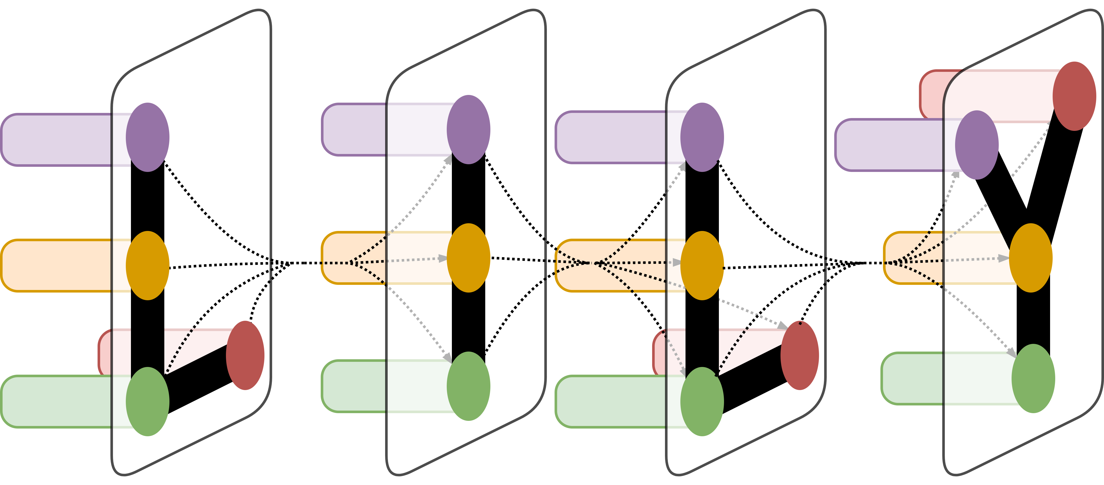
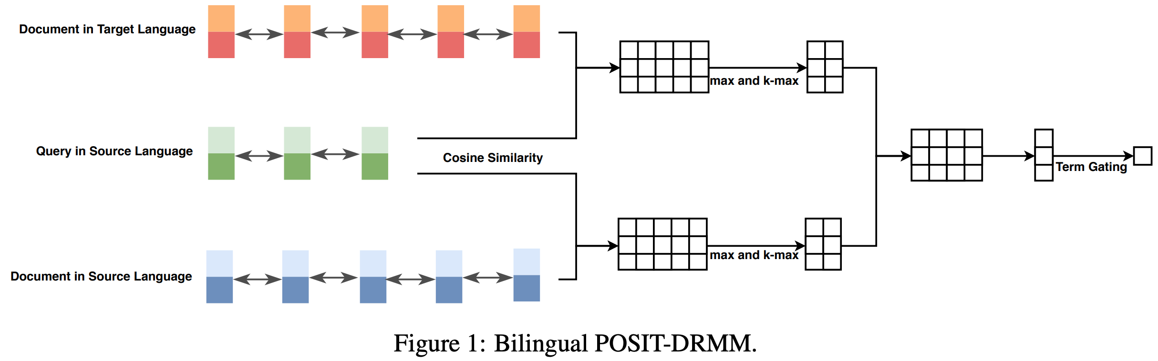
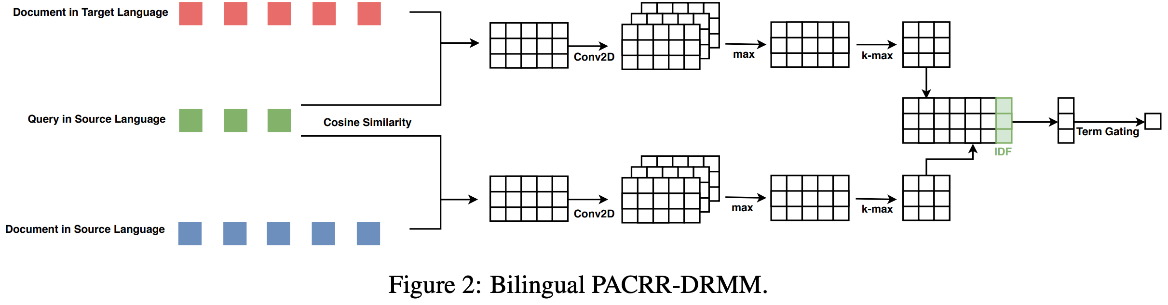
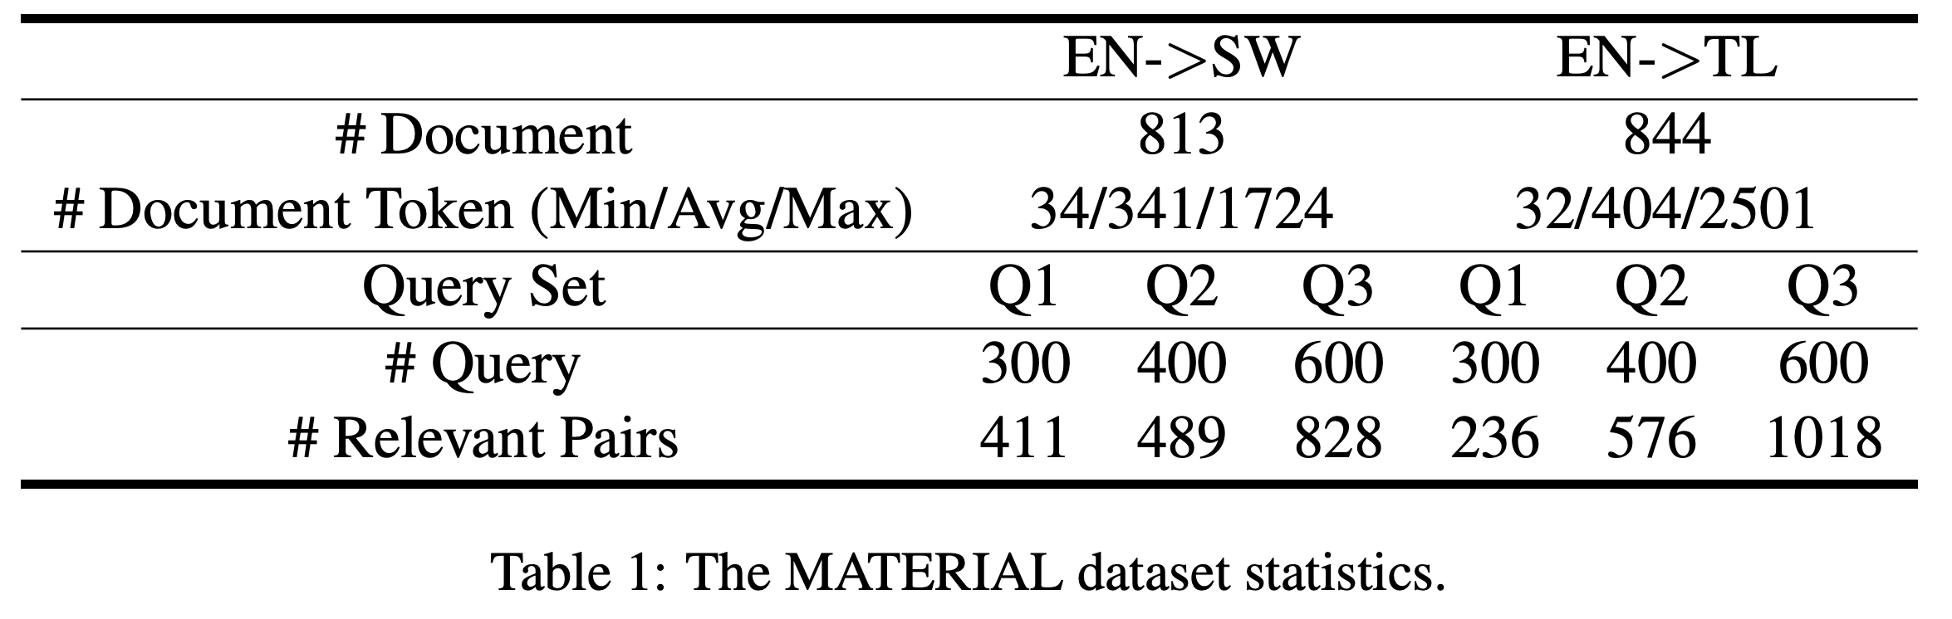
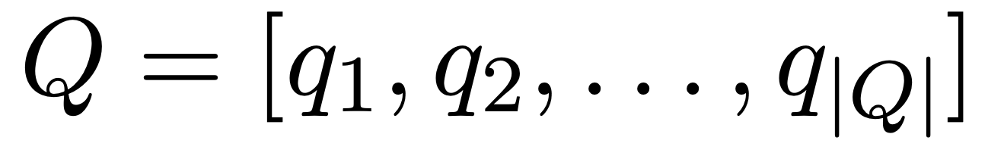
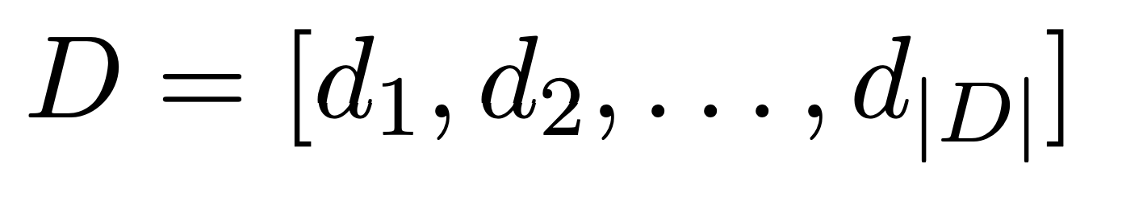
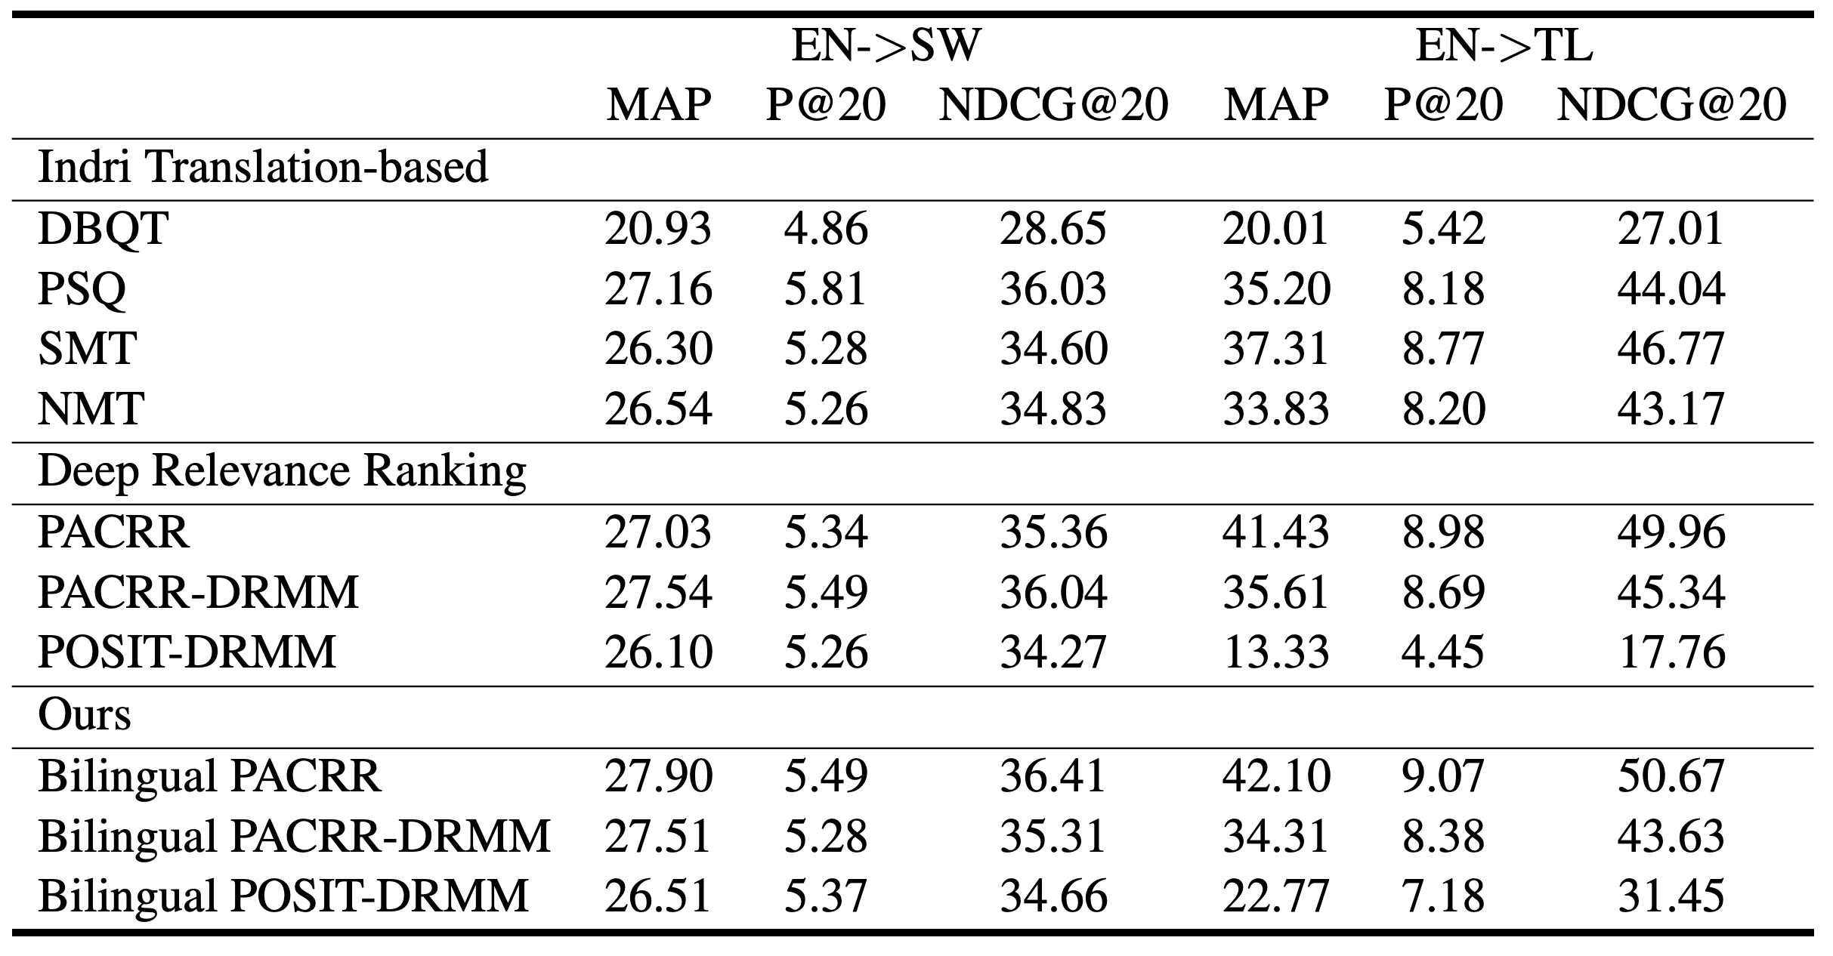
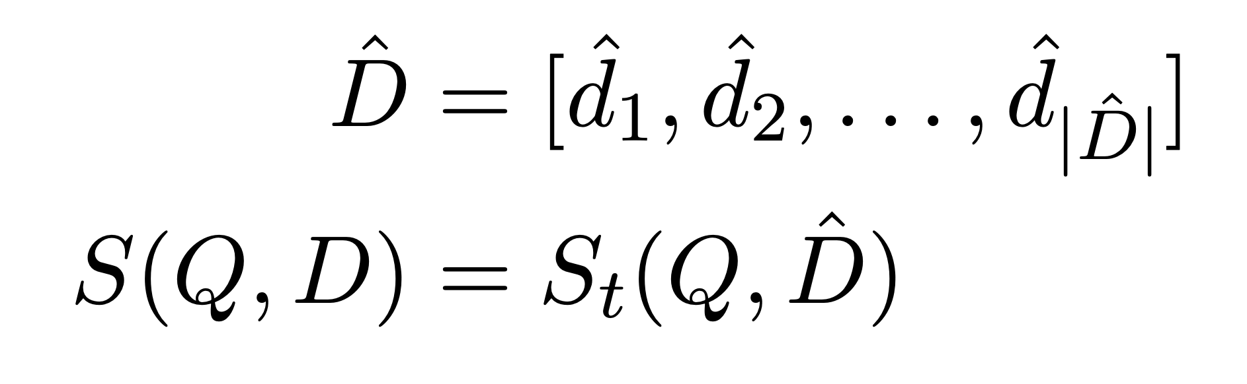
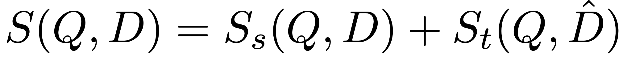
Cross-lingual Deep Relevance Ranking with Bilingual Document Representations
Rui Zhang
Yale University
LILY Lab
Cross-lingual Information Retrieval (CLIR)
Our Model Architecture
Experimental Setup
Cross-lingual Deep Relevance Ranking, or Cross-lingual information retrieval (CLIR), is the task of ranking a large foreign document collection against a user query using only the text of documents.
In cross-lingual information retrieval, the language of the user query differs from the language of the document collection.
As multilingual documents are more accessible, cross-lingual information retrieval is becoming increasingly more important whenever the relevant information is in other languages.
For example, an English speaker traveling in the Philippines wants to find information about local food when all the relevant information is only in Philippine languages.
Dataset: Our experiments are evaluated on the data sets from the MATERIAL program. It consists of two language pairs for cross-lingual information retrieval: (1) English queries on Swahili documents (EN->SW), and (2) English queries on Tagalgo documents (EN->TL). We use the ANALYSIS document set for our experiments. The queries are divided into three sets (Q1, Q2, and Q3) and we use Q1 as the training set, Q2 as the develop set, Q3 as the test set.
Cross-lingual Word Embeddings: We apply the supervised iterative Procrustes approach to align cross-lingual word embeddings using the MUSE implementation. The supervised Procrustes approach learns an orthogonal linear mapping to align two monolingual word embeddings from the source language to the target language. For monolingual word embeddings we download fastText embeddings. To build bilingual dictionary, we use the translation pages of Wiktionary. We then learn the cross-lingual word embeddings from Swahili to English, and from Tagalog to English. Therefore, all three word embeddings are in the English word embedding space.
CLIR by Document Translation
In cross-lingual document retrieval, the system is given a user query in the source language:
and a document in the target language:
The system output will be the relevance score between the query and the document as s(Q,D).
We then use the relevance score to produce a ranked list of documents with reppect to the query.
By machine translation, we can get a translated document in the source language, and the problem is reduced to a monolingual retrieval problem by:
Experimental Results
CLIR with Bilingual Document Representations
we propose to improve the translation-based CLIR with a bilingual view of learning-to-rank models.
To this end, our model consists of two separate components, one that matches the query with the translated document in the source language, one that matches the query with the document in the target language.
The final relevance score combines both components which are jointly trained given the relevance labels:

