Slide 1

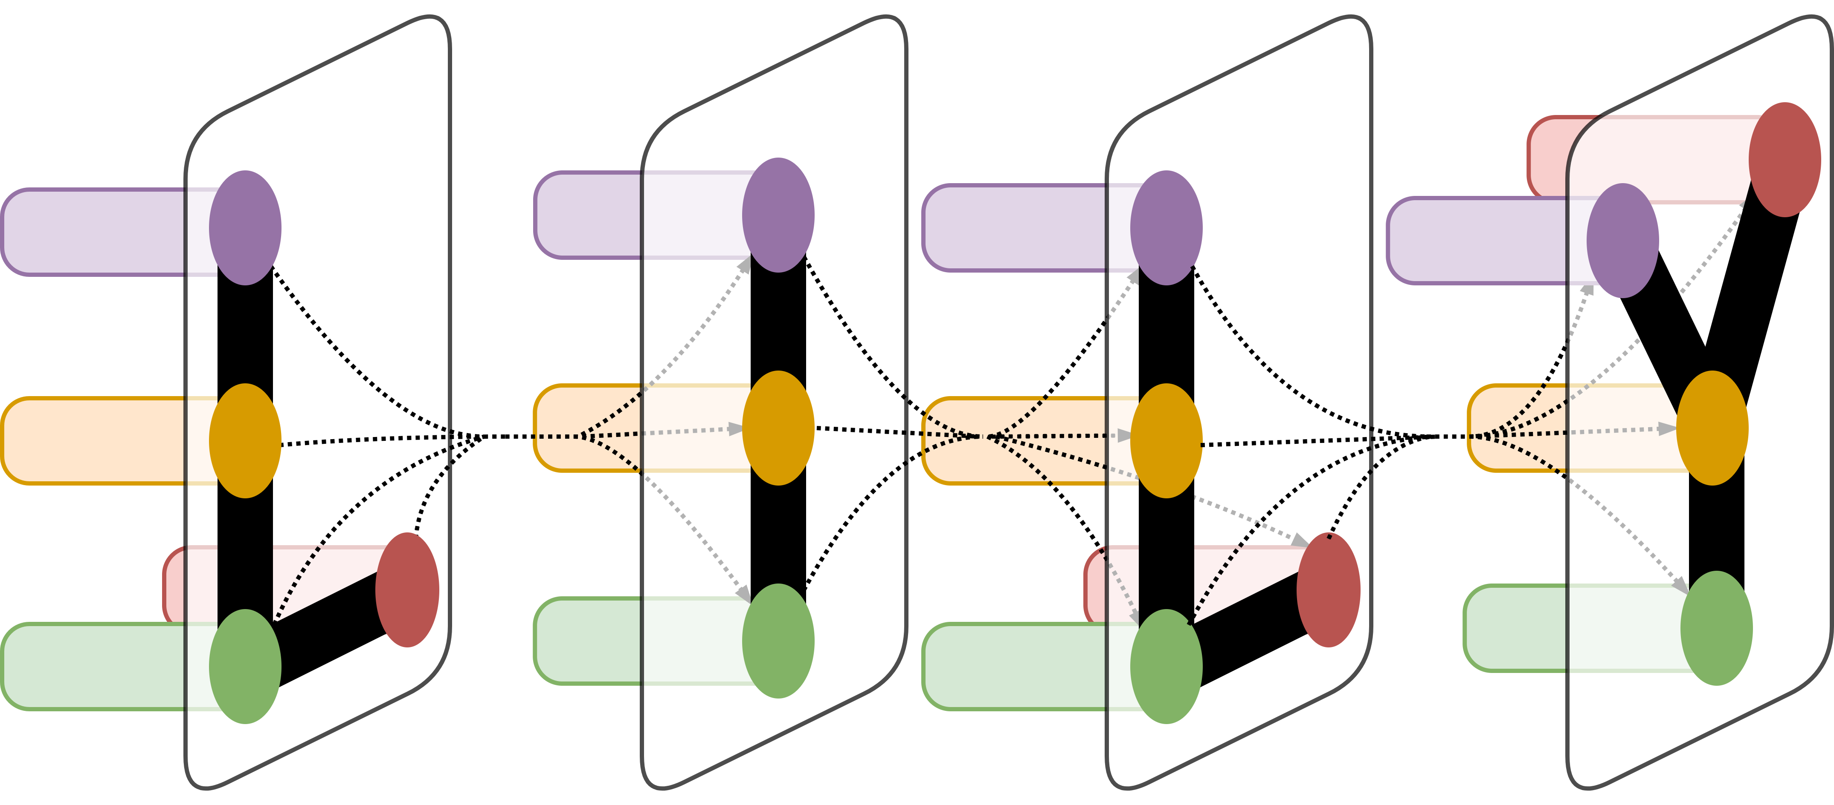
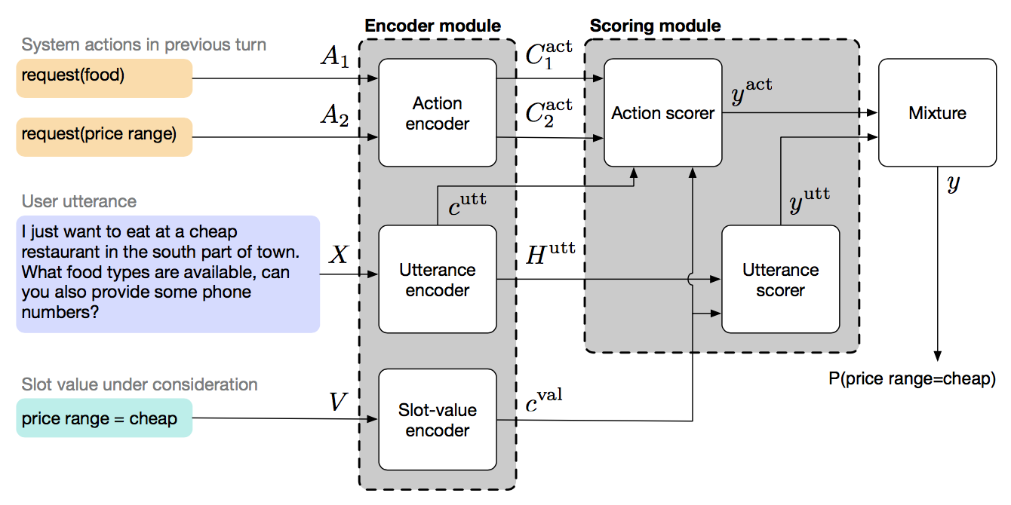
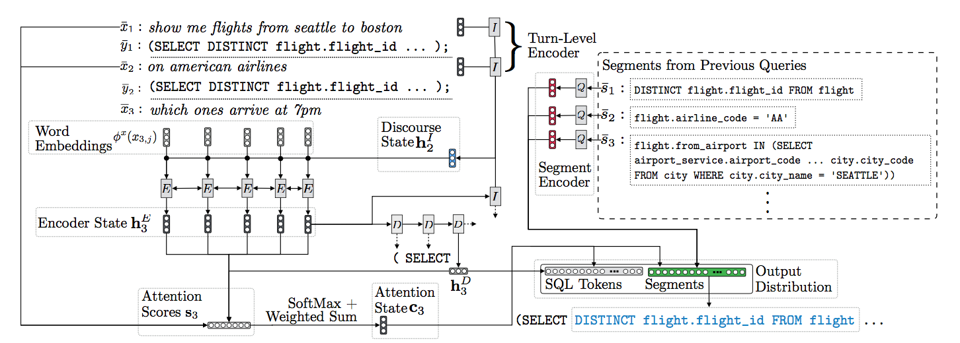
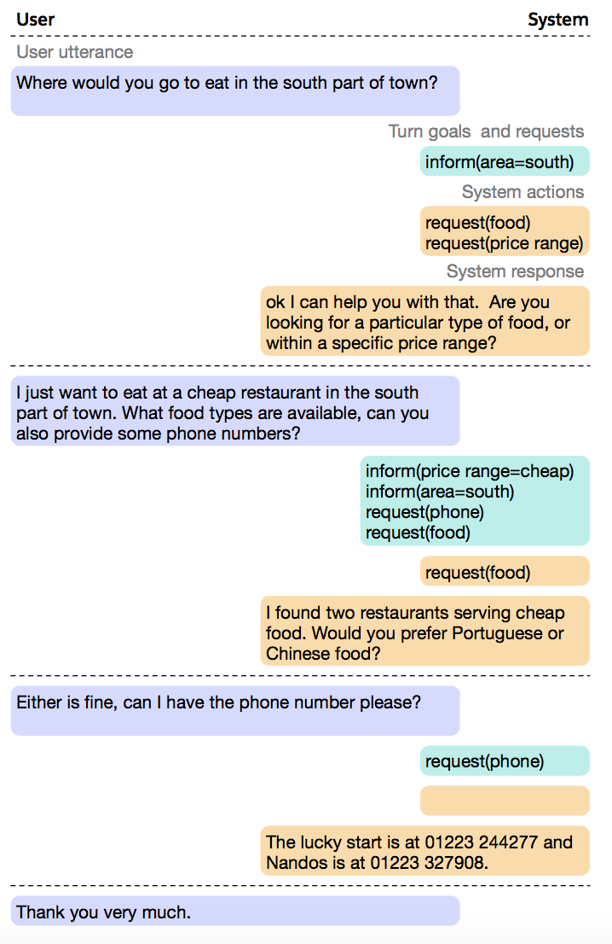
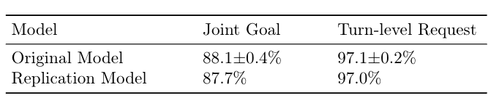
Dialogue State Tracking & Dialogue Corpus Survey
Suyi Li, Tao Yu, Dragomir Radev
LILY Lab, Yale University
LILY Lab
Introduction
Table 1. Comparison of Existing Dialogue Corpus
Dialog system is an automatic human-computer conversation system that intends to converse with a human with a coherent structure. With the development of big data and deep learning techniques, the goal of creating an automatic human computer conversation system is no longer an illusion. One of the challenging tasks in dialogue system area is dialogue state tracking, which aims to find requests and goals expressed in the user utterances. Encoder-encoder and attention mechanism are applied to solving this problem, which are proven to be effective. In the future, we will base on dialogue state tracking to develop our new dialogue system task.
My work includes: 1. Survey the current dialogue system papers. 2. Analyze the current corpus used to build dialogue systems. 3. Collaborate with Tao to define and refine the task settings for new dialogue task.
And the future work includes: 1. build up our large-scale and cross-domain corpus for new dialogue system task. 2. Develop baseline models on corpus to prove usability.
Metric
MultiWOZ
WOZ2.0
Frames
DSTC2
Dialogue Corpus
#Dialogues
8438
600
1369
1612
One of the big challenges in developing a large-scale and cross domain dialogue system is the lack of high-quality labeled data in large-scale corpus. In order to detailly define the task settings of the coming dialogue task, I conducted a survey of the existing dialogue corpus, including MultiWoZ 2.0 and Frames, and mainly focused on the pipeline of data collection. MultiWoZ is entirely developed based on crowd-sourcing without the need of hiring professional annotators. The data collection process is human-to-human using Amazon Mechanical Turk. In the conversation, dialogue systems act as assistants to answer users’ questions and help users with restaurant reservation, information query and taxi booking, etc.. Another dataset is Frame, which consists of 1369 human-human dialogues with an average of 15 turns per dialogue. The authors formalized the frame tracking task in their work, which extends the state tracking task to a setting where several semantic frames are simultaneously tracked throughout the dialogue. All values discussed in the conversation are recorded in the frames so that the users can access to the previous constraints at any point. Besides, datasets such as, DTSC2, WOZ2.0 are similar datasets. More details could be found in Table 1.
Avg. turns per dialogue
13.68
7.45
14.60
14.49
Avg. tokens per turn
13.18
11.24
12.60
8.54
Total unique tokens
24071
2142
12043
986
#Slots
25
4
61
8
#Values
4510
99
3871
212
Figure 2. Overview of the GLAD architecture [1].
Dialogue System Research
In the project, I surveyed and replicates several papers of dialogue system research. These papers are related to dialogue state tracking and our future dialogue system work. One of the influential work is the Global-Locally Self-Attention Dialogue State Tracker (GLAD) [1]. The model focus on the rare slot value pairs in the training dataset and is able to track these slot value pairs. Two modules are employed in the mode. The global module shares parameters between each slot and the local module is responsible to learn slot-specific features. Experimental results show that the GLAD model outperforms the state-of-the-art models. Another important work is proposed by [2]. Their work mainly focus on mapping natural language sentences to SQL query, which is related to both semantic parsing and dialogue system. The model adopts encoder-decoder architecture with different mechanism to improve the model performance. For example, a turn level encoder is added to understand the context in the conversation. Experimental results show that mechanisms to handle contexts lead to higher denotation accuracy.
Conclusion and Future Work
Figure 3. . Illustration of the model architecture during the third decoding step while processing the instruction which ones arrive at 7pm from the interaction [2]
During this semester, I mainly focus on dialogue state tracking challenge and how to develop dialogue corpus for new dialogue system task. Encoder-decoder architecture with attention mechanism is proven to be effective in dialogue state tracking research. I surveyed and replicated several papers in this area. However, one of the biggest challenges for dialogue system task is the lack of high-quality cross-domain corpus. In the next months, I will devote myself to developing our corpus with Tao and build models to prove the usability and sets a baseline for future studies.
Table 2. Replication Results of the GLAD model.
Reference
[1] Victor Zhong, Caiming Xiong, and Richard Socher. “Global-Locally Self-Attentive Dialogue State Tracker”. In:
Association for Computational Linguistics (ACL). 2018.
[2] Alane Suhr, Srinivasan Iyer, and Yoav Artzi. “Learning to Map Context-Dependent Sentences to Executable Formal Queries”. In: North American Chapter of the Association for Computational Linguistics: Human Language Technologies (NAACL-HLT). 2018.
Acknowledgement
I would like to acknowledge Prof. Dragomir Radev for his supervision of my project. Also, I feel grateful to Tao Yu for his guidance and help in the through the progress.
Figure 4. Example of dialogue state tracking task.

