Slide 1

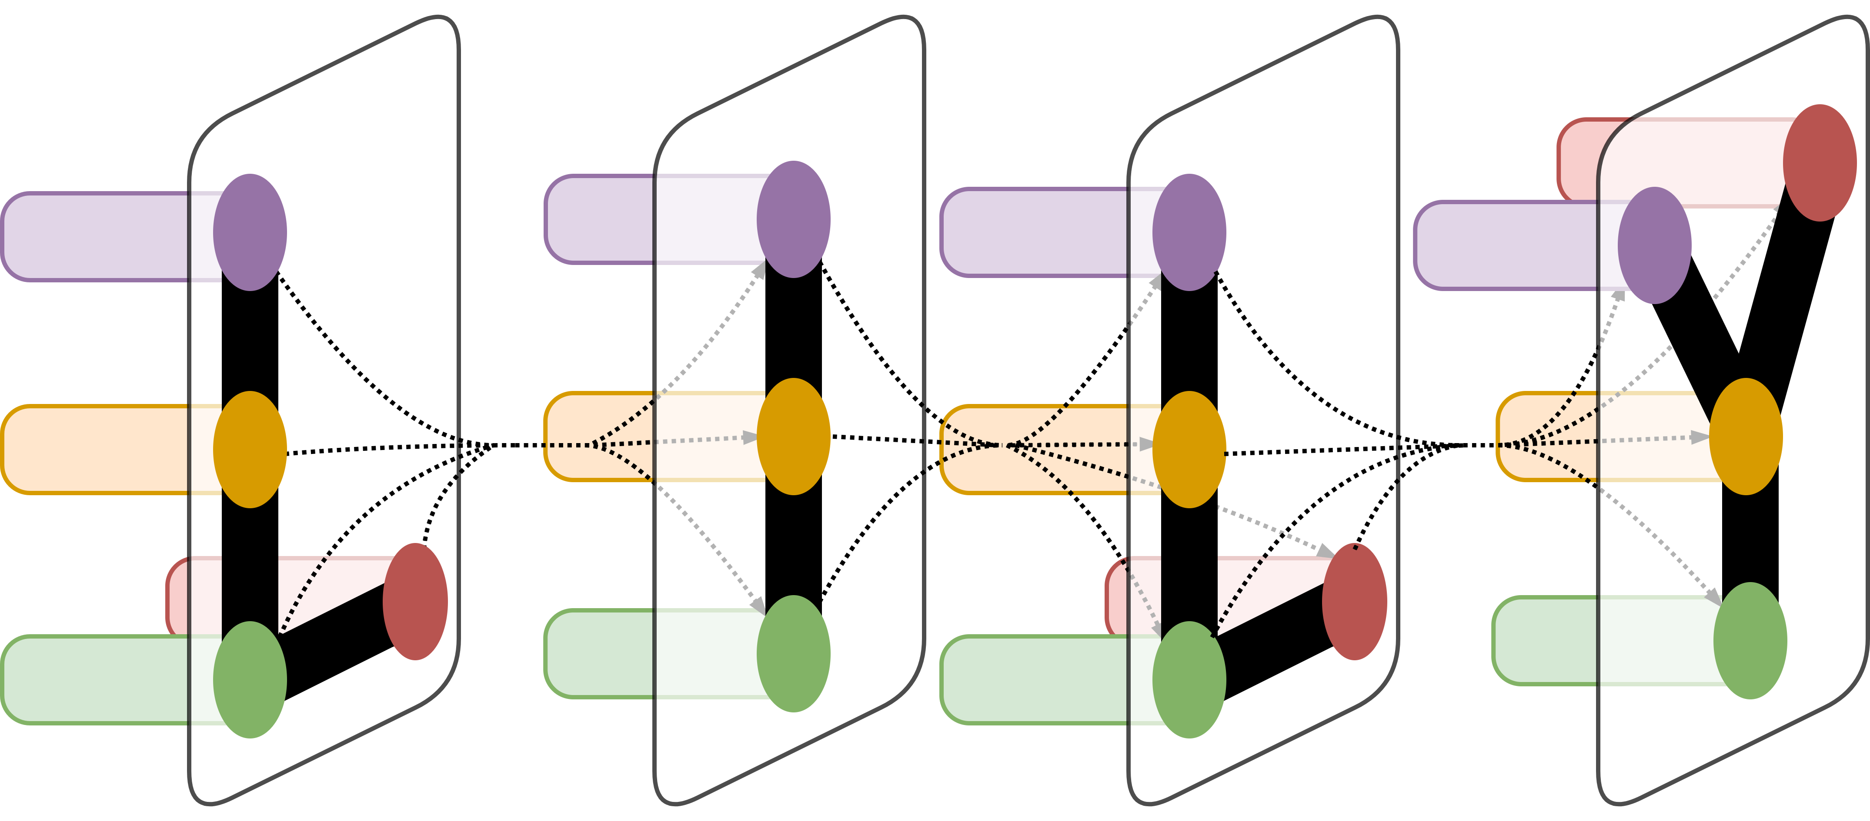
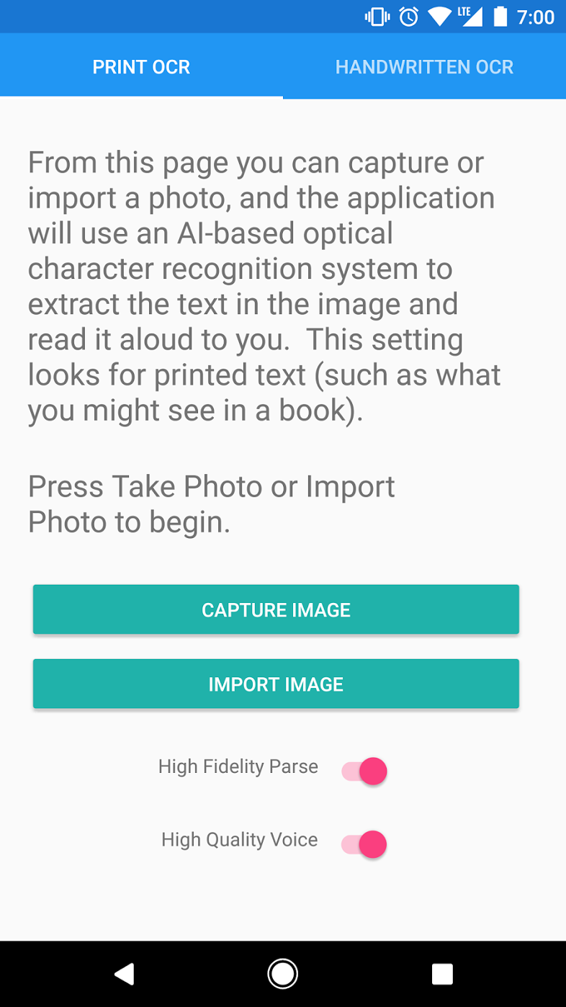
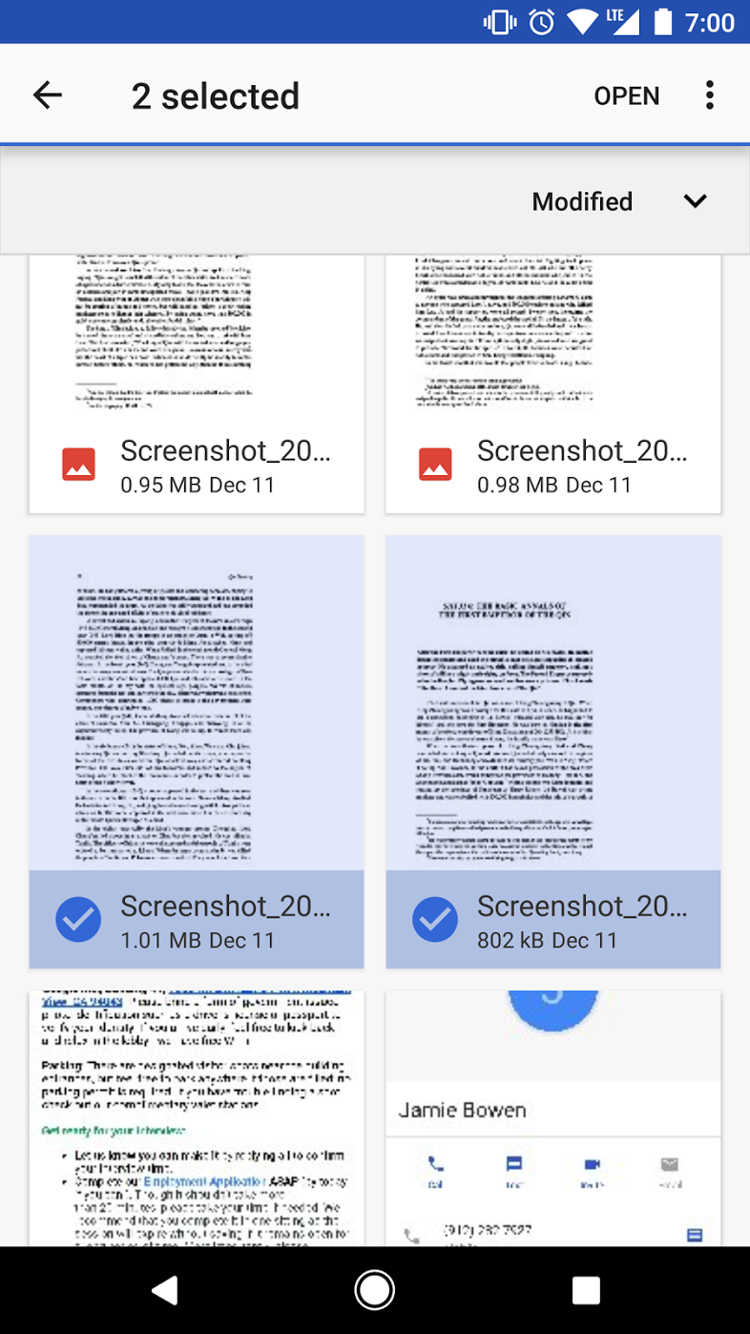

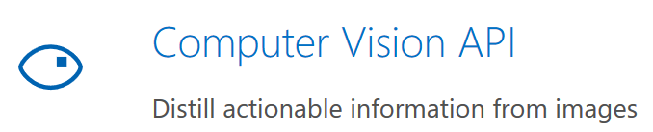
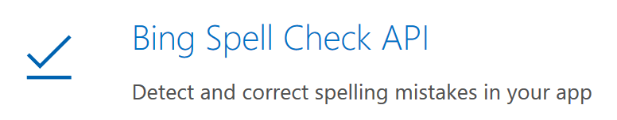
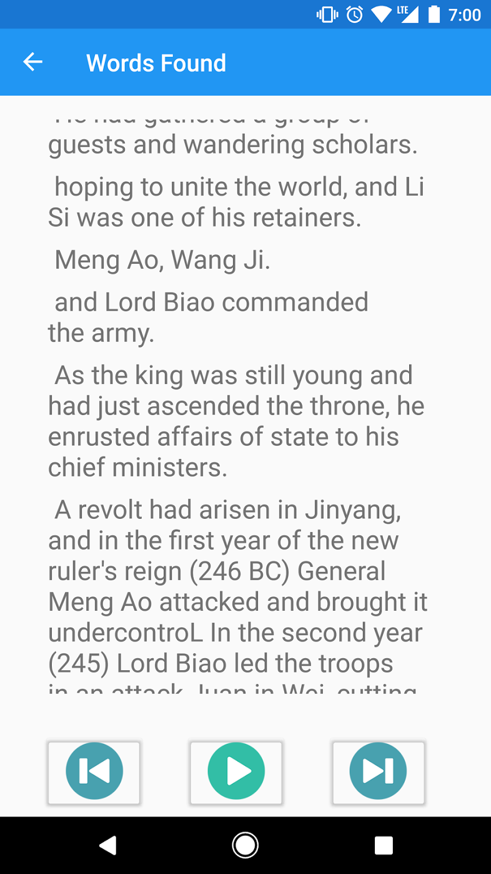
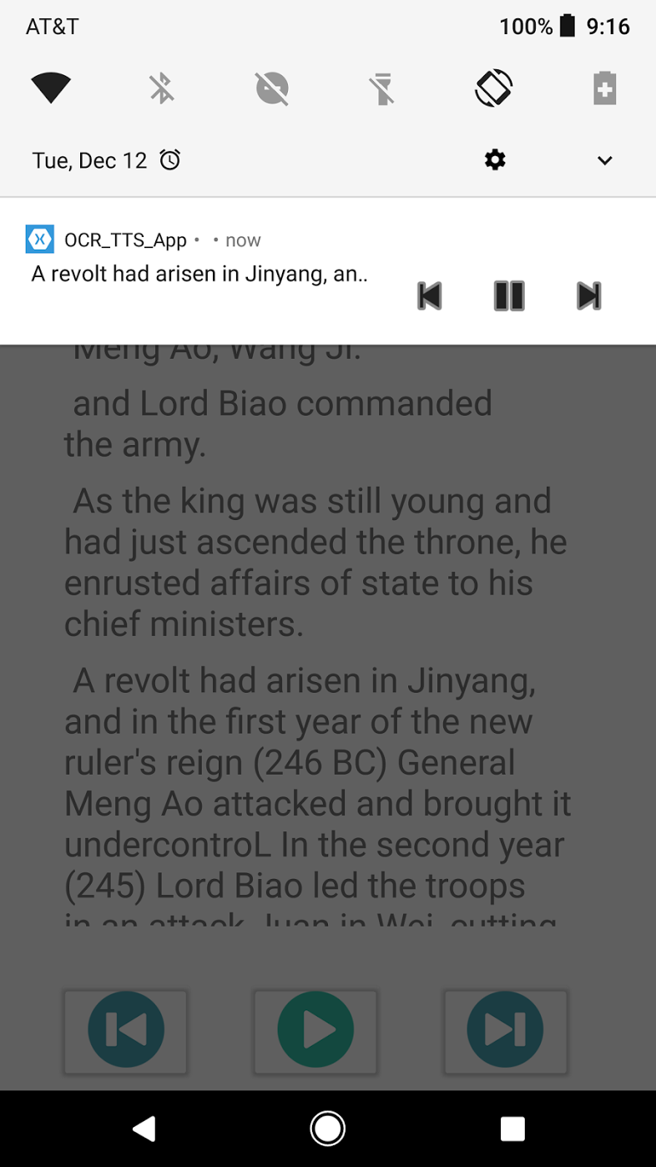
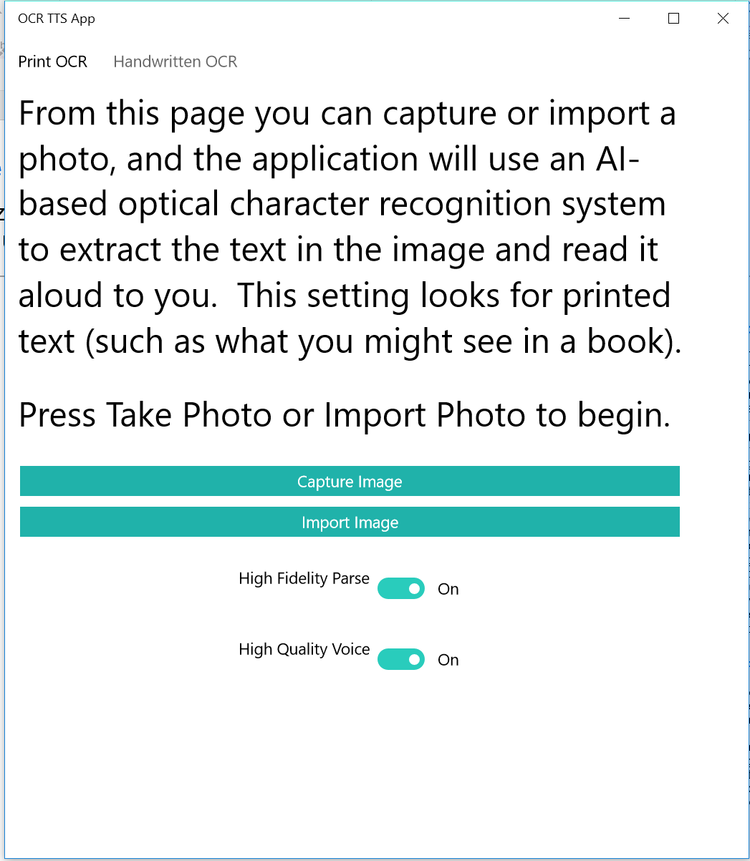
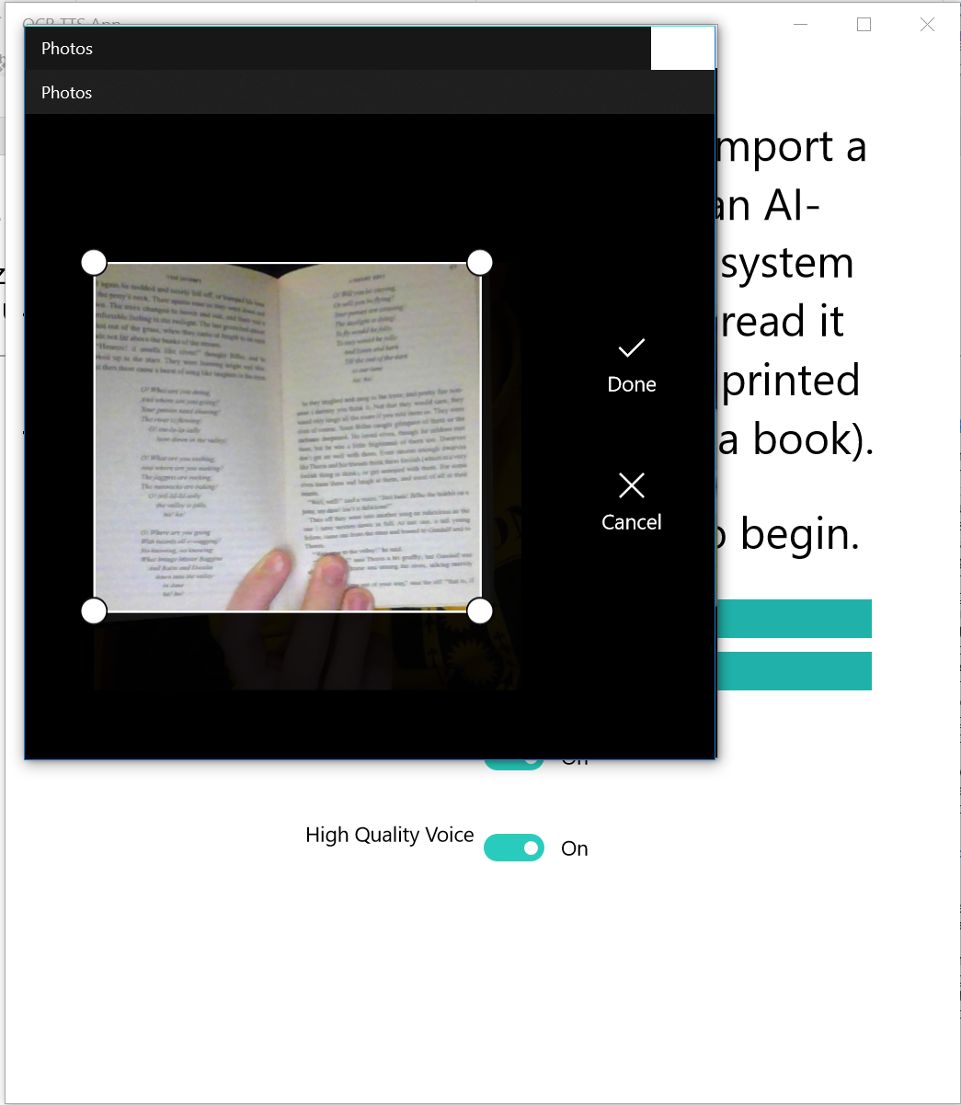
A Mobile Application for the Blind and Dyslexic
Joseph Lanzone
LILY Lab, Yale University, New Haven, CT
LILY Lab
Introduction
The proliferation of new AI technologies based on deep learning and powered by massive industrial data sets has enabled the widespread dissemination of easy-to-use, cloud-based, artificial intelligence APIs for application development. Instead of expanding upon a specific facet of foundational research, the goal of this project is to explore the utility of some of these APIs, and to develop new and valuable usage scenarios for these AI-based utilities. Specifically, this project focused on the development of a cross-platform text-to-speech (TTS) system that leveraged cutting-edge optical character recognition (OCR) and human-like speech synthesis endpoints to extract text from captured images and read that text aloud to users. In time, hopefully this application and applications like it will serve as valuable learning tools for the visually impaired and dyslexic
Basic Pipeline
Figure 1. The basic screens of the app (Android)
A user imports a set of images in the main view
These images are processed and sent to the Azure Computer Vision OCR endpoint.
The Azure Computer Vision endpoint returns a list of parsed strings
These strings are sent to a new view, along with flags signaling which TTS system to use, and whether to clean up the strings via spellcheck.
All strings are combined and re-split on sentence delimiters.
Should the spellchecking flag be set, each line is sent to the Azure Spell Check API for correction. The specifics of the iterative spellchecking process are further unpacked in the paper.
Each processed fragment of text is then fed to a TTS engine, sound bytes are generated for each line (and saved in a temp folder on the device), and each sound byte is linked to a user interaction event (click) within the app. Upon beginning to play audio from the app, all files are queued into the OS media player for OS-level playback control.
Figure 2. The key industrial APIs used by the app (Amazon Polly, Bing Computer Vision, Bing Spell Check)
Background
Figure 3. Screens from the Windows version of the application, showing the main page landing page, and OS-specific photo import
In the United States today, somewhere around 5-10% of school children suffer from dyslexia¹, and roughly 3% are either completely blind or in some other way severely visually impaired². To put that in numbers, between 26 and 42 million Americans are faced with reading based impairments caused by these common disabilities alone. At the same time, nearly 77% of the American population owns a smartphone equipped with a camera³, and even simple OCR systems are performant enough to succeed at basic reading tasks.
At the same time, the development of virtual assistants such as Amazon’s Alexa and the Google Assistant have sparked increased interest and development of human-like generative speech systems, and the recent movement toward cloud computing has made it such that highly intensive computation can be carried out even on mobile devices
These trends inspired the creation of the cross-platform, computer vision based text-to-speech application detailed in this paper.
Moving Forward
In the future, it would be really valuable to further streamline the parsing and processing of a multi-page PDF document (approaches for this detailed in paper). This would be extremely valuable for the visually impaired, as it would lower the number of total user-interaction events asked of them.
It would also be valuable to make the parsed text searchable. Given the large comorbidity of dyslexia and attention deficit disorder, building out features to features that would help distracted users get back on track are highly valuable.
Acknowledgement
This work was only made possible through the support of Professor Dragomir Radev. Thanks so much for allowing me to pursue this Drago.

