Slide 1
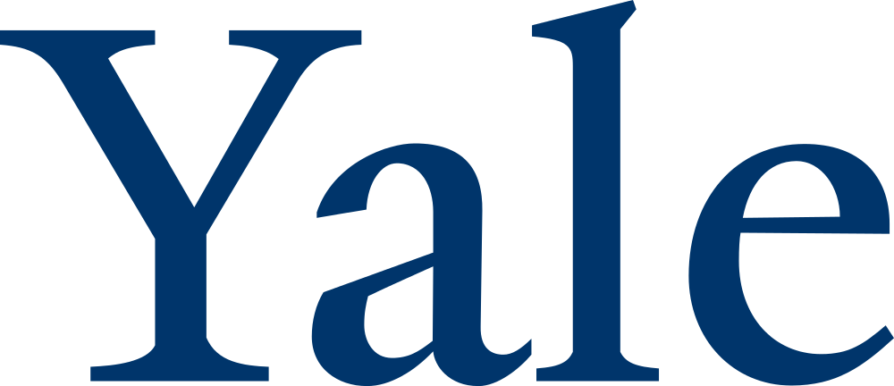
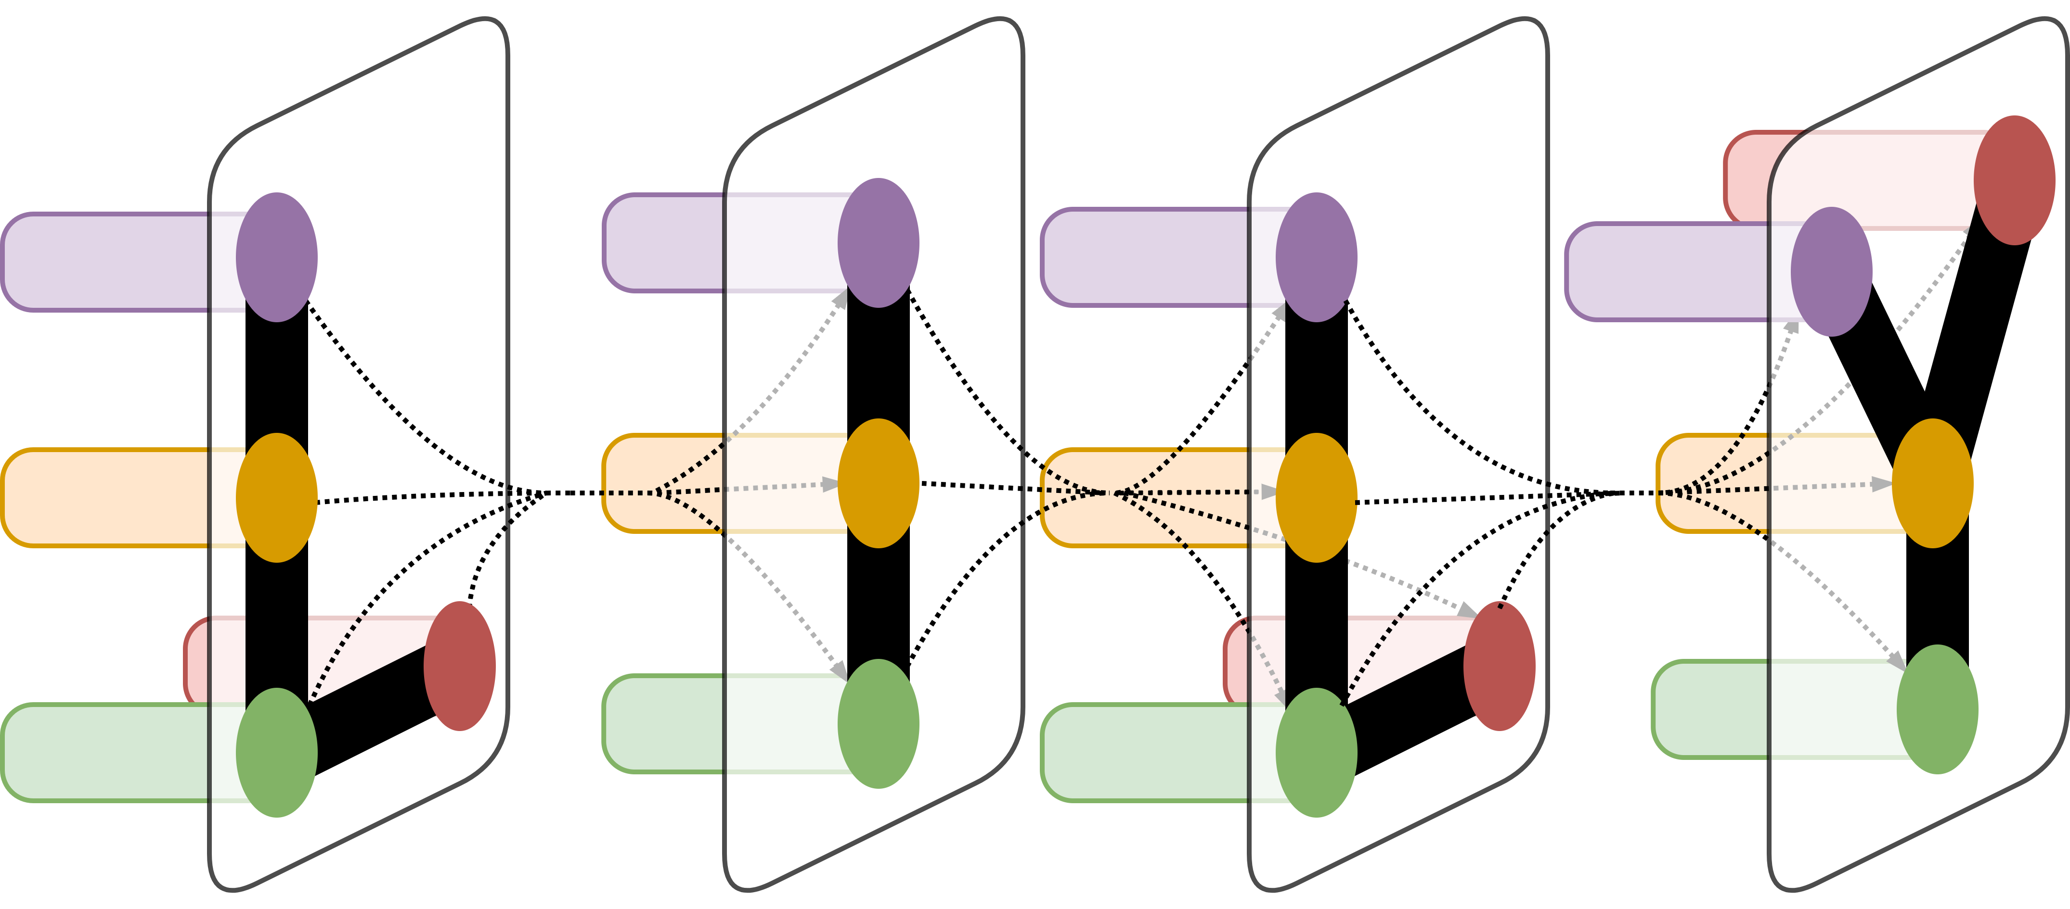
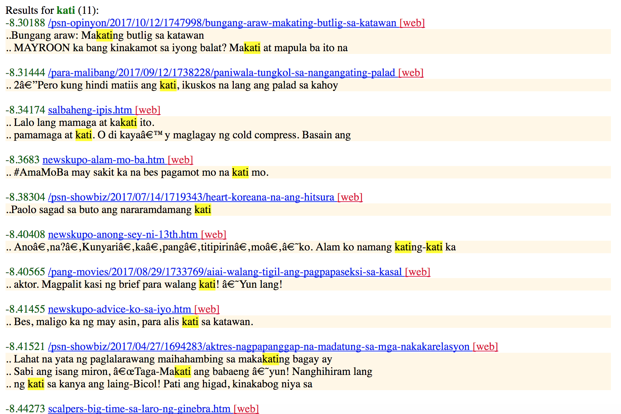
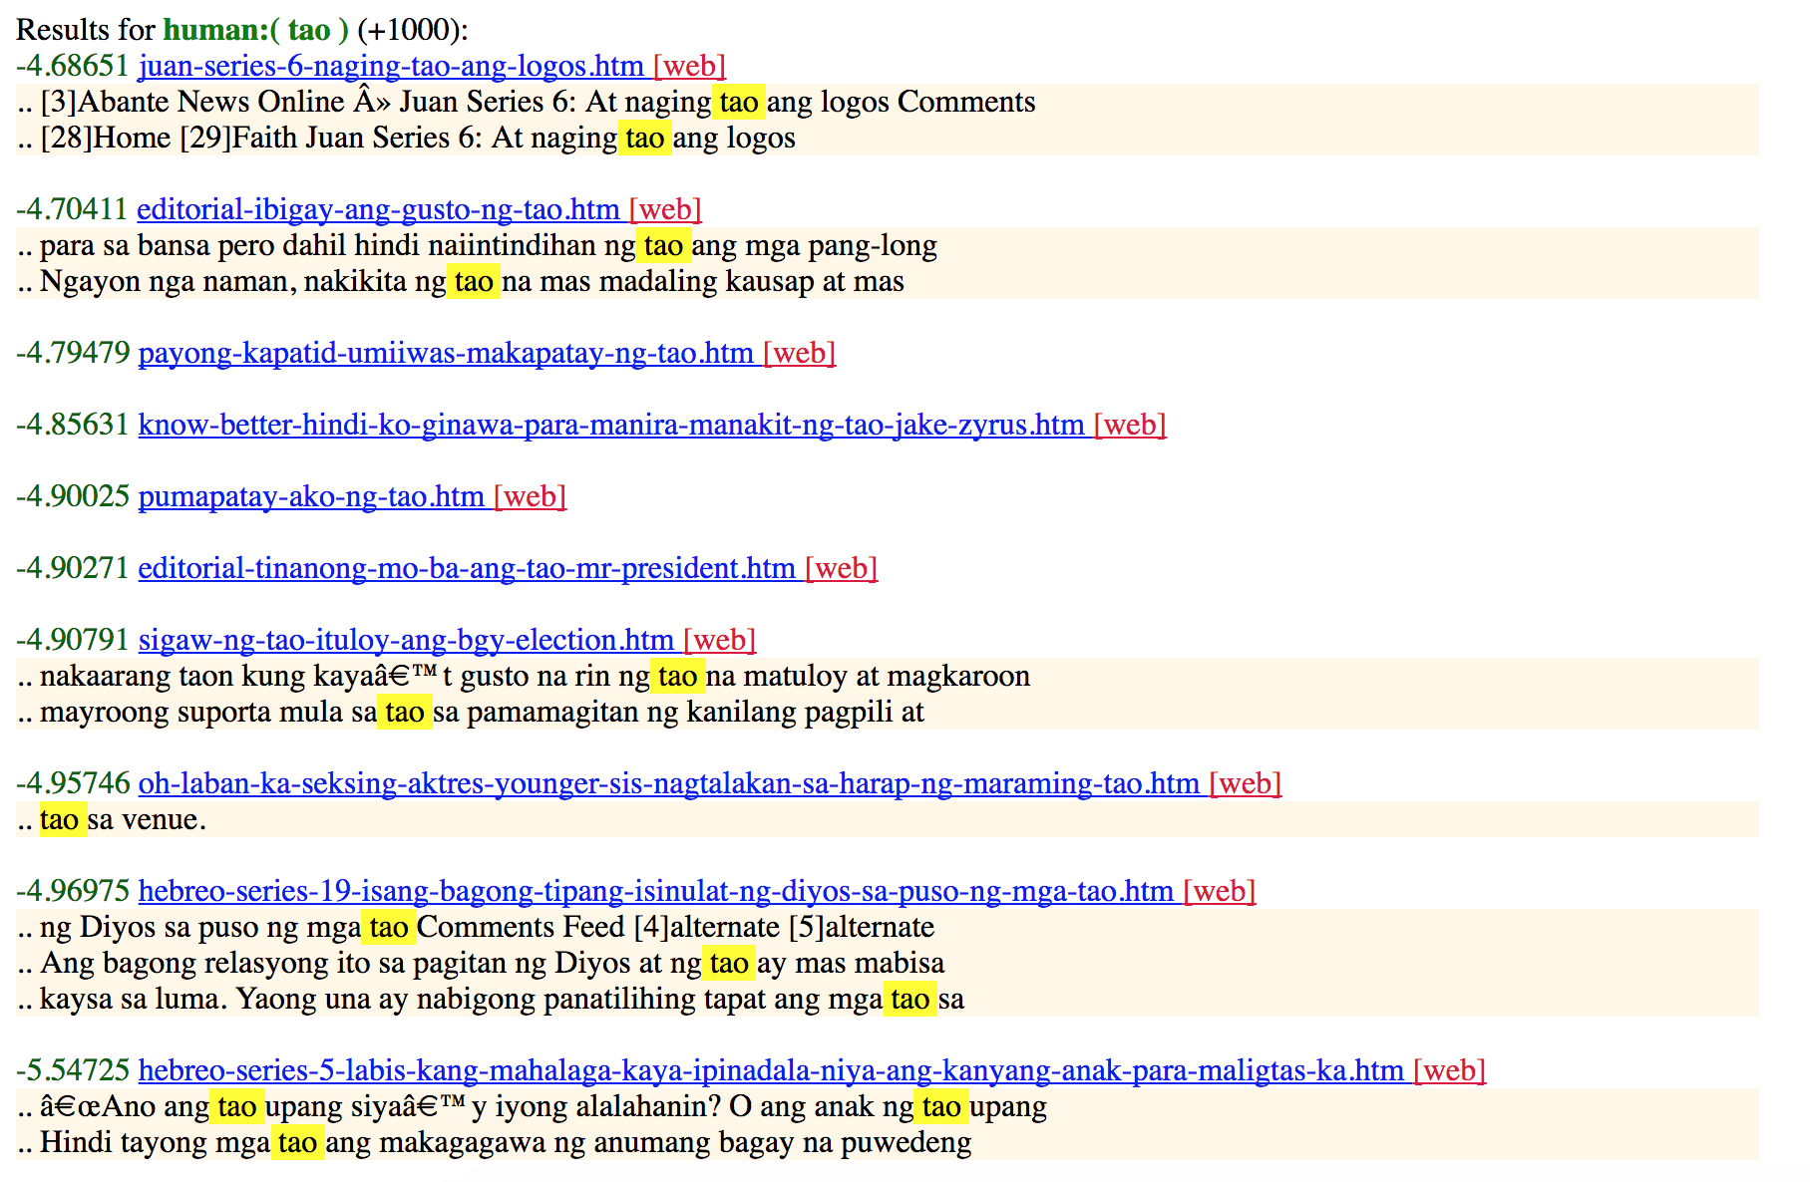
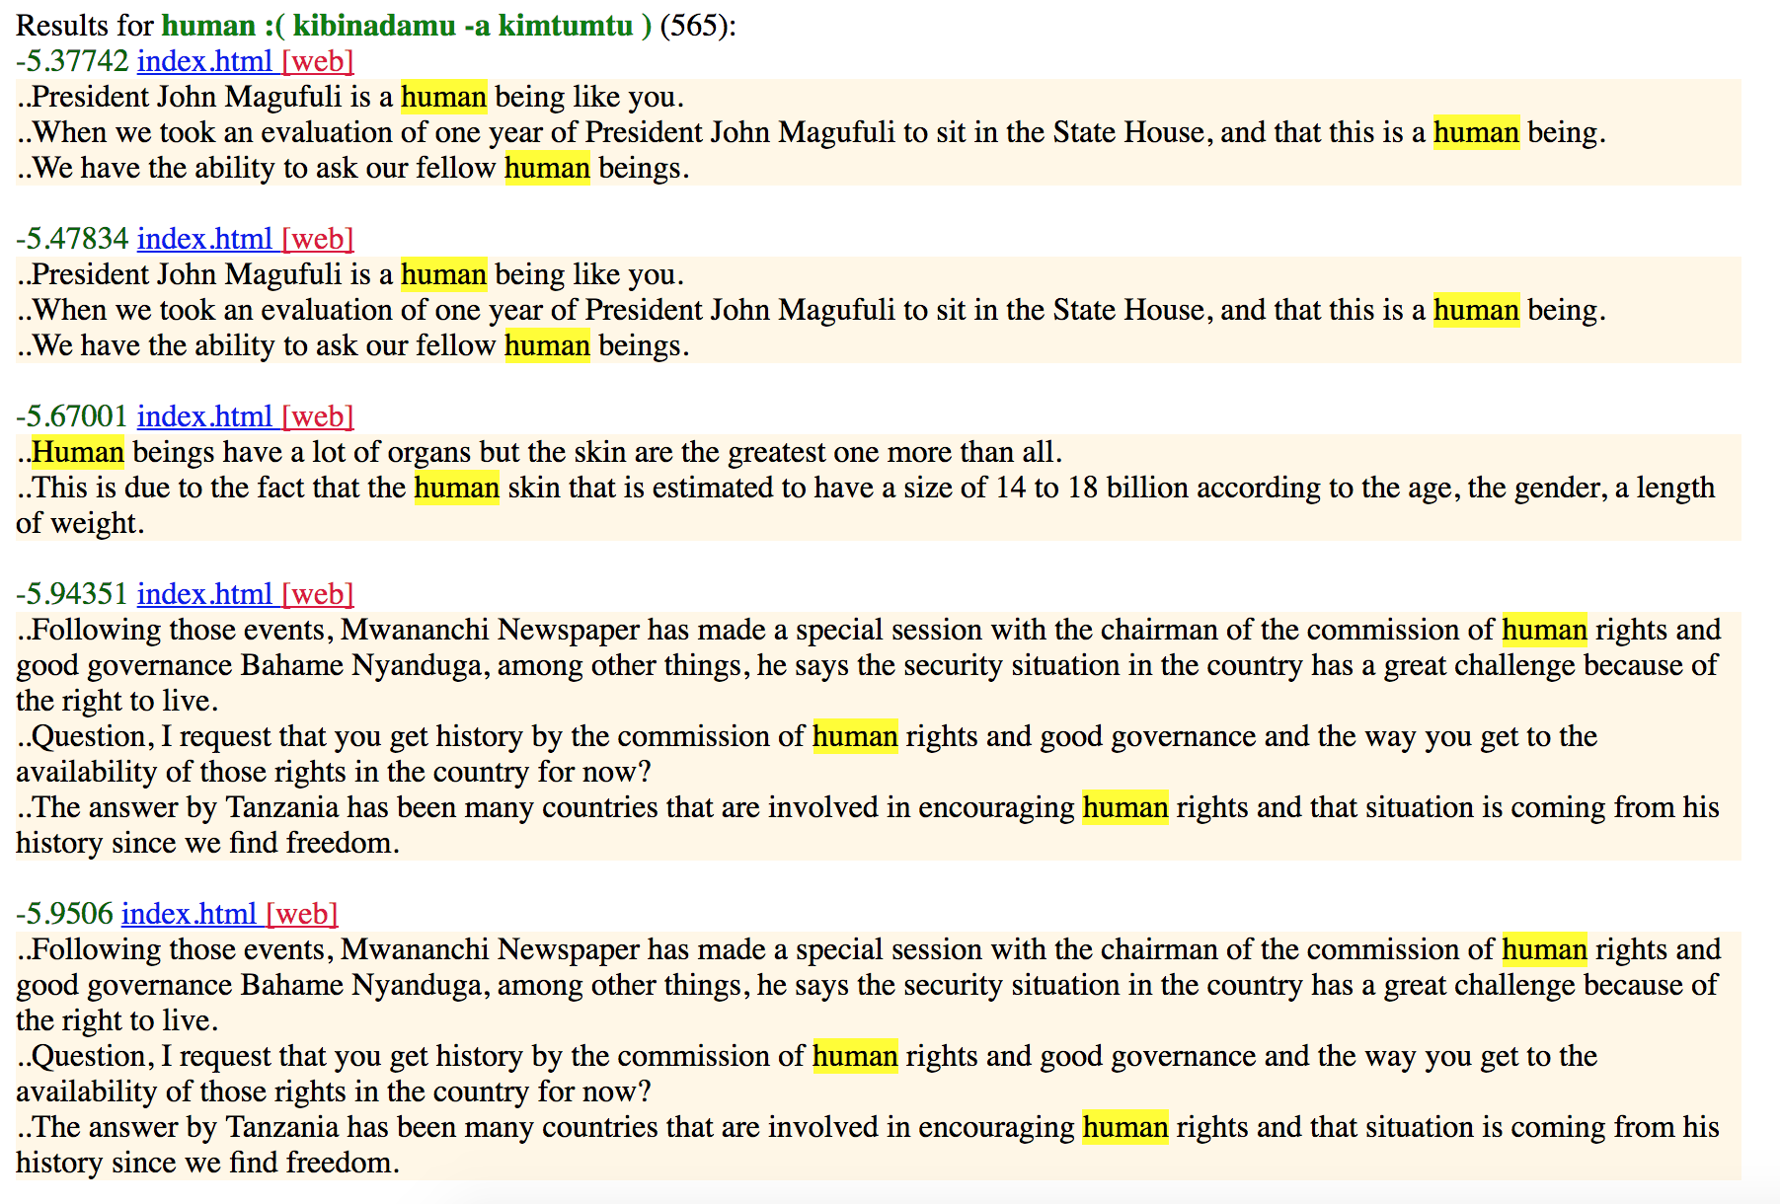
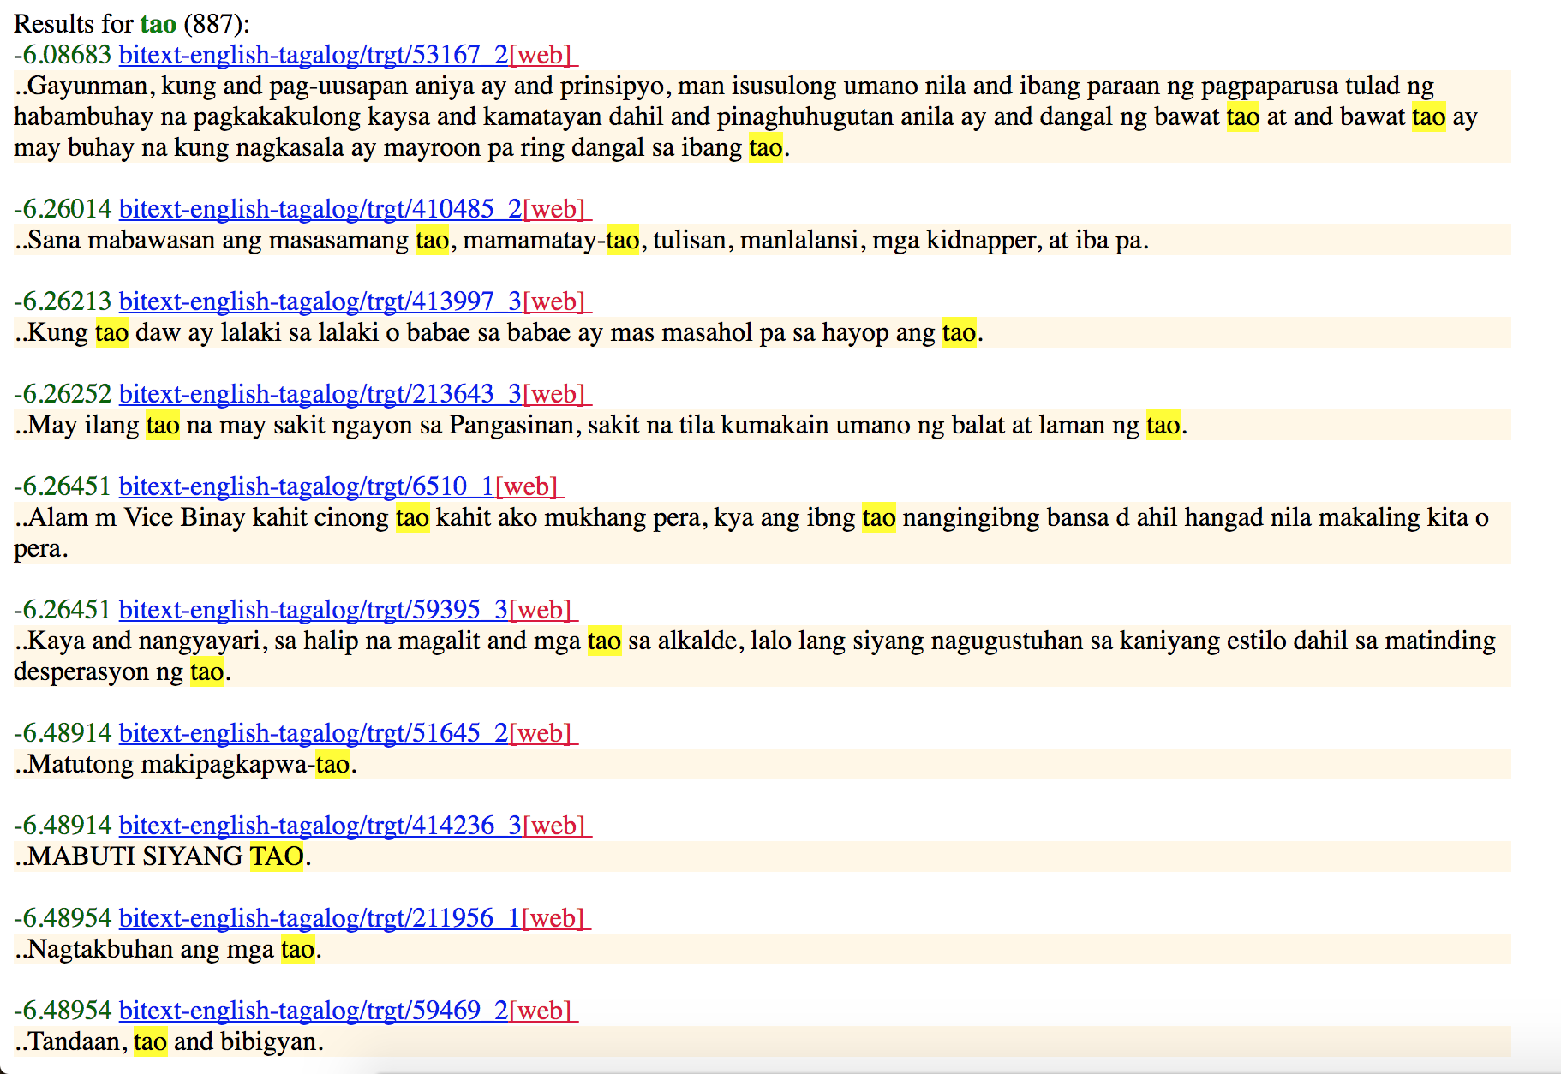
MATERIAL Resources for Cross-Lingual Information Retrieval
Caitlin Westerfield¹
¹Language Information and Learning Lab, Yale University, New Haven, CT
LILY Lab
Introduction
Results
There are many languages for which there exist databases with the language’s corresponding grammar and syntax, which provides us with the capability to directly translate documents or queries in that language. However, there are also minority languages and dialects that are not possible to translate directly because we do not know their grammars. The goal of this project is to use similar languages that are part of the same family to build the grammar and then translate these minority languages in order to retrieve information using a search engine. My personal project was to find and annotate resources for the MATERIAL project to facilitate language translation when submitting a query in the INDRI search bar that is in minority languages or when parsing documents written a minority language. This will better the development of the Cross-Lingual Information Retrieval (CLIR) system for the Machine Translation for English Retrieval of Information in Any Language (MATERIAL) Project.
With the help of other members of the MATERIAL team at Yale, the INDRI search bar can now be used for Swahili and Tagalog documents and returns a sorted list of documents that match the query. The returned results give a count of the number of relevant documents, passages from the documents along with the highlighted search query that was found, and the URL of the document.
As for resources, I acquired language-specific databases and dictionaries for Tagalog and Swahili that are now being used for the current MATERIAL software, as well as various multi-lingual embedding resources. The multi-lingual embedding resources include tools for evaluation, overviews of a wide variety of models and algorithms, and vector embeddings for multiple languages in a shared embedding space. I also found word embeddings for languages beyond Tagalog and Swahili, including Yoruba, Amharic, Somali, Farsi, Russian, and Uzbek. Many of the other resources I compiled fall under the category of linguistic databases for both world languages and endangered languages, such as the World Atlas for Linguistic Structures and a Google-Sponsored project on Endangered Languages.
Figure 1. Query: Kati, Query Language: Tagalog, Document Language: Tagalog, Corpus: 40k, View Documents: English
Figure 3. Query: Human, Query Language: English, Document Language: Tagalog, Corpus: 40k, View Documents: English
Materials and Methods
To begin, I designed the initial MATERIAL website with the use of pre-existing software such as the INDRI search bar, which is able to search documents using input queries in a wide variety of languages. This has been expanded upon such that the user can search and return results in Tagalog, English, or Swahili. At this time, queries in Swahili will only search Swahili documents, and equivalently Tagalog queries only search Tagalog documents. However, queries in English can search documents in English, Tagalog, and Swahili.
The majority of my work thus far has been focused on finding relevant resources for this project. I have been looking into various multi-lingual embedding resources and world etymology databases that can be used to aid in the production of word vectors for the information retrieval. There are multi-lingual embeddings resources available for many low-density languages that will be helpful for the development of the CLIR system.
Future Research
Future steps for Yale’s MATERIAL project team as a whole include aligning bilingual embeddings for Swahili and Tagalog and adding functionality to the INDRI search bar such that it becomes possible to search Tagalog documents with Swahili queries and vice versa. This project would also benefit from expanding to include queries in more languages. Another potential area for further work is to alter the search results such that they are ranked based on the occurrences of search queries and the proximities of these occurrences to each other.
Figure 2. Query: Human, Query Language: English, Document Language: Swahili, Corpus: 40k, View Documents: English
Figure 4. Query: Tao, Query Language: Tagalog, Document Language: Tagalog, Corpus: Bitext, View Documents: Tagalog
Acknowledgement
Thank you to Dragomir Radev and others on the MATERIAL project at Yale for their advising, as well as to those who have made available extensive resources on cross-lingual information retrieval.

