Slide 1

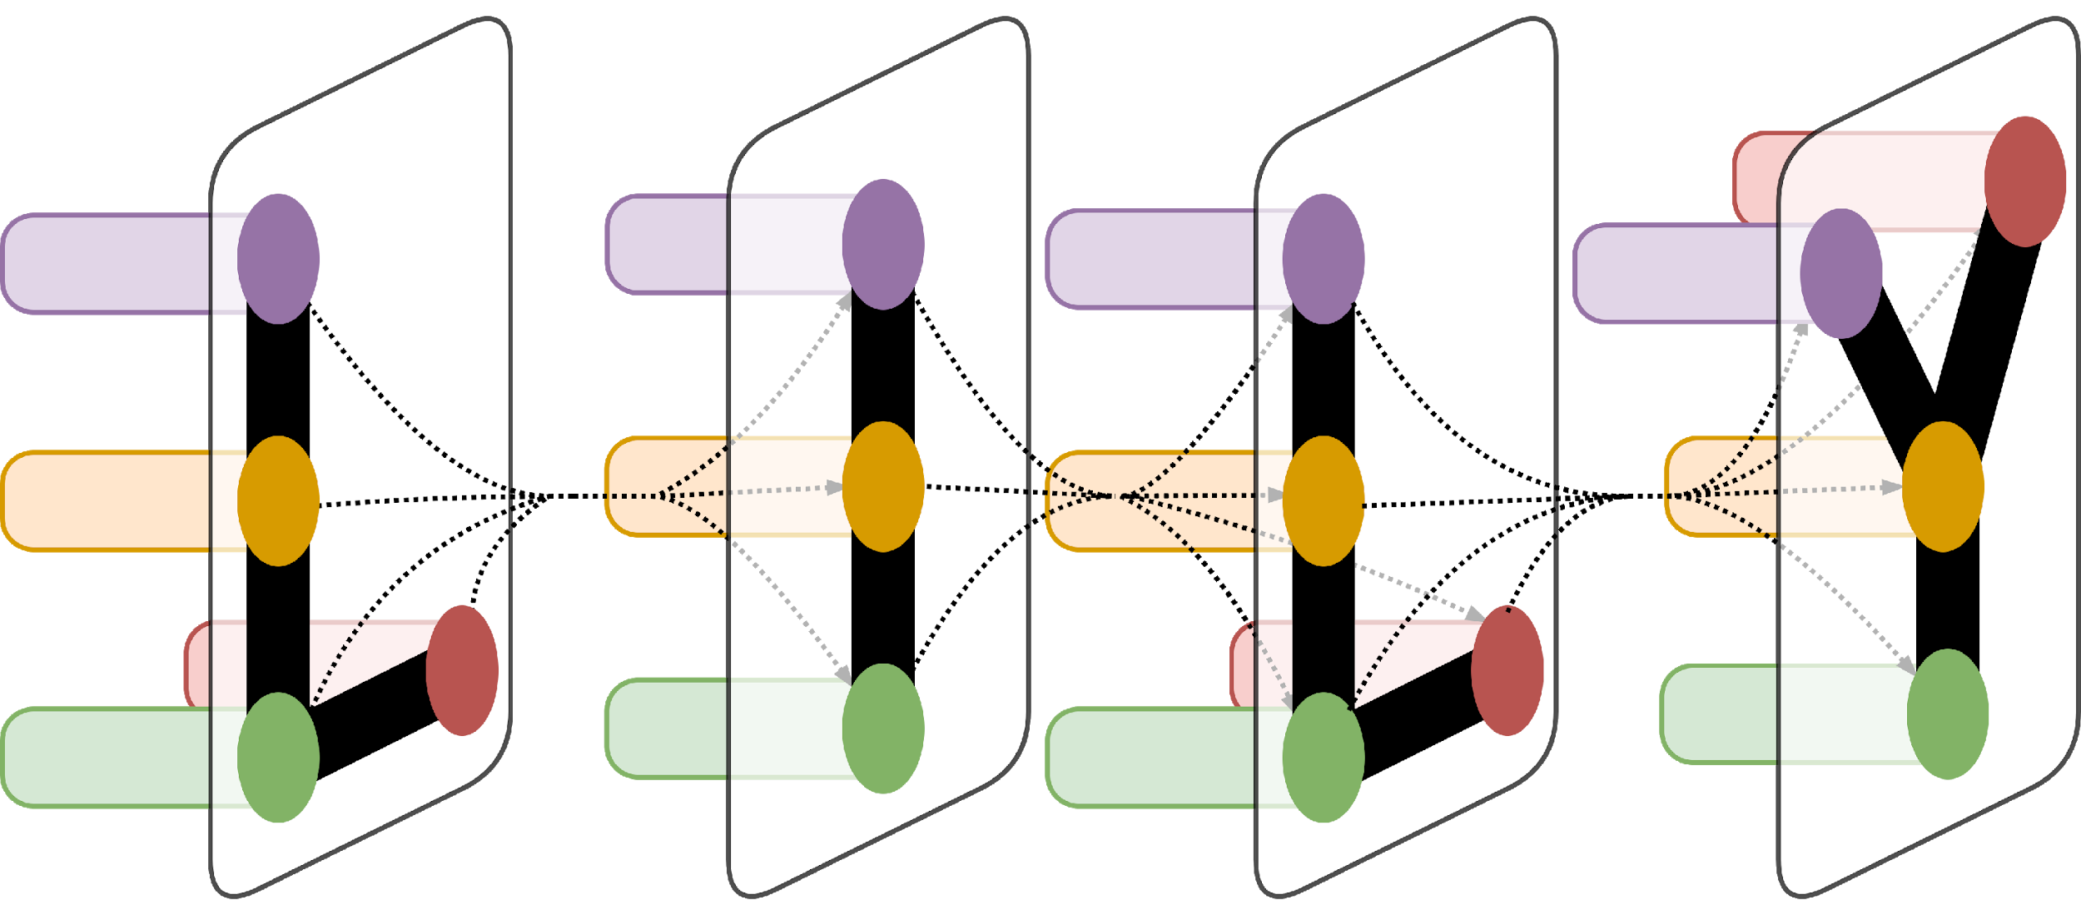
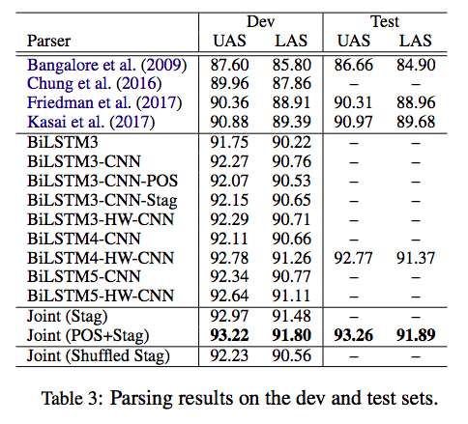
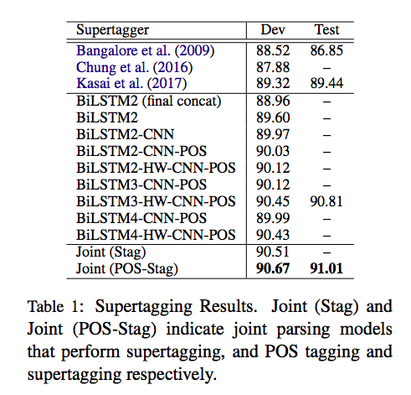
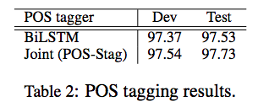
Tree-Adjoining Grammar Parsing and Applications
^{Jungo Kasai}
Department of Computer Science, Yale University
Introduction
Supertaggers
Parsers
Tree Adjoining Grammar (TAG, Joshi and Schabes
(1997)) and Combinatory Categorial Grammar
(CCG, Steedman and Baldridge (2011)) are
both mildly context-sensitive grammar formalisms
that are lexicalized: every elementary structure is associated with exactly one lexical item, and every
lexical item of the language is associated with
a finite set of elementary structures in the grammar
(Rambow and Joshi, 1994). In TAG and CCG, the task of parsing can be decomposed into two
phases: supertagging, where elementary units or supertags are assigned to each lexical item and parsing where these supertags are combined together. The first phase of supertagging can be considered as “almost parsing” because supertags for a sentence almost always determine a unique parse (Bangalore and Joshi, 1999). This near uniqueness of a parse given a gold sequence of supertags has been confirmed empirically (TAG: Bangalore et al. (2009); Chung et al. (2016); Kasai et al. (2017); CCG: Lewis et al. (2016)). We focus on TAG parsing in this work. TAG differs from CCG in having a more varied set of supertags. Concretely, the TAG-annotated version of the WSJ Penn Treebank (Marcus et al., 1993) that we use (Chen, 2001) includes 4727 distinct supertags (2165 occur once) while the CCG-annotated version (Hockenmaier and Steedman, 2007) only includes 1286 distinct supertags (439 occur once). This large set of supertags in TAG presents a severe challenge in supertagging and causes a large discrepancy in parsing performance with gold supertags and predicted supertags (Bangalore et al., 2009; Chung et al., 2016; Kasai et al., 2017). In this work, we present a supertagger and a parser that substantially improve upon previously reported results.
Our BiLSTM POS tagger yielded 97.37% and 97.53% tagging accuracy on the dev and test sets, performance on par with the state-of-the-art (Ling et al., 2015; Ma and Hovy, 2016). Seen in the middle section of Table 1 is supertagging performance obtained from various model configurations. “Final concat” in the model name indicates that vectors from forward and backward pass are concatenated only after the final layer. Concatenation happens after each layer otherwise. Numbers immediately after BiLSTM indicate the numbers of layers. CNN, HW, and POS denote respectively character-level CNNs, highway connections, and pipeline POS input from our BiLSTM POS tagger. Firstly, the differences in performance between BiLSTM2 (final concat) and BiLSTM2 and between BiLSTM2 and BiLSTM2-CNN suggest an advantage to performing concatenation after each layer and adding character-level CNNs. Adding predicted POS to the input somewhat helps supertagging though the difference is small. Adding a third BiLSTM layer helps only if there are highway connections, presumably because deeper BiLSTMs are more vulnerable to the vanishing/exploding gradient problem. Our supertagging model (BiLSTM3-HW-CNN-POS) that performs best on the dev set achieves an accuracy of 90.81% on the test set, outperforming the previously best result by more than 1.3%.
Table 3 shows parsing results on the dev set. Abbreviations for models are as before with one
addition: Stag denotes pipeline supertag input
from our best supertagger (BiLSTM3-HW-CNN-POS
in Table 1). As with supertagging, we observe a gain from adding character-level CNNs. Interestingly, adding predicted POS tags or supertags deteriorates performance with BiLSTM3. These results suggest that morphological information and word information from character-level CNNs and word embeddings overwhelm the information from predicted POS tags and supertags.
Again, highway connections become crucial as the
number of layers increases. We finally evaluate the parsing model with the best dev performance (BiLSTM4-HW-CNN) on the test set (Table 3). It achieves 91.37 LAS points and 92.77 UAS points, improvements of 1.8 and 1.7 points respectively from the state-of-the-art.
We provide joint modeling results for supertagging
and parsing in Tables 2 and 3. For these
joint models, we employed the best parsing configuration (4 layers of BiLSTMs, character-level
CNNs, and highway connections), with and without
POS tagging added as an additional task. We
can observe that our full joint model that performs
POS tagging, supertagging, and parsing further
improves performance in all of the three tasks,
yielding the test result of 91.89 LAS and 93.26
UAS points, an improvement of more than 2.2
points each from the state-of-the-art.
Conclusion
In this work, we presented a state-of-the-art TAG
supertagger, a parser, and a joint parser that performs
POS tagging, supertagging, and parsing.
The joint parser has the benefit of giving a full syntactic
analysis of a sentence simultaneously. Furthermore,
the joint parser achieved the best performance,
an improvement of over 2.2 LAS points
from the previous state-of-the-art. We have also
seen that the joint parser yields state-of-the-art in
textual entailment and unbounded dependency recovery
tasks, and raised the possibility that TAG
can provide useful structural analysis of sentences
for other NLP tasks. We will explore more applications
of our TAG parsers in future work

