Slide 1

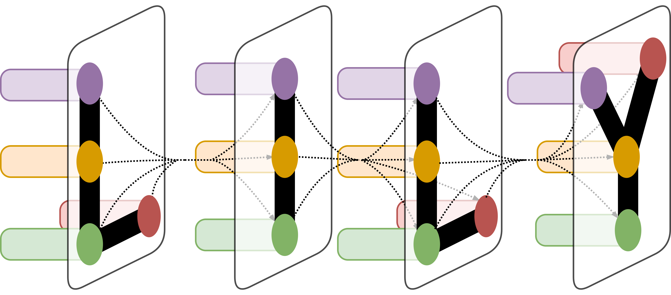
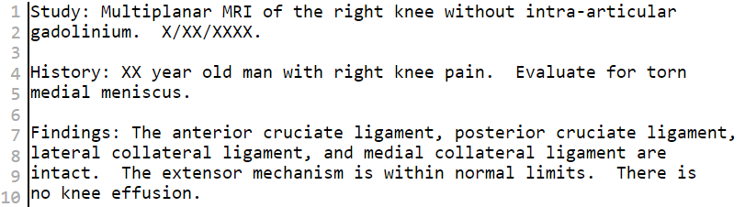
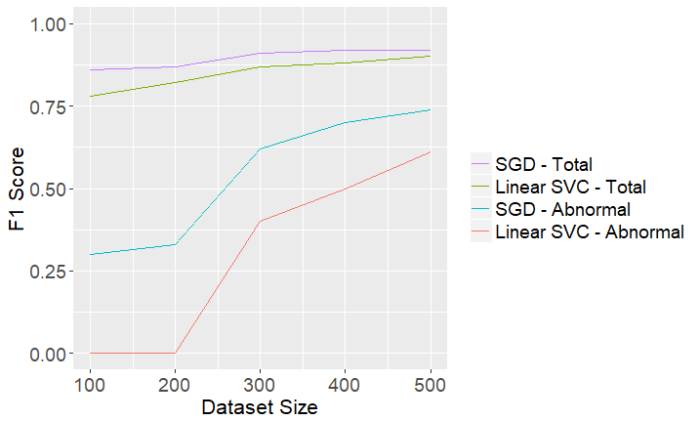
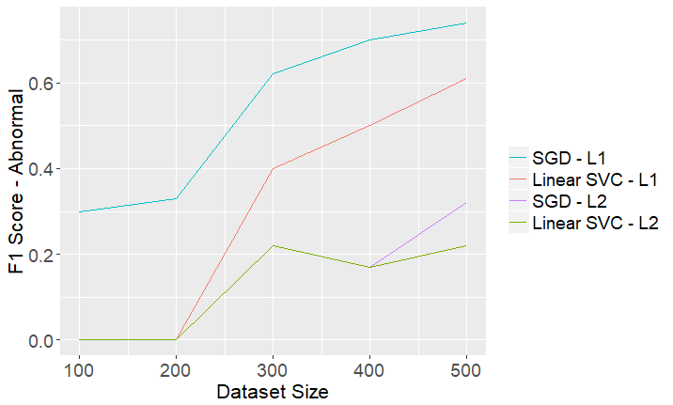
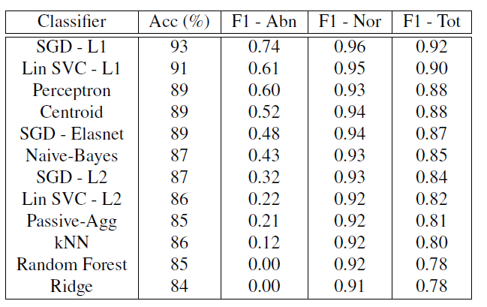
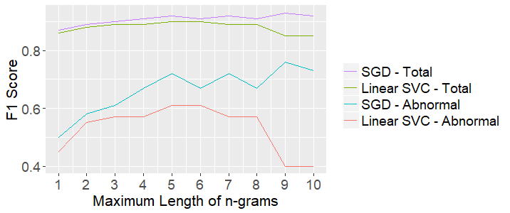
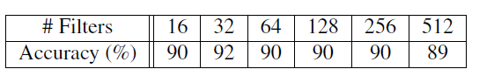
Natural Language Processing of Knee MRI Reports
Lionel Jin¹
¹Department of Computer Science, Yale University
LILY Lab
Introduction
Results
Natural Language Processing can be a powerful tool for processing the large quantity of radiology reports generated in the clinical setting. This project aims build a system that processes knee MRI reports produced at Yale-New Haven Hospital to diagnose knee conditions with good precision and recall. I apply different NLP tools to classify whether the reports reflect any abnormality of the Anterior Cruciate Ligament (ACL). The pipeline can be applied to other knee regions such as the Posterior Cruciate Ligament. Building a pipeline to classify knee MRI reports will be useful for labeling radiology reports available in online databases, facilitating medical research and image recognition work. It will also guide physician diagnosis.
Data Exploration: 80 of the 505 reports (15.8%) have an ACL abnormality.
Baseline: An accuracy of 89% was achieved, with an F1-score of 0.56 for abnormal reports and an weighted overall F1-score of 0.88.
Machine Learning: The Stochastic Gradient Classifier using a L1 loss was consistently the best performing classifier, achieving an accuracy of 93%. Linear SVC also performed well when a L1 loss was used, giving an accuracy of 91%. kNN, Random Forest, and Ridge classifiers did poorly. These algorithms are known to be suboptimal when dealing with high-dimensional data.
Larger training sets led to better performance, though the improvement in performance slows with larger dataset sizes.
For both SGD and Linear SVC, better classification is achieved with a L1 loss compared to L2 loss. This suggests that it is beneficial that the weight on many of the features be reduced to zero.
For both classifiers, using an n-gram set that includes n-grams going from 1-grams to 5-grams gives optimal performance.
Deep Learning: Accuracy and F1-scores slightly lower than that obtained by SGD. A maximum accuracy of 92% was achieved with the result obtained by setting the character embedding dimensions to 128, applying a dropout of 0.5, using filters ranging from 3 to 5 words, and using 32 filters.
Figure 1. Excerpt from knee MRI report
Label more samples
32,000 knee MRI reports
- From Yale-New Haven Hospital
Label 505 knee MRI reports
- Filter non-knee MRIs and Label by ACL condition
- Split into training (80%) and test (20%) sets
Figure 3. Classification results with different dataset sizes
Data and Methods
32,000 knee MRI reports were acquired from Yale-New Haven Hospital. A gold standard dataset of 505 reports was constructed, with reports given one of seven labels: "Normal", "Full Thickness", "Near Full", "Partial", "Mucoid Degeneration", "Low grade strain", and "ACL graft". The training/test split was 80:20.
Baseline Model: A baseline text search was trained:
Filter out normal reports by searching for ACL[a-zA-z ]* (intact|unremarkable|normal) or Anterior Cruciate Ligament[a-zA-z ]* (intact|unremarkable|normal)
Identify abnormal reports as those remaining that contain: ACL or Anterior Cruciate Ligament
Feature Vector Construction: The reports were tokenized by computing the Term Frequency-Inverse Document Frequency statistic. Sets of n-grams where the maximum n ranged from 1 to 10 were used.
Machine Learning: Classifiers including Naive Bayes, kNN, Nearest Centroid, Stochastic Gradient Descent, Linear Support Vector Machine, Random Forest, Perceptron, and Passive-Aggressive algorithm were trained on the features.
Deep Learning: I also trained a Convolutional Neural Network on the data. Words in each report were embedded into low-dimensional vectors using Word2Vec embeddings. Then, a convolutional layer is added, and the output is max-pooled. Dropout and regularization is added, and a final softmax layer is used to classify the reports.
Extract features with Tf-Idf statistic
- Use 1- to 10-grams
Embed words as low-dimensional vectors
- Use Word2Vec embeddings
Train Machine Learning Classifiers
- Random Forest, kNN, SGD Classifier, Linear SVC, Perceptron, Nearest Centroid
Train Convolutional Neural Network
- Perform convolutions
- Max-pool result
- Add dropout and regularization
- Classify using softmax layer
Figure 2. Project Method
Figure 4. Comparison of classifiers with L1 and L2 loss
Conclusion
I successfully built an NLP pipeline to classify knee radiology reports and achieved high accuracy, precision, and recall. I found that SGD and Linear SVC, both with L1 loss, work best amongst the different machine learning classifiers.
The performance of these classifiers can be increased by using the tool to create a larger training set using a human-in-the-loop approach. The use of medical ontology, and section-specific parsing of the radiology reports may also improve performance.
Figure 5. F1-score with different maximum n-gram lengths
Acknowledgement
Thank you Dragomir Radev for advising my research. Thank you Elliott Brown for acquiring the dataset and driving this work forward, Lawrence Staib for your helpful input, and Douglas Herrin, Daniel Oazi, and Atin Saha for your work in putting together the dataset.
Table 1. Classification Results
Table 2. CNN classification accuracy with different number of filters

