Slide 1

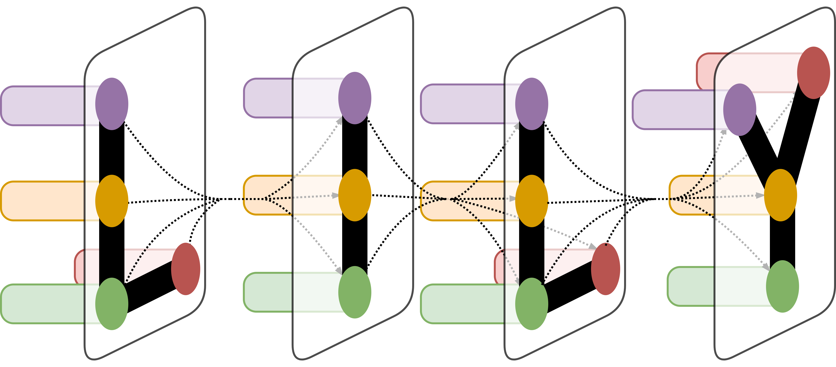
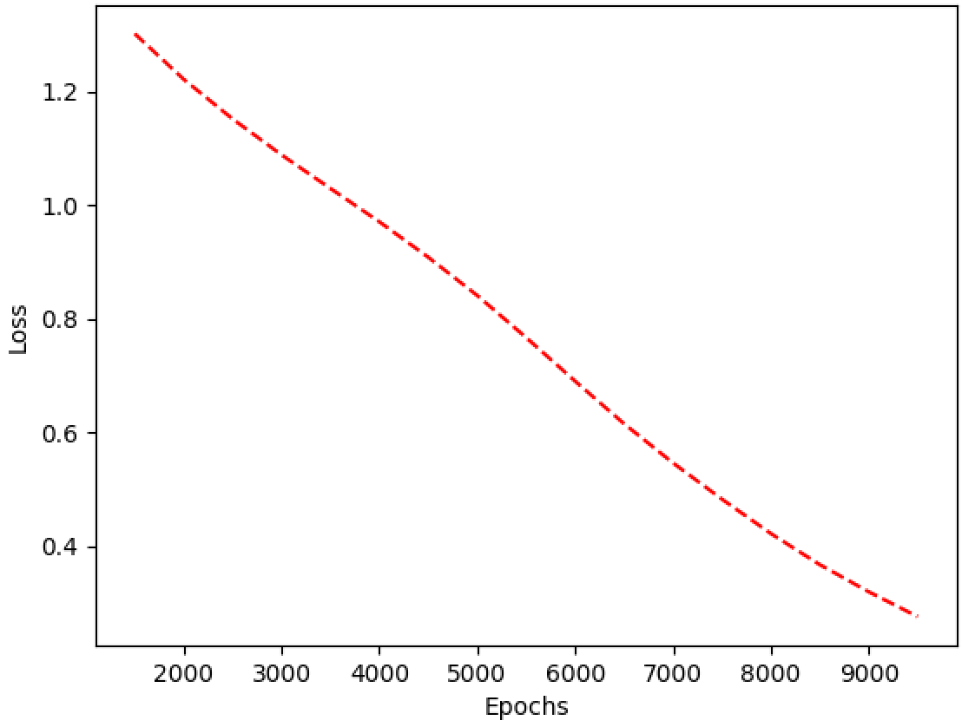
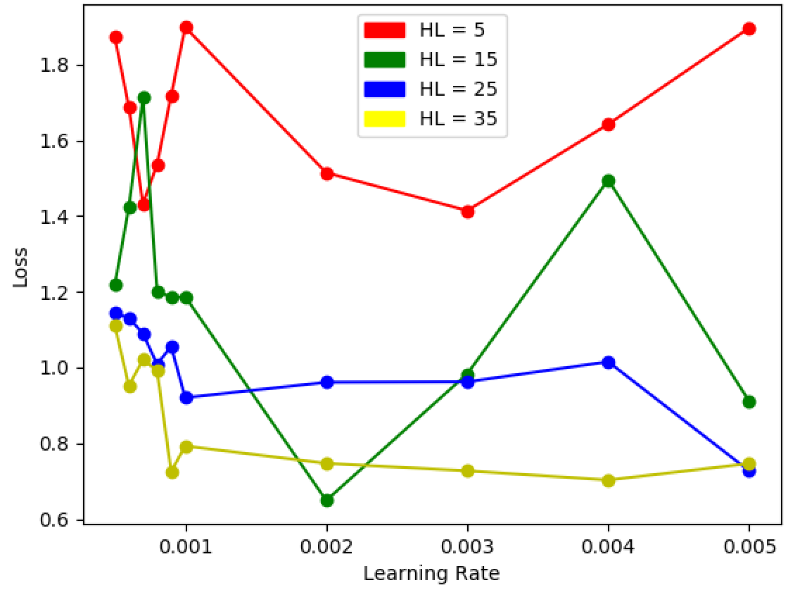
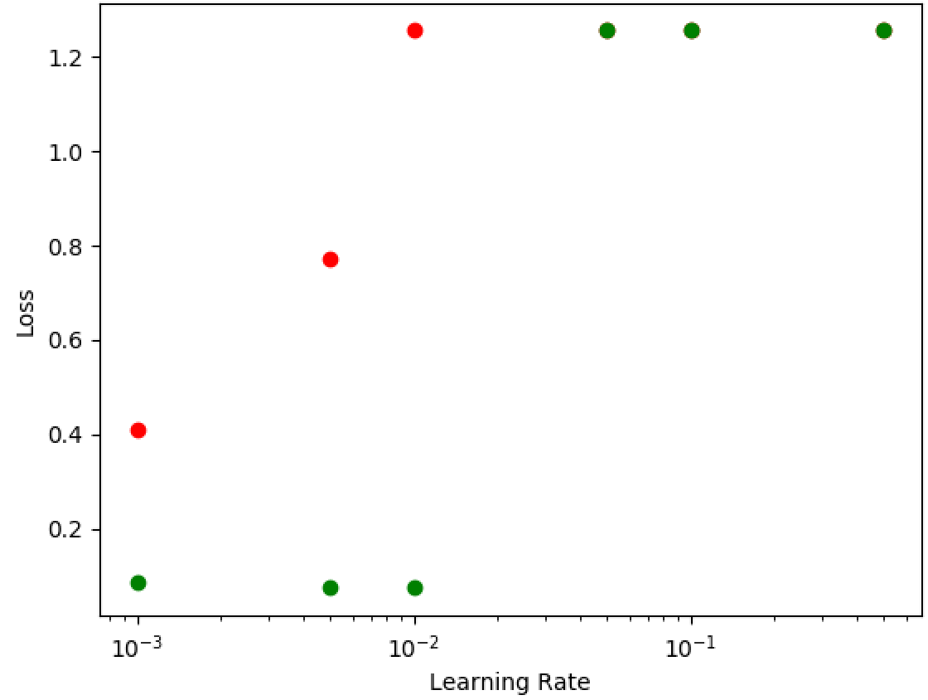
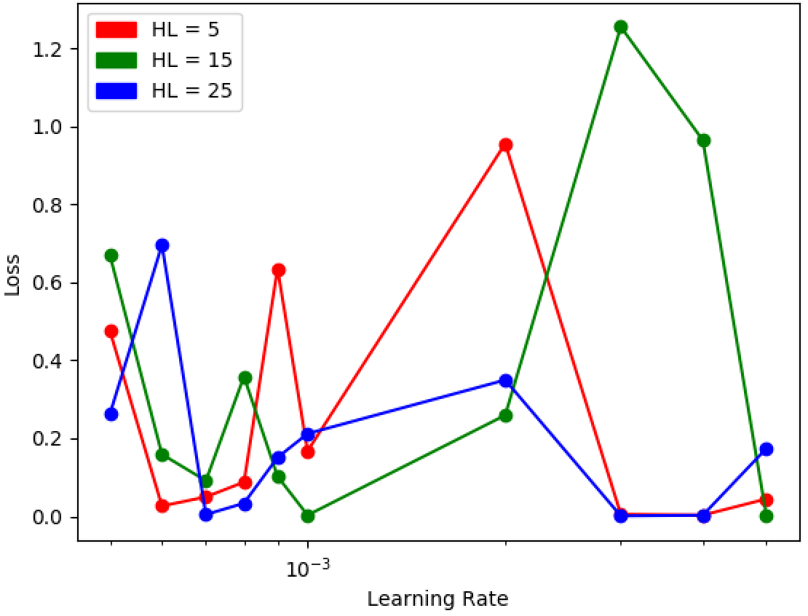
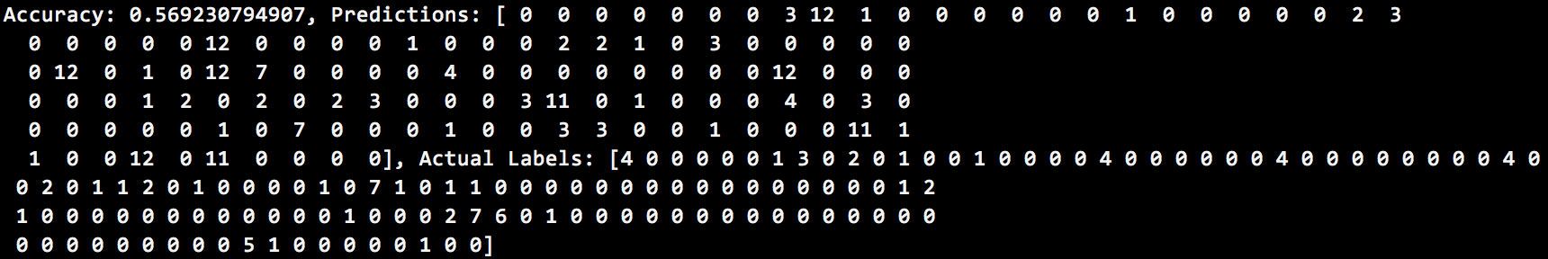
Deep Learning for the Soft Cutoff Problem
Miles Saffran
Department of Computer Science, Yale University, New Haven, CT
LILY Lab
Introduction
The MATERIAL project, commissioned by IARPA, seeks to create a search engine capable of retrieving content in low-resource languages using English queries. An important component of this project is discerning which results are relevant enough to be included. Though there might be 100 documents associated with a certain query, users are presumably not interested in every particular document. The metric being used to assess the quality of a cutoff system, AQWV, penalizes both for missing relevant documents and for returning irrelevant documents. The training data provided to us comes with a means of calculating the cutoff that maximizes AQWV; however, this information is undisclosed on the private cases the contractor will run. My project attempts to predict the optimal cutoff score based on AQWV by using a multi-layered neural network to learn certain characteristics about query/document pairs and successfully predict the best cutoff.
Results
Figures 3 and 4 demonstrate the loss of the model with various hyper-parameters tested, while Figure 5 shows the test results of training on ANALYSIS-EN and testing on a set from DEV-EN.
Generally speaking, the results had high levels of variance depending on the training and testing data as well as the parameters of the model. The overall AQWV score of the network when trained on one English dataset and tested on another was 0.1, which was close to the optimal score of .1408. However, when performing cross-lingual training (training on one language and testing on another), the model underperformed with an overall AQWV score of .151 compared to an optimal .3575.
More specifically, the performance of the model improved drastically when I added two features. First, using word embedding of queries (sourcing a script written by Caitlin Westerfield) as a feature helped improve model accuracy. Second, adding another hidden layer allowed the model to perform better on cross-lingual tasks than it previously had, indicating that the model was actually capable of picking up on generalizable features related to the input.
Figure 1. Training loss over epochs
Figure 3. French loss in the simple model
Materials and Methods
The data – query and document pairs – were training examples provided to the MATERIAL group at Yale. To format the information in a structure useful for a neural network, I wrote code to extract certain features for input and used a program written by Javid Dadashkarimi to calculate the ideal cutoff point. These features include document length, relevant Indri score for each document, and query embedding in GloVe. I then used the TensorFlow library to create a neural network with a hidden layer and softmax activation function. Once this was set up, I iterated through different hyperparameters like learning rate and hidden layer size to optimize the model. Upon further experimentation, I added another hidden layer to the network to compress the input and avoid overfitting. For each language I was training on, I saved the best performing results(those with lowest loss) and used it to predict cutoff points on test data.
Conclusion
Figure 2. English loss with different learning rates
Ultimately, though the network in its current iteration is not consistently successful in finding the optimal cutoff, initial results indicate room for improvement. Adding dropout and regularization might help improve model performance while adding more training and test data could amplify the learning process. In addition, collecting other features to use as input (Duet scores, etc) might yield a more robust model capable of generalized learning both within and across languages.
Figure 4. English loss with the complex model
Acknowledgement
Figure 5. Output of the ANALYSIS-EN set tested on DEV-EN
Thanks to Prof. Radev for advising, Javid and Jungo for helping me navigate the amount of material in Material and reviewing my code, and Caitlin for her word embedding script.

