Slide 1

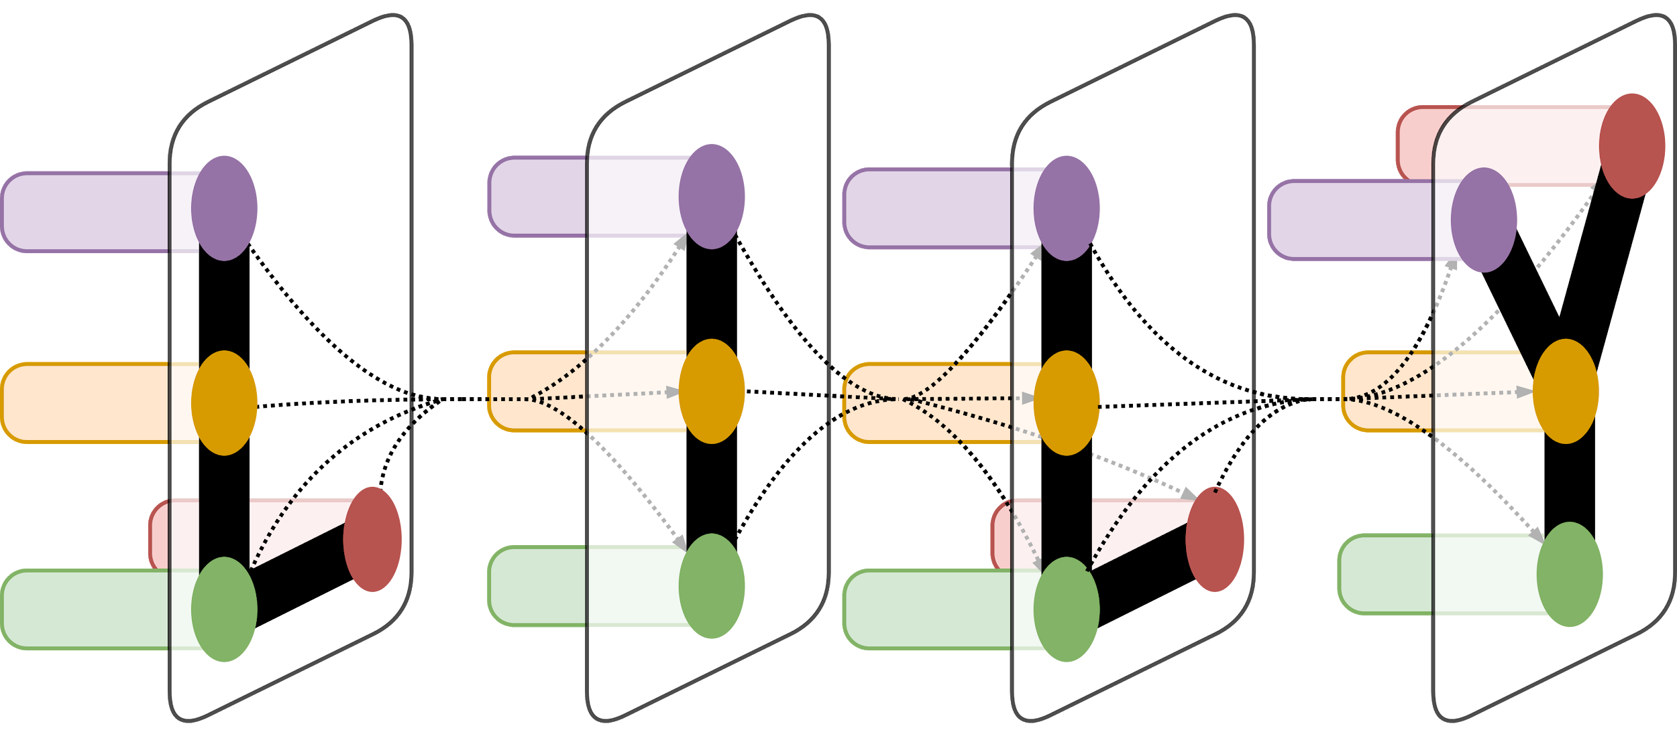
Surveytree
Automatic Generation of Survey Structures for NLP and AI topics
Prawat Trairatvorakul, Alexander Fabbri, Dragomir Radev

Slide 2
Why is structure important?
Structure increases readability Consider: (1) Definition, Task, Evaluation, Results (2) Results, Task, Definition, Evaluation
Current systems
Domain-specific templates by clustering (Sauper and Barzilay, 2009)
HMM of topic ordering (Jha et al., 2015)
Surveys cover many subtopics Each with their own subtopics Eg. Automatic Summarization -> Evaluation -> ROUGE -> BLEU -> DUC Quality Questions

Slide 3
Approach
Convert document to tree Nodes are section headings with subheadings as children
Extract features from heading Adaptation of tf-idf – tf: ancestor headings taken into account – idf: word frequencies from ACL Anthology
Combine trees into single tree Nodes merged recursively if similar Other nodes are simply added

Slide 4
Dataset
Five topics considered
Linear Algebra
Statistics and Probability
Sentiment Analysis
Automatic Summarization
Dependency Parsing
4 - 6 input documents from AAN each
Document Frequencies: Calculated from papers in ACL Anthology

Slide 5
Evaluation
& Results
Wikipedia Term Coverage
Human Evaluation of Node Merges
Tree Properties
Inspection of Output

Slide 6
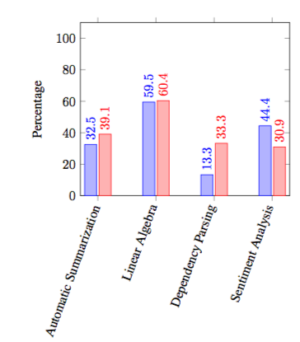
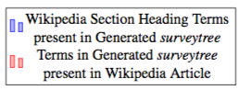
Wikipedia Term Coverage

Slide 7
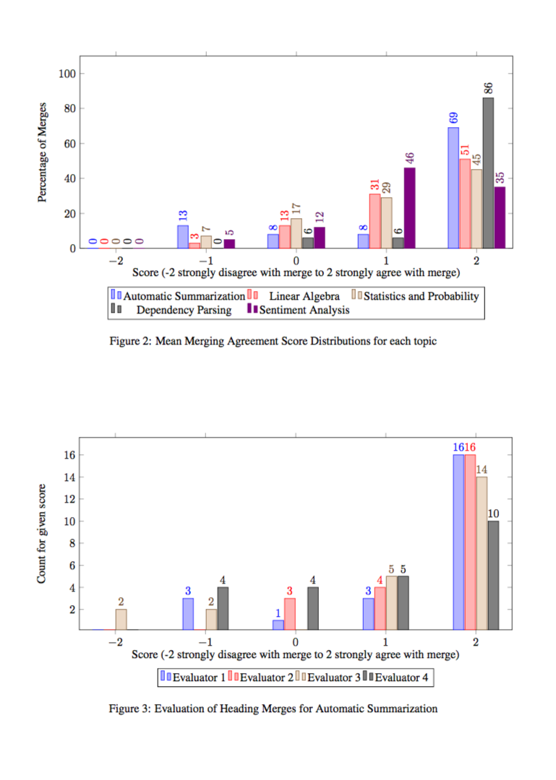
Human Evaluations of Node Merges

Slide 8
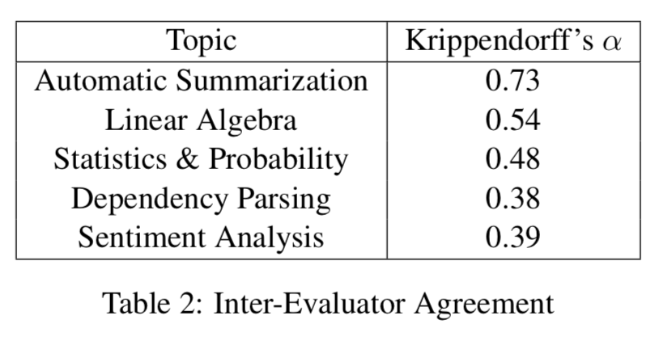
Human Evaluations of Node Merges
Thanks Alex, Michi, and Ryan!

Slide 9
Human Evaluations of Node Merges

Slide 10
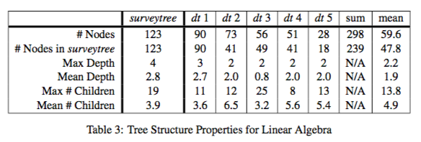
Tree Properties

Slide 11
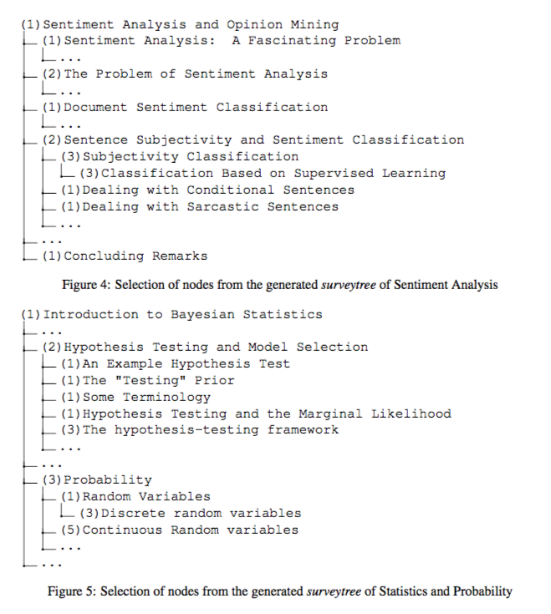
Selections from Generated Survey Trees

Slide 12
Conclusion
& Future Work
This approach has potential
Heading comparison works fairly well
Also has a lot of room to improve
Explore possibility of using vector magnitudes
We need more reliably parsed input documents

