Slide 1

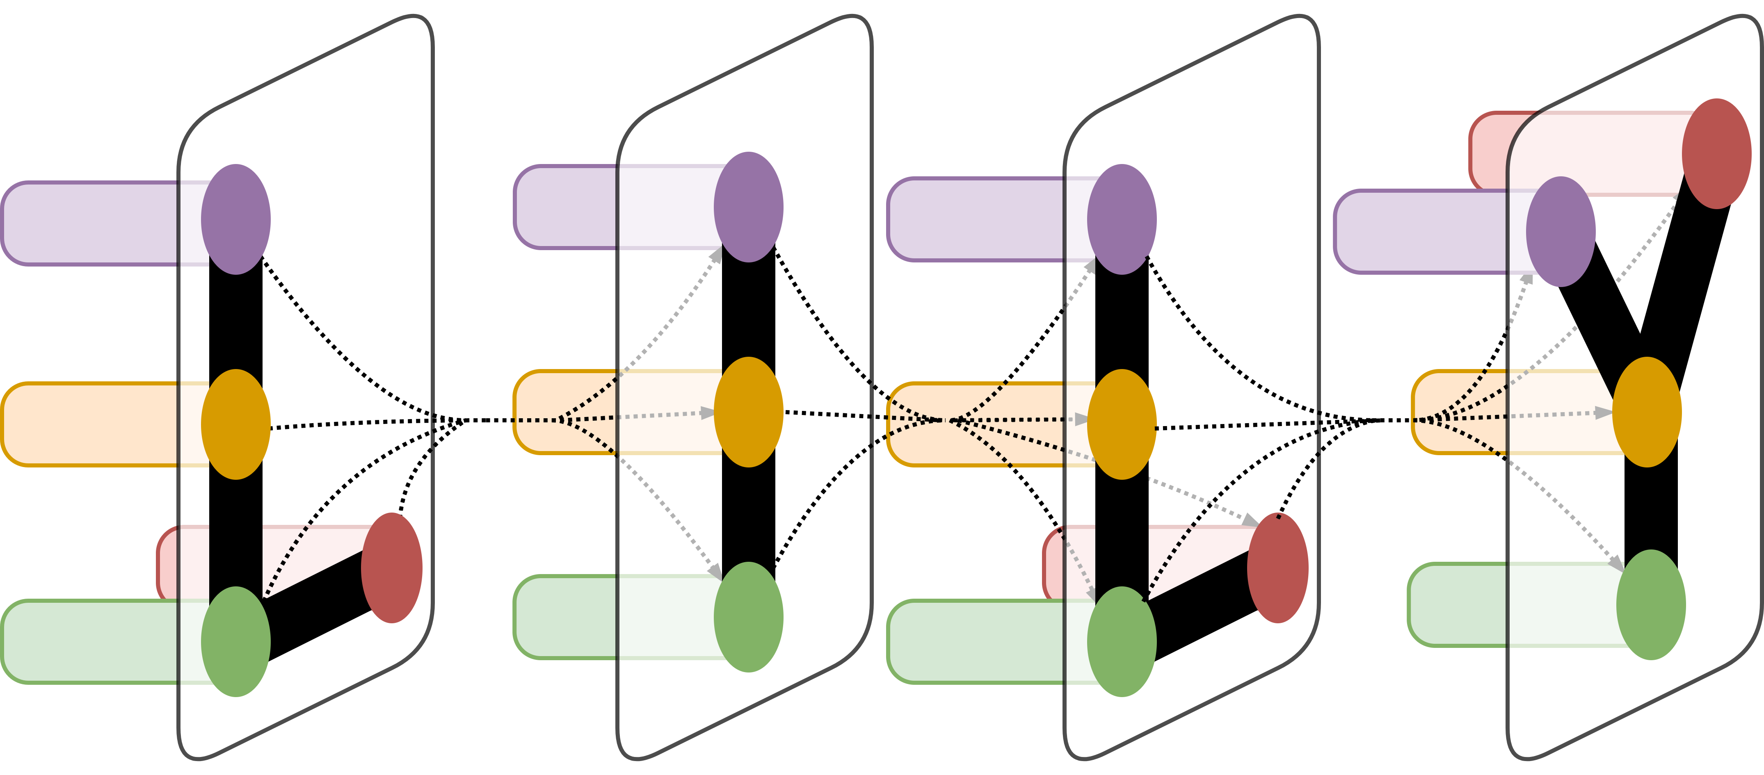
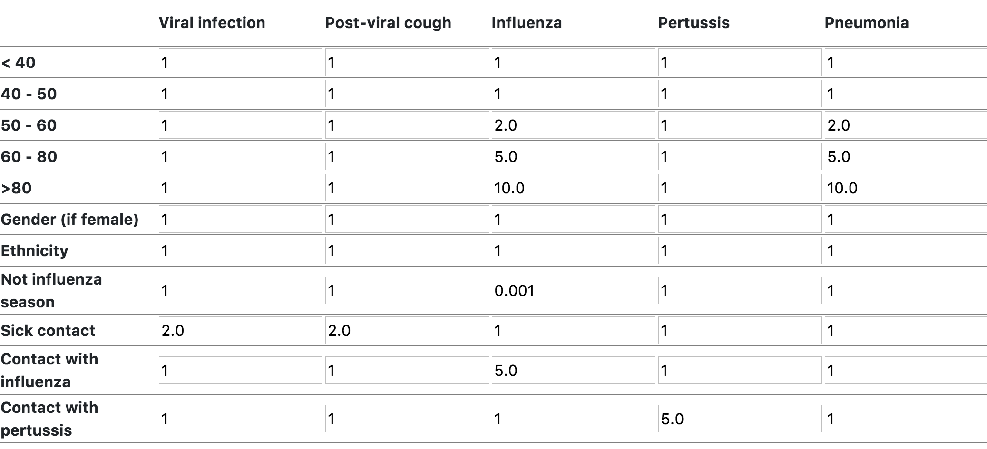
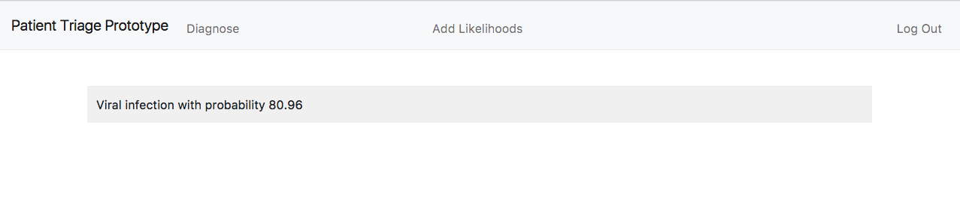
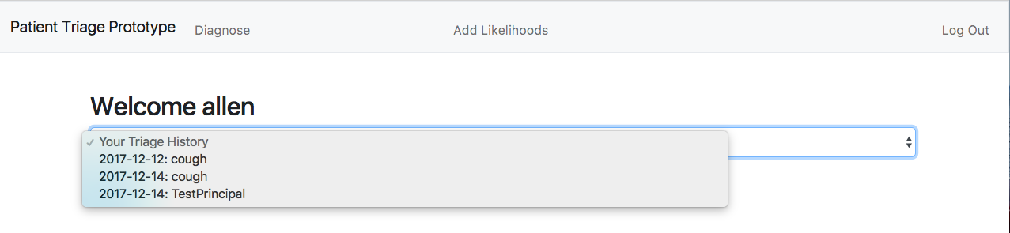
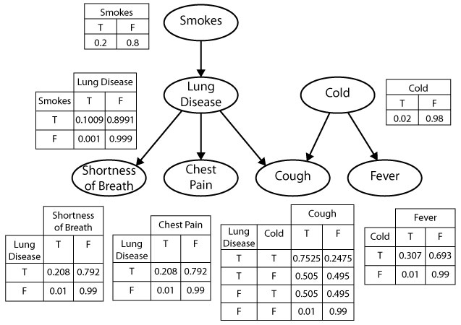
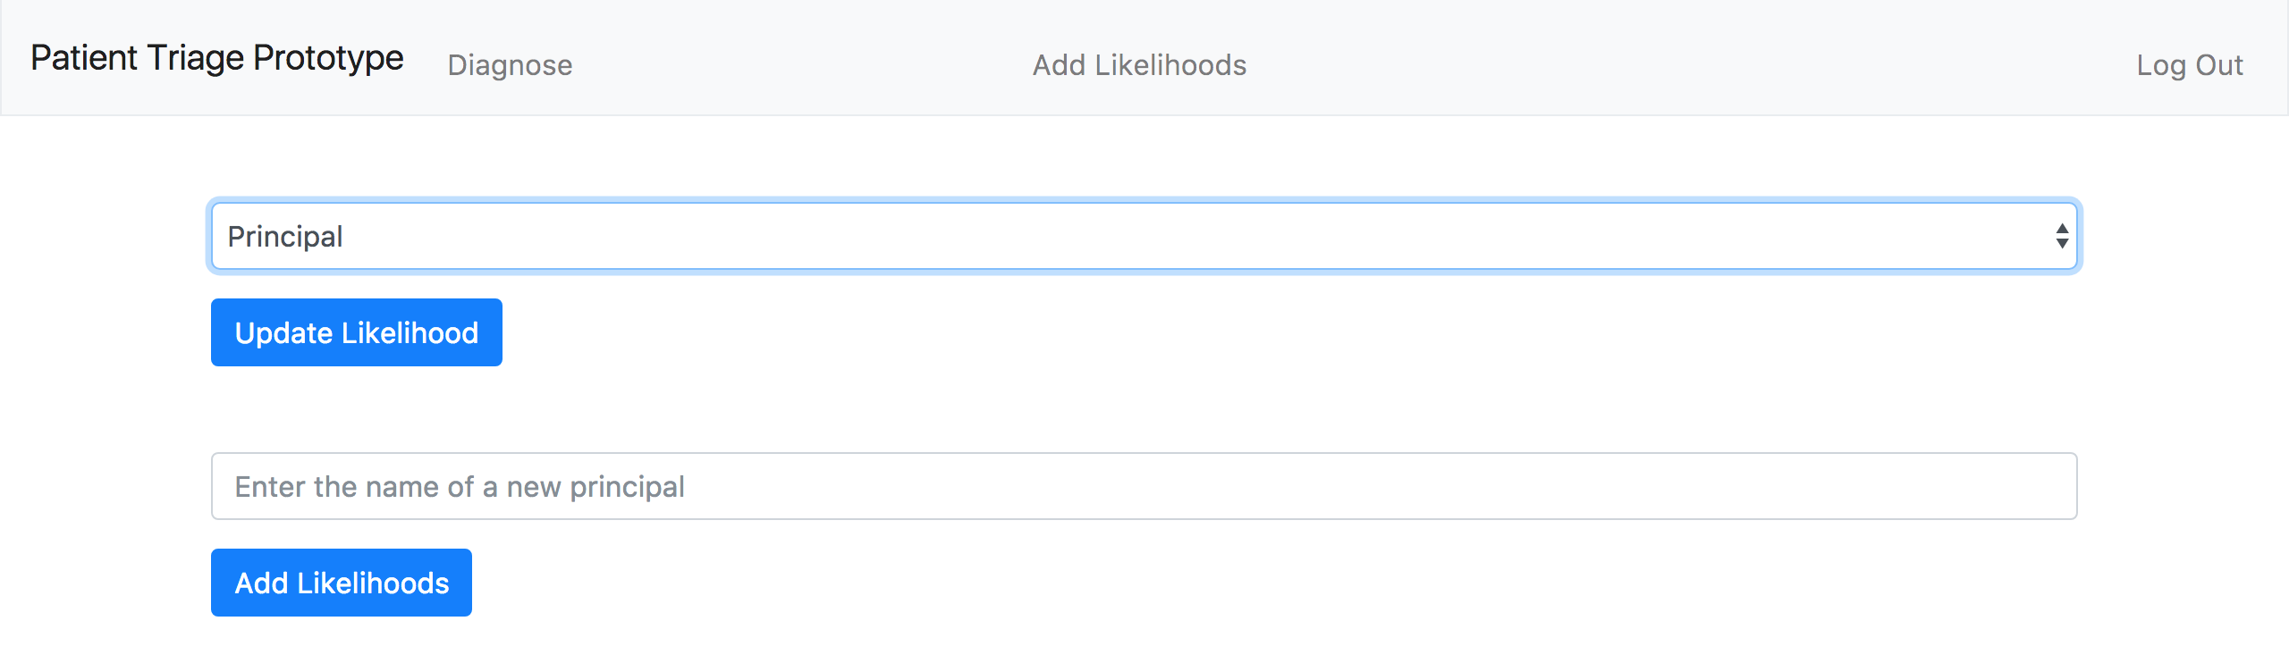
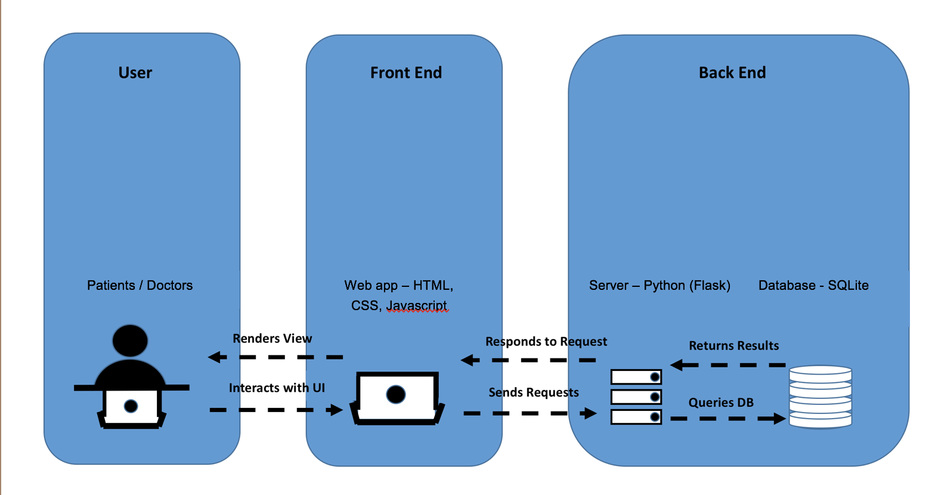
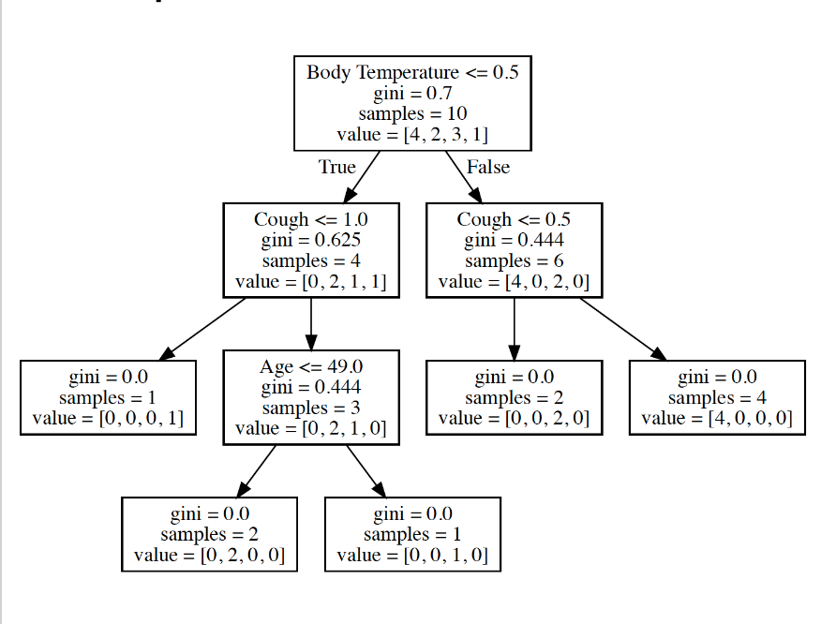
A System to Diagnose Patients with Cough
Allen Wang¹ and Stylianos Rousoglou¹
¹LILY Lab, Department of Computer Science, Yale University, New Haven, CT
LILY Lab
Introduction
Web Application Results
This project involved evaluating different machine-learning and probabilistic techniques to build a diagnosis system for both doctors and patients. The work was split into two phases: determining the appropriate predictive model for diagnosing a principal symptom, and building a functional web-application around this model to demonstrate a proof-of-concept for clinical diagnosis support systems. The predictive model focused on producing diagnoses from a single principal symptom: cough. The web-application handles both doctor and patient inputs and generates a set of diagnoses probabilities as the results.
Predictive Model:
Relative likelihoods combined with patient input calculations
Resultant diagnoses likelihoods summed and normalized
Diagnoses that meet our cutoff (5%) are returned
Patient Interface:
Patients can view a history of their diagnoses
Start a self-diagnosis by answering several question pages grouped by related symptoms
Receive a set of likely diagnoses based on patient inputs for the questions and the predictive model
Doctor Interface:
Doctors can modify relative likelihoods and add principal symptoms
Once a new input grid is filled out, diagnosis results are updated for either existing or new principal symptoms
Currently stores just the relative likelihoods for cough
Figure 3. Web-application Predictive Model Results
Table 1. Table of Relative Likelihoods for Cough From Doctor Interface
Models and Methods
Figure 4. Web-application Patient Interface Diagnosis History
Relative Likelihoods:
For the cough principal, there are 92 symptom-based questions and 23 possible diagnoses.
For each diagnosis, all of the symptoms have a value relative to 1 that represents the likelihood of this diagnosis if the symptom is present (Table 1).
Questions, diagnoses, and relative likelihoods compiled from Lajos Pusztai and Frederick Howard, our partners from the school of Medicine.
Bayesian Network:
Lack of training data - could not train based on real patient diagnoses
Conditional Probabilities - if known, allows for Bayesian networks implementation with small data sets
Relative Likelihoods - independent probabilities of diagnoses given symptoms
Unfeasible to generate conditional probabilities of diagnoses based on 92 symptoms
Maximum Likelihood Estimator - also unfeasible despite requiring less conditional probabilities
Decision Tree:
Lack of training data- generated sample data from self-generated patient inputs
Small training set led to overtraining
Classified patient inputs producing labels based on severity
Figure 5. Web-application Doctor Interface Update/Add Likelihood
Conclusion and Future Work
This project presented a user-friendly web application that can diagnose cough patients as well as preliminary research for future development. The application’s Doctor Interface can incorporate additional principal symptoms. The biggest issue faced was finding a large source of reliable patient diagnosis data. Some possibilities include unstructured free-text data from clinician notes or Electronic Health Records (EHR). NLP techniques could be applied to build models from free-text and with enough data, the machine learning approaches we explored could be implemented. A clinical diagnosis system could draw conclusions from multiple different predicative models as well as update the relative likelihoods based on empirical data or learning parameters.
Figure 1. Bayesian Network And Conditional Probabilities for a few symptoms
Figure 6. Web-application System Architecture
Acknowledgement
We would like to thank the LILY Lab and all of our team members that were integral to this project: Frederick Howard, Irene Li, Lajos Pusztai, and Professor Dragomir Radev.
Figure 2. Cough Decision Tree

