Slide 1

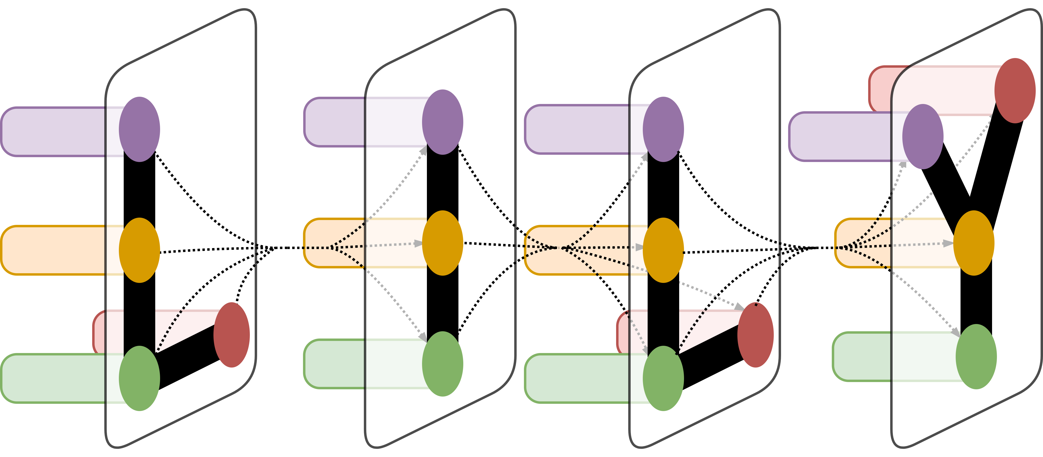
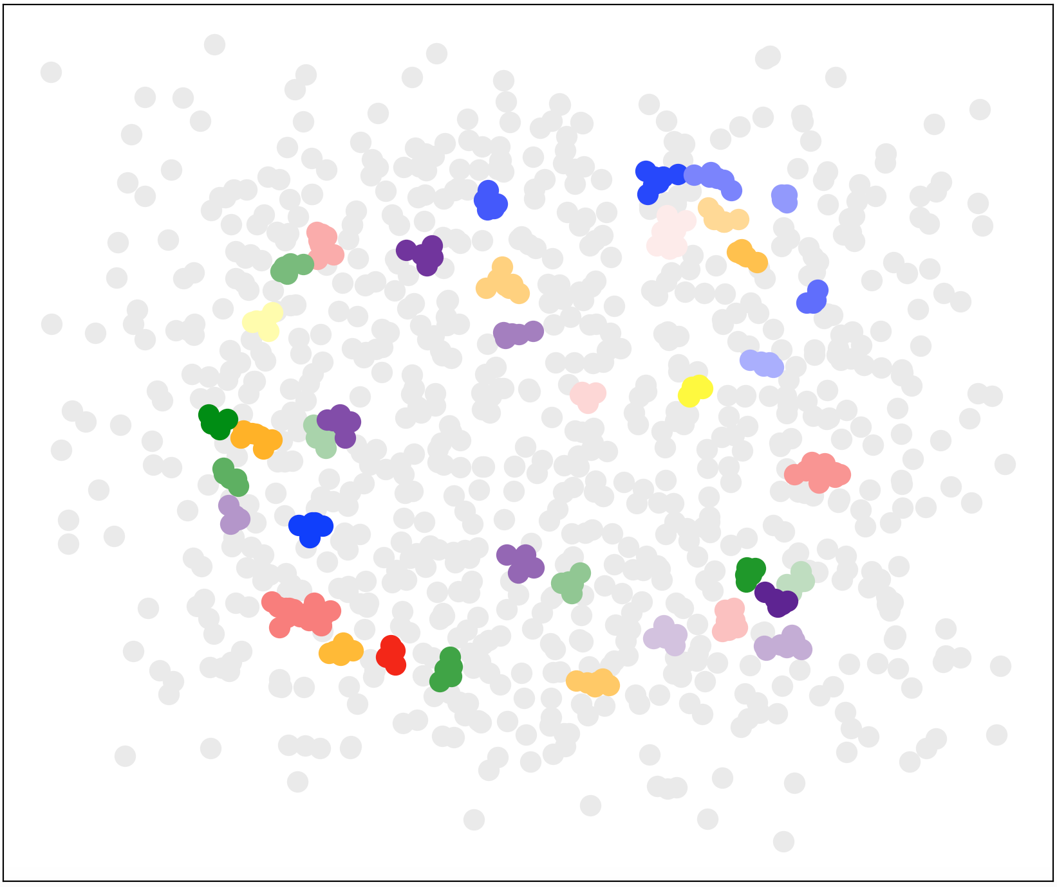
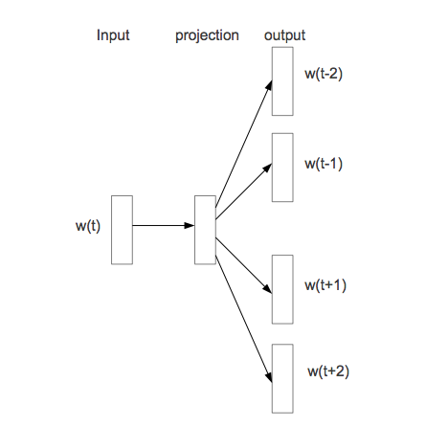
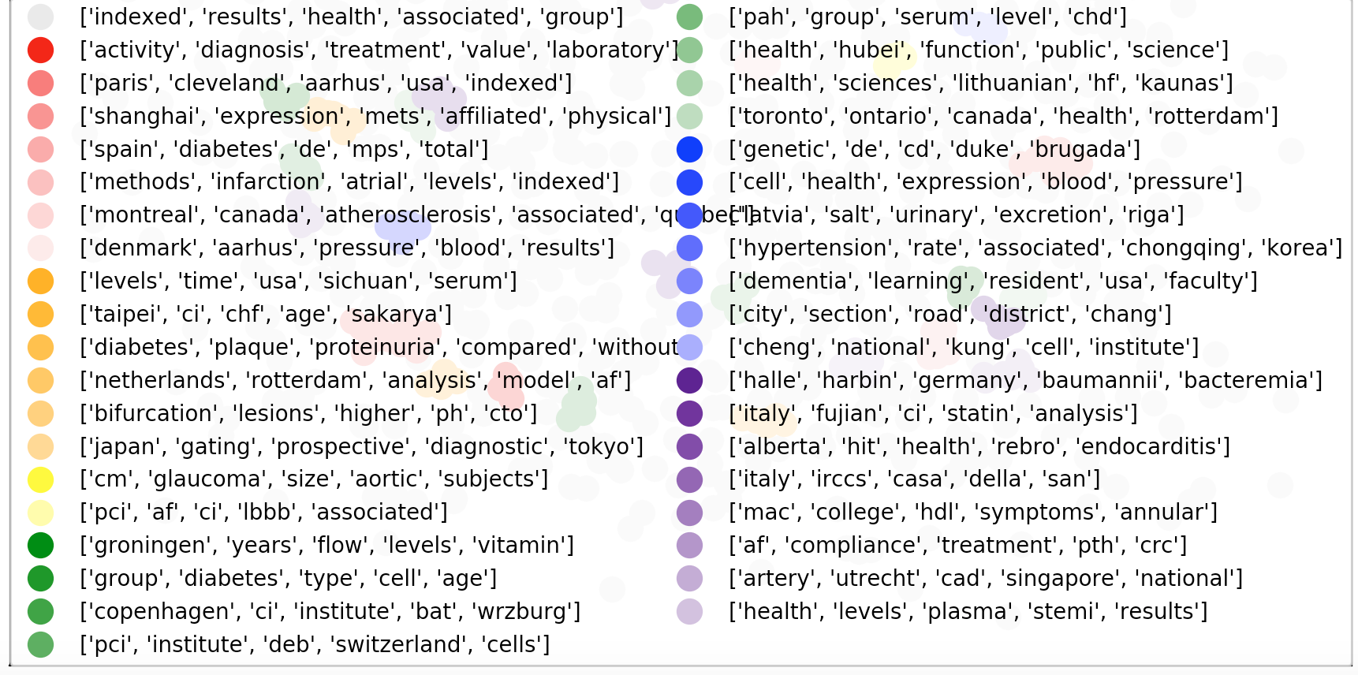
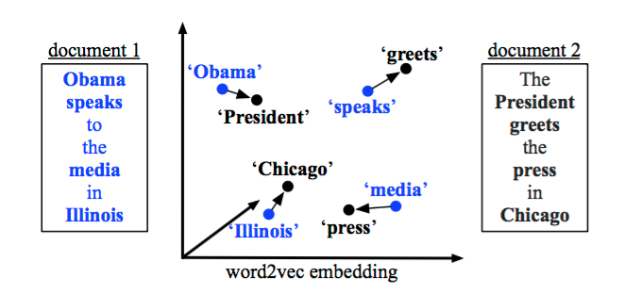
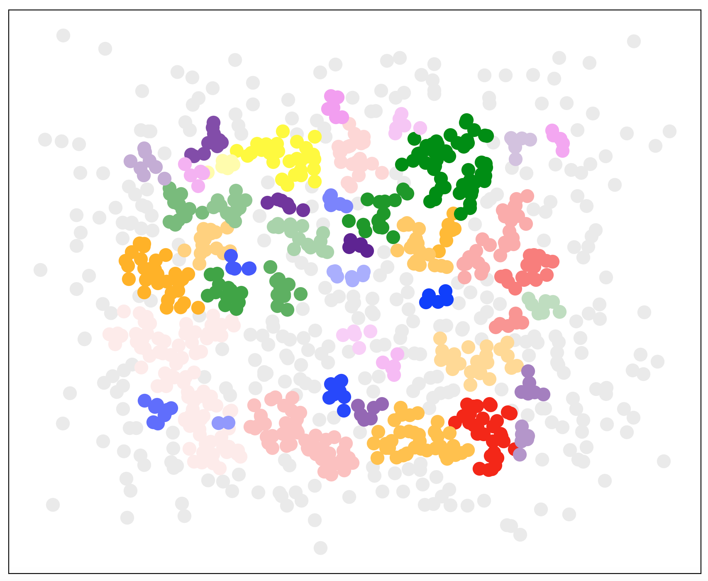
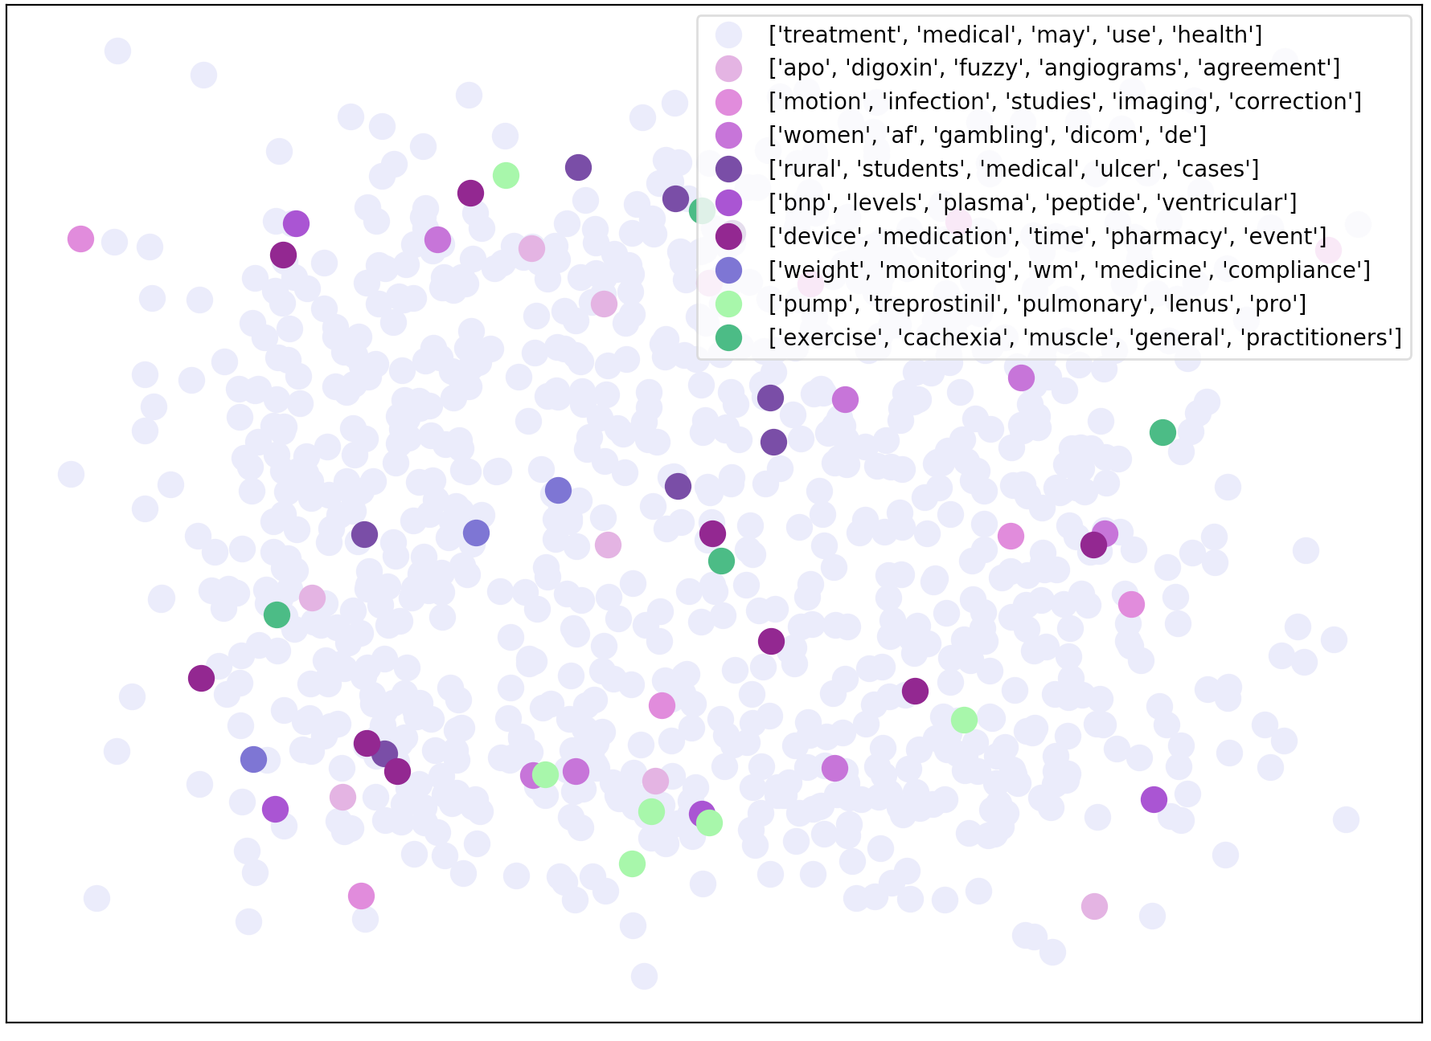
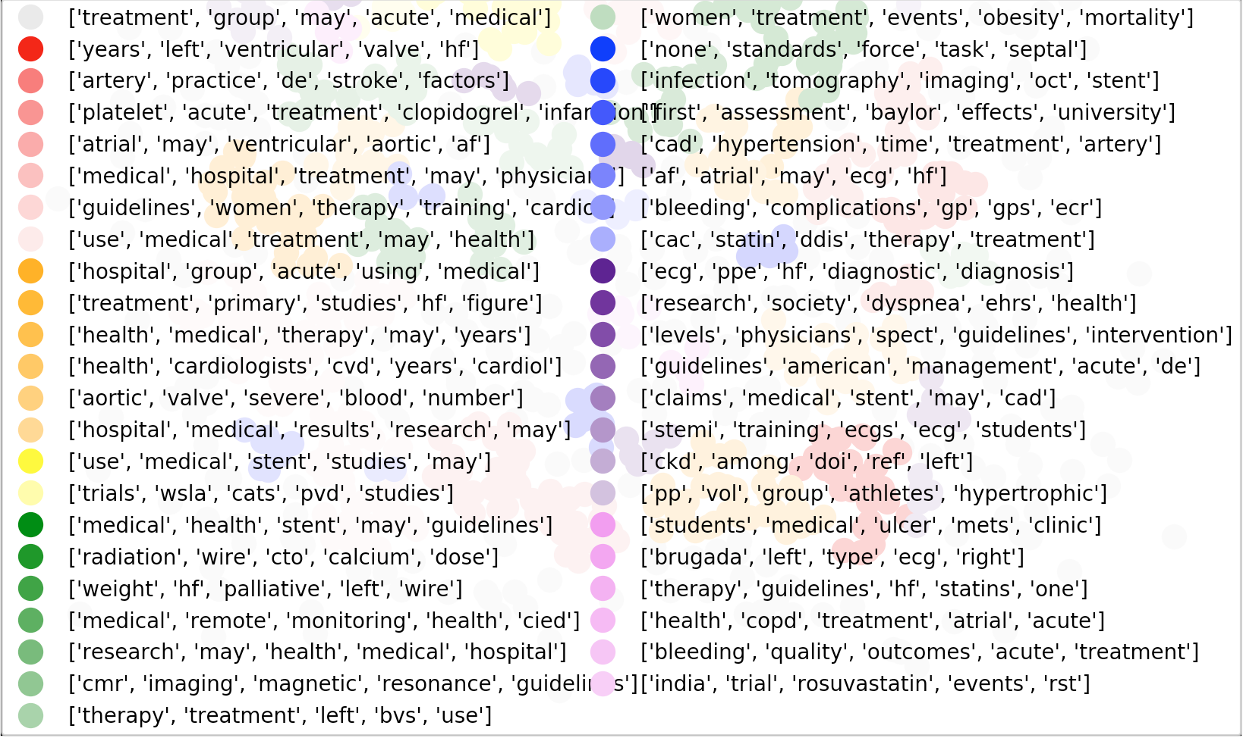
Medical Document Data Mining to Cluster Cardiology Research Papers
Alison Visher¹
¹LILY Lab, Yale University
LILY Lab
Introduction
Results
In order to deliver high quality care, physicians need to be knowledgeable about current research in their field and specific to their unique patients. However, medical research is published at an alarmingly fast rate that makes it difficult for physicians to absorb all the information they need when making potentially life saving decisions for their patients. The purpose of this project is to demonstrate a method to cluster cardiology research papers based on similarity, to ultimately facilitate easy navigation through immense amounts of research. While artificial intelligence to analyze the similarities between documents is a well-defined field, applying these methods to medical documents adds an additional layer of complexity due to the more complex structure and language. In order to achieve this goal, natural language processing was conducted to pre-process documents, before creating a Word2Vec model of word embeddings. Using this model, a document similarities were calculated using both Cosine Similarities and Word Mover’s Distance. Using similarity matrixes from these metrics, two different clustering methods were attempted, Spectral Clustering and DBSCAN and these clusters were visually represented.
It was difficult to establish the accuracy of clusters due to a lack of established “true” clusters of the documents. Results were analyzed through the ability of the method to visualize clusters close to one another that appeared similar in content. Overall, while the Pre-Trained model and the self-trained model produced similar results, the Pre-trained model was slightly more effective. DBSCAN produced significantly more related document groupings than Spectral Clustering. Furthermore, the WMD conducted on the text documents produced the most obviously related clusters. For instance one cluster in the graph pictured contained documents all pertaining to weight, obesity, and nutrition. However, some of the documents were grouped based off of less meaningful attributes like city of publication. On the other hand, the WMD groupings created on the smaller documents did not significantly improve the groupings using the similarity matrix. This is most likely attributable to the fact that the WMD was calculated for too few document pairs. Overall, while this method was able to cluster the documents, even the strongest clusters weren’t specific enough to be of use to a cardiologist.
Figure 1. Skip-Gram Architecture for Word2Vec
Materials and Methods
Figure 4. PubMed_Text, DBSCAN, WMD-K-Nearest Neighbors, Pre-trained Model, eps=0.025
Conclusion
These methods were experimented on three different corpuses of data, one of 1000 full papers in PDF form, one of 100 full papers in PDF form, and one of 1000 text abstracts all in the cardiology domain. First the PDFs were converted to text, and pre-processing was applied to remove negated words and stop words, as well as detect common word pairs (bigrams). Then a word2vec skip-gram model was trained on the largest dataset using the skip-gram architecture to get word embeddings. Pre-Trained Word embeddings trained on a significantly larger corpus of medical documents was also downloaded to compare results. Using these embeddings, documents were vectorized and Cosine Similarities were calculated. Then for each document, the Word Mover’s Distance was calculated for the n most similar documents. This calculation was only performed on the text documents and the smaller sample of PDFs due to its time complexity. These similarity and distance matrixes were transformed to k-nearest neighbor matrixes. Finally, these documents were clustered using both Spectral Clustering and Density Based Spacial Clustering of applications with Noise(DBSCAN)
In order to make the clusterings more similar, several steps can be taken to improve the method. First of all, because all of the documents were referring to cardiology and contained many of the same words, the algorithm ended up separating documents based off of less meaningful information. More rigorous pre-processing to extract pertinent features of the document would improve the clusters specificity. Furthermore, potentially applying a medical ontology, like MeSH to extract document features could improve performance. Additionally, performing the WMD on more document pairs in the full document datasets would improve the results. Because identifying information for each document was tracked throughout this process, it would be fairly simplistic to create a linking from cluster to document link. However, while the methods described above were able to cluster documents in a meaningful way, more work would need to be done to improve both the calculations and the display of the clustering to make this interface a workable tool for physicians.
Figure 2. Word Mover’s Distance Illustrated
Figure 2. PMC_Corpus Spectral Clustering, K-Nearest Neighbors
Acknowledgement
Figure 4. Another imported image.
Thank you to Professor Radev and Yale University’s department of Computer Science.

