Slide 1

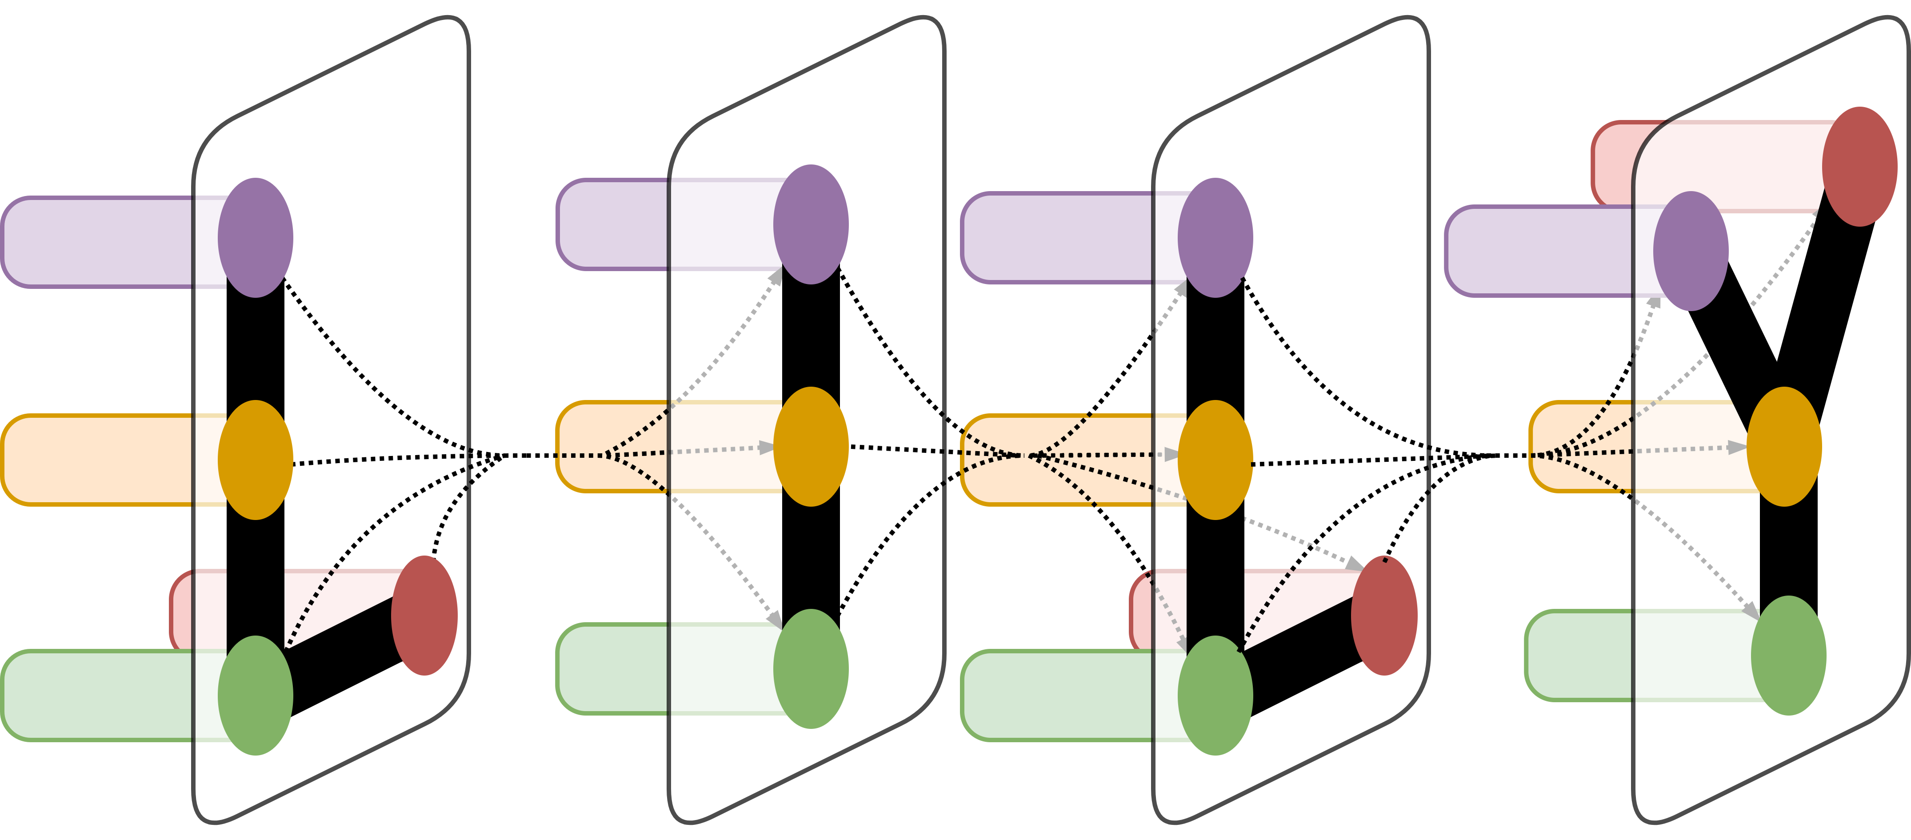
Evaluating Word Embeddings for Cross-Lingual Information Retrieval in Low Density Languages
Dennis Zhao,¹ Dragomir Radev PhD¹
¹Department of Computer Science, Yale University, New Haven, CT
LILY Lab
Introduction
Results
This project is under Project MATERIAL, MAchine Translation for English Retrieval of Information in Any Language. Over the course of this project, we will find methods that will aid in information retrieval from documents in low density languages. The queries provided into the system and the summaries outputted will both be in English. We will use Tagalog and Swahili to research and develop our models initially. In order to evaluate our model and methodology, we will be assigned another low density language at a later date.
To aid with information retrieval, the IR system will use cross-lingual word embeddings. To perform preliminary evaluation, I find the “most similar” words, as defined by cosine similarity. Similarity is important because because we will use a similar metric when we perform query expansion, the process of reformulating a seed query to improve retrieval performance in information retrieval operations. Finding similar words to replace or add into our query will certainly involve where words are located relative to other words.
We see that a lot of the similar words are plural forms of query terms. However, there area lot of similar/related words that will help in query expansion, especially for query terms like “buildings”, “bird”, “picture”, and “eye”. We also have the 5 closest terms for Swahili (Table 2) and Tagalog (Table 3) below as well. For these language, we first translate the query terms from English to the respective language using our parsed dictionaries. We then looked at the transformed word embeddings to find the closest five words.
Looking across the cosine similarity scores, we see that in general, the similarity scores of the corresponding pairs are not far off from similarity scores of the query terms. For Tagalog, the similarity scores seem higher across the board and there were not too many “drop-offs” in similarity scores between query terms, especially in the first or second most similar terms. For Swahili, there are more deviations from the similarity score of the query terms. However, most of these deviations were in the third, fourth, and fifth most similar terms. This suggests that our embedding space is fairly well set up, although we may want to consider way to obtain a higher similarity score for translations.
Table 1. Table of 5 closest words to query terms. The first column indicates the query term and column i indicates the i-th closest word.
Table 4. Table of cosine similarity scores for query terms and 5 closest words to query terms in English-Swahili. The first column indicates the query term pair and column i indicates the i-th closest word pair across translations.
Materials and Methods
After creating the word embeddings, I was also tasked with doing some preliminary evaluations of their quality. Using Gensim and Word2Vec packages in Python, I first computed the five most similar words to those listed in the sample queries. I also restricted the vocabulary to only 200,000 words in order to filter out less frequently occurring words that could have been the result of imperfect parsing or unclean data.
Now, we will find the cosine similarity between the original query terms in English and in one of the low-density languages and then compare the similarity between each of the i-th closest words. That is, I will take the first closest word to “buildings” and the first closest word to the Swahili translation of “buildings” and then find the cosine similarity between those two words. By doing this, we can see how consistent the constructed embedding spaces are.
Conclusion and Future Work
Table 2. Table of 5 closest words to query terms in Swahili. The first column indicates the query term and column i indicates the i-th closest word.
Next steps for this project can involve making further improvements to the cross-lingual embeddings. We can consider the idea of using “relevance-based” word embeddings where we place word vectors close to each other by relevance instead of by proximity. We can also integrate our word embeddings to perform query extension in our information retrieval systems. Following this, we have to create relevance judgments for evaluating our information retrieval system. We can use French to train the system and determine what improvements need to be made, and then simulate a “surprise” language by using Tagalog.
Table 5. Table of cosine similarity scores for query terms and 5 closest words to query terms in English-Tagalog. The first column indicates the query term pair and column i indicates the i-th closest word pair across translations.
Acknowledgement
I would like to thank Professor Dragomir Radev providing guidance and helping me with this project. I would also like to thank the other members of the LILY lab for their willingness to answer all my questions.
Table 3. Table of 5 closest words to query terms in Tagalog. The first column indicates the query term and column i indicates the i-th closest word.

