Slide 1
AST Based Sequence to Sequence Natural Language Question to SQL Method
Kai Yang, Tao Yu, Professor Dragomir Radev

Slide 2
Problem Description - Dataset
WikiSQL: very simple SQL queries, only contains select … from table where …
Atis/Geoquery/Scholar
Same SQL queries show multiple times in dataset
Same SQL queries show in both training and test dataset
All SQL queries is corresponding to only one database

Slide 3
Problem Description - Evaluation Methods
SQL queries exactly match
order-insensitive in select clause
Extra space or bracket does not change effectiveness of the queries
SQL queries execution result match
Different SQL queries could generate same query result (like empty set)

Slide 4
Data
Prepared by LILY Project members
About 60 Database
About 5000 natural language and SQL query pairs

Slide 5
Evaluation
Parse golden queries and generated queries into syntax tree
Separate SQL queries into several components
For each component, compare the different in tree structure of golden queries and generated queries

Slide 6
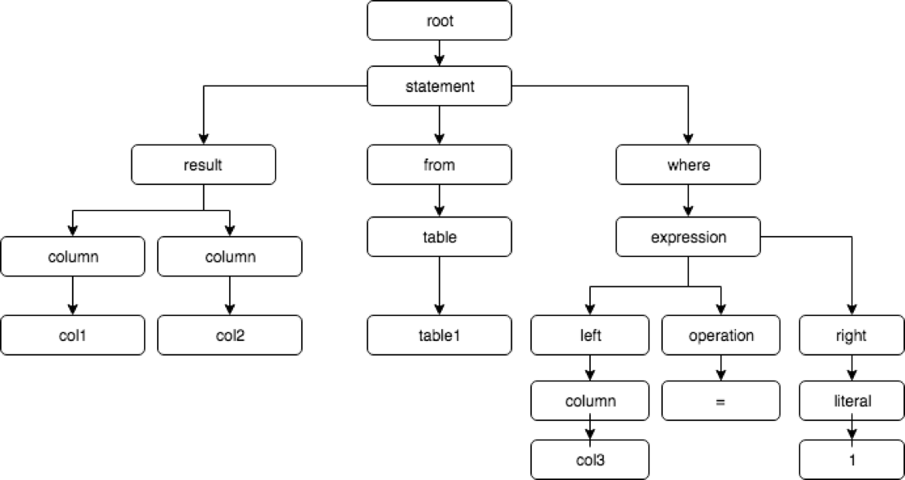
Approach
Parse train SQL into AST and generate a sequence of ordered grammar rules (from top to down and from left to right)
root->statement
statement->result,from,where
result->column,colum
column->col1
column->col2
from->table
table->table1
where->expression
expression->left,operation,right
left->column
column->col3
operation->=
right->literal
literal->1
select col1,col2 from table1 where col3=1;

Slide 7
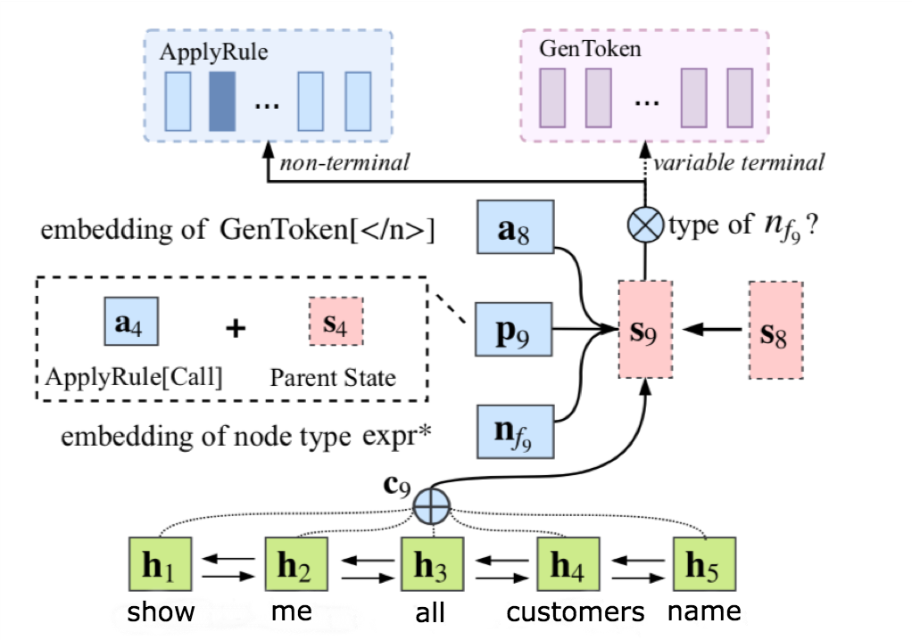
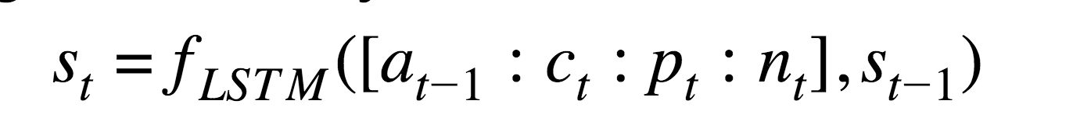
Approach

Slide 8
Result
Can only predict column name that shows in training data
Could not predict complex SQL queries (nested, compound clause)
SQL Components | Accuracy
select | 0.216
select_without_agg | 0.140
select_agg | 0.424
where_expression | 0.029
where_operator | 0.183
where_nested | 0.040
group | 0.047
order by | 0.250
compound | 0.000

Slide 9
Conclusion and Future Work
We proposed a new dataset and evaluation method
The model served as a baseline of our NL2SQL task
The capacity of this model is limited
We could make progress to improve the result

