Slide 1
Translating Natural Language Questions into SQL Queries
Shanelle Roman
Notes:
CS 490
Tao Yu’s NL2SQL project
Explaining the problem definition, going over the dataset, and delving into my part of the project.

Slide 2
The Problem & Previous Research
Translation of natural language queries into SQL queries
Zhong 2017: Seq2SQL with Reinforcement Learning
Reinforcement learning on WHERE prediction
Xu and Song 2018: SQLNet
WikiSQL DataSet
What are the names of all female students? =>
SELECT name where gender = ‘F’
Limited utility: “for each…”, “give me names and student ids”, etc

Slide 3
Goal
Create a more real-world dataset
Implement the seq2SQL model baseline for this new dataset

Slide 4
WikiSQL vs New Dataset
AGG
SELECT
WHERE
AGG
SELECT
WHERE
GROUPBY
LIMIT
SORTBY
HAVING
ASC / DESC
JOIN
….
How many students are female?
Vs.
How many sports does each female student play?

Slide 5
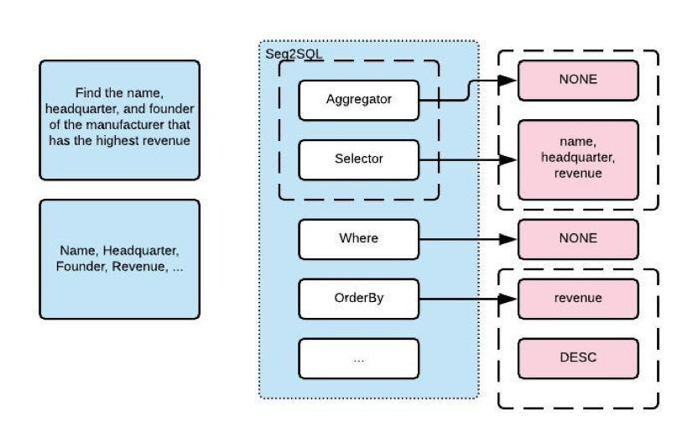
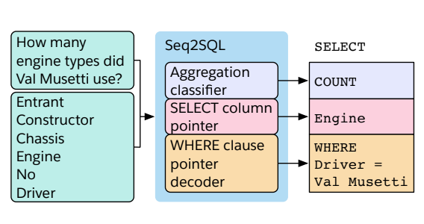
Seq2SQL: Then vs Now

Slide 6
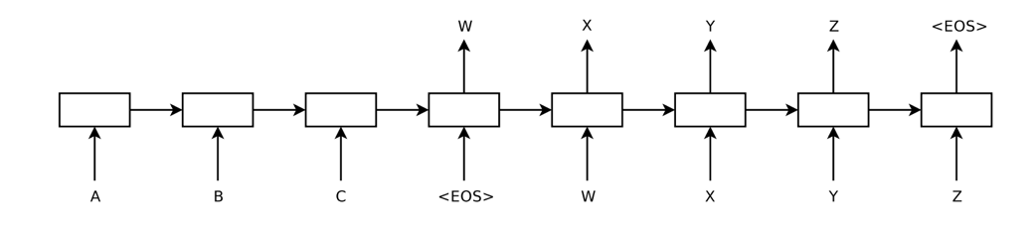
Architecture: Encoder - Decoder

Slide 7
Results & Future Issues
Embeddings of multiple columns with the same name
Improve selection of SQL template format
Reinforcement learning for all of the column components
Finish all of the components
Best Dev Agg Accuracy = .48892405
Best Dev Sel Accuracy = .1205316
Best Dev Cond Accuracy = .371835

