Slide 2
y
x

Slide 3
Position
…
Resources of each
type available
y
Density of each type
Catches of each type
x

Slide 4
Prey 1
Prey 2
Type
Predator

Slide 5
Prey 1
Prey 2
Position
Resource
pool
Type
Predator
Average offspring
Max consomption
Max move
range

Slide 6
Catch
probability
Resource
per catch
Feeding function

Slide 7
Regime
Hunting function

Slide 8
Prey 1
Prey 2
y
Predator
x

Slide 9
 | Res 1 | Res 2 | Prey 1 | Prey 2 | Predator
Res 1 | 0 | 0 | 1 | 0 | 0
Res 2 | 0 | 0 | 0 | 1 | 0
Prey 1 | 0 | 0 | 0 | 0 | 1
Prey 2 | 0 | 0 | 0 | 0 | 2
Predator | 0 | 0 | 0 | 0 | 0

Slide 10
 | Res 1 | Res 2 | Prey 1 | Prey 2 | Predator
Res 1 | 0 | 0 | 1 | 0 | 0
Res 2 | 0 | 0 | 0 | 1 | 0
Prey 1 | 0 | 0 | 0 | 0 | 1
Prey 2 | 0 | 0 | 0 | 0 | 2
Predator | 0 | 0 | 0 | 0 | 0
Order of
preference

Slide 11
Possible
predation
Prey 1
Prey 2
y
Predator
x

Slide 12
Time steps

Slide 13
Preys
M+F
Preys
M+F
Preys
M+F
Preys
M+F
…
Time steps

Slide 14
Survival trial
Preys
M+F
Preys
M+F
Preys
M+F
Preys
M+F
…
Time steps

Slide 15
Reproduction trial
Survival trial
Preys
M+F
Preys
M+F
Preys
M+F
Preys
M+F
…
Time steps

Slide 16
Lanscape refill
Reproduction trial
Survival trial
Preys
M+F
Preys
M+F
Preys
M+F
Preys
M+F
…
Time steps

Slide 17
Lanscape refill
Reproduction trial
Survival trial
Preys
M+F
Preys
M+F
Preys
M+F
Preys
M+F
…
Time steps
Time steps

Slide 18
Lanscape refill
Reproduction trial
Survival trial
Time steps

Slide 19
Time steps

Slide 20
Predator introduction
Time steps

Slide 23
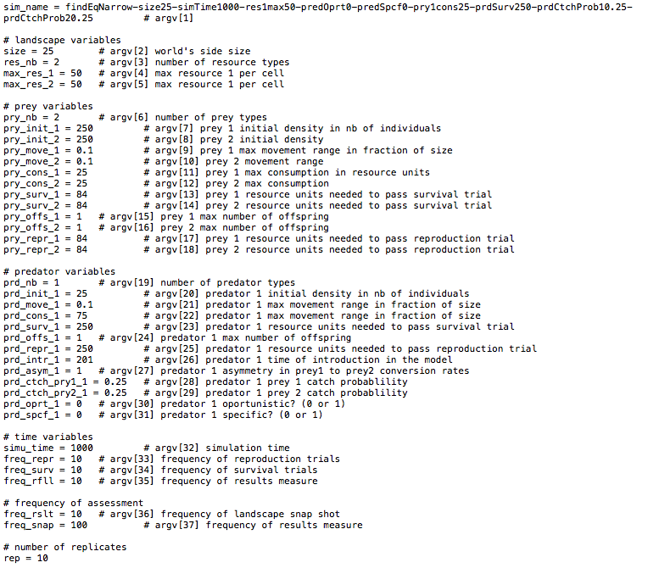

Slide 24
