Slide 1
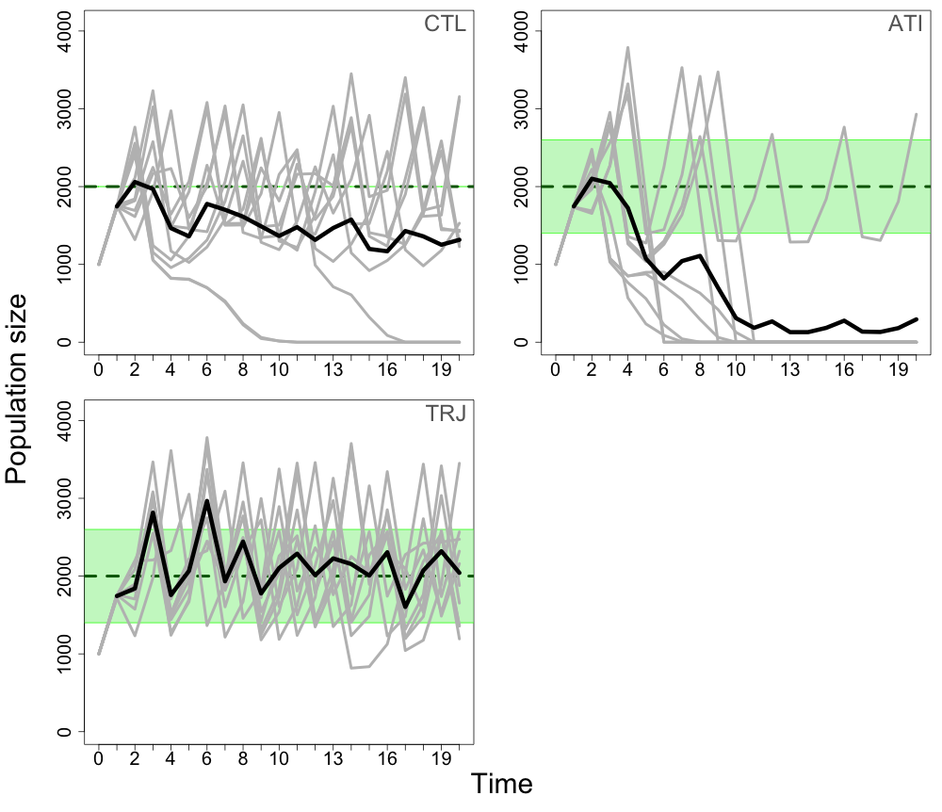
Replicates
Mean
Manager target
Permissive range

