Slide 1



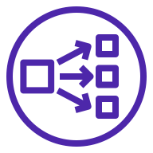

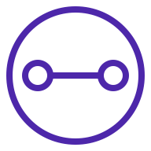

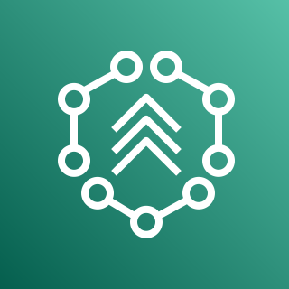
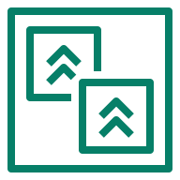
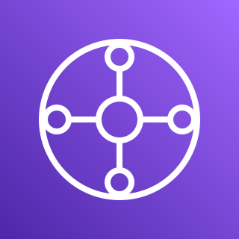

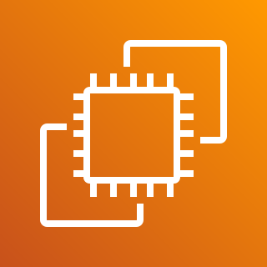

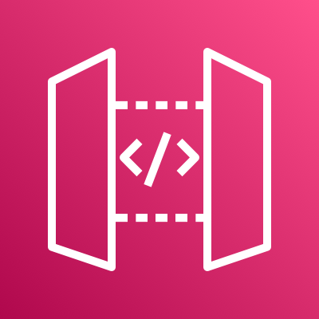


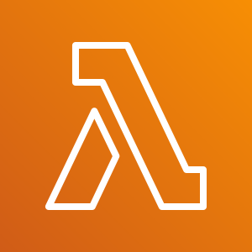
AWS Cloud
Region
Availability Zone 1
Availability Zone 2
VPC-Application-Example-Proxy
VPC Link
Private subnet
Network Load Balancer
Private subnet
Transit Gateway Attachment
Transit Gateway Attachment
AWS Migration Hub
Refactor Spaces Environment : Unicorn-Dev
Monolith VPC
AWS Transit
Gateway
Private subnet
Private subnet
Refactor Spaces Application : Unistore
Transit Gateway Attachment
Transit Gateway Attachment
Application Load Balancer
Service : Monolith
Default Route (/)
Unistore Legacy
Unistore Legacy
Users
Amazon API Gateway
Service : Unistore-AddToCartService
Route /unicorns/basket {GET, POST}
AWS Lambda
AddToCart Microservice

