Slide 1





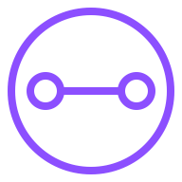
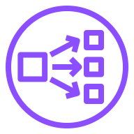

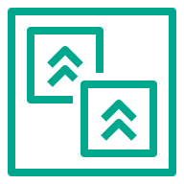
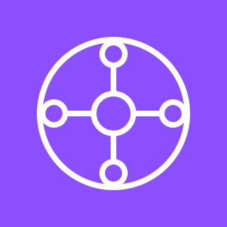


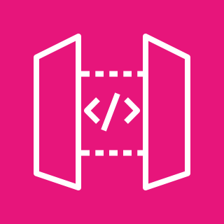




AWS Cloud
Region
VPC link
Availability Zone 1
Availability Zone 2
Virtual private cloud (VPC)
Private subnet
Private subnet
AWS Migration Hub
Attachment
Network Load Balancer
Attachment
Refactor Spaces environment
Virtual private cloud (VPC)
AWS Transit
Gateway
Private subnet
Private subnet
Refactor Spaces application
Application Load Balancer
Attachment
Attachment
Amazon API Gateway
Refactor Spaces
service (Default)
Unistore legacy
(monolith)
Unistore legacy
(monolith)
Users
Refactor Spaces
service (AddToCart)
Lambda function
AddToCart

