Slide 1




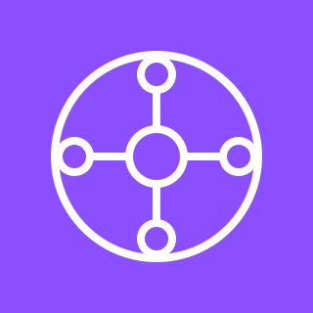

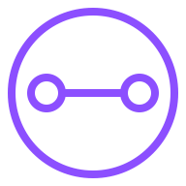
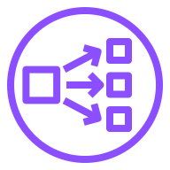

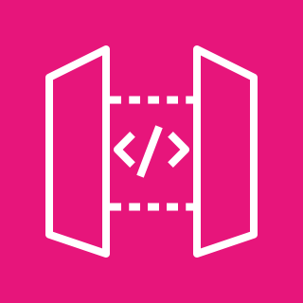

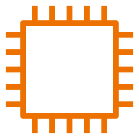


AWS Cloud
VPC Link
Availability Zone 1
Availability Zone 2
AWS Migration Hub
VPC
Refactor Spaces environment
Private subnet
Private subnet
Attachment
Network Load Balancer
Attachment
AWS Transit Gateway
Refactor Spaces application
VPC
Private subnet
Private subnet
Refactor Spaces
service (Default)
Users
Attachment
Attachment
Amazon API Gateway
Refactor Spaces
service (AddToCart)
Unistore legacy
(monolith)
Application Load Balancer
Unistore legacy
(monolith)
Lambda function AddToCart

