Slide 1
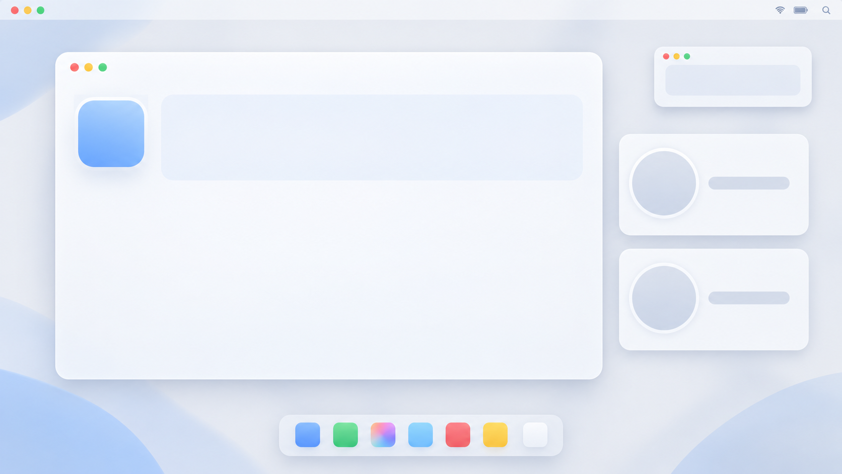










HelloHacks 2026 Team 17
Lyle Lo
Adrian
Cheung
Jayden
Tsai
Notes:
25s
Lyle

Slide 2
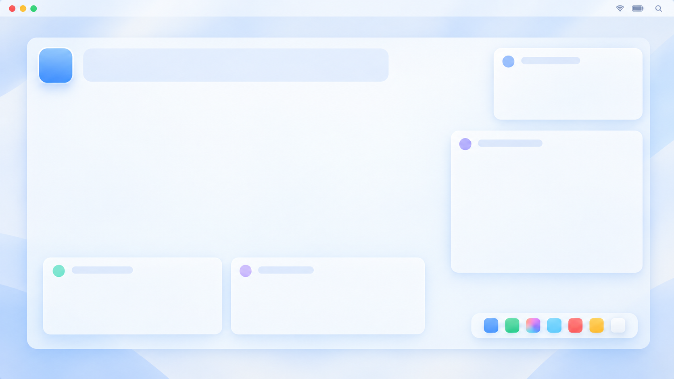
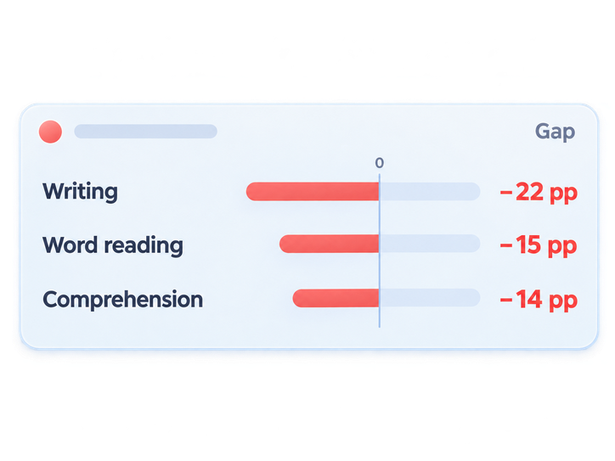
So... what’s the problem?
3 in 4
reported challenges understanding graphs or photos
School outcomes for students with vision impairment.
The gap shows up across early literacy. Age 5 outcomes:
RNIB’s 2026 analysis of England’s official 2023–24 pupil attainment data
25%
20%
Age 5: gap in expected
early-development standard
Age 11: gap in expected reading and writing
Notes:
explain the link of the issue, like people underperform because they cant easily use material or smt
maybe explain that tablets and phones have absolute coordinates, but what about laptops?
35s
Lyle

Slide 3
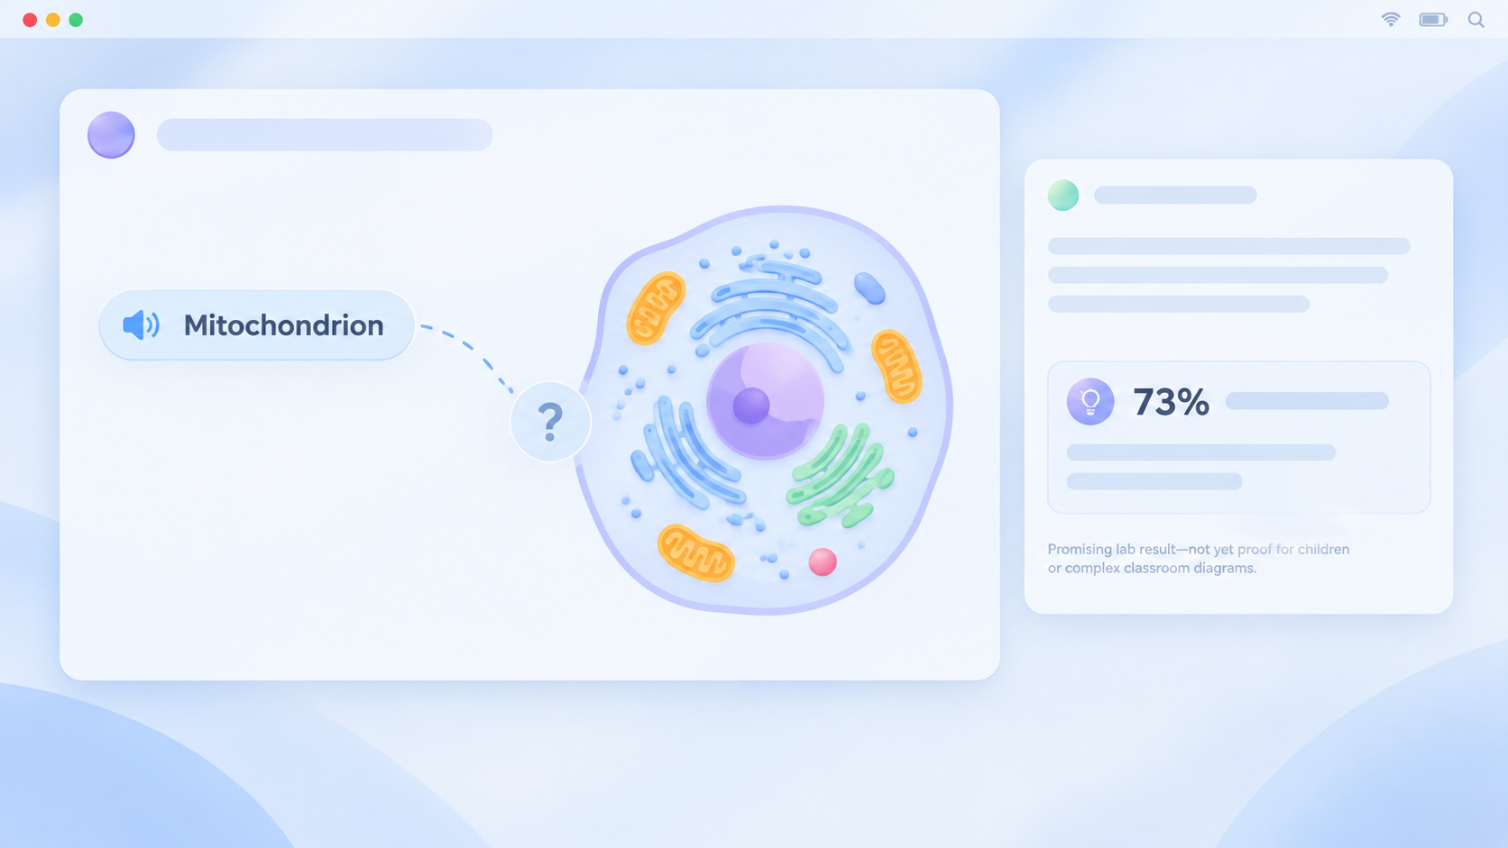


Let’s tackle the missing link
Spatial sound can be learned.
After training, accuracy reached:
A label gives the name.
But where does it point?
73%+
What if we gave people...
Topo-Speech, 2023
Superpowers?
Notes:
Adrian

Slide 4
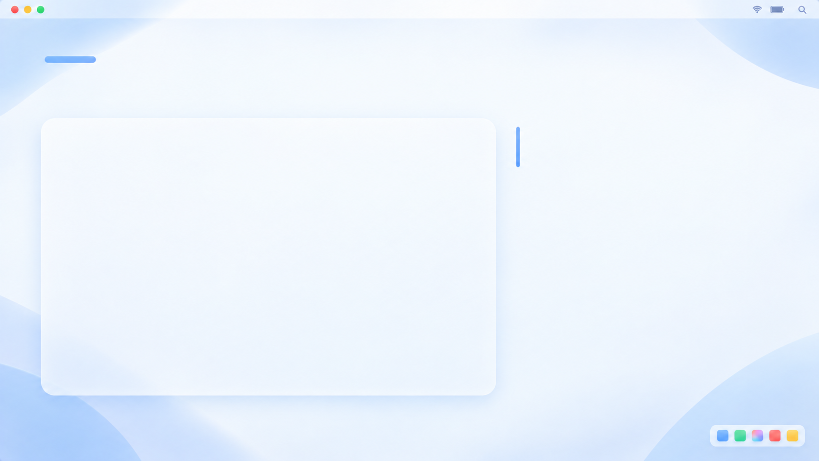
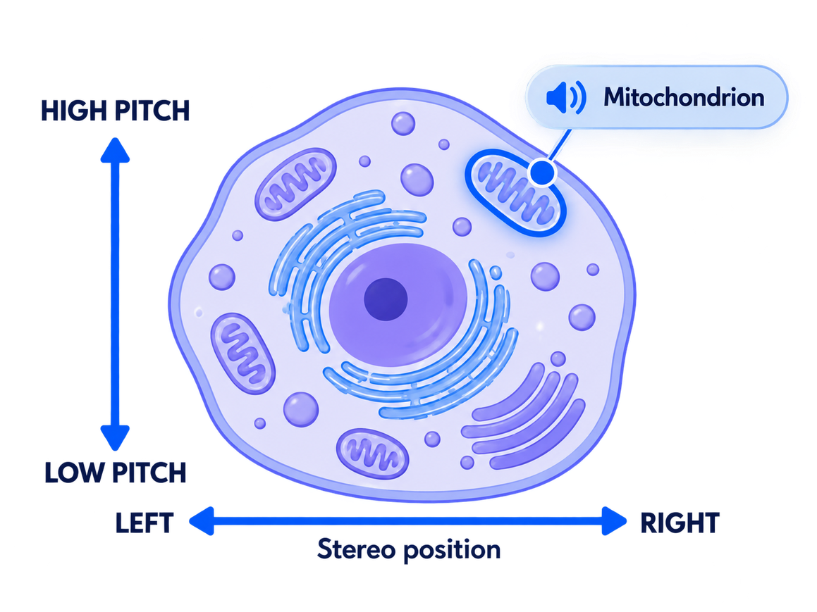




Two systems, one spacial map.
Meet TouchSight
Explore imagery through sound.
Hear the layout
Spatial audio and spoken labels connect.
Teach your way
Upload media, invite students, adjust experience.
On screen or on paper
Lightweight browser, or printable paper.
Fully private and offline.
Notes:
Adrian

Slide 5


Slide 6
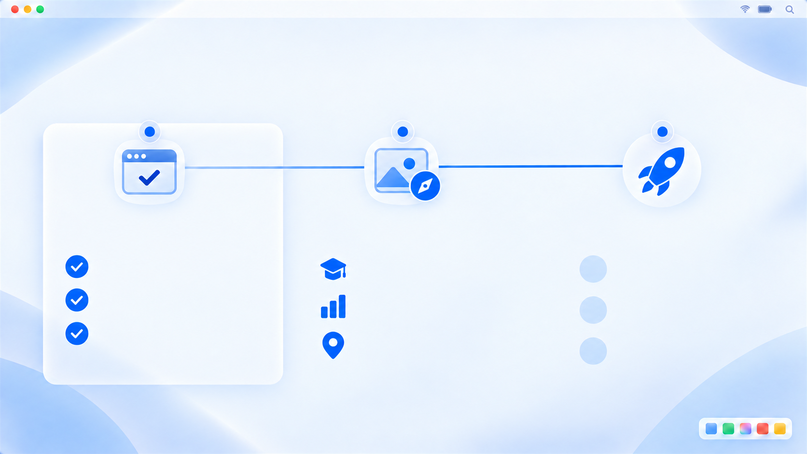
Where TouchSight goes next
BUILT IN HELLOHACKS
POTENTIAL USE CASES
NEXT STEPS
Working prototype
Wider possibilities
Build with users
Explore a mapped image
Learning diagrams
Test with visually impared users
Customize regions
Charts and infographics
Automate region-label mapping
Export printable copies
Maps and visual guides
Measure accuracy and ease of use
Demonstrated in demo.
Our goal: more independence when exploring visual information.
Notes:
Lyle
40s

Slide 7
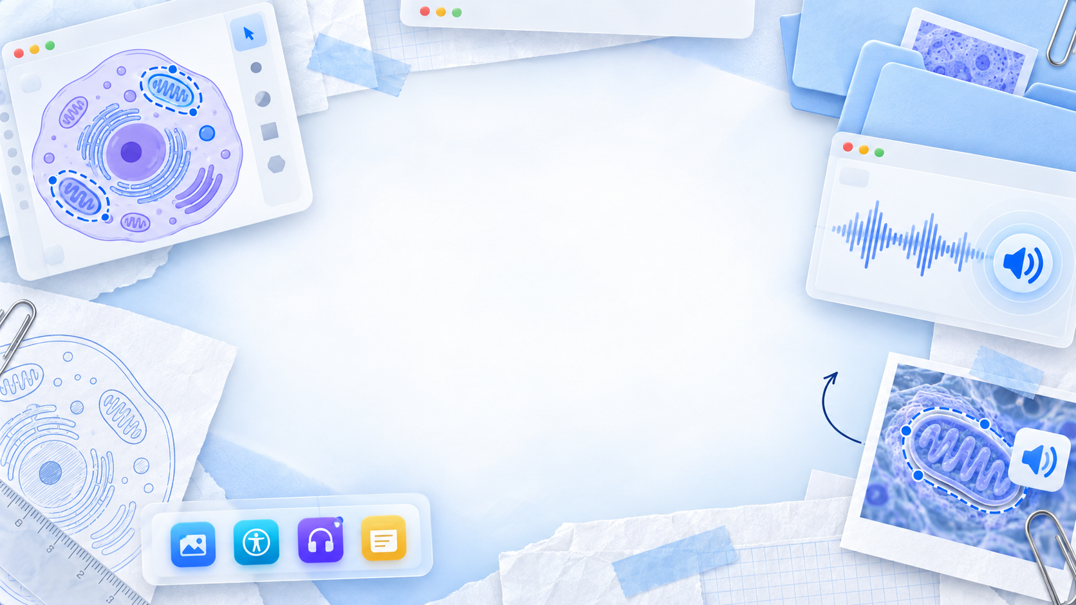

Thank you judges!
Notes:
Lyle
20s

Slide 8
APPENDIX

Slide 9
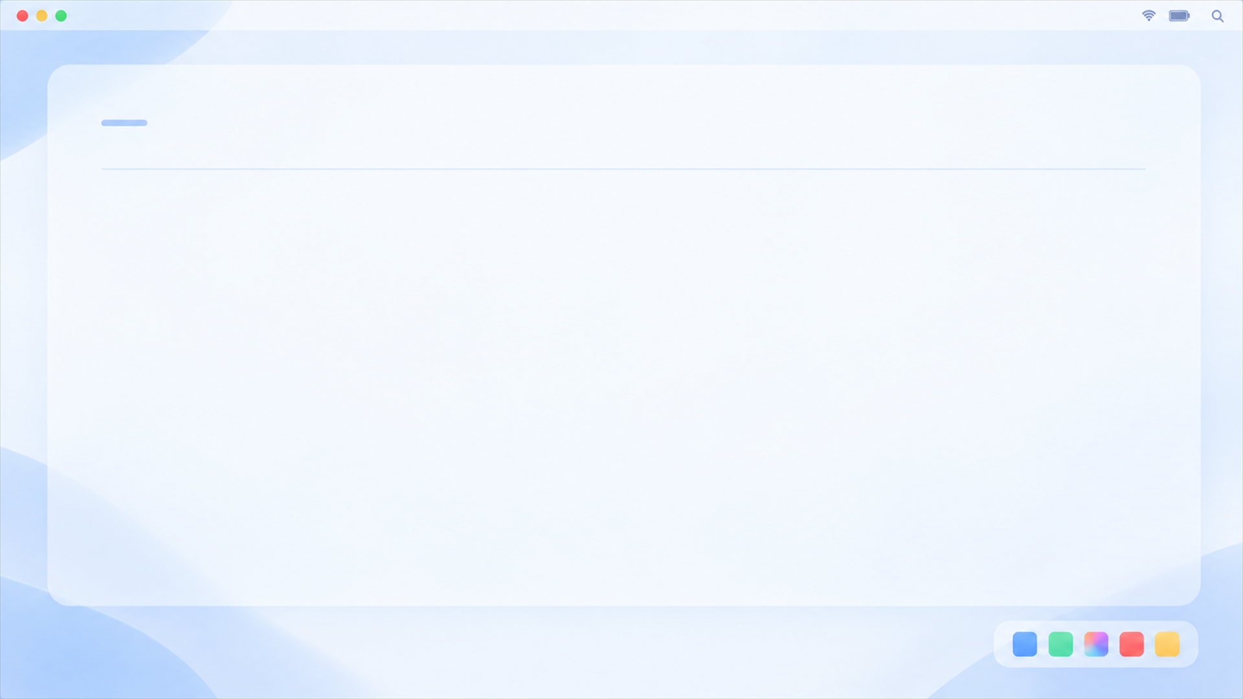
Can people learn the sounds?
A1
Research supports the idea. TouchSight still needs user testing.
73.39% accuracy
Topo-Speech participants identified locations after training.
21 adults analyzed
Blind and low-vision participants completed a 3 × 3 location task.
11.1% chance level
The study supports learnable sound-to-location associations.
Different system, adult lab study. This is not TouchSight accuracy or proof of learning gains.
Source: Topo-Speech, Frontiers in Human Neuroscience, 2023
Notes:
A1 | Appendix slide 1 | Full deck slide 9
LIKELY QUESTIONS: Does it work? Have blind people tested it? Where does 73% come from?
OPENING ANSWER (about 20 seconds): A related study found 73.39% accuracy on a nine-location task after training, compared with 11.1% chance. That supports the underlying idea. We have not tested TouchSight with blind or low-vision users yet, so we are not claiming that result for our app.
IF ASKED: Topo-Speech recruited 22 adults and excluded one participant, leaving 21 analyzed. Training included 27 trials, followed by 90 test trials. It encoded height using pitch and horizontal position using timing. TouchSight uses stereo panning horizontally, so this is supporting research, not a direct validation of our implementation. No claim of improved school attainment, automatic skill, or restored vision.
SOURCE: Frontiers in Human Neuroscience (2023), The Topo-Speech sensory substitution system as a method of conveying spatial information to the blind and vision impaired. https://www.frontiersin.org/journals/human-neuroscience/articles/10.3389/fnhum.2022.1058093/full
PROJECT EVIDENCE: User confirmed on 2026-09-27 that no blind or low-vision people have tried TouchSight.

Slide 10
How would someone use it without sight?
A2
Sound gives position. Speech names the selected region.
Listen for location
Stereo indicates left/right. Higher pitch means higher on the image.
Move between parts
Use the trackpad or arrow keys. Tab selects the next region.
Practice with feedback
F starts a find-it challenge. Edge thunks and spoken labels guide exploration.
Headphones preserve stereo cues. Pitch alone does not convey left/right.
Current prototype: explorer controls and audio implementation
Notes:
A2 | Appendix slide 2 | Full deck slide 10
LIKELY QUESTIONS: How do the sounds work? How do blind users navigate? Do they need headphones?
OPENING ANSWER: The two sound cues form a coordinate system: stereo for left and right, pitch for height. Speech names the region. Users can explore continuously or use Tab to jump between regions, then practice with the find-it game.
IF ASKED: Enter starts exploration. Arrow keys move, Tab and Shift+Tab select regions, Space explains, W announces location, C returns to center, Q toggles the movement tone, S toggles screen-reader mode, Escape pauses, and ? reads help. F announces the target, plays a three-second location cue during a locked orientation phase, then starts the search. Stereo headphones help separate horizontal positions; a single speaker or one-ear listening reduces this cue. Screen-reader support uses an ARIA live region but has not undergone a broad assistive-technology audit.
IMPLEMENTATION EVIDENCE: src/student/audio.ts, useExplorer.ts, Explore.tsx, findIt.ts. Audio uses StereoPannerNode, with pitch from 220 Hz at the bottom to 880 Hz at the top. These are implementation details, not measured usability outcomes.

Slide 11
What is different from existing tools?
A3
Our focus is a customizable workflow for exploring mapped visuals on any device.
Existing tools already help
Seeing AI describes images and supports photo exploration.
TouchSight's focus
Editable regions, continuous position cues and a target-finding game.
No touchscreen needed
Similar programs using ticks to identify walls only exist on mobile devices with absolute coordinates (ipads, tablets, etc)
Sources: Seeing AI official site; Microsoft Accessibility Blog
Notes:
A3 | Appendix slide 3 | Full deck slide 11
LIKELY QUESTIONS: Why not Seeing AI or a screen reader? Is this new?
OPENING ANSWER: Existing accessibility tools already do valuable work, including image descriptions and photo exploration. Our focus is the workflow around a prepared visual: editable regions, continuous positional sound, a practice game, and a printable version from the same map.
IF ASKED: We are not claiming to have invented sensory substitution or to be the first image exploration tool. A screen reader can read a prepared description, and TouchSight can hand announcements to a screen reader. The contribution is our combination and implementation. We would compare task success and user preference before claiming an advantage.
SOURCES: Seeing AI official overview, https://www.seeingai.com/ ; Microsoft Accessibility Blog, photo exploration feature, https://blogs.microsoft.com/accessibility/seeing-ai-2/ .
PROJECT EVIDENCE: src/teacher/Edit.tsx, exportSvg.ts; src/student/useExplorer.ts, audio.ts.

Slide 12
Can someone upload their own image?
A4
Yes. A person prepares the regions and labels in the editor.
Upload a PNG or JPG
The current upload limit is 10 MB per image.
Trace and explain
Mark the regions, name them and add the explanation users will hear.
Preview and refine
Explore the result, adjust the map and export when ready.
Automatic region detection and label matching are future work. Setup time varies by image.
Current prototype: image uploader, region editor and prepared cell annotations
Notes:
A4 | Appendix slide 4 | Full deck slide 12
LIKELY QUESTIONS: Does it work on any image? Is mapping automatic? How much setup is needed?
OPENING ANSWER: Yes, users can upload a PNG or JPG and prepare it in the editor. A person traces the regions and supplies labels and explanations, then previews the experience. We have not automated image understanding yet.
IF ASKED: The cell example has prepared regions and manually defined associations with its existing printed labels and leader lines. Thin-region hit areas and edge buffers are tuned for that image. New uploads start with no regions. They become explorable after manual mapping. Dense diagrams may need simplification, and an accessible authoring workflow for blind creators needs testing. The 10 MB limit comes from the current uploader. Do not claim every image works well without preparation, or quote a setup speed that has not been measured.
IMPLEMENTATION EVIDENCE: src/teacher/Upload.tsx, Edit.tsx; src/student/figureAnnotations.ts, geometry.ts; src/data/figures/animal-cell.json.

Slide 13
What did you build, and where is the AI?
A5
The core is interactive geometry and audio, with local voice input.
Exploration and practice
Region detection drives sound, spoken labels and the timed find-it game.
Authoring and export
The editor saves mapped images and creates printable SVG outlines.
Voice questions
Whisper transcribes locally. Answers use a local llm model ollama
Current prototype: exploration, authoring and voice input
Notes:
A5 | Appendix slide 5 | Full deck slide 13
LIKELY QUESTIONS: Is it real or just a mockup? What did you build? What AI did you use? Biggest challenge?
OPENING ANSWER: We built the interaction from mapped regions to sound, the editing workflow, the find-it game and SVG export. Whisper provides local speech transcription. The answers currently come from prepared content and author explanations, rather than a generative tutor.
IF ASKED ABOUT THE STACK: React and TypeScript handle the interface. Point-in-polygon logic detects regions. Web Audio generates tones and stereo position. Browser speech synthesis or a screen reader speaks labels. IndexedDB stores the local data. Transformers.js runs the Whisper model with WebGPU.
IF ASKED ABOUT THE CHALLENGE: Turning pointer movement into understandable cues required edge thunks, reduced continuous sound and buffered hit areas around thin cell structures. Synchronizing announcements, audio and locked challenge orientation was another implementation challenge. We separated student exploration and teacher authoring behind shared data types. Do not invent who wrote individual files or claim unaided authorship; explain AI development assistance honestly if asked.
IF ASKED ABOUT THE DASHBOARD: It includes seeded profiles and history. The app can record new find-it sessions locally. Seeded history is not user-study evidence.
IMPLEMENTATION EVIDENCE: src/student/{audio,geometry,useExplorer,findIt,speechRecognition}.ts; src/data/{ai,answers,db,seed}.ts; src/teacher/{Edit,exportSvg}.tsx/ts; package.json.

Slide 14
How private and secure is it?
A6
The app stores its working data in the user's browser.
Local app storage
Images, preferences and session records use IndexedDB on that browser.
Local voice transcription
Whisper processes the recording on the device after its model downloads.
Clear security limits
Profiles are local selections. School account security and cloud sync are future work.
Current prototype: browser storage, microphone and speech code
Notes:
A6 | Appendix slide 6 | Full deck slide 14
LIKELY QUESTIONS: Does student data leave the device? Is the microphone private? Is it secure?
OPENING ANSWER: The app keeps images and records in the browser's local database, and Whisper transcribes the microphone recording on the device. There is no application backend for syncing those records. We still need school-grade access controls before deployment on shared devices.
IF ASKED: The model and runtime need initial downloads from external hosts. The speech-input code makes a temporary local audio URL and revokes it after transcription. It stops microphone tracks after recording. Browser speech synthesis is separate: the code selects an English voice but does not enforce localService, so an online voice may send spoken text to its provider. We cannot promise that every possible voice configuration is fully offline or private.
SECURITY BOUNDARY: Browser-local storage does not imply application-level encryption, authenticated student accounts or protection from another person using the same browser profile. Clearing browser data may remove saved work. A deployment would need a device policy, backup/export decisions, access controls and a privacy review. No claim of FERPA, COPPA or other compliance.
IMPLEMENTATION EVIDENCE: src/data/db.ts; src/student/speechRecognition.ts, audio.ts; src/teacher/StudentPage.tsx. This is a code-based description, not a security audit.

Slide 15
What devices and internet does it need?
A7
The current experience is built around a laptop browser.
Everyday controls
Explore with a keyboard or trackpad and audio output.
Voice has extra requirements
Microphone permission, a model download and WebGPU support are needed.
Offline use needs preparation
A local app setup, downloaded resources and an offline speech voice are needed.
Minimum specs and full mobile support are not established. Typed questions provide a fallback.
Current prototype: browser APIs and local deployment requirements
Notes:
A7 | Appendix slide 7 | Full deck slide 15
LIKELY QUESTIONS: Any phone or cheap laptop? Does it need Wi-Fi? Is it lightweight or free?
OPENING ANSWER: Core exploration runs in a laptop browser using ordinary controls. Optional voice transcription needs a downloaded model and compatible WebGPU support, with typing as a fallback. Offline use requires the app and its resources to be available locally.
IF ASKED ABOUT OFFLINE: The project can be served locally on a laptop. It has no service worker for an installable offline website. A hosted page is not guaranteed to reopen without internet. Initial model/runtime downloads and the chosen speech voice are additional dependencies. We have not verified every disconnected browser configuration.
IF ASKED ABOUT COST: Core exploration needs no specialist tactile display and has no per-question cloud AI service in this implementation. The optional model increases download and processing requirements. Device, hosting, support and tactile-printing costs still exist. No minimum hardware benchmark or universal phone compatibility claim.
IMPLEMENTATION EVIDENCE: vite.config.ts, package.json, src/student/speechRecognition.ts, audio.ts, useExplorer.ts. No service-worker registration found in current source.

Slide 16
How does the printable version work?
A8
Mapped outlines become an SVG for a tactile-printing workflow.
Reuse the traced regions
Export outlines with basic uncontracted braille labels.
Keep crowded labels readable
The export uses numbered keys when a full label does not fit.
Create raised lines
Swell paper and a heat fuser turn a suitable print into a tactile graphic.
Ordinary paper stays flat. Physical print quality and braille readability still need validation.
Sources: TouchSight SVG exporter; Perkins School for the Blind
Notes:
A8 | Appendix slide 8 | Full deck slide 16
LIKELY QUESTIONS: Can a normal printer make braille? How does paper help? Have you tested the tactile output?
OPENING ANSWER: The same mapped regions become SVG outlines with basic braille labels or a numbered key. A tactile workflow prints on swell paper and uses a heat fuser to raise the lines. A standard print on ordinary paper remains flat.
IF ASKED: The exporter uses US Letter dimensions and draws braille dots in millimeters. Its character support covers English letters, numbers and a small set of punctuation. It is not a full braille translation engine and should be reviewed by a qualified tactile-graphics or braille specialist. We do not have evidence of a successful physical tactile print or a blind reader's evaluation. Scale and spacing must be checked in the real print workflow.
SOURCES: Perkins School for the Blind, https://www.perkins.org/resource/tips-for-creating-raised-line-images-using-tactile-graphics-machine-piaf-or-swell/ .
IMPLEMENTATION EVIDENCE: src/teacher/exportSvg.ts and braille.ts.

Slide 17
Who could use this beyond school?
A9
The wider goal is access to prepared visual information.
First use case
Students explore labeled diagrams with content a teacher prepares.
Potential extensions
Charts, reference maps and visual instructions could use the same approach.
A route to adoption
Pilot with accessibility groups and educators, then build reusable templates.
Wider uses are proposals. Live navigation, universal access and a business model are not validated.
Proposed use cases and adoption path
Notes:
A9 | Appendix slide 9 | Full deck slide 17
LIKELY QUESTIONS: Only for students? Could it scale? Who would use or pay for it?
OPENING ANSWER: Education is the first use case because diagrams give us a clear task to test. The same approach could support prepared charts, reference maps and instructions. We would expand with blind and low-vision users after learning which tasks actually help them.
IF ASKED ABOUT ADOPTION OR MONEY: A possible route is pilots through educators or accessibility organizations and a reusable library of mapped content. Grants, partnerships or paid preparation/support services are options to investigate, not agreed plans. No customers, signed partnerships, revenue, pricing or demand study have been established. Manual mapping remains a scaling bottleneck. Local-only data also means school-wide distribution and secure synchronization require additional work.
IF ASKED WHO IT MAY NOT SUIT: The audio approach depends on usable hearing and may not fit every hearing profile or preference. It does not replace a mobility aid and is not a validated live navigation system. Static reference maps are a possible content type.
BASIS: Team's stated wider vision and current reusable Figure/Region data model. The expansion and adoption ideas on this slide are proposals.

Slide 18
What would you do next?
A10
Validate the experience with users before expanding it.
Co-design a small pilot
Invite blind and low-vision participants and accessibility educators.
Measure useful outcomes
Track target accuracy, completion time, comfort and authoring effort.
Improve the biggest barriers
Refine onboarding, test more devices and assist region mapping.
The next milestone is evidence of usefulness, followed by broader deployment.
Proposed evaluation and development plan
Notes:
A10 | Appendix slide 10 | Full deck slide 18
LIKELY QUESTIONS: What is next? Biggest limitation? How will you prove impact?
OPENING ANSWER: Our next step is a small pilot with blind and low-vision people and accessibility educators. We would measure whether users find targets accurately, how long it takes, and whether the sounds feel comfortable. That feedback should drive the next features.
PROPOSED STUDY: Begin with adults and a small set of simple visuals. Teach the cues consistently, then compare TouchSight with an accessible description for the same tasks, balancing task order. Record target accuracy, time, requests for assistance, comfort and author preparation time. Treat this as usability discovery, not a powered efficacy trial. Involving children later requires appropriate consent and oversight.
PRIORITIES: Investigate confusing sounds or dense regions first. Test screen readers, hearing differences and device compatibility. Explore automated region/label suggestions with human review. Validate the physical print output. Add secure sharing only after the local workflow proves useful.
CURRENT LIMITS: No blind/low-vision user testing, manual mapping, prepared answer coverage, image-specific hit-area tuning, unverified hardware breadth and no school-grade multiuser backend.
BASIS: User confirmation and source review. All pilot details and next steps are proposals, not completed work.

Slide 19
How does it know which part you are on?
A11
It checks your position against the regions saved with the image.
1. Save a region map
Each traced shape stores its boundary points, label and explanation.
2. Check the cursor
The app checks which shape contains your position. Smaller nested parts take priority.
3. Keep selection steady
The cell example adds a buffer around thin parts to reduce accidental switching.
The cell's printed-label highlights use prepared associations. Automatic label detection is future work.
Current logic: saved region polygons, hit testing and cell annotations
Notes:
A11 | Appendix slide 1 | Full deck slide 19
LIKELY QUESTIONS: How do you identify a region? What if parts overlap? How do labels connect?
OPENING ANSWER: We store each traced region as a shape with a label. As the user moves, the app checks which shape contains the cursor. Smaller nested parts take priority, and the cell example has extra buffer space around thin structures so the selection does not flicker.
SIMPLE EXAMPLE: The nucleolus sits inside the nucleus. A point can lie inside both shapes, so choosing the smaller matching shape lets the user select the nucleolus. For buffered cell regions, the previous selection can remain active near its edge before the app switches.
IF ASKED FOR THE ALGORITHM: pointInPolygon uses a ray-crossing check and includes points directly on an edge. hitTest chooses the smallest matching polygon by area. Cell-specific rules then retain a buffered previous region or choose the nearest buffered region. Ordinary uploads use the polygon check without this cell-specific buffer tuning. Pointer coordinates are mapped back into image coordinates, accounting for scale and letterboxing.
LABEL LOGIC: Region IDs connect the selected shape to its stored text. For the animal-cell visual overlay, figureAnnotations.ts also stores prepared label rectangles and leader-line paths. The program highlights the existing label and line using those associations. It does not infer the relationship from image pixels.
SOURCE: Read-only inspection of src/student/geometry.ts, figureAnnotations.ts and src/contract/types.ts. No application files were changed.

Slide 20
How does a position become sound?
A12
The same screen position always produces the same location cues.
1. Left/right becomes stereo
Move left and the sound pans left. Move right and it pans right.
2. Height becomes pitch
Bottom: 220 Hz. Middle: 440 Hz. Top: 880 Hz.
3. Region changes add meaning
A transition triggers a thunk. Entering a part speaks its saved label.
Example: near the top-left means a higher tone, panned left. Headphones make stereo cues clearer.
Current logic: Web Audio position mapping and region-change events
Notes:
A12 | Appendix slide 2 | Full deck slide 20
LIKELY QUESTIONS: Are sounds random? How do you calculate pitch? What triggers the thunk?
OPENING ANSWER: The sounds follow a fixed coordinate mapping. Horizontal position sets stereo panning, and vertical position sets pitch. The bottom is 220 hertz, the center is 440 and the top is 880. When the selected region changes, the app adds a thunk and announces the new part.
IF ASKED FOR THE MATH: pan = 2x / width - 1, clamped from -1 to +1. pitch = 220 times 4 raised to the power of (1 - y / height), with y / height clamped from 0 to 1. Image y starts at the top, so a smaller y gives a higher pitch. The pitch curve is exponential: halfway up is one octave above the bottom, and the top is another octave higher.
IMPLEMENTATION: Web Audio creates an oscillator for pitch, a gain node for volume and a StereoPannerNode for left/right balance. Cursor movement updates the parameters. Region selection is handled separately by geometry, and a changed region triggers feedback. Movement tones fade when movement stops and reduce during speech. Attempting to move beyond the image boundary has its own wall thunk.
LIMIT: Pitch encodes height only. It does not replace the horizontal cue when stereo is unavailable. The two cues together supply location, while a stored spoken label supplies identity.
SOURCE: Read-only inspection of src/student/audio.ts and useExplorer.ts. The frequencies are calculated from the current implementation, not user-study measurements.

Slide 21
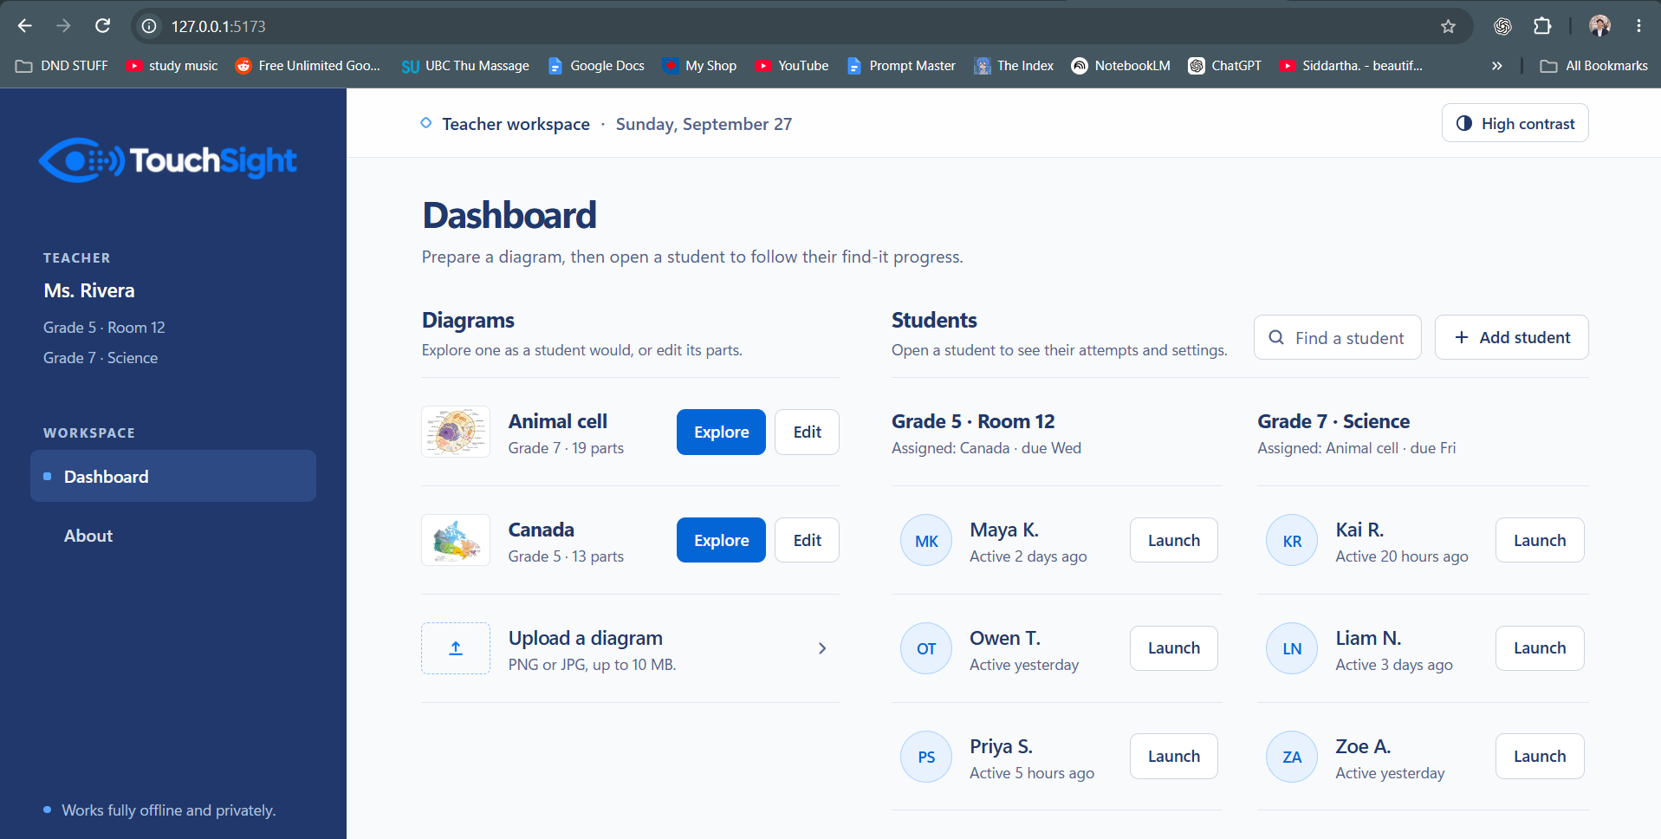

Slide 22
