Slide 1
Heat sensor SmartHome
By Adrian De Braga - N01153774

Slide 2
Intro
Smarthome heat sensor made to pair up with my teammates sensor to regulate room temperature in different locations.
Important to have regulated heating in all rooms in a house so that no room is hotter than the other.
Next semester will be able to keep logs for whenever the buzzer rings and connect to the software and other heat sensor to regulate temperature.

Slide 3
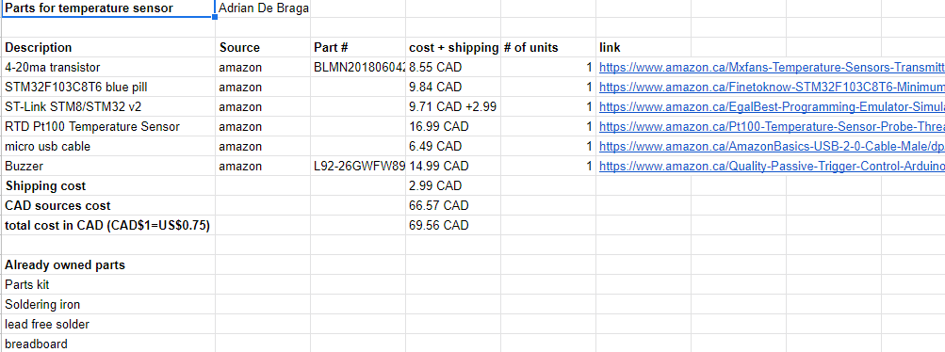
Budget

Slide 4


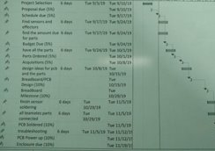



Schedule
Issues with PCB design and soldering

Slide 5
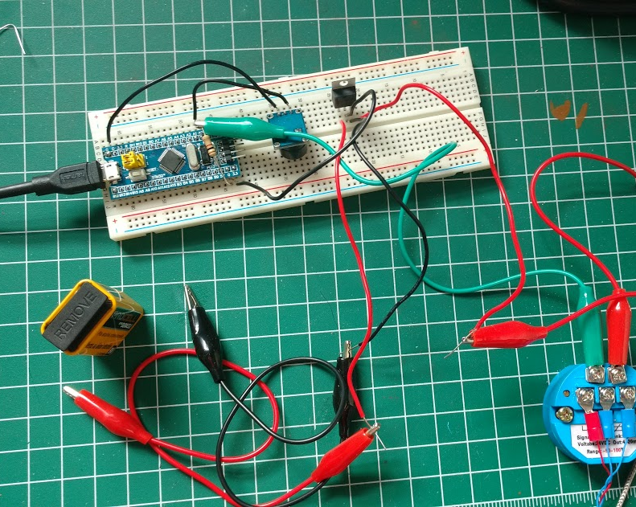
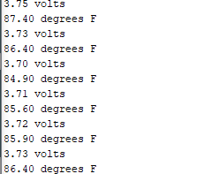
Hardware - Readings

Slide 6
Conclusion
Ceng252, tech 150, hands on and coding.
Voltage dividers and utilizing datasheets
Soldering and breadboarding

