Slide 1
Example presentation
Made with python-pptx

Slide 2
Agenda
Text, pictures and speaker notes
Presenter view: P
Notes:
These are the speaker notes.

Slide 3
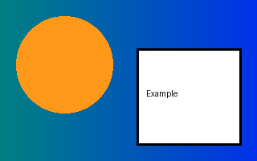
A picture

