Slide 2
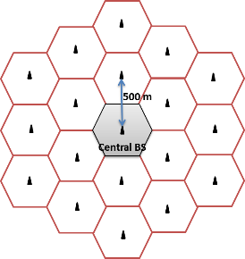
Scenario
Hard Handoff
Downlink
Propagation model = fading + path loss + shadowing

Slide 3
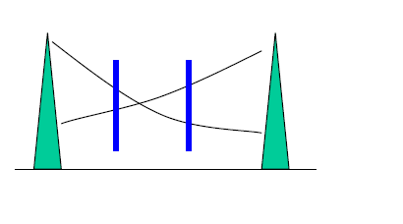
Criteria
- Threshold
- Distance about ping – pang effect
SINR

Slide 4
Evaluated term
Drop time
Number of handoff
Number of reconnection

Slide 5
Input parameter
Simulation time
Number of users
Inter side distance
Moving average size
Mobility – minSpeed, maxSpeed
Threshold of dropping
Distance of ping pang effect

Slide 6
Handover mechanism
Moving average on SINR
(propagation model = fading + path loss + shadowing)
> Threshold of drop?
→drop or not drop
Max SINR from the same BS?
Mobile distance to boundary > configured distance about ping pang
(ping pang effect)
Handoff?

Slide 7
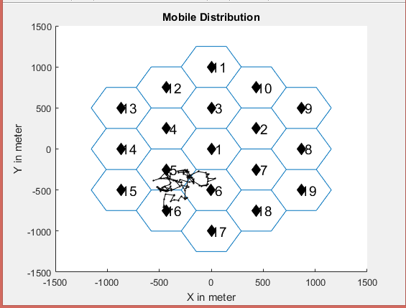
User number = 50
Simulation time = 100 s
Criteria : SINR-based
Moving average size = 10
Ping Pang Prevention ? No
Mobility :

Slide 8
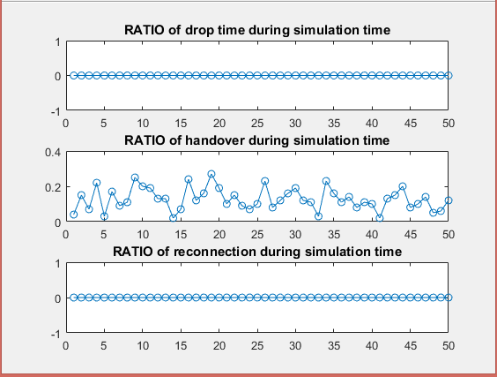
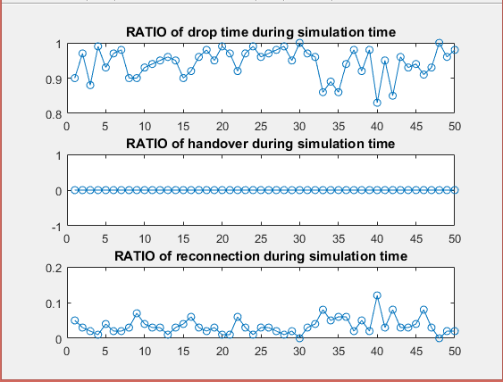
Experiment 1 – Threshold to handover
Extreme Case
Threshold of drop = 0.00000001
Threshold of drop = 10

Slide 9
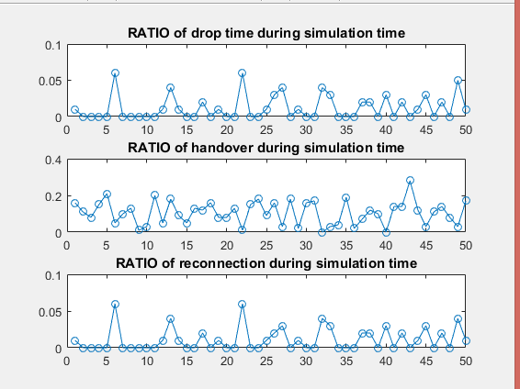
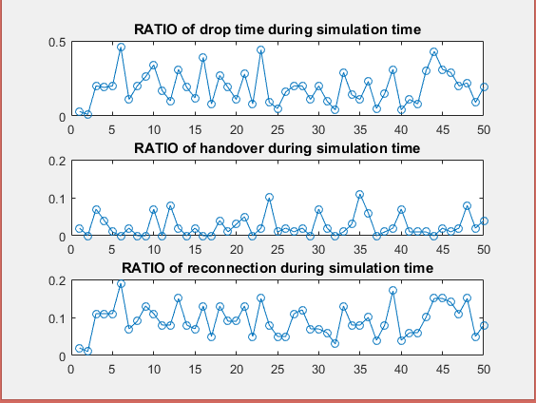
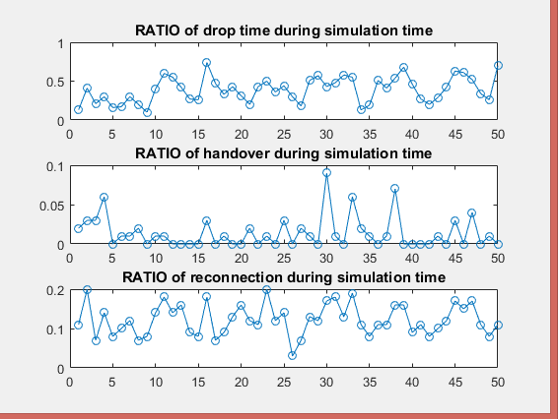
Threshold of drop = 0.25
Threshold of drop = 0.5
Threshold of drop = 0.75
Threshold of drop 越高 → User drop 時間越高
Handover 發生次數越低

Slide 10
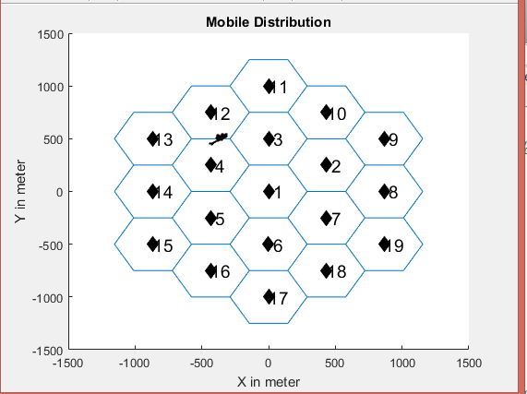
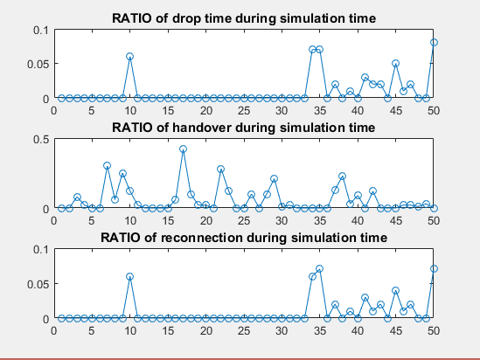
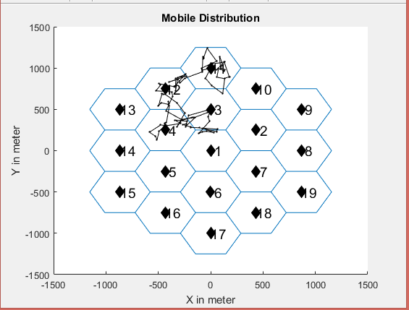
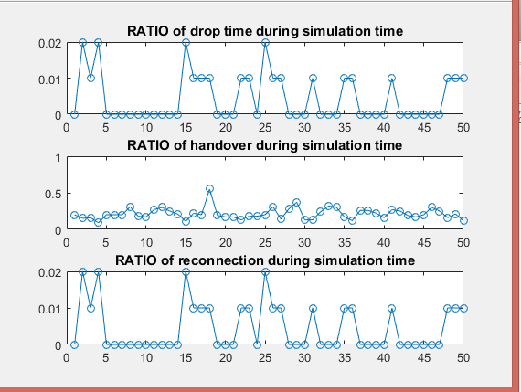
Experiment 2 – Mobility to handover
Low mobility
High mobility

