Slide 1
ENGI 301 LoveBox 2.0
November 19th 2018
Adrian Perez

Slide 2


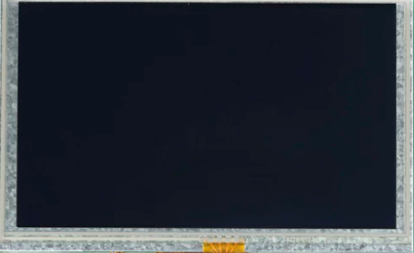
Background Information
I will be upgrading my anniversary gift for my girlfriend
Smaller PCB design will be hidden
Box will now have storage space inside
Ultrasonic/IR sensor detects when top lid is opened
Also optional button to turn on

Slide 3
Functional Block Diagram
PocketBeagle
GPIO
Speaker
I2C
LCD Screen
GPIO
IR Sensor
PWM
LED Strip
GPIO
Push Button/Side Switch

Slide 4
Layout (approx. 100mm x 50mm)
Speaker
PocketBeagle
Screen
IR
LED CXN
BTN

