Slide 1
ENGI 301 Vision of Love Proposal
October 4th 2018
Adrian Perez

Slide 2


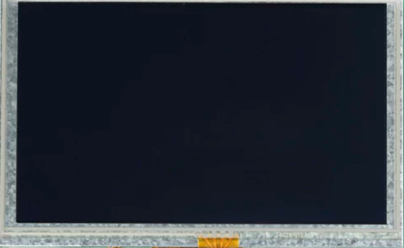
Background Information
I will be creating an anniversary gift for my girlfriend
External Heart shaped frame (laser cut wood)
Embedded components (hidden view) except for screen
OLED screen going through pictures from the past few years of us
Speakers that play La Vie En Rose when powered on
Red LEDs will fade on frame
Lid switch will turn on processes

Slide 3
System Block Diagram
2200mAH USB battery
MS2811 LED Strip
Mini External USB Speaker
PocketBeagle
microUSB
PWM
USB OTG Cable
Microusb Breakout Board
GPIO
Push Button
USB1
Mikro Click Board OLED C
GPIO

Slide 4
Power Block Diagram
2200mAH USB battery
MS2811 LED Strip
5V
3.3V, .500 -1000mA
PocketBeagle
microUSB
5V
(up to 500mA)
GPIO
Push Button
Mini External USB Speaker
3.3V
VB
SYS VOUT
Mikro Click Board OLED C
3.3V

Slide 5
Components / Budget
Component | Need to Buy | Cost
Mikro Click Board OLED C | 1 | 44.99
Microusb Breakout Board | 1 | 1.50
USB OTG Cable | 1 | 7.99
Mini External USB Speaker | 1 | 12.50
LIPO Battery (4400mAh) | 1 | 19.95
WS2811 LED Strip | 1 | 16.99
USB Battery | 1 | 14.95
TOTAL: $118.87

