Slide 1
Movie budget
Annie Donnelly
Adrian Aguilar
Eric Martinez
Robert Casiano
Tony Ponce

Slide 2
Movie Budget vs Movie Outcome
Does the amount of money that a movie uses to make it affect the outcome of the movie?

Slide 3
Terms to Know
Production Budget
Domestic
Gross
Worldwide Gross
The amount of money a movie used to create that movie.
The amount of money that a movie made in the United States.
The amount of money that a movie made worldwide.

Slide 4
The Major Questions
Does the budget vs gross outcome change from genre to genre?
How has the budget vs gross outcome changed over the years?
Does the budget reflect the viewer ratings
Does the director affect the budget and/or gross outcome?

Slide 5
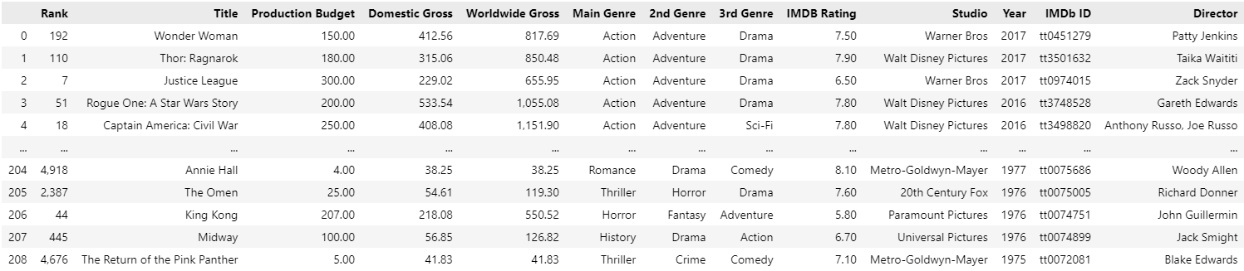
The Dataset

Slide 6
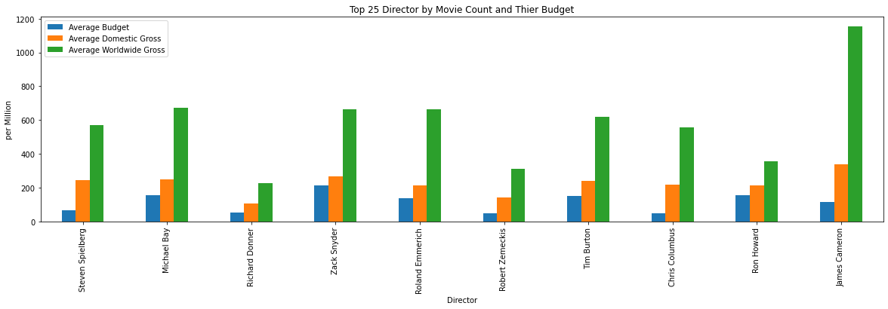
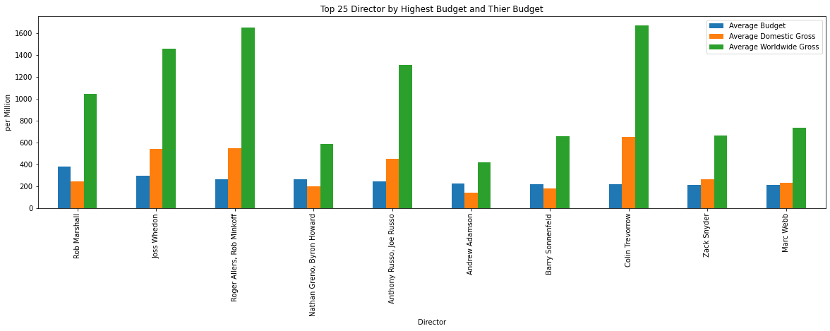
Director Experience vs Director Budget

Slide 7
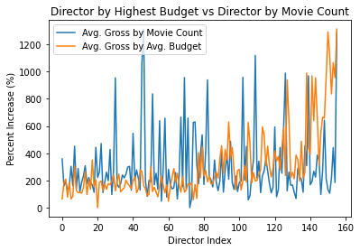
Domestic Gross: Director by Average Budget vs Movie Count

Slide 8
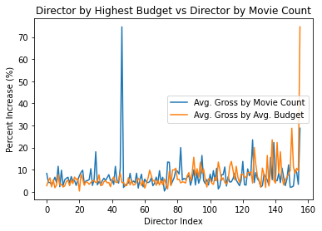
Worldwide Gross: Director by Average Budget vs Movie Count

Slide 9
Conclusion

