Slide 1
DATA 201 · MIDPOINT REPORT
Traffic Incidents Across Calgary’s Neighbourhoods
Where, when and who: the socioeconomic patterns behind 58,536 incidents, 2017–2025
Adrian Julve, Kein Ritarita, Xinqi Zha · Data 201 · Oct 20th, 2026
Notes:
Hi, I’m Adrian. My project looks at traffic incidents in Calgary and asks whether they follow neighbourhood income and other socioeconomic conditions. The grid on the right is the colour key from my main map, which I’ll come back to. In the next five minutes I’ll cover the project, my questions, the data, how I cleaned it, and what the dashboard shows so far.

Slide 2
Project overview
Traffic incidents aren’t spread evenly across Calgary. This project asks whether neighbourhood income and other socioeconomic conditions help explain where, and when, they happen.
AREA
PERIOD
OUTPUT
City of Calgary, 113 community service areas
2017–2025, nine complete years
An interactive, single-page Power BI dashboard
Notes:
Traffic incidents aren’t random. They cluster on certain roads, at certain times, and in certain parts of the city. My project uses City of Calgary open data to ask whether neighbourhood income and related conditions, like renting, low income and how people commute, line up with where incidents happen. The study area is the whole city, split into 113 community service areas. I use nine complete years, 2017 to 2025, and the result is an interactive Power BI dashboard.

Slide 3
Analysis questions
01
WHERE
Where do incidents concentrate once population is accounted for, and does that match neighbourhood income?
02
WHO
Which other neighbourhood traits, such as renting, low income and commuting, go with higher incident rates?
03
WHEN
When do incidents happen, by hour of day, day of week and month of year?
Notes:
I have three questions. First, where: once we account for how many people live in an area, where do incidents concentrate, and does that match neighbourhood income? Second, who: beyond income, which neighbourhood traits, like renting, low income or commuting by car, go along with higher incident rates? Third, when: what times of day, days of the week and months of the year see the most incidents? Each question maps to a part of the dashboard.

Slide 4
Datasets obtained
Dataset | Source | What it holds | Size | Role
Traffic Incidents | City of Calgary Open Data | Location, description and time of each reported incident | 65,138 records | The events analysed
Equity Index Overlay Statistics | City of Calgary Open Data | Population, median income and 16 other measures per area (2021 Census), plus area boundaries | 113 areas | Who lives where
Community District Boundaries | City of Calgary Open Data | Community name, land-use class and development era | 313 communities | Residential filter, area names
Notes:
All three datasets come from the City of Calgary’s open data portal, and all are obtained. Traffic Incidents is the core: 65,138 records, each with a location, description and timestamp. The Equity Index file covers 113 community service areas with population, median income and 16 other census measures, plus their boundaries. Community District Boundaries adds 313 communities with their land-use class, which lets me separate residential areas from industrial ones.

Slide 5
Data wrangling and cleaning
1 · Kept full years
2 · Located each incident
3 · Sorted incidents
65,138 → 58,536
Point → area
Text → 5 types
Dropped the partial years at each end (Dec 2016 and 2026), leaving 2017–2025.
GeoPandas in Python checked which area outline each point falls inside. 639 fall outside. The outlines also became the Shape Map.
Keywords in each description set the incident type. Street names flag highways, so area rates only count local roads.
4 · Reshaped census data
5 · Linked and rated areas
6 · Key measures in DAX
2,091 → 113 rows
307 → 113
Rows → measures
Used Python to give each area one row, with each trait as its own column, and fixed the number formats.
Each incident has both its community (307) and its area (113), which links the two. Then: incidents per 1,000 residents a year.
DAX turns raw rows into numbers that update with every click, like rate vs. city average and the busiest hour.
Notes:
Each card shows what the data looked like before and after one step. First, I kept only full years: the raw file has 65,138 incidents from December 2016 to 2026, and keeping 2017 to 2025 leaves 58,536. Second, each incident only had a map point, so I used GeoPandas in Python to check which area outline each point falls inside. 639 fall outside every area, and the same outlines became the Shape Map. Third, I turned the free-text description into five incident types using keywords, which powers the incident type filter, and flagged highways like Deerfoot and Glenmore by street name, so the map’s rates only count local roads. Fourth, the census file had one row for every area and trait, 2,091 rows, so I reshaped it to one row per area, 113 rows, with each trait as its own column. Fifth, every incident carries both its community and its area, which links the 307 communities to the 113 areas, and I then rated each area by incidents per 1,000 residents a year. Finally, DAX measures turn those rows into the numbers on the dashboard, like rate versus the city average and the busiest hour, and they update with every click.

Slide 6
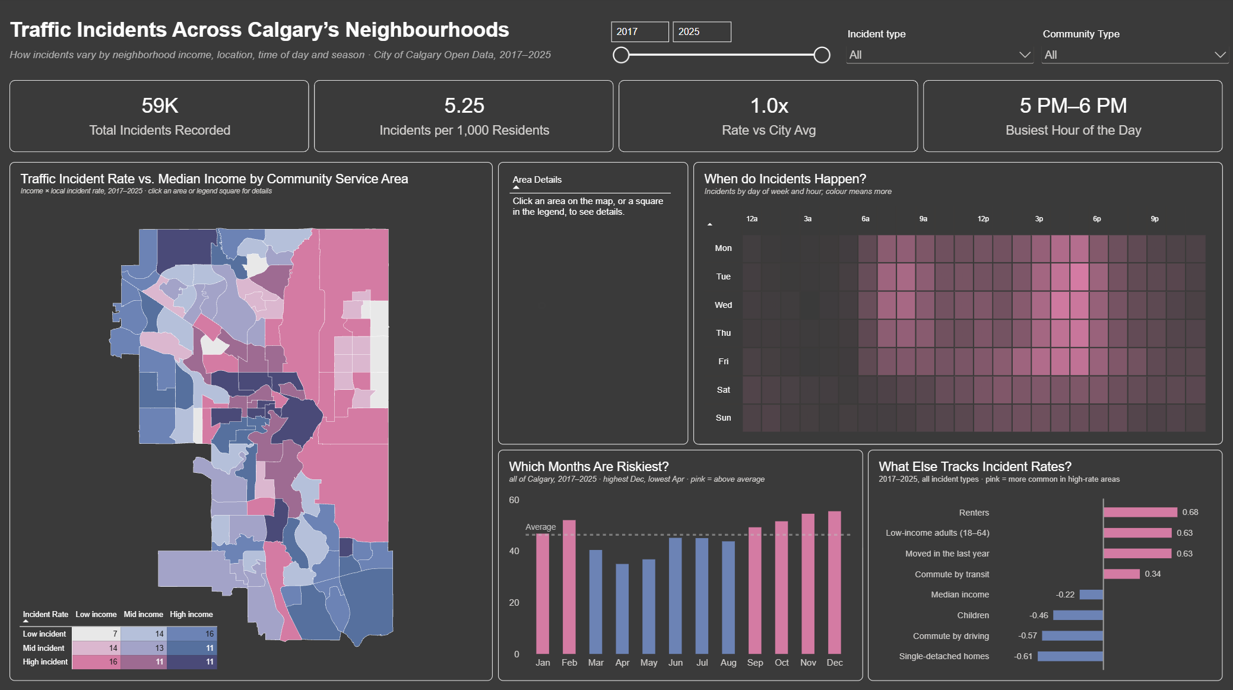
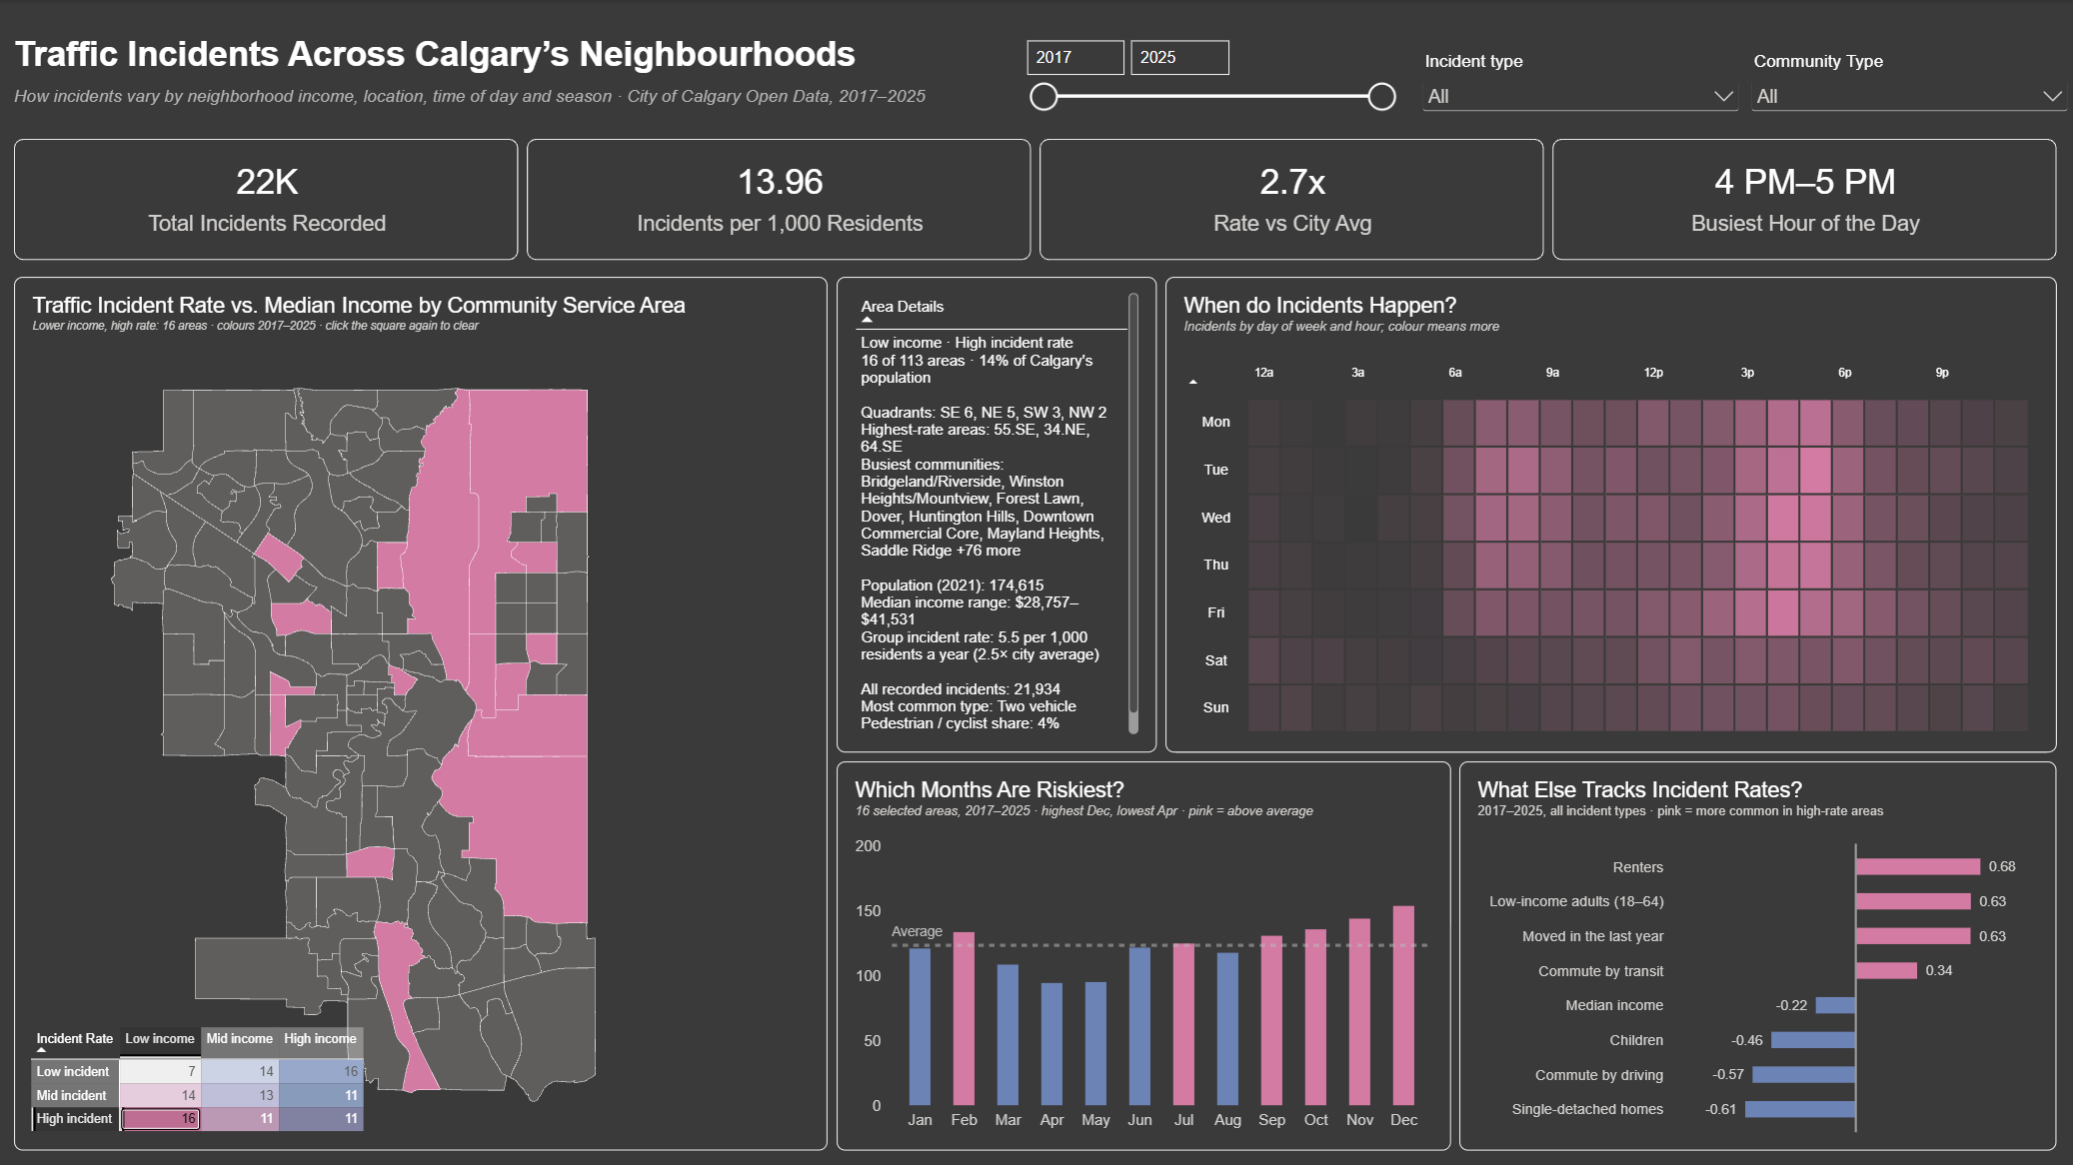
The dashboard so far
DEMO · WALKTHROUGH
Default view: all 113 areas, every chart citywide
One click: 16 lower-income, high-rate areas, at 2.7× the city rate
Open the live report in Power BI
Notes:
Backup for the live demo, about 2 minutes. Left: the default view, with all 113 areas coloured by income and incident rate, and every chart showing the whole city. Right: the same dashboard after one click on the legend square for lower-income, high incident-rate areas. The map highlights those 16 areas, mostly in the east. The details panel summarises the group: about 14% of Calgary’s population, a median income range of roughly $29,000 to $42,000, and a local incident rate about 2.5 times the city average. The KPIs, heatmap and month chart all filter to those areas, so you can see their busiest hour moves to 4 to 5 PM. If there’s time, open the live report from the link and click an individual area.

Slide 7
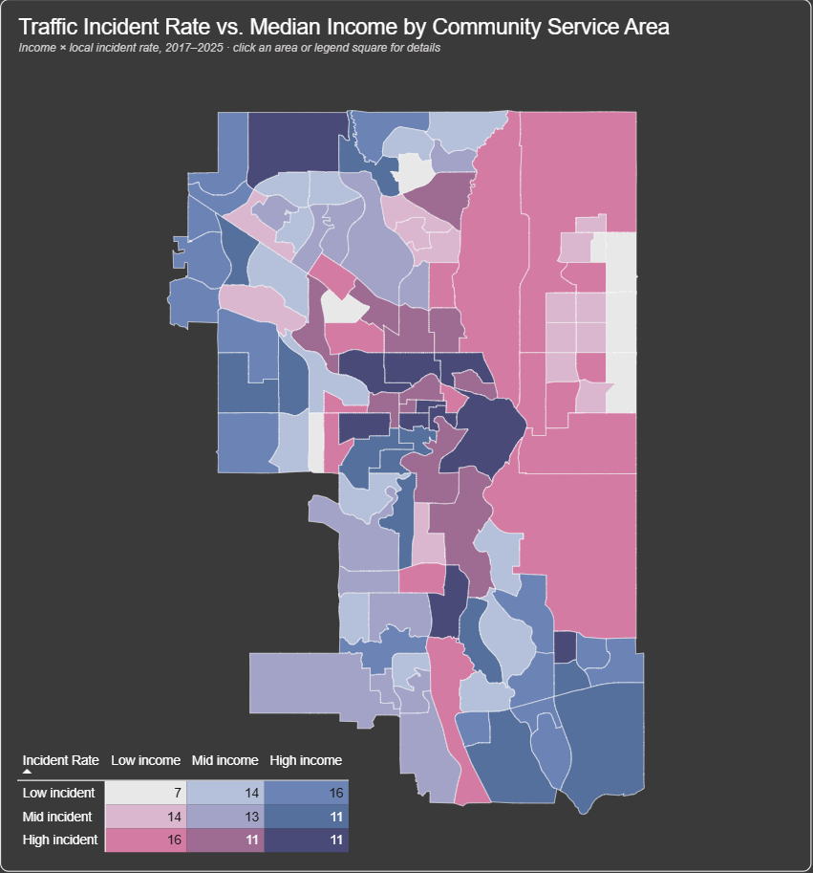
Findings: where and who
16
16
lower-income areas have high incident rates (pink)
higher-income areas have low incident rates (blue)
The two largest groups on the map are mirror images of each other.
East vs. west
Pink areas line the east side of the city; blue areas fill the west and south.
11
higher-income areas still have high rates (dark purple), mostly in the city centre
Notes:
Here’s what the map itself shows. Each area is coloured by two things at once: its median income and its local incident rate. Two groups stand out, both with 16 areas each. Sixteen lower-income areas have high incident rates, shown in pink, and sixteen higher-income areas have low incident rates, shown in blue. They’re the two largest groups on the map, and mirror images of each other. Geographically, the pink areas line the east side of the city, while the blue areas fill the west and south. The exception is the city centre: 11 higher-income areas still have high rates, shown in dark purple, mostly downtown and in the inner city, where commuters and through-traffic add incidents that resident-based rates don’t account for.

Slide 8
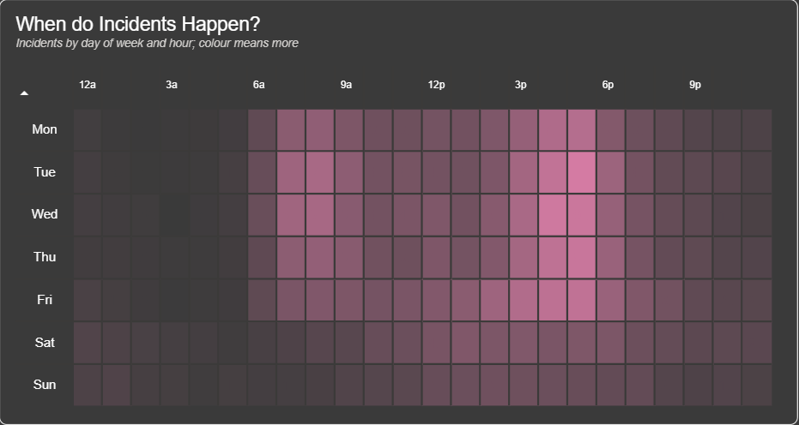
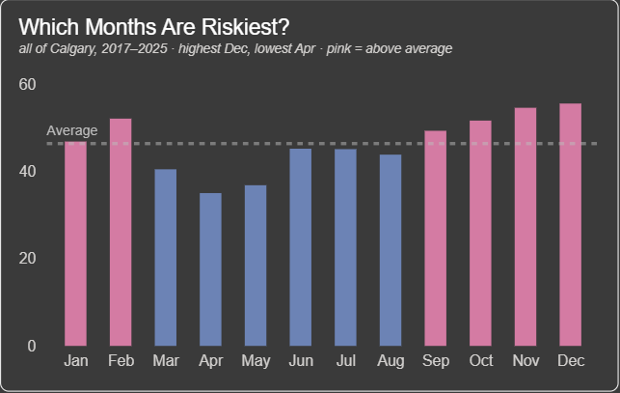
Findings: when
26% of incidents happen between 3 and 6 PM, peaking 5–6 PM. Sundays see about half of Wednesday’s total.
December runs 1.6× April (55.5 vs. 35.0 per 100,000 residents a month). Fall and winter sit above average.
Notes:
The time patterns are clear. The heatmap shows incidents concentrate on weekday afternoons: about a quarter of all incidents happen between 3 and 6 PM, and 5 to 6 PM is the single busiest hour, which lines up with the evening commute. Weekends are much quieter; Sunday has about half as many incidents as Wednesday. By month, the rate climbs through fall and peaks in November and December, at about 1.6 times April’s rate, which points to winter driving conditions and shorter daylight.

Slide 9
Thank you
Questions?
Notes:
[9:45 – 10:00] Thanks for listening. I’m happy to take questions, or to go back into the dashboard to look at any area you’re curious about.

