Slide 1
Our tool is built and used by the Unity game engine. We assume a minimum of familiarity with the engine and will not outline how to do Unity related tasks (such as creating gameobjects). In addition to this, we use the standalone version of GOH. This means that the emphasis of the tool is on creating and displaying all information related to visibility as opposed to simply creating a data structure containing data related to the visibility manifold.

Slide 2
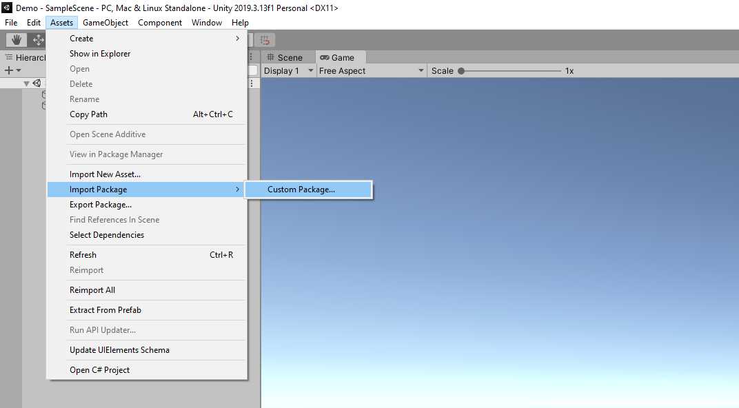
After opening your unity project, import a custom package and select the Geometry Of Hiding (GOH) package

Slide 3
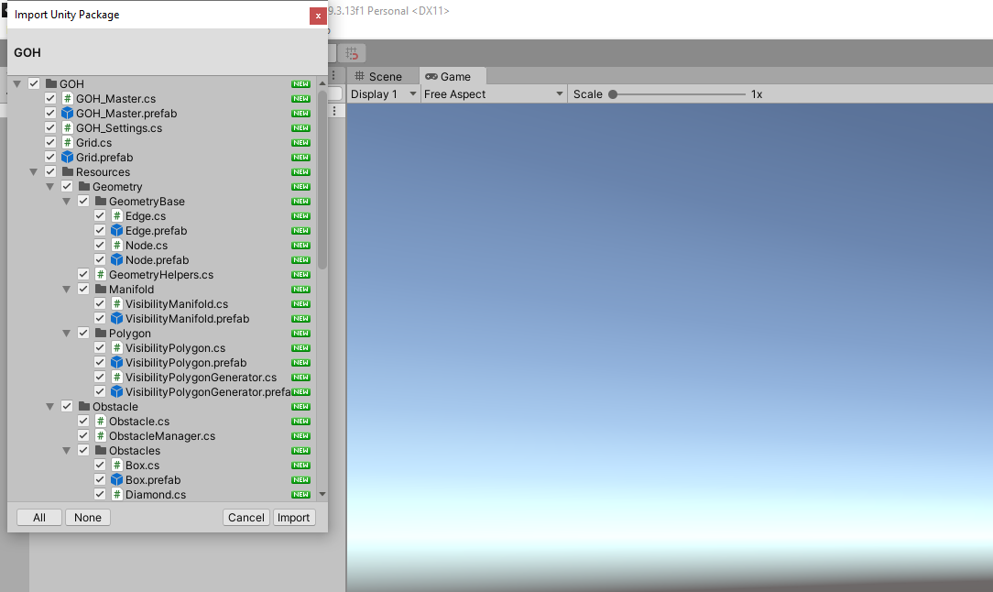
When importing, select everything for the import

Slide 4
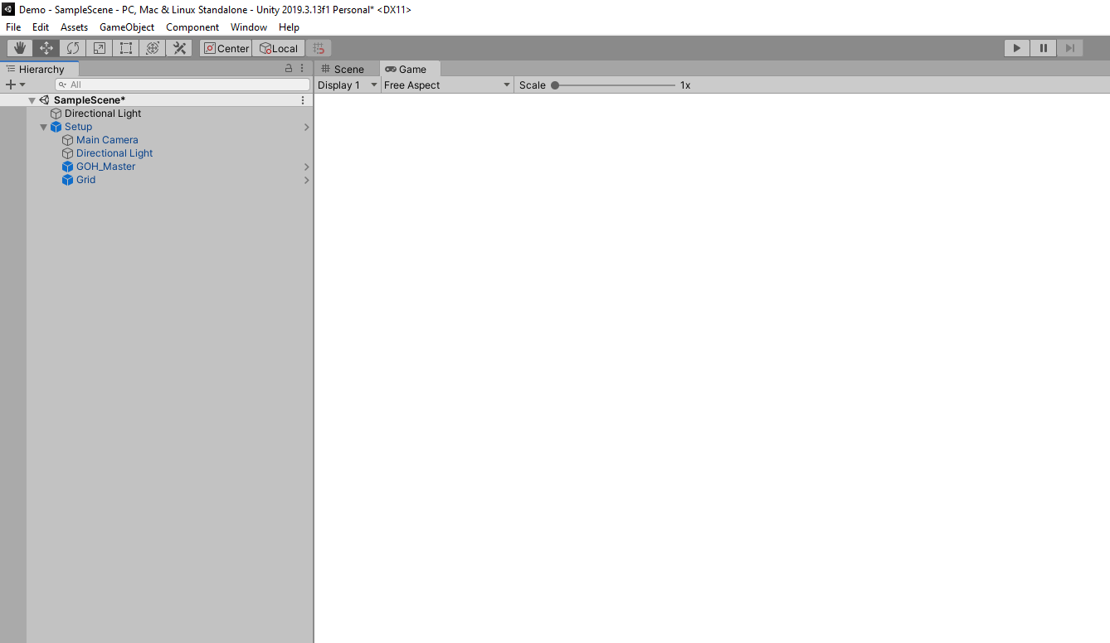
Navigate to the GOH folder where you will find the “Setup” gameobject. Add this to your scene and disable the main camera unity gives you by default.

Slide 5
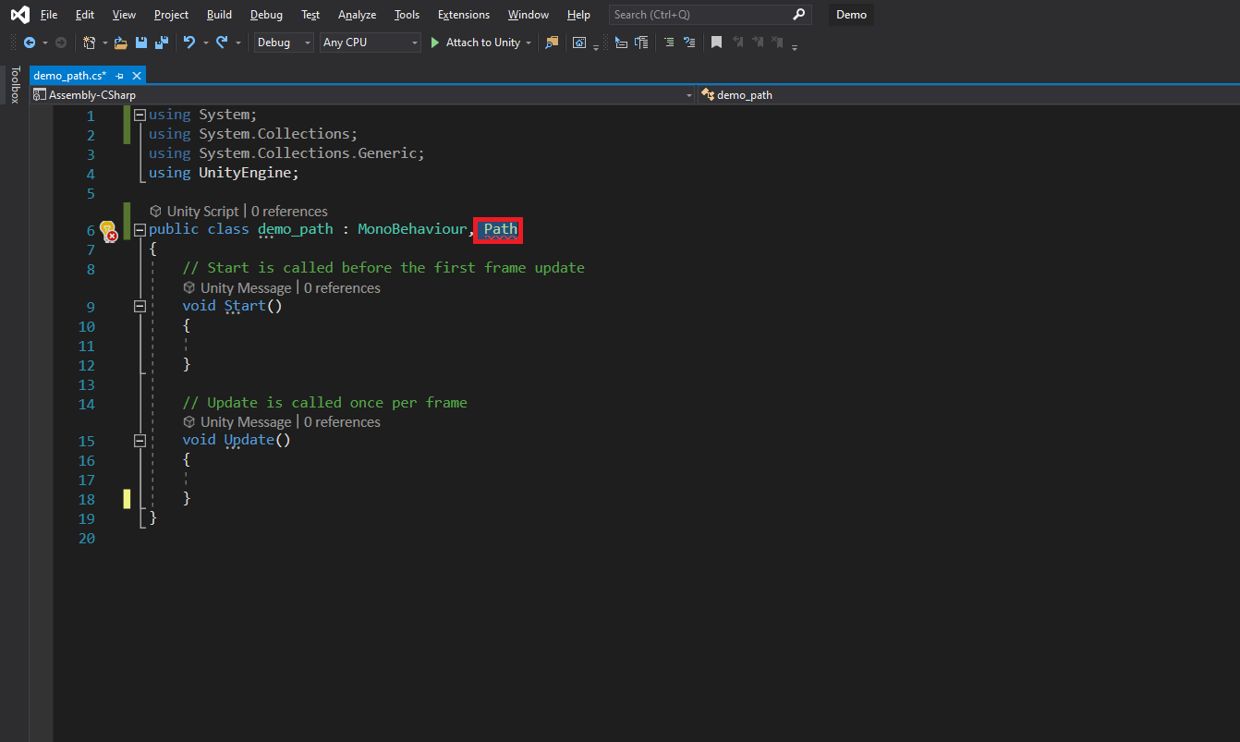
Next you need to create a script. This will be your path script and it needs to inherit the “Path” class.

Slide 6
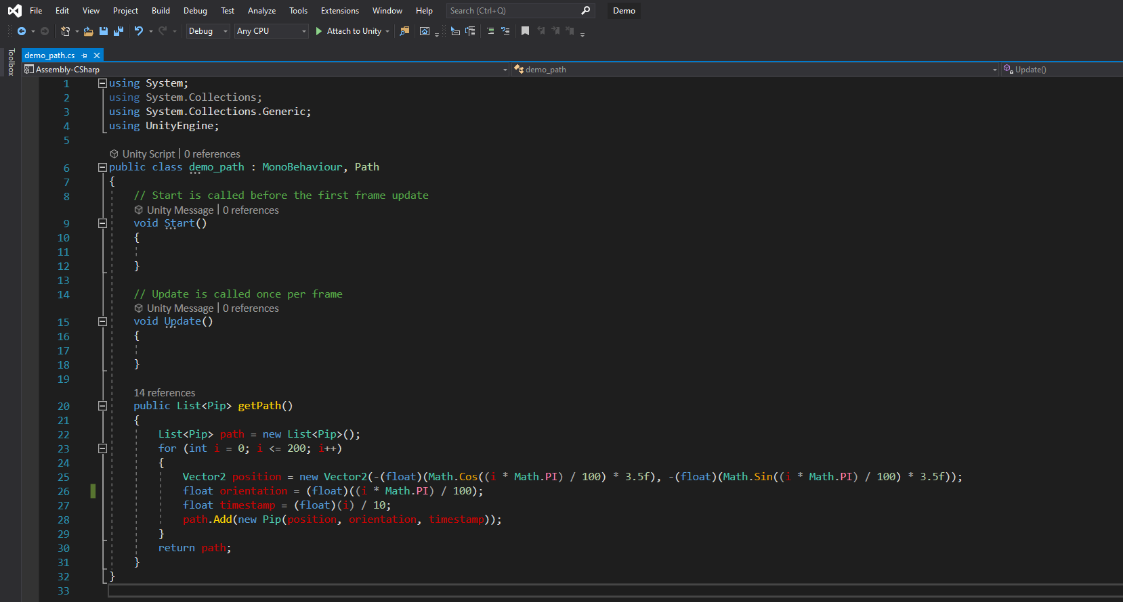
You then need to implement the getPath() function which returns a list of path pips representing the path. A pip consists of a vector2 (position), a float (orientation) and a second float (timestamp).

Slide 7
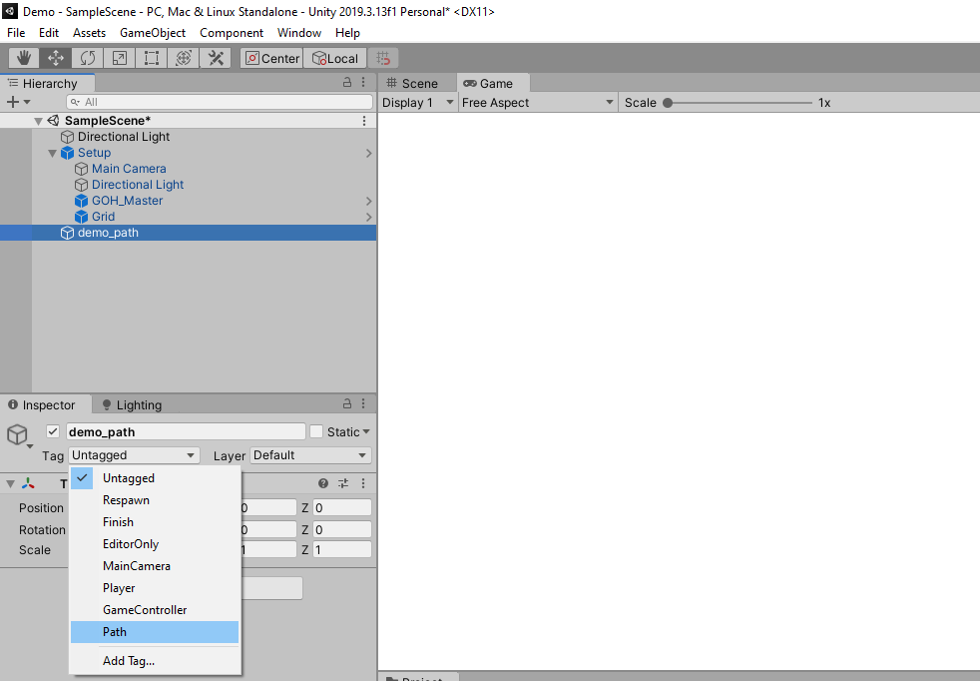
Now create an empty gameobject in your scene and tag it with “Path”. You may need to create this tag before doing so.

Slide 8
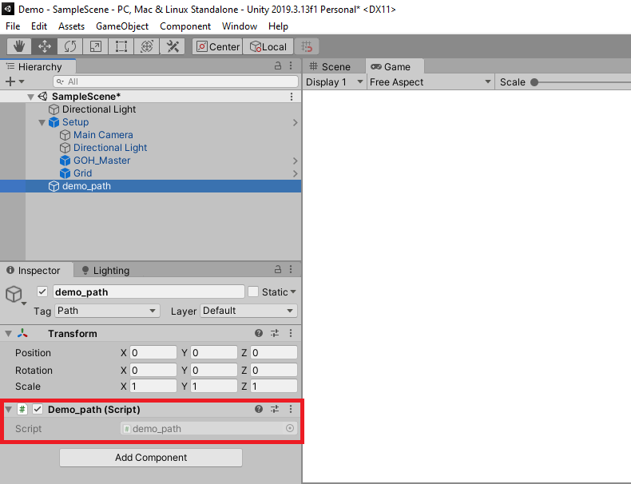
You will now need to add the script you made to your path gameobject

Slide 9
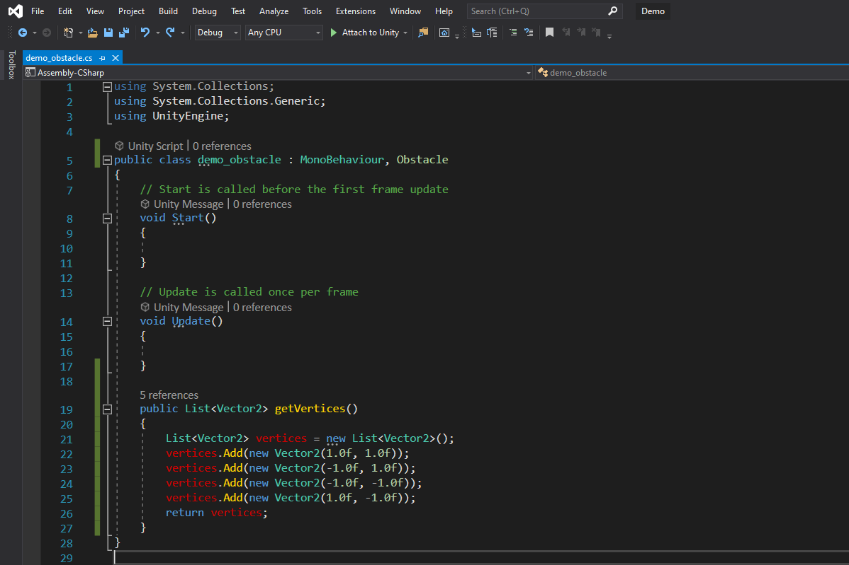
A similar process is followed for making obstacles. Instead of inheriting from Path, you now need to inherit from “Obstacle”, implement “getVertices()” which returns a list of obstacle vertices defining the circumference of the obstacle.

Slide 10
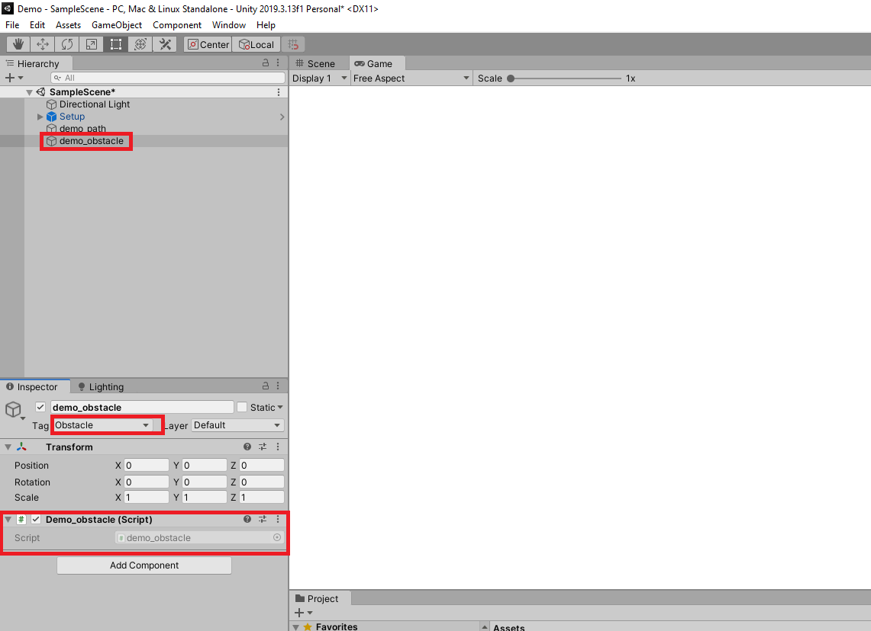
You then need to create an empty gameobject which you tag with “Obstacle” and attach your script. Note that this is for one obstacle. To create multiple obstacles, you need to create multiple obstacle gameobjects using the same process.

Slide 11
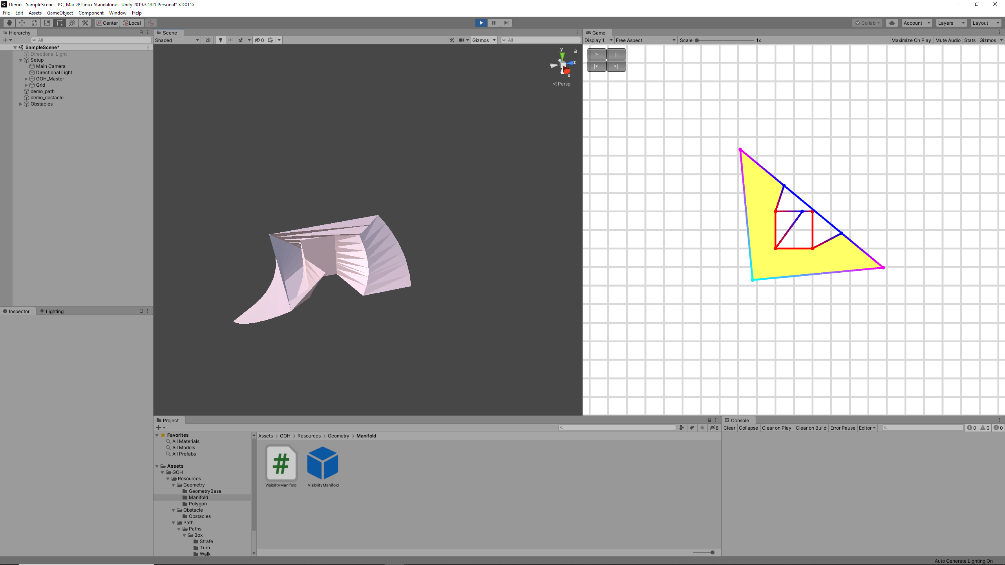
You can now visualise the generation process. It is advised to split your view into your camera view and inspector view. The manifold appears off camera and is easier to study with the inspector view. Once you start the simulation, the camera view will have a play button which will continuously step the agent through the path, a pause button which will pause the agent as well as forward and backward buttons which allow you to move step by step to view the generated polygons.

Slide 12
