Slide 1
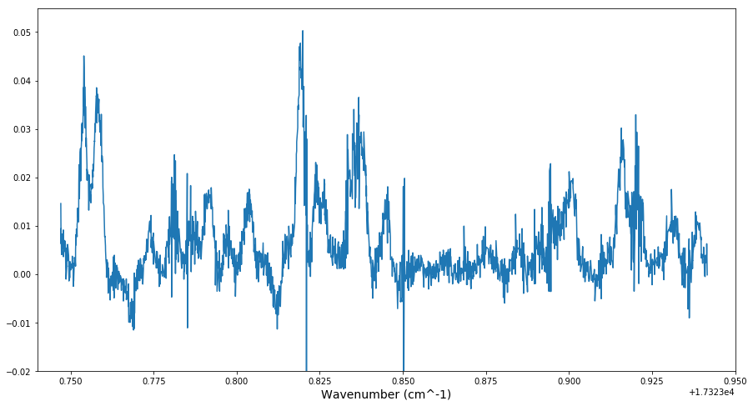
17323.83634(8)
17323.75397(4)
17323.81923(5)
17323.75821(4)
17323.9207(1)
17323.91596(9)
17323.7810(1)
17323.8960(5)
17323.82384(9)
17323.9005(3)
17323.7866(2)
17323.8261(1)
17323.79157(9)
17323.8449(1)
17323.80354(7)
17323.9311(1)
17323.7973(1)
17323.8909(2)
17323.93873(9)
17323.7740(1)
17323.8846(2)
17323.8751(2)

