Slide 1
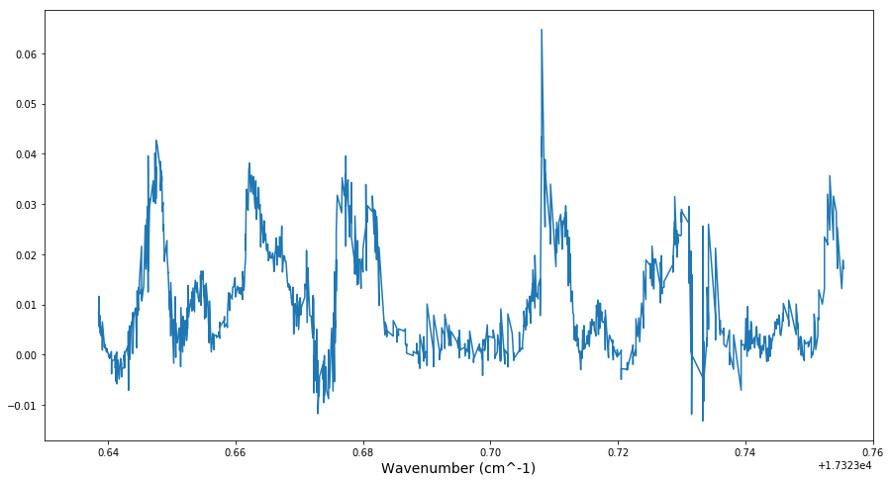
17323.64748(4)
17323.70844(5)
17323.66273(8)
17323.67736(7)
17323.68114(7)
17323.7301(1)
17323.71125(9)
17323.6663(3)
17323.7350(1)
17323.67126(8)
17323.7062(2)
17323.7258(2)
17323.6542(1)
17323.6594(5)
17323.7168(2)
17323.7464(1)

