Slide 1
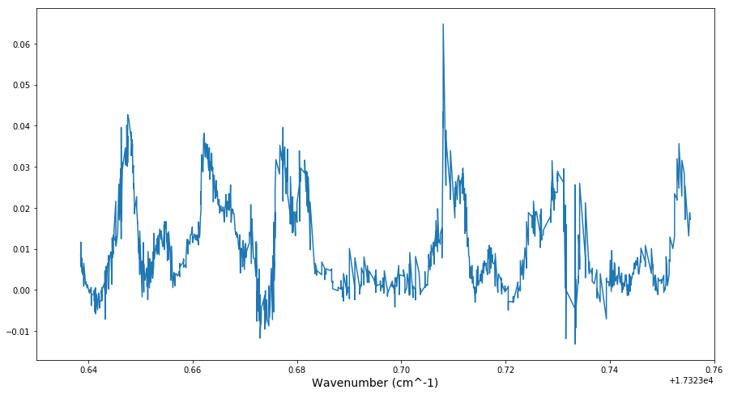
17323.47651(4)
17323.53747(5)
17323.49177(8)
17323.50640(7)
17323.51018(7)
17323.5591(1)
17323.54029(9)
17323.4954(3)
17323.5641(1)
17323.50030(8)
17323.5352(2)
17323.5549(2)
17323.4832(1)
17323.4884(5)
17323.5459(2)
17323.5755(1)

