Slide 1

webdollar.io
...
First Web Coin of Internet

Slide 2
MARKET CAP
Bitcoin Market Cap: $150 B
Digital Currencies: $280 B

Slide 3

Question?

Slide 4
THE PROBLEM – MASS ADDOPTION
0.04% people used BITCOIN

Slide 5
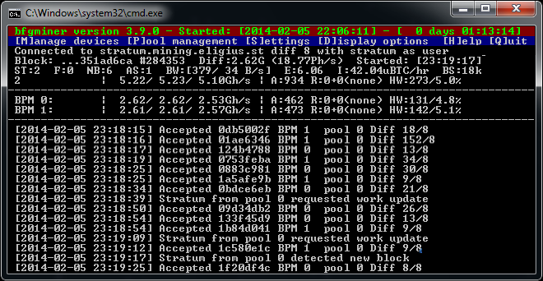
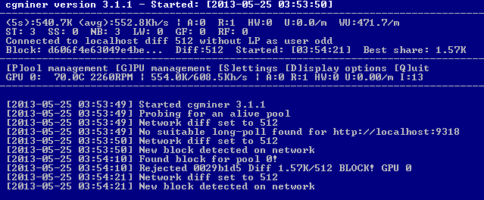
BITCOIN
TERMINAL
INSTALLATION
200GB

Slide 6

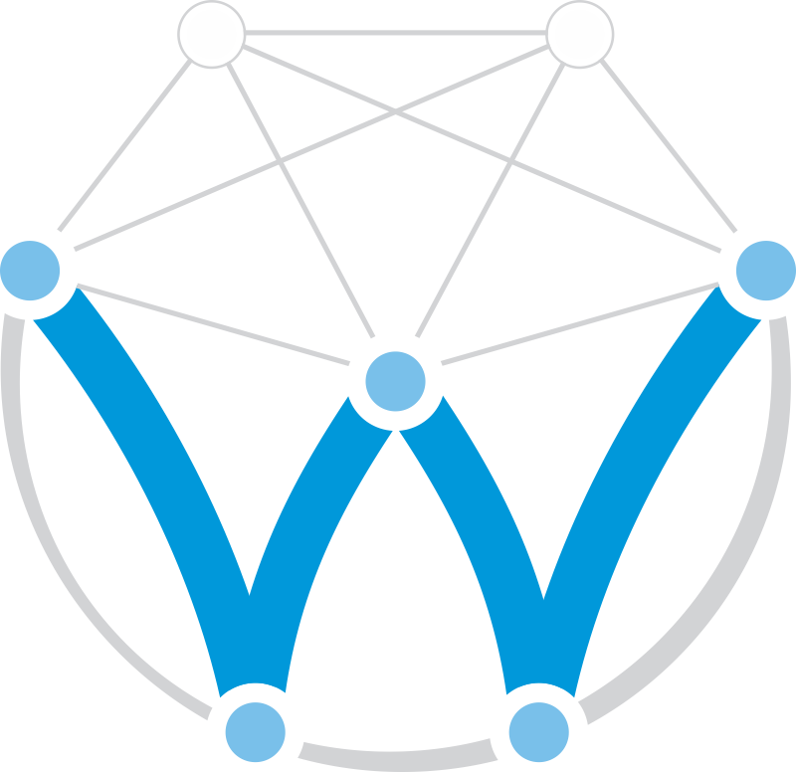
BITCOIN: DIGITAL CURRENCY
WEBDOLLAR: INTERNET CURRENCY

Slide 10
ADVANTAGES
Wallet saved in Browser
Peer 2 Peer Blockchain directly in Browser
Mass Adoption by Human Miners, and not farms
Easiest Blockchain Integration in WEB Apps - JS
Micro Transactions

Slide 11
SAMPLE CODE - CHECKING BALANCE
<html>
<body>
Hello Blockchain !
<script src="cdn://WebDollarNodes.js">
<script>WebDollar.Nodes.CheckBalance( address, balance => alert(balance) )</script>
</body>
</html>

Slide 12
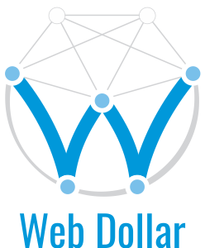
Disrupting industries
MINING REPLACE ADS
MONETIZE USERS ONLINE
REFERRAL SYSTEM
IN GAME MONEY REWARDS

Slide 13




MILESTONES
Peer 2 Peer in Browser 100%
Mining 80%
Blockchain 70%
Node-WebDollar - 243 commits, 5.4K LOC
Vue-Frontend - 230 commits, 5.6K LOC

Slide 14
ICO & ECOSYSTEM
CURRENCY EXCHANGE APP
TRADING APP
MASSIVE ADOPTION
70,000 €

Slide 15
FORECAST MARKET CAP WEBDOLLAR

Slide 16






WE. THE TEAM.
Alexandru Ionuț Budișteanu
Full Stack Developer
Adrian Robescu
Blockchain Business Developer
Vadim Mura
Business Guy
Iulian Vasilescu
UI / UX Design / Front end
Cristian Lac
Productivity Addict
Adrian Mihai Stratulat
Advisor

Slide 17
webdollar.io
...
demo live

