Slide 1
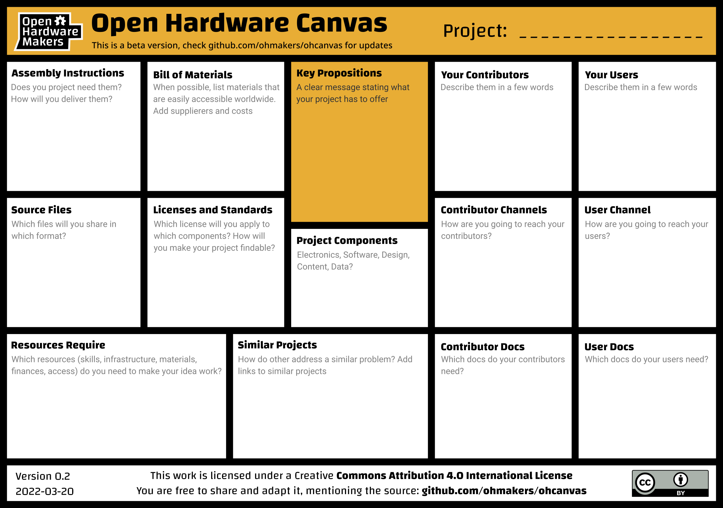

Slide 2
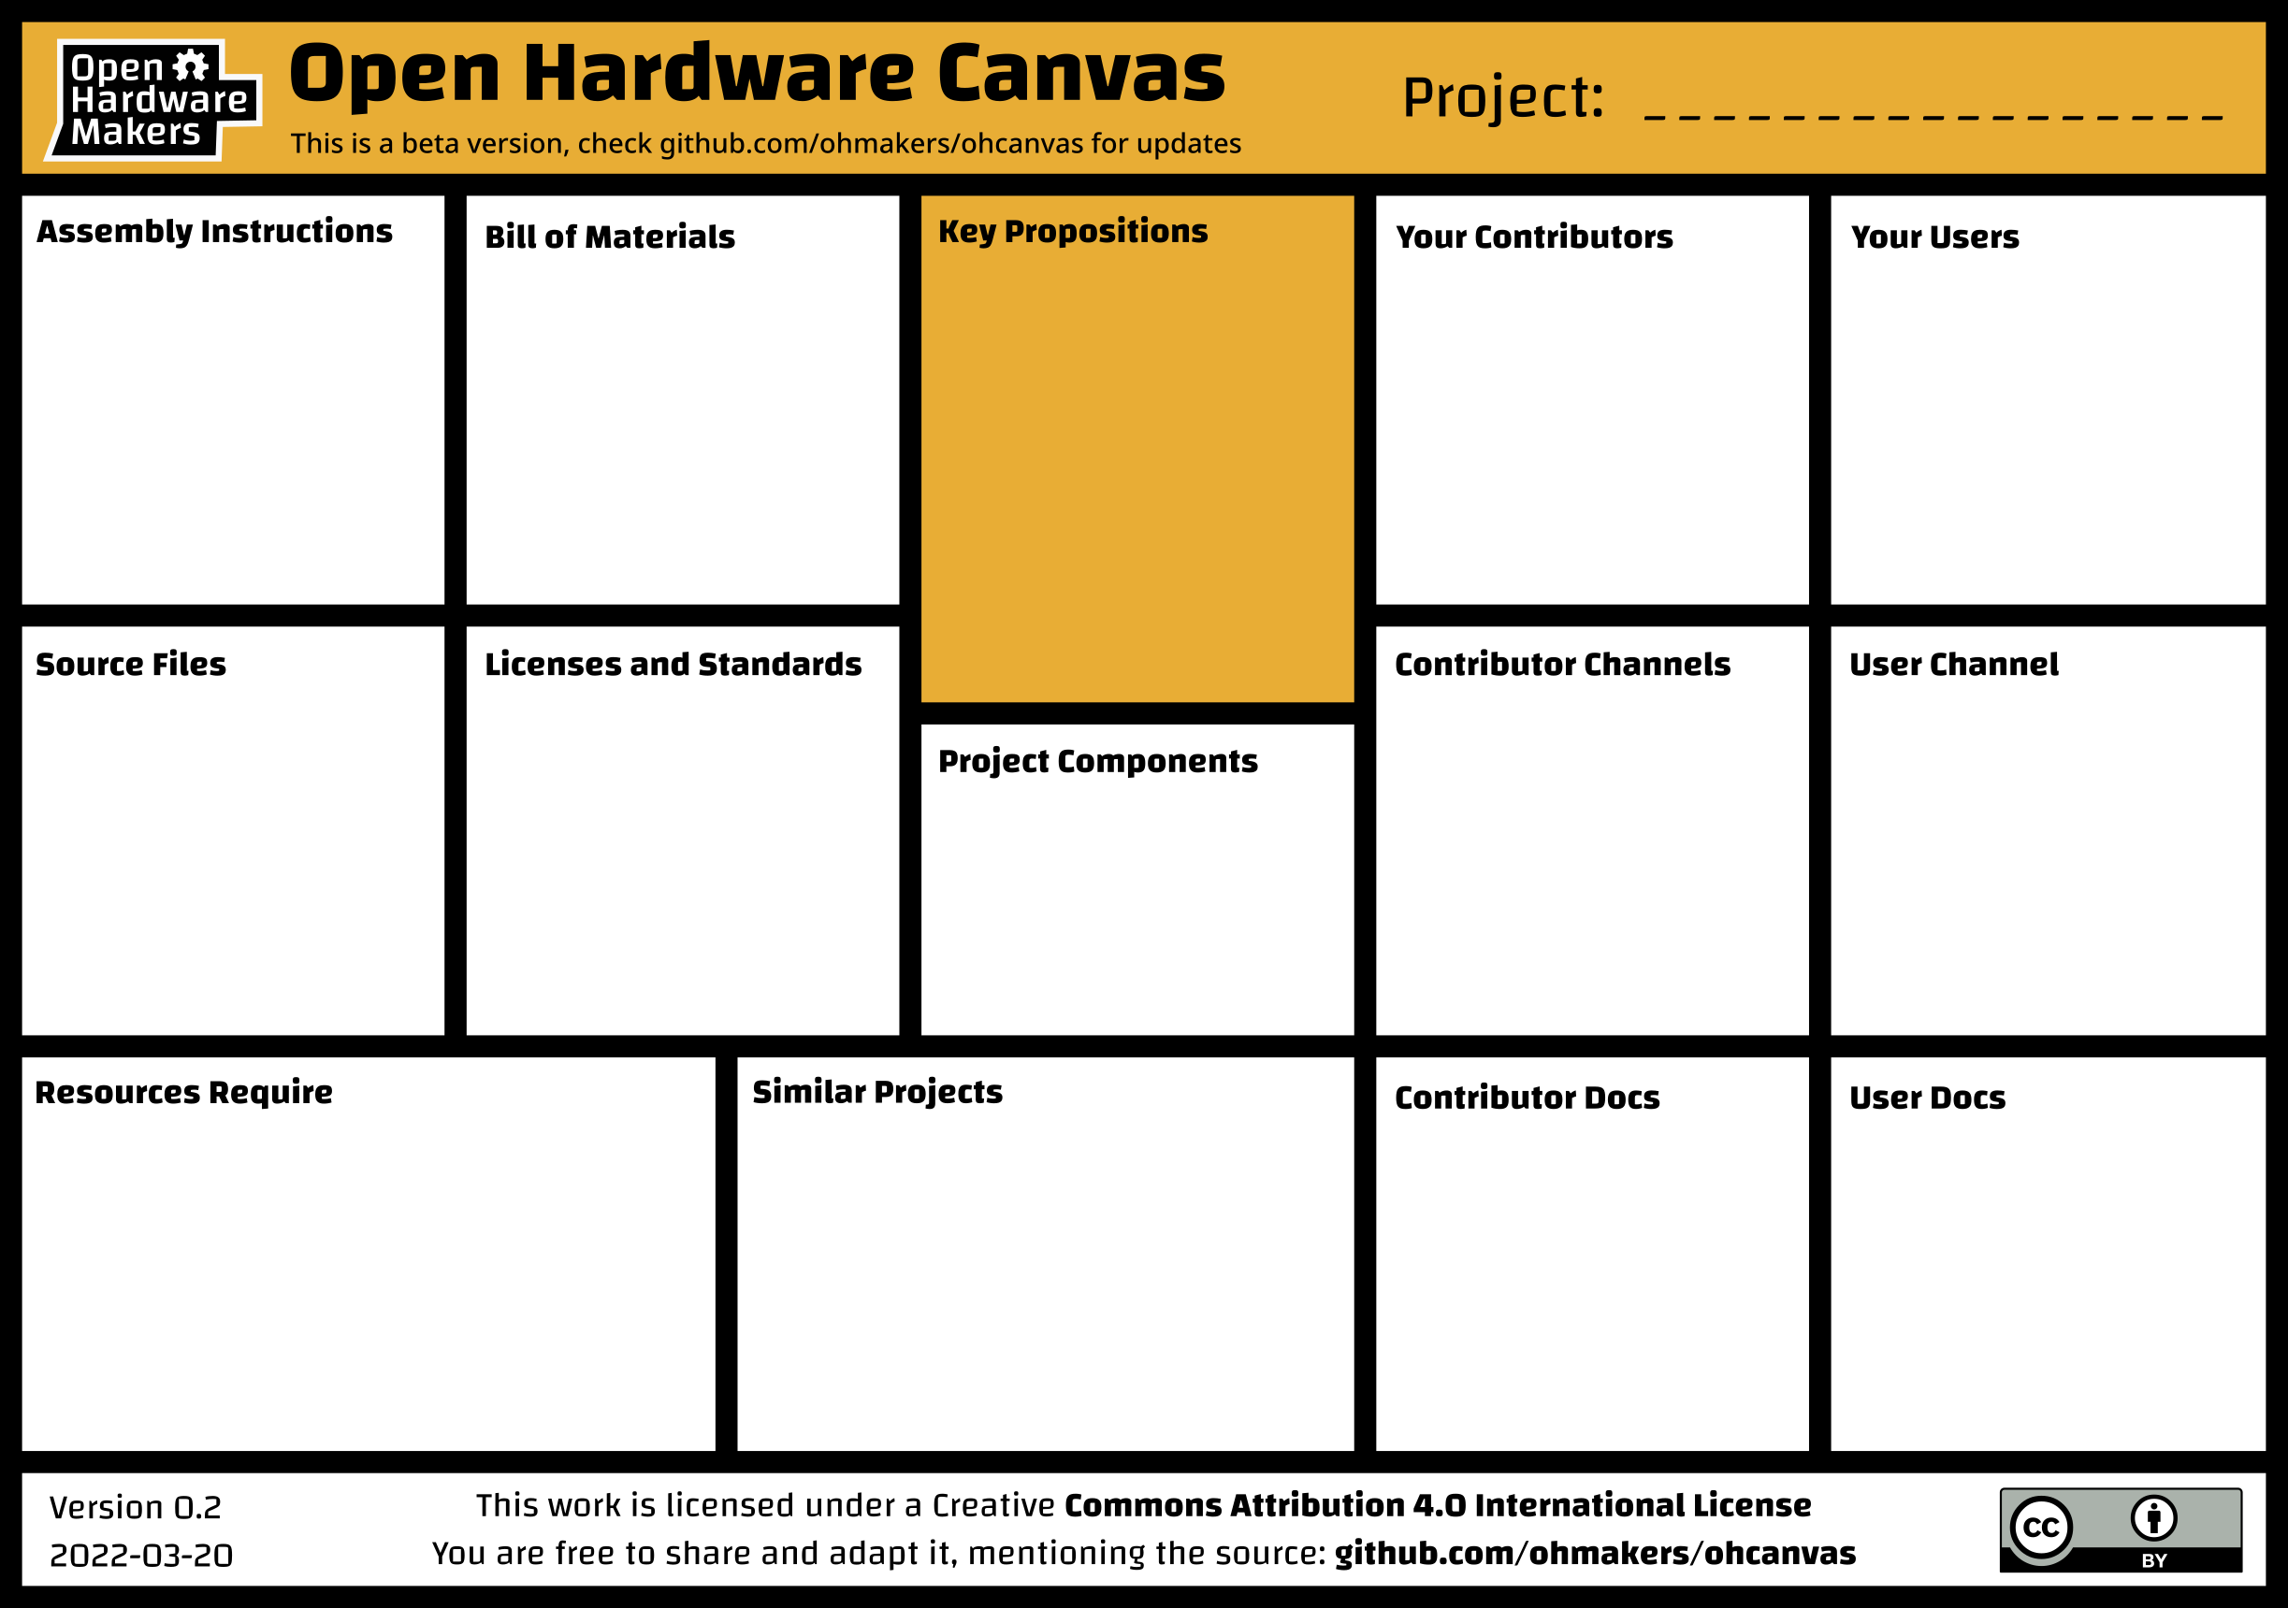
All the assembly info is here
Bill of materials
code
License
code
3d printer
https://cheapassscience.wordpress.com/category/pipette/
Docs

