Slide 1
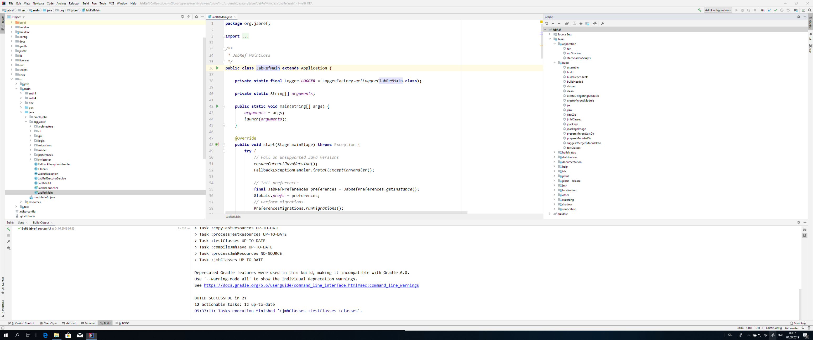
Project Window
Gradle Window
Gradle tasks: run
Starten von JabRef
Gradle tasks: build
Öffnen von JabRefMain.java

