Slide 1
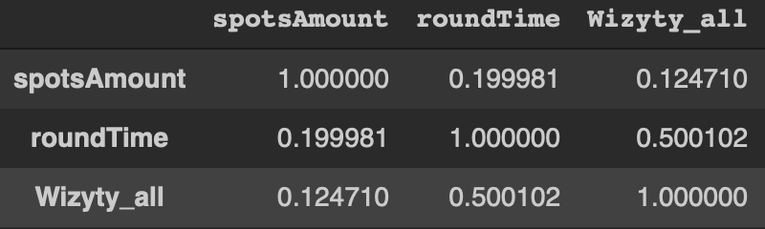
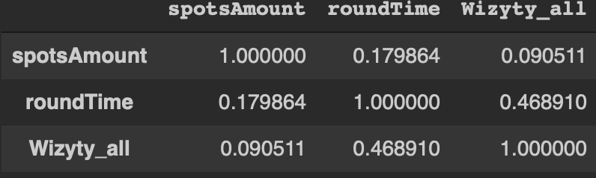
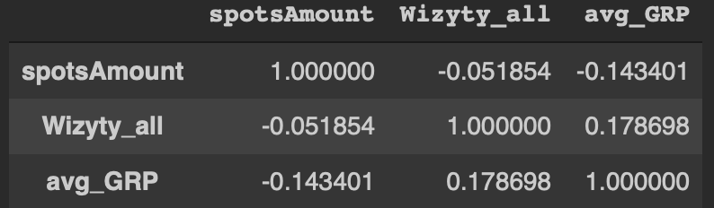
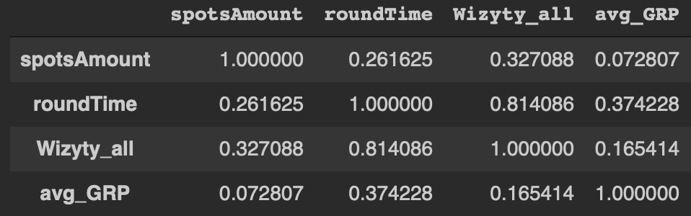
Spots and views relation - technical background
Model: Linear regression
Pearson’s correlation for whole dataset, without data modification
Moderate positive correlation between visits and time of spots
3. Pearson’s correlation for week days, without data modification
Low positive correlation between visits and time of spots
2. Pearson’s correlation for whole dataset, with GRP higher than 0.00
No significant correlation
3. Pearson’s correlation for weekend days, without grp modification
High positive correlation between visits and time of spots and low positive correlation between visits and spots amount in one hour

Slide 2
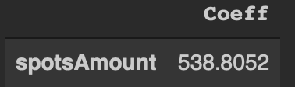
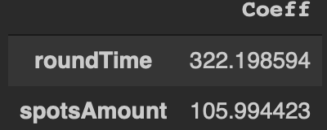
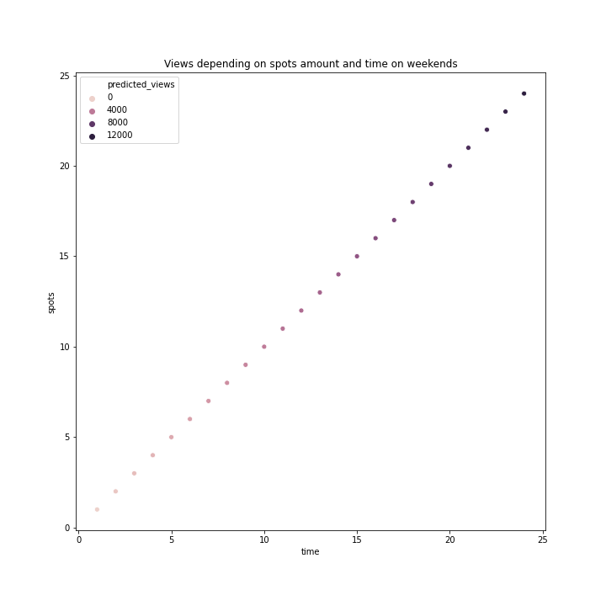
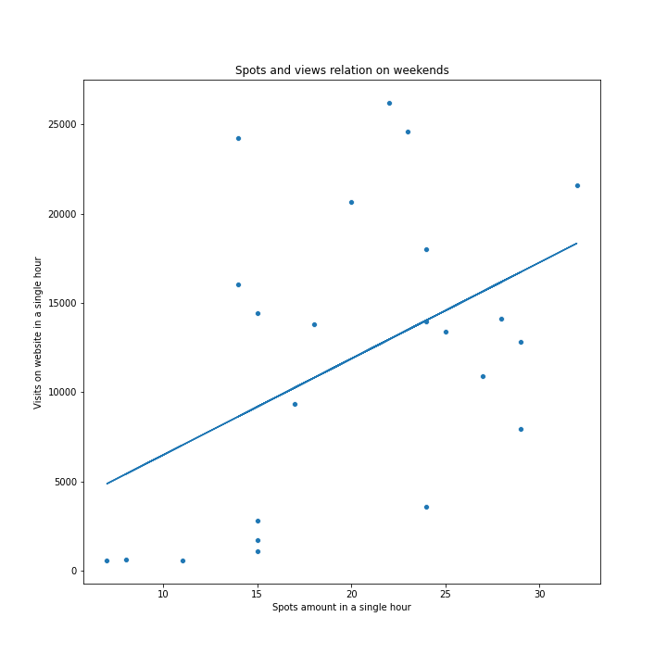
Spots, views and time relation on weekends - technical background
model: simple linear regression
y = visits on weekends by hours
x = amount of spots on weekends by hours
model: polynomial regression
y = visits on weekends by hours
x1 = spots amount on weekends by hours
x2 = cumulated hour

Slide 3
Spots and views relation on weekends - business value
Research time range: 10.11.2014 - 23.11.2014
Below conclusions are based on spots amount only.
Average amount of views in a single hour:
general avg: 6315 views
week days avg: 7047 views
weekend days avg: 3986 views
Significant relation between views on website and spots amount on TV was found only on weekends.
Increase amount of spots on weekends, in single hour by one is associated with increase of views on website by 534 views in the same hour.
Increase of spots amount by one increases over 13% of current weekend average amount of views.

Slide 4
Spots, views and time relation on weekends - business value
If we will take into account time additionally we can precise our estimations even more
If we take into account time we discover that the later time we will choose for spots emitting the higher amount of viewers it will generate.
Increase of time by one hour on weekends is (in model including time) associated with increase of visits amount by 322
Increase of spots amount (in model including time) is associated with increase of visits amount by 106.
Thus by emitting spot f.e. on Saturday at 23:00 p.m. we will attract 9148 more views at the same hour according to our model
It’s 230% of current weekend average of visits in a single hour
Final conclusion:
To optimize website visits we should emit spots as late as it possible on weekends.

