Slide 1
A3R
GROUP 3

Slide 2




Team
Members
Peñaflor, Angel M.
Moh.Hashim, Rana A.
Suson, Adrian DR.
Abdurasad, Allen S.

Slide 3
Problem
Task management is often complex and disorganized for individuals, leading to inefficiency and frustration.
Solution
To address this issue, we propose developing a task management app called "To-Do List" that offers a straightforward and user-friendly interface for adding, viewing, and deleting tasks.

Slide 4
“To Do List”
PACT Framework:
People:
Users: The target users are individuals looking for a straightforward tool to manage their tasks without any complexities.
User Goals: Users aim to quickly add new tasks, delete completed tasks, and view their existing tasks in a simple list format.
Activities:
Task Management: Users can add new tasks by typing text into an input field and pressing a button to save. They can delete tasks by sliding the task to the left.
Task Viewing: Users expect to see their existing tasks displayed in a list format, with the ability to scroll through the list to view all entries.

Slide 5
“To Do List”
PACT Framework:
Context:
Usage Context: Users may use the app on their smartphones while on the go or at home, making it important to optimize the interface for mobile usability and quick task management.
Technology:
Flutter Framework: Leveraging Flutter's capabilities to create a simple and responsive user interface optimized for mobile devices.
Local Storage: Storing task data locally on the user's device to ensure quick access and responsiveness without relying on internet connectivity or external servers.
Minimalistic Design: Designing a clean and uncluttered interface with minimal visual elements, focusing on essential controls for adding, deleting, and viewing tasks.

Slide 6
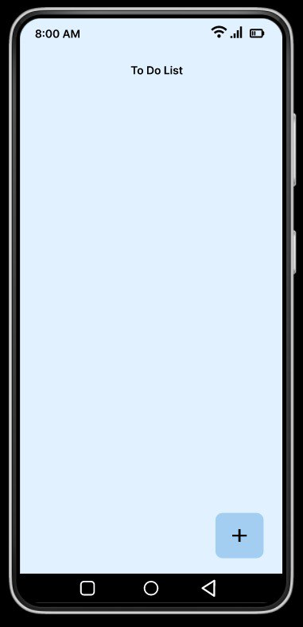
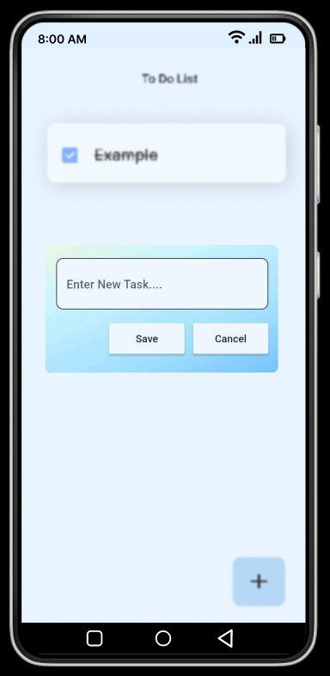
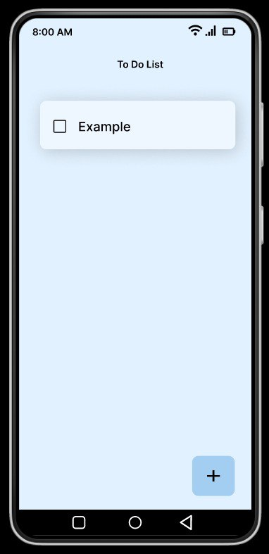
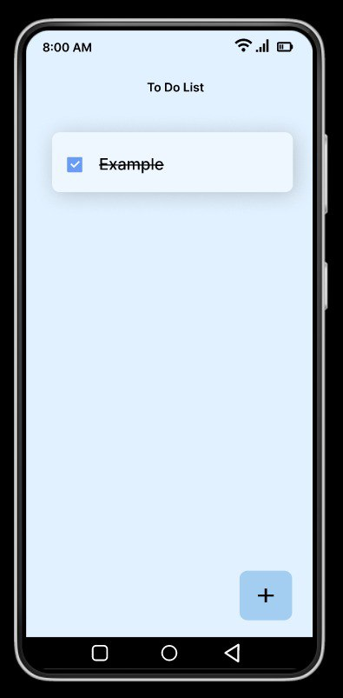
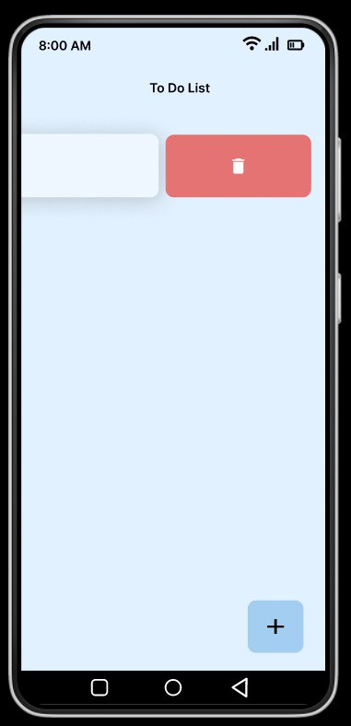
Figma Layout

Slide 7
THANK YOU!
GROUP 3

