Slide 1


Slide 2
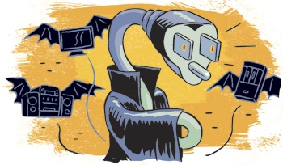
Notes:
Well known fact of unplugging devices but isn’t followed
Bill comes in -> blames on computer
3 possible reasons: bad habits, faulty devices, power vampires
https://www.texascooppower.com/energy/efficiency/general/the-vampires-lurking-in-your-home

Slide 3


Taken for Granted
26,782 GWh
1339.1 GWh
17,408,300 PHP
DOE, 2017
Notes:
DOE 2017
26,782GwH yearly, at 5% assumed power vampire consumption – 1339.1 GwH, 17,408,300php worth of electricity wasted.

Slide 4
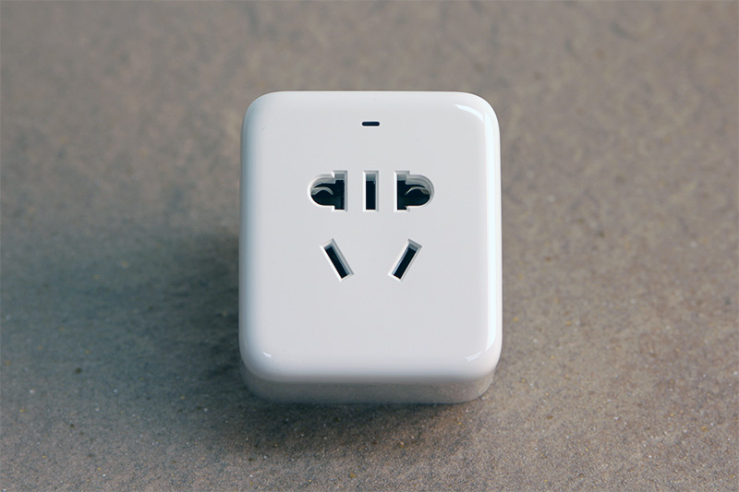
Existing Solutions
Notes:
Limited in power, and general monitoring

Slide 5
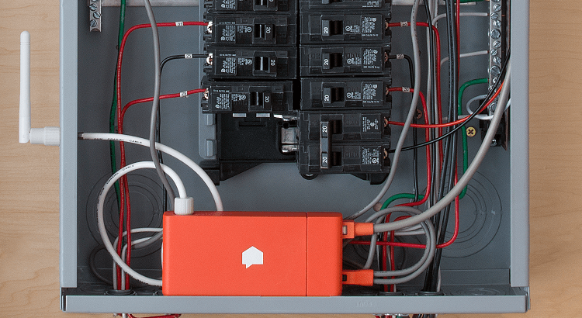
Existing Solutions
Notes:
Clumsy guesses

Slide 6
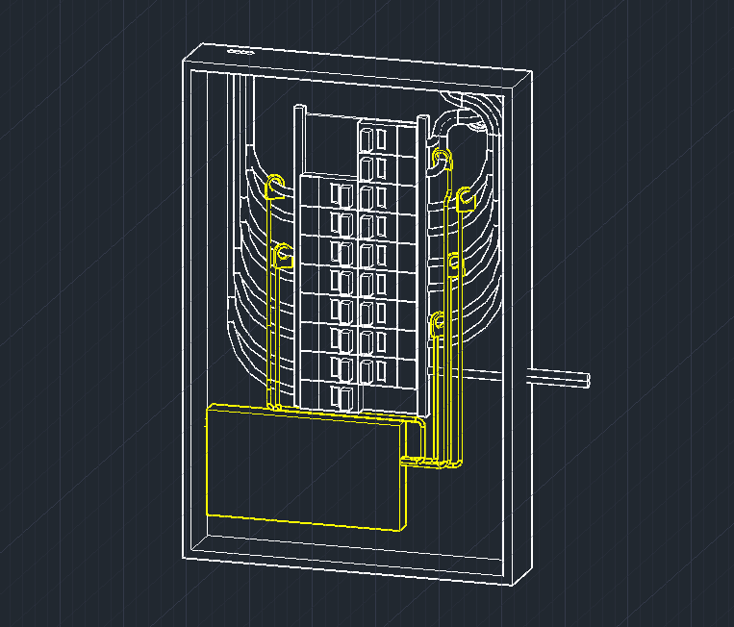
Prototype
Notes:
Clumsy guesses

Slide 7
Prototype

Slide 8
Insert Dashboard Screenshot Roll here
Notes:
Combining specificity of individual meters and the general oversight of breaker
Realtime power consumption characteristics
Device status insights: preemptive actions
Standby power tracker

Slide 9
Future Developments
Supply Quality
Sometimes it’s not
you and your home.
IoT Data Pool
Anonymization of data
is of utmost importance.
For Prosumers
All hail the renewables
and distributed generation!
Notes:
Supply Quality – Harmonics, Reactive Power
IoT Data Pool – Providing a consistent source of energy consumption data
Prosumers – Small producers induce stress in the current grid system, a better data source will help load balancing better

Slide 10
More effective Grid Management
Better Allocation for Renewables
Possible Adoption Model for Smart Grid Infrastructure

Slide 11
Empowerment
Notes:
Consumer – Energy Savings
Electricity Grid – PQR, Emission, Sustainability
Service Providers – Path of access

Slide 12

Team
Giancarlo Conti
V – Electrical Engineering
UPLB
Adrian Vincent Tayag
V - Electrical Engineering
UPLB
Russ Delos Santos
V – Electrical Engineering
UPLB
Cedric Velandres
BS Electrical Engineering
UPLB
Minerva
Page | 3
Notes:
Selling peace of mind

