Slide 1
Method for choosing catchment size (level), and time bin width

Slide 2
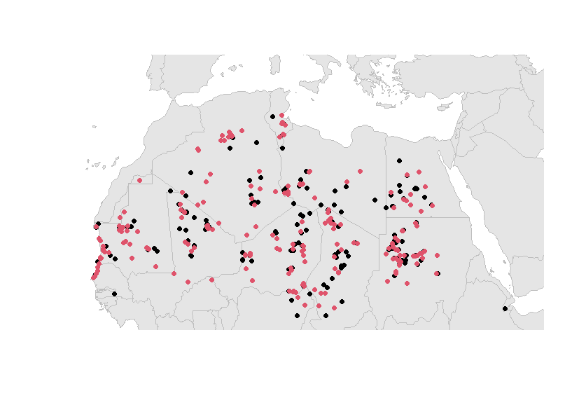
Catchment size
Randomly separate all unique sites into two (approximately) equal subsets.
For a particular catchment level, count how many catchments have both red and black dots (match)
And how many catchments have only red or black (mismatch)

Slide 3
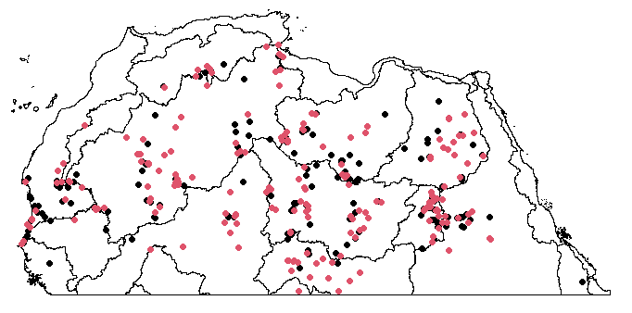
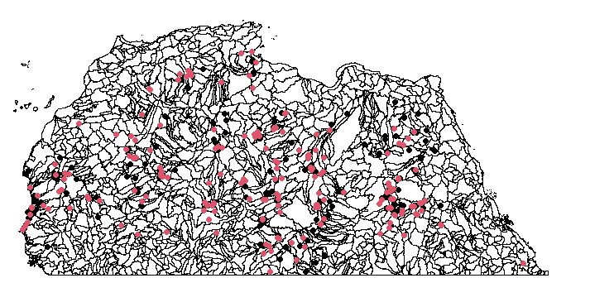
Level 3:
12 match, 2 mismatch
Level 6:
50 match, 139 mismatch

Slide 4
Level 4 shows best congruence
level | matches | mismatches | profit
1 | 1 | 0 | 1
2 | 4 | 1 | 3
3 | 12 | 2 | 10
4 | 36 | 17 | 19
5 | 58 | 76 | -18
6 | 56 | 133 | -77

Slide 5
Random CV split data again…
level | profit | profit | profit | profit
1 | 1 | 1 | 1 | 1
2 | 3 | 3 | 3 | 3
3 | 12 | 12 | 10 | 10
4 | 19 | 17 | 13 | 15
5 | -20 | -6 | -16 | -12
6 | -83 | -73 | -65 | -81
Clearly level 4 always wins

Slide 6
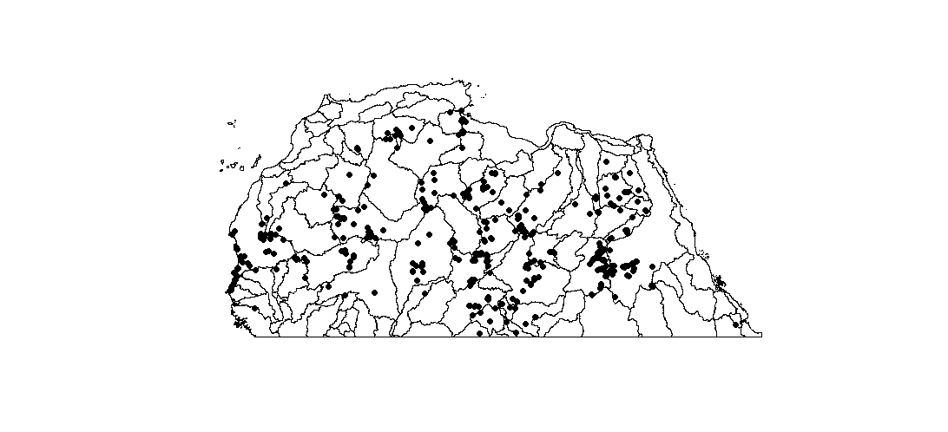
Level 4

Slide 7
Time bin width (given best catchments are level 4)
Similar CV approach:
Assign data to catchments and time bins
How many catchment-time bins have data from both CV sets?

Slide 8
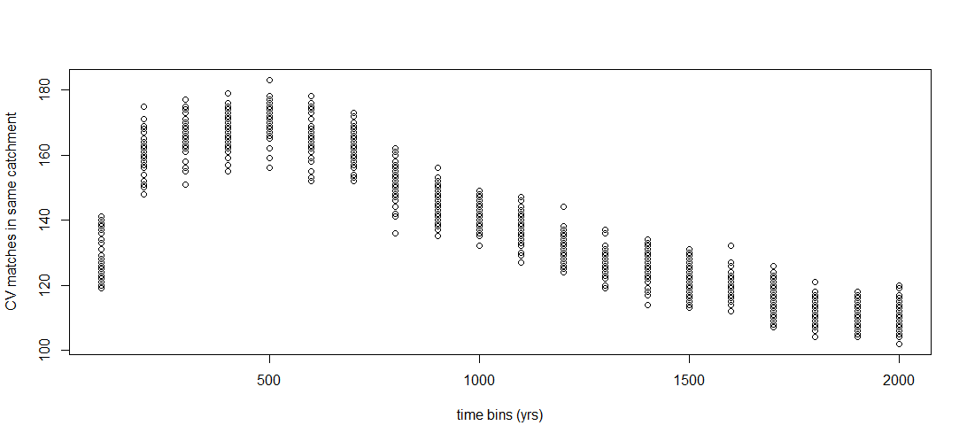
Time bin width (given best catchments are level 4)
Similar CV approach:
Assign data to catchments and time bins
How many catchment-time bins have data from both CV sets?
500 yr time bins win, for analytical purposes.

Slide 9
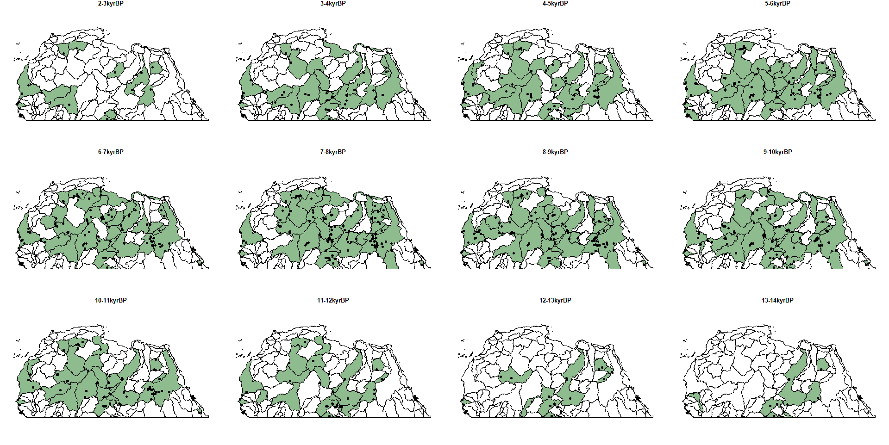

Slide 10
Is it justified to aggregate data longitudinally?

Slide 11
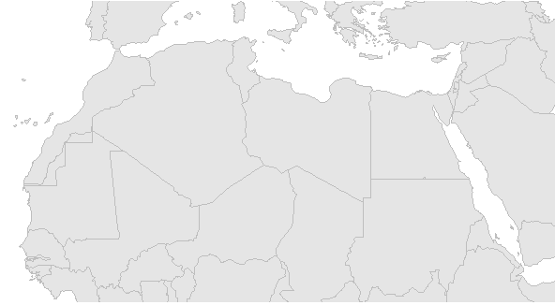
Formal model comparison using BIC (Bayesian Information Criterion)

Slide 12
Model | Top rain Gaussian |  |  |  | Bottom rain gaussian |  |  |  |  |  | N pars | Log likelihood | BIC
 | Angle (degrees from horizontal) | Gaussian SD (degrees) | Start latitude (deg at GM at 14kyBP) | Spread rate (degrees per century) | Angle (degrees from horizontal) | Gaussian SD (degrees) | Start latitude (deg at GM at 14kyBP) | Spread rate (degrees per century) | Bottom proportion | Reverse date (BP)
4 | none | none | none | none | 0 | 4.70 | 16.68 | 0.068 | none | 7021 | 4 | -3351.099 | 6758.437
5 | none | none | none | none | 1.60 | 4.68 | 17.02 | 0.070 | none | 7247 | 5 | -3347.739 | 6765.778
6 | 0 | 3.28 | 31.55 | 0.055 | 0 | same | 16.49 | same | 0.88 | 7910 | 6 | -3262.400 | 6609.159
7 | 0 | 3.28 | 31.55 | 0.055 | 0 | same | 16.49 | same | 0.88 | 7910 | 7 | -3262.400 | 6623.219
8 | 0 | 3.28 | 31.68 | 0.054 | -0.34 | same | 16.38 | same | 0.88 | 7788 | 8 | -3262.140 | 6636.759
9a | -33.23 | 2 | 31.90 | 0.054 | -0.81 | 3.58 | 16.59 | same | 0.91 | 7744 | 9 | -3244.022 | 6614.584
9b | 0.00 | 3.23 | 27.75 | 0.033 | -0.04 | same | 15.98 | 0.067 | 0.87 | 8004 | 9 | -3257.290 | 6641.119
10 | -33.63 | 2 | 29.66 | 0.013 | -0.76 | 3.58 | 16.14 | 0.063 | 0.91 | 7645 | 10 | -3240.952 | 6622.503

Slide 13
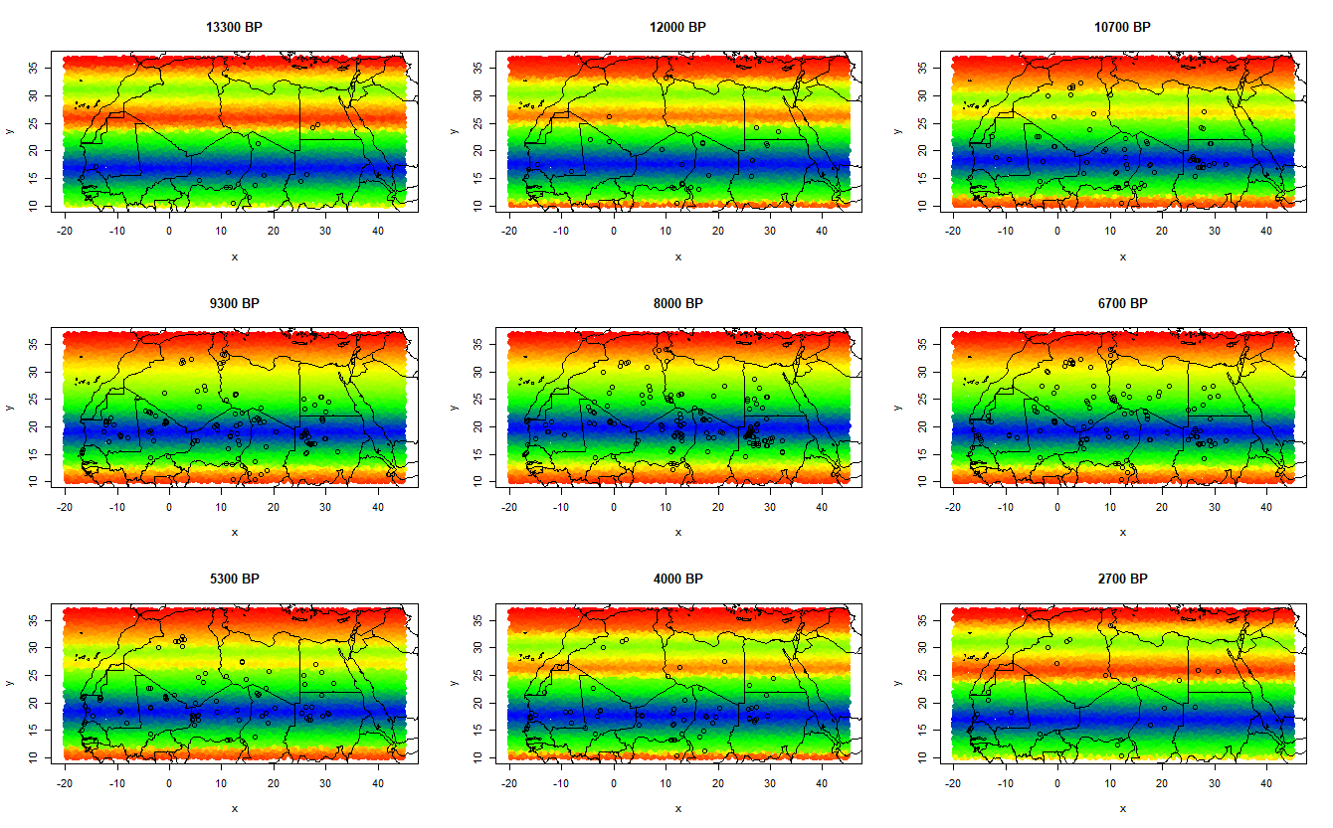
Model 6 (best)

Slide 14
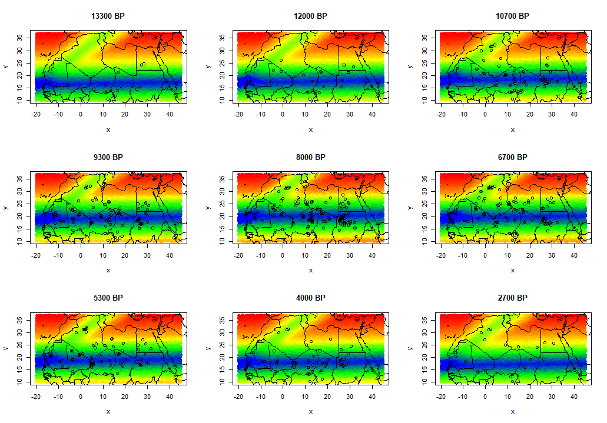
Model 10 (overfit)

Slide 15
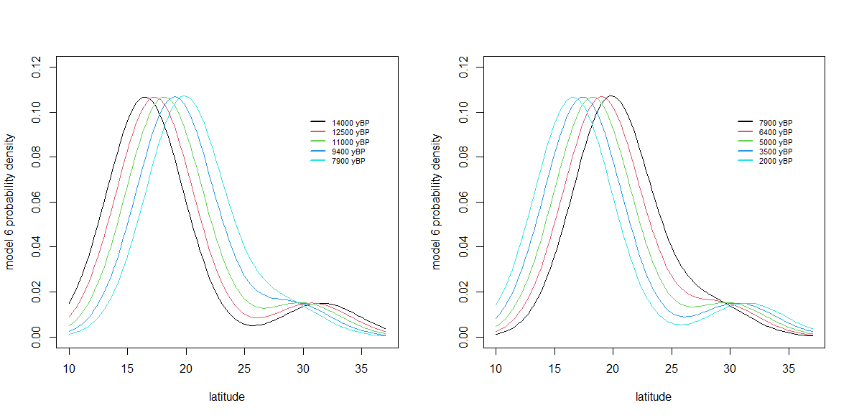
Model 6 (best)

