Slide 1
Brain Tumor Segmentation
Adrian-Valentin Ciu

Slide 2
Dataset Overview
Dataset: BRATS (Brain Tumor Segmentation Challenge)
Each scan is a 4D volume: (H, W, D, 4 modalities)
Modalities: FLAIR, T1, T1Gd, T2
Ground truth includes multiple tumor regions
Big dataset ~ 8GB (zipped); unzipeed ~70GB (32GB after prepressing)
~ 550 volumes (~ 34000 slices)

Slide 3
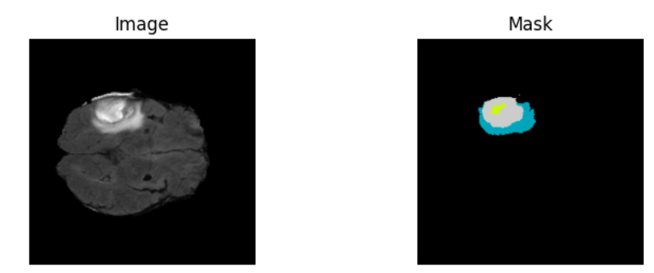
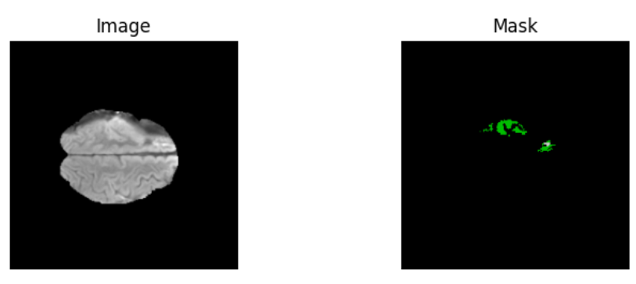
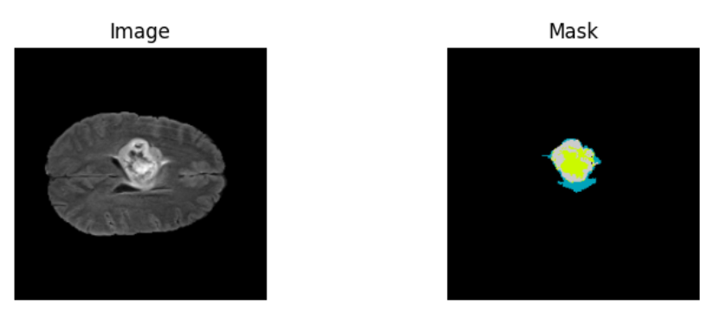

Slide 4
Task Definition
Problem Type: Semantic segmentation
- Input: 2D axial MRI slices
- Output: Pixel-wise label masks (4 classes)
- Objective: Accurately localize tumor subregions

Slide 5
Preprocessing Steps
Loaded .nii.gz files and extracted 2D slices
Used only tumor-containing slices for training
Normalized each slice (mean 0, std 1)
Resized to 256x256
Saved as .npy for fast disk access
Split dataset by volume to avoid data leakage
Applied augmentation for training

Slide 6
Data Augmentation (Training Only)
Horizontal and vertical flips
Random rotations (90 degrees)
Brightness and contrast adjustment
Gaussian blur for generalization

Slide 7
Why 2D U-Net?
Lower memory requirements than 3D U-Net
Enables training on 2D tumor-containing slices
Pretrained encoders (e.g., ResNet34) available via segmentation_models.pytorch
Much faster training, good for prototyping
Slices capture tumor features effectively in axial view

Slide 8
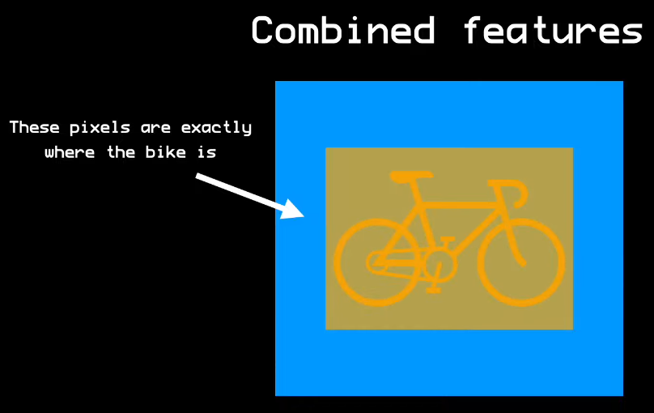
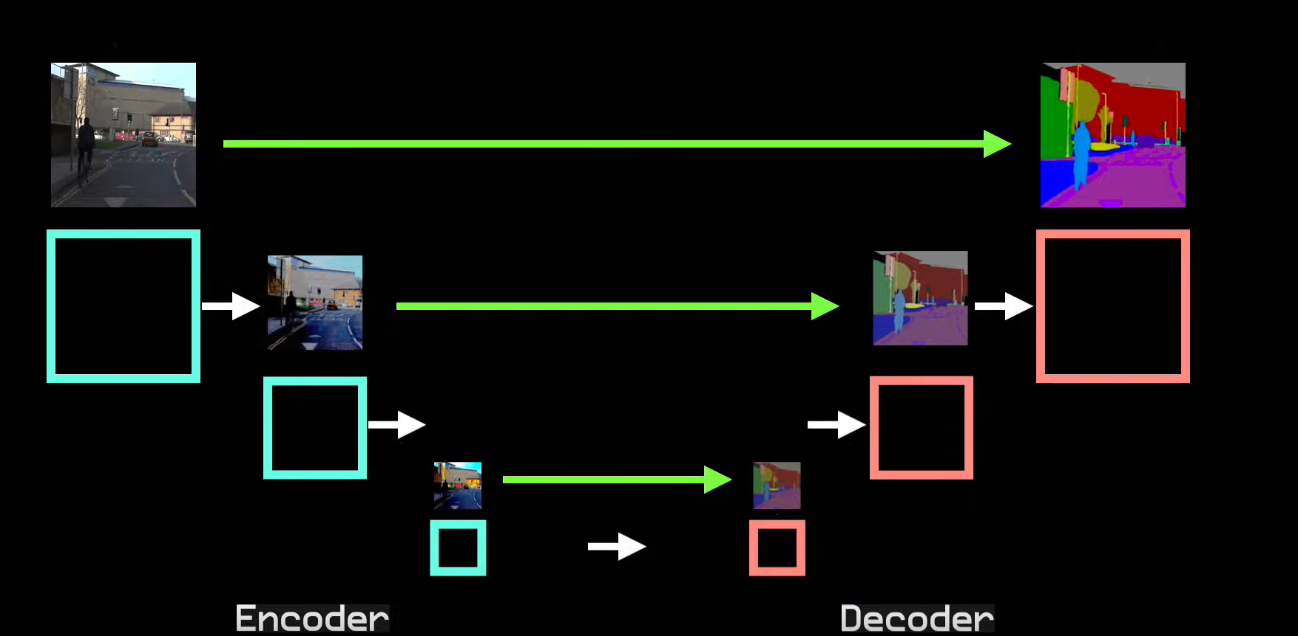
2D U-Net Architecture
Contracting path: convolution + max pooling to
extract context
Expanding path: upsampling + concatenation for localization
Skip connections: combine low-level features from encoder with decoder
Each layer
outputs feature
maps with
higher spatial
resolution
Final output:
per-pixel class
prediction
(segmentation map)

Slide 9
Training Details
Loss: CrossEntropyLoss
Optimizer: Adam
Early stopping based on validation loss
Dice Score used as evaluation metric
Batch size: 8, learning rate: 1e-3
Best model saved automatically

Slide 10
Early Stopping
Monitors validation loss score
Stops training if no improvement for 5 epochs
Prevents overfitting and wasted compute
Custom early stopping callback implemented

Slide 11
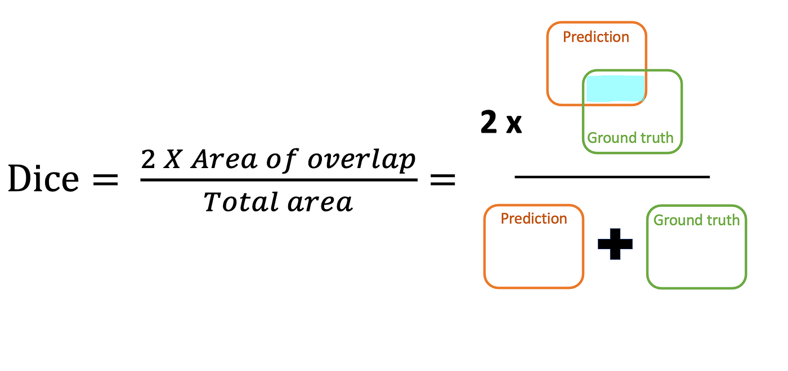
Validation Strategy
Split dataset 70/15/15 into training, validation and test
Test set used only for evaluation
Dice score monitored to check generalization

Slide 12
Results
Train Dice ~0.85+, Val Dice ~0.65
Val Dice stagnated early → early stopping triggered
Train/val loss gap widened → overfitting observed
FLAIR-only input may limit generalization
Pretrained encoder converges fast

Slide 13
Model Evaluation Metrics
Dice Score (per class and average)
Pixel accuracy: correct pixels / total pixels
Optional: confusion matrix to analyze misclassifications

Slide 14
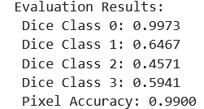
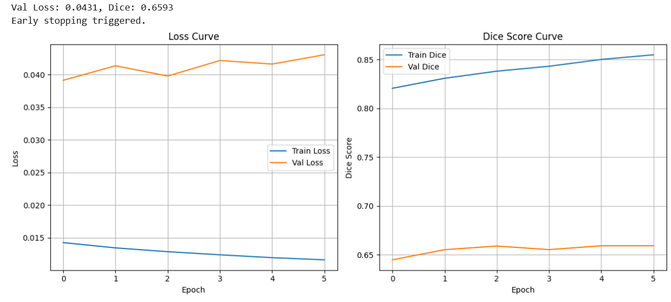
2d u-nET (No Augmentation)

Slide 15
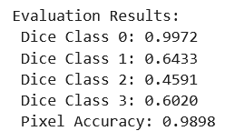
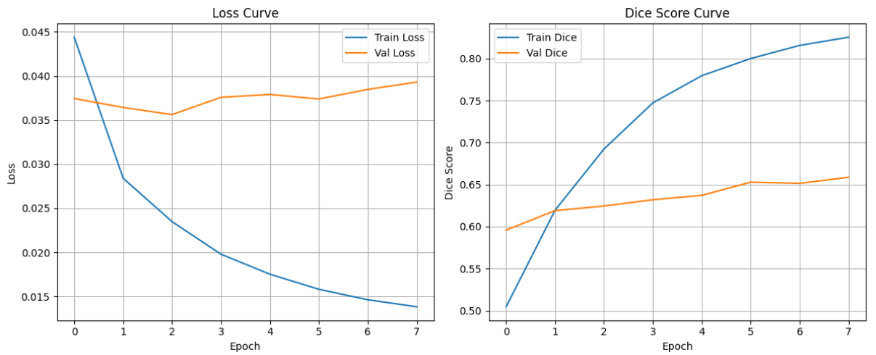
2d u-nET pretrained(No Augmentation)

Slide 16
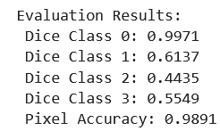
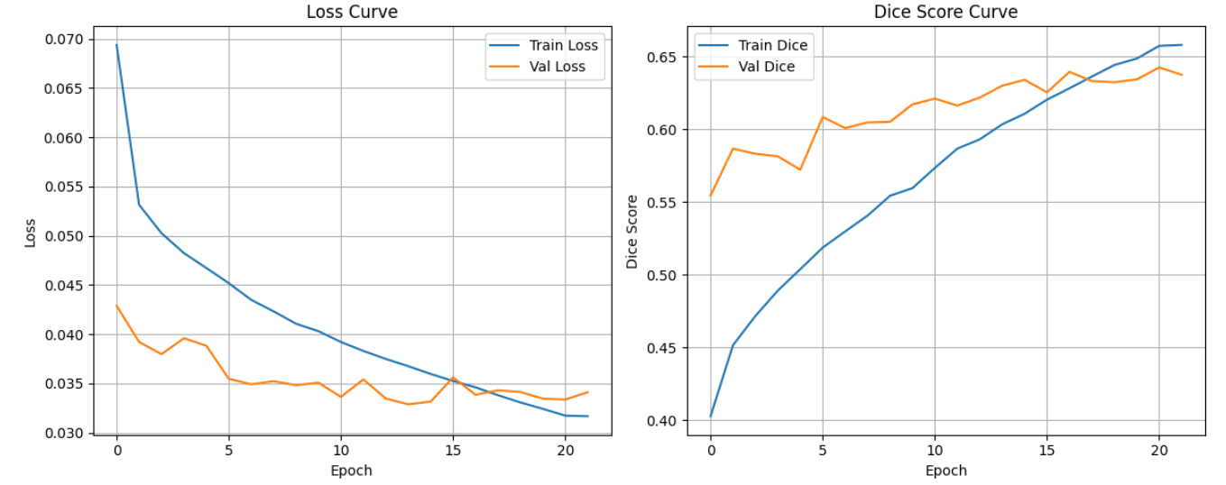
2d u-nET

Slide 17
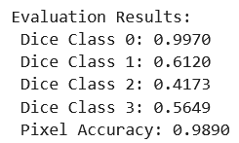
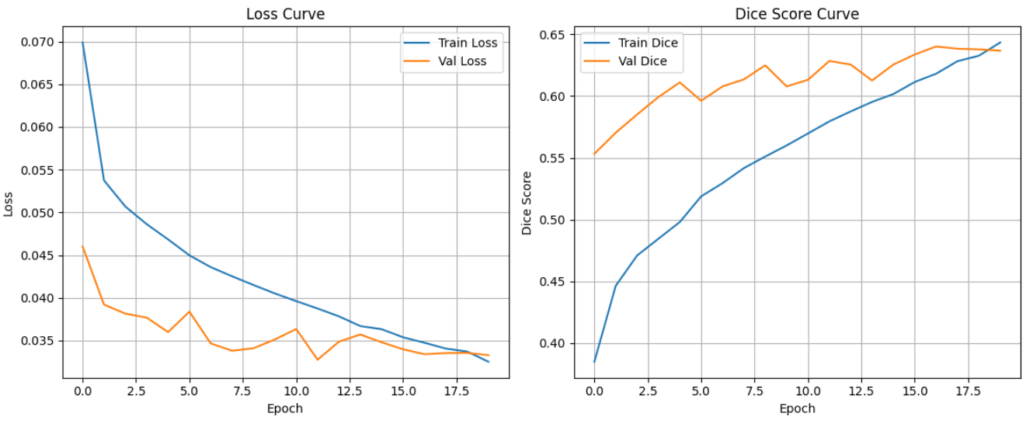
2d u-nET pretrained

Slide 18
Results
The 2D U-Net with pretrained ResNet34 encoder trained well on tumor slices. However, validation loss and Dice score plateaued early, indicating limited generalization. This could be due to using only FLAIR modality, lack of tumor class diversity, or need for stronger regularization.
Overfitting was controlled with early stopping.
Data augmentation improved the model’s learning as it could be seen in the diagrams from a few slides ago.

Slide 19
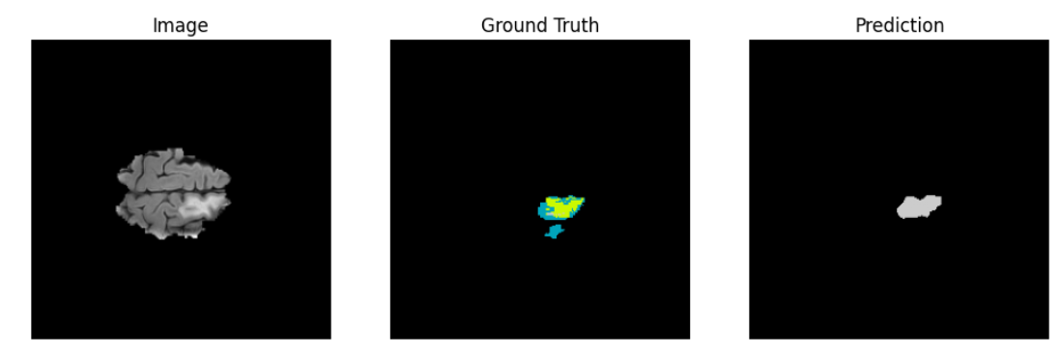
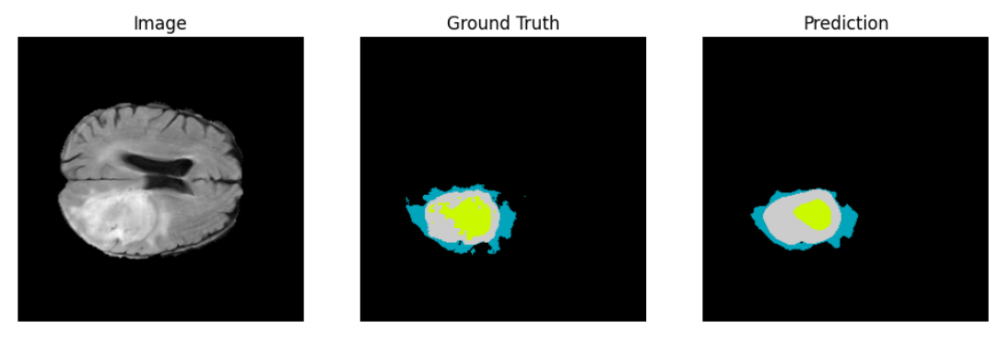

Slide 20
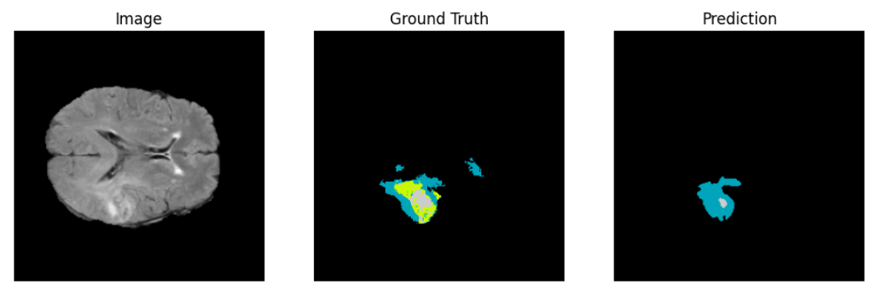
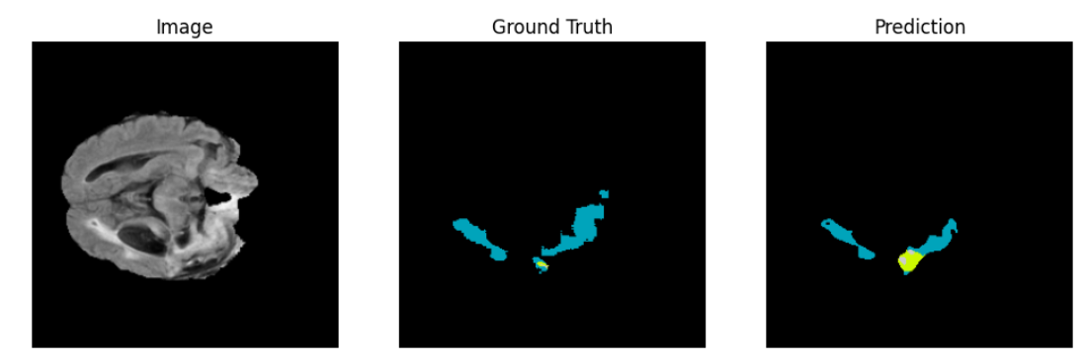

Slide 21
HARDWARE
Nvidia RTX 3090
Intel I9
32 GB RAM

Slide 22
Future Work
Upgrade to 3D U-Net for volumetric context
Use all modalities as multi-channel input
Test other pretrained encoders (e.g., EfficientNet)

Slide 23
References and Resources
BRATS: http://medicaldecathlon.com/
SMP: https://github.com/qubvel/segmentation_models.pytorch
PyTorch: https://pytorch.org
Nibabel: https://nipy.org/nibabel
BRATS Paper: https://www.nature.com/articles/s41467-022-30695-9
U-NET: https://arxiv.org/abs/1505.04597

