Slide 1

Create MTG Trading Card Database By Crawler
By Adrian Waldera
05. December 2022

Slide 2
Outline
Start of the ETL workflow
Approach for gathering data
Explanation of the ETL workflow
3.1 Web crawler
3.2 HiveToMySQL
Data Model
Demo of the frontend

Slide 3
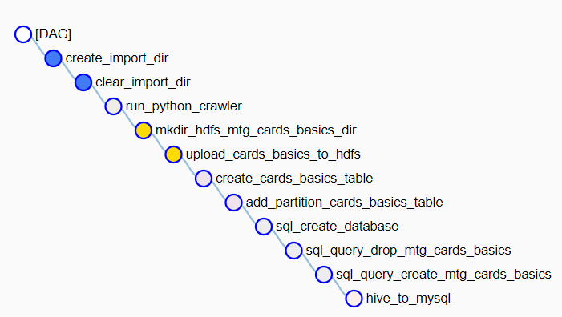
1. Start of the ETL workflow

Slide 4
2. Approach for gathering data
web crawler crawling the URL "https://gatherer.wizards.com/Pages/Search/Default.aspx?page={pageNum}&name=+[]"
pageNum is the respective number of the page
pageNum starts at 0 and can theoretically be very large

Slide 5
2. Approach for gathering data
the data is crawled as HTML string
the respective data is filtered out of these HTML strings

Slide 6
3. Explanation of the ETL workflow

Slide 7
3. Explanation of the ETL workflow
self-written scripts were used for:
Web crawler
HiveToMySQL
used Python libs:
bs4
asyncio
aiohttp
urllib3
pyhive
mysql.connetor

Slide 8
3.1 Web crawler
consists of the components:
actual web crawler
HTML information extractor
CSV creator
function prototype of the actual web crawler:
async def main(self, pageNum = 0, div = 20, offset = 0)

Slide 9
3.2 HiveToMySQL
transfers data from Hive to MySQL

Slide 10


4. Data Model
airflow container
Website
/user/airflow/airflow/dags/libs/crawler.py
/user/airflow/mtg/*
chronological order
1
2
3

Slide 11
4. Data Model
airflow container
hadoop container
/user/airflow/mtg/*
/user/hadoop/mtg/*

Slide 12


4. Data Model
hadoop container
airflow container
mysql container
/user/hadoop/mtg/*
/user/airflow/airflow/dags/libs/HiveToMySQL.py
chronological order
1
2

Slide 13
4. Data Model
mysql container
frontend container
0.0.0.0:5000
/webfrontend/frontend.py
website
/webfrontend/MySQLHandler.py
chronological order
1
2
3
4

Slide 14
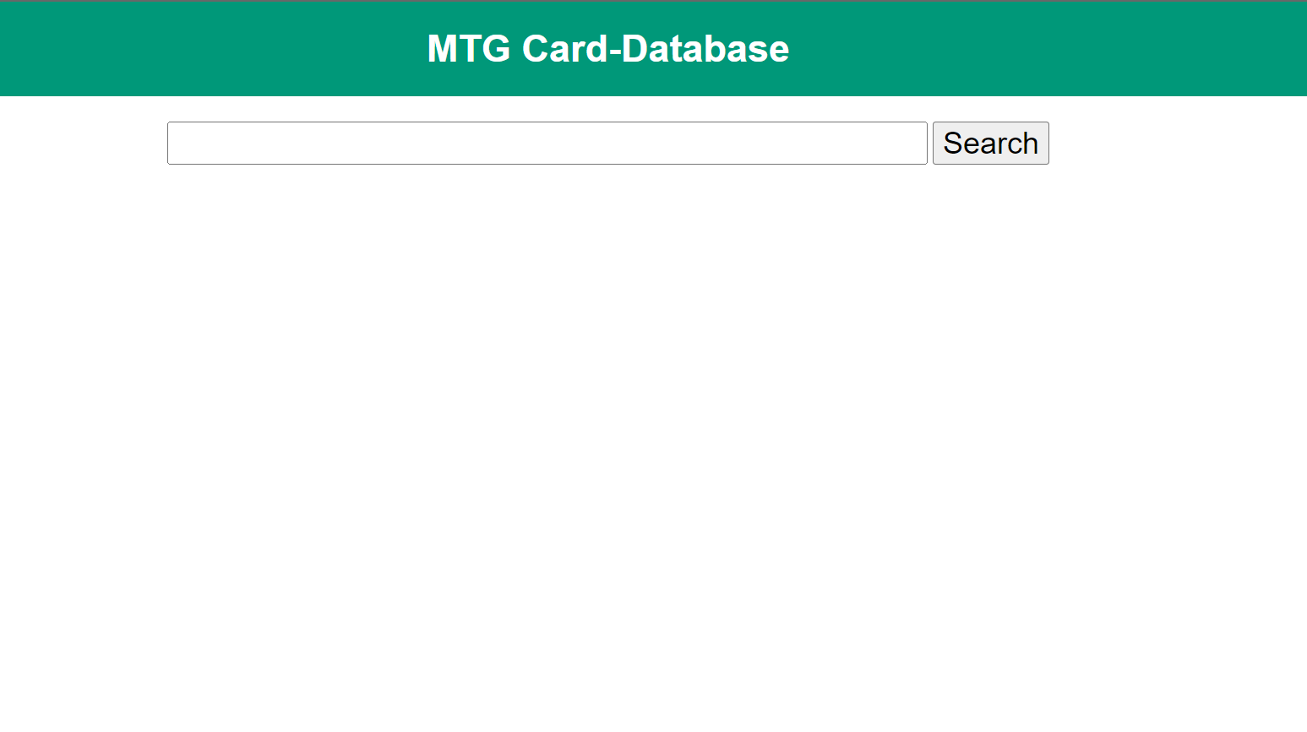
5. Demo of the frontend

Slide 15
Sources
Images:
https://cdn-icons-png.flaticon.com/512/103/103077.png
https://freeiconshop.com/wp-content/uploads/edd/csv-outline.png
https://upload.wikimedia.org/wikipedia/de/thumb/d/dd/MySQL_logo.svg/1200px-MySQL_logo.svg.png
https://upload.wikimedia.org/wikipedia/commons/thumb/b/bb/Apache_Hive_logo.svg/1138px-Apache_Hive_logo.svg.png

