Slide 1
Polarization and Interferometry
2020/2021
Adriana Barbieri
University of Padova
Prof. Mauro D’Onofrio
Astronomical Interferometry
Master Degree in Astrophysics and Cosmology

Slide 2
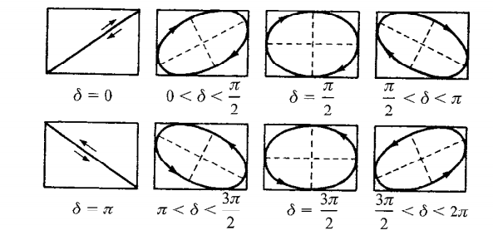
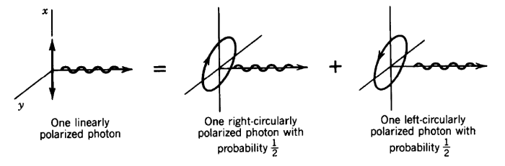
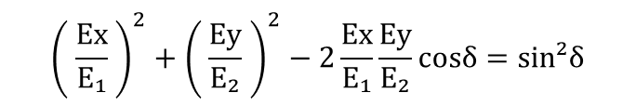
The elliptical polarization of the EM field implies that, in general, photon states are elliptically polarized.
For a monochromatic wave the orthogonal x and y components of the electric field vector share the same harmonic dependence, despite a different phase; hence they are not independent and by combining them the equation of an ellipse can be derived, where the sign of the phase difference determines the sense in which the wave vector is rotating. Such a light beam will have helical wavefronts.
Ex = E₁ cos(kz-ωt +δ₁) Ey= E₂ cos(kz-ωt +δ ₂)
δ = δ₁ - δ₂
A simpler description involves two orthogonal basis states, namely the H/V crossed linear or RH and LH circular polarization; it should be noticed that an elliptically polarized wave can be regarded as the superposition of two orthogonal linearly polarized waves, and linearly polarized states can be decomposed in two opposed states of circular polarization.
$${\left( \frac{Ex}{E₁} \right)}^{2}+{\left( \frac{Ey}{E₂} \right)}^{2}−2\frac{Ex}{E₁}\frac{Ey}{E₂}cosδ=sin²δ$$

Slide 3
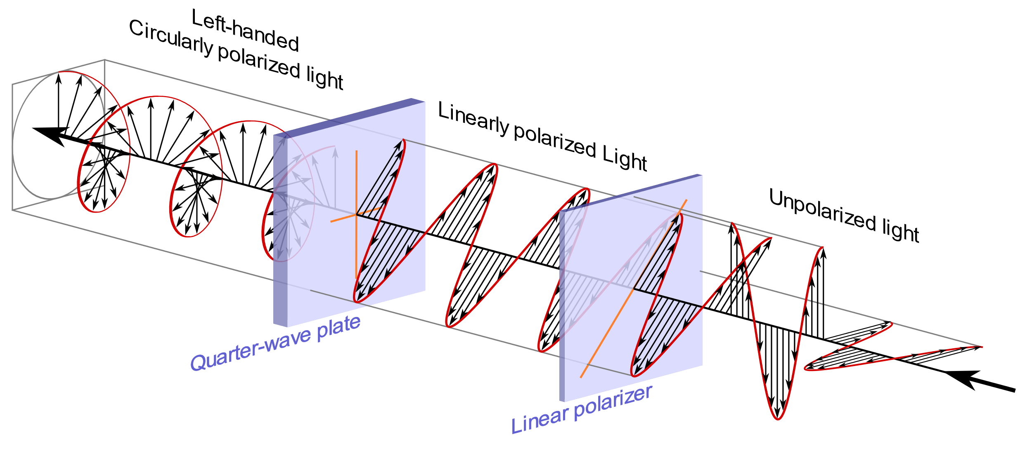
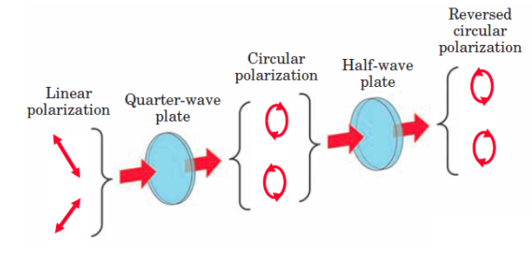
The total angular momentum of the electromagnetic field can be splitted into two components: the intrinsic or spin angular momentum and the orbital angular momentum, with the latter independent of the light beam’s pol.
The magnitude of the photon spin is quantized to the two values S = +/- ħ.
Right-handed (left-handed) circularly polarized photons have their spin vector parallel (antiparallel) to the momentum vector, whereas linearly polarized photons have an equal probability of exhibiting parallel or antiparallel sign.
With a quarter wave plate it is possible to convert a light beam carrying spin angular momentum from linearly into circularly polarized.
Polarizers are polarizing receivers that split the signal coherently into two orthogonal polarization states. Linear polarizers decompose elliptical or circular polarization into H/V linear pol., circular polarizers decompose elliptical or linear pol. into L/R circular polarization.

Slide 4
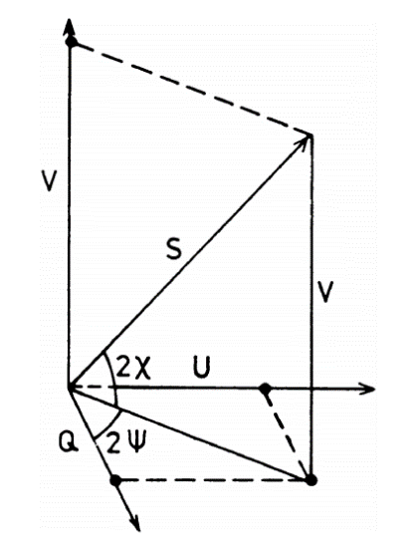
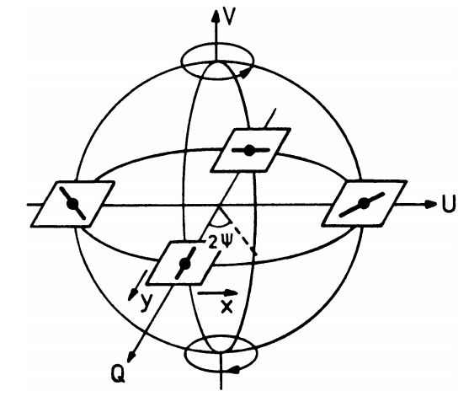
The total Poynting flux of the polarized wave is equal to the sum of the fluxes of the two orthogonal directions:
S = E₁² +E₂²
The Stokes parameters I, Q, U, and V are four quantities that fully describe the polarization state of monochromatic light, conveying information respectively about the amount of polarized and unpolarized light, the intensity and direction of the linear and of the circular polarization.
Only three among these parameters are independent, since I² = Q² + U² + V².
The Stokes parameters can be regarded as the Cartesian coordinates of the points on the Poincaré sphere, a polar (ψ,χ) representation allowing an easier visualization of the polarization modes of a vector wave.
It can be shown that: or a circularly pol. wave
I = E₁² + E₂² Q = E₁² - E₂² U = 2 E₁ E₂ cosδ V = 2 E₁ E₂ sinδ
F
I = S Q = 0 U = 0 V = ±S
For a linearly pol. wave I = S, Q = I cos2ψ , U = I sin2ψ , V = 0

Slide 5
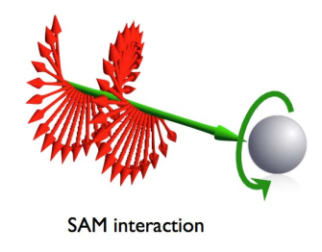
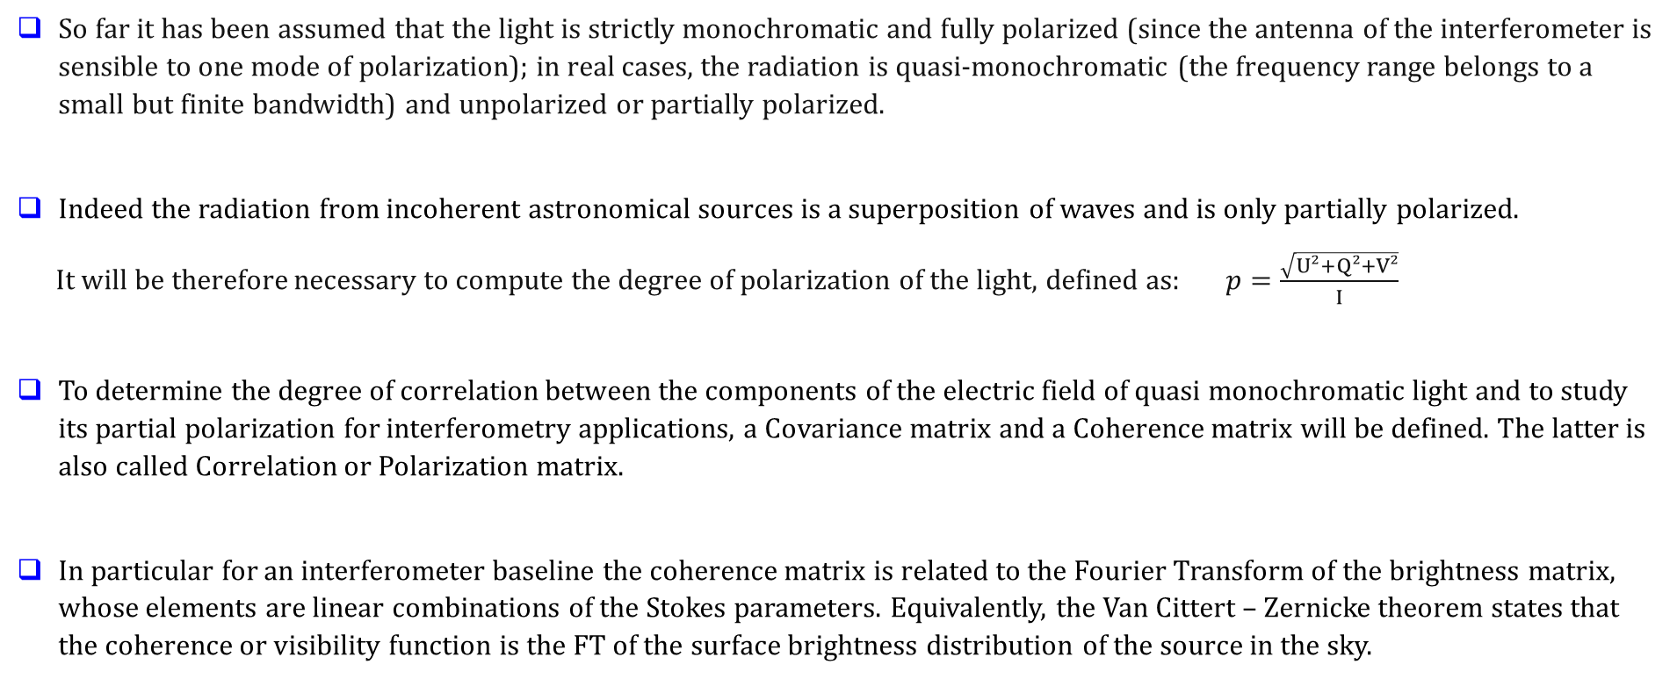
When a light beam interacts with matter, circularly polarized photons can exert a torque by transferring spin angular momentum to an absorbing particle, setting it in a rotational motion around its own axis (spinning).
So far it has been assumed that the light is strictly monochromatic and fully polarized (since the antenna of the interferometer is sensible to one mode of polarization); in real cases, the radiation is quasi-monochromatic (the frequency range belongs to a small but finite bandwidth) and unpolarized or partially polarized.
Indeed the radiation from incoherent astronomical sources is a superposition of waves and is only partially polarized.
It will be therefore necessary to compute the degree of polarization of the light, defined as: $p=\frac{\sqrt{U²+Q²+V²}}{I}$
To determine the degree of correlation between the components of the electric field of quasi monochromatic light and to study its partial polarization for interferometry applications, a Covariance matrix and a Coherence matrix will be defined. The latter is also called Correlation or Polarization matrix.
In particular for an interferometer baseline the coherence matrix is related to the Fourier Transform of the brightness matrix, whose elements are linear combinations of the Stokes parameters. Equivalently, the Van Cittert – Zernicke theorem states that the coherence or visibility function is the FT of the surface brightness distribution of the source in the sky.

Slide 6
References:
Wilson, Rohlfs, Huttemeister. Tools of Radio Astronomy, Springer 2009
Born, Wolf. Principle of Optics, Cambridge University Press 2003
Mandel, Wolf. Optical coherence and quantum optics, Cambridge University Press 1995
Ivan Martì Vidal. Polarization in Interferometry, ESO ERIS 2015
Robert Laing. Fundamentals of Interferometry, ESO ERIS 2013

