Slide 1
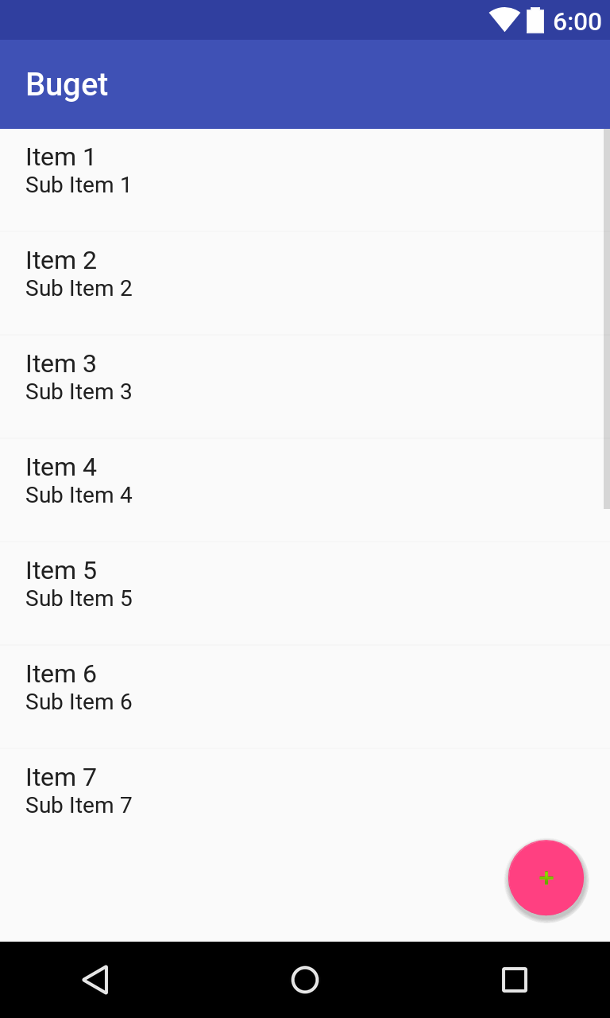
MainActivity

Slide 2
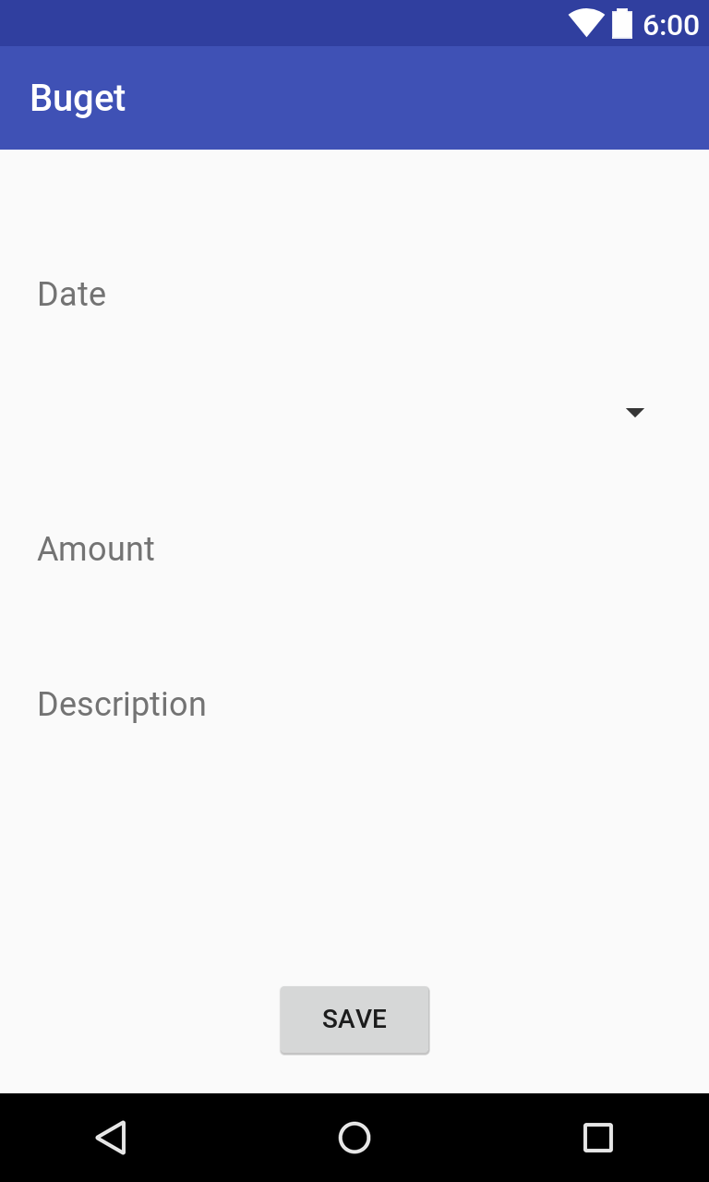
NewExpenseActivity
TextInputLayout
Spinner
Button

Slide 3
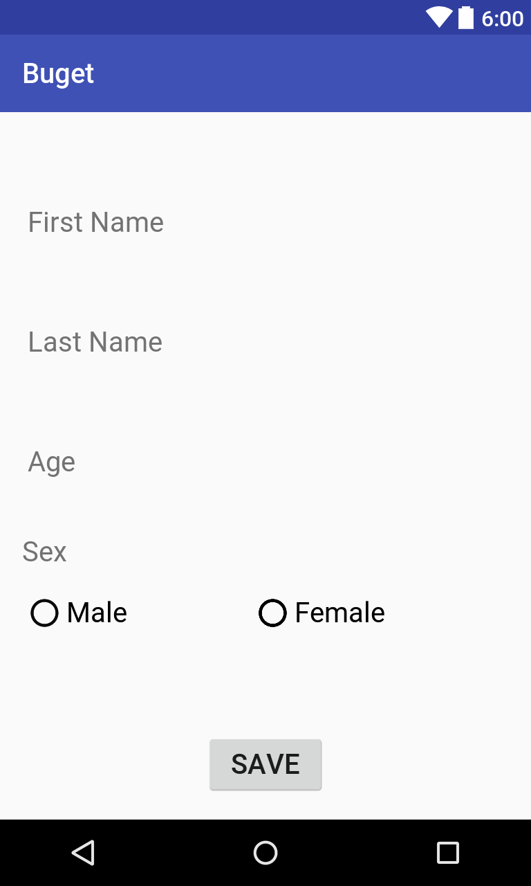
ProfileActivity
TextInputLayout
RadioButton + RadioGroup
TextView
Button

Slide 4
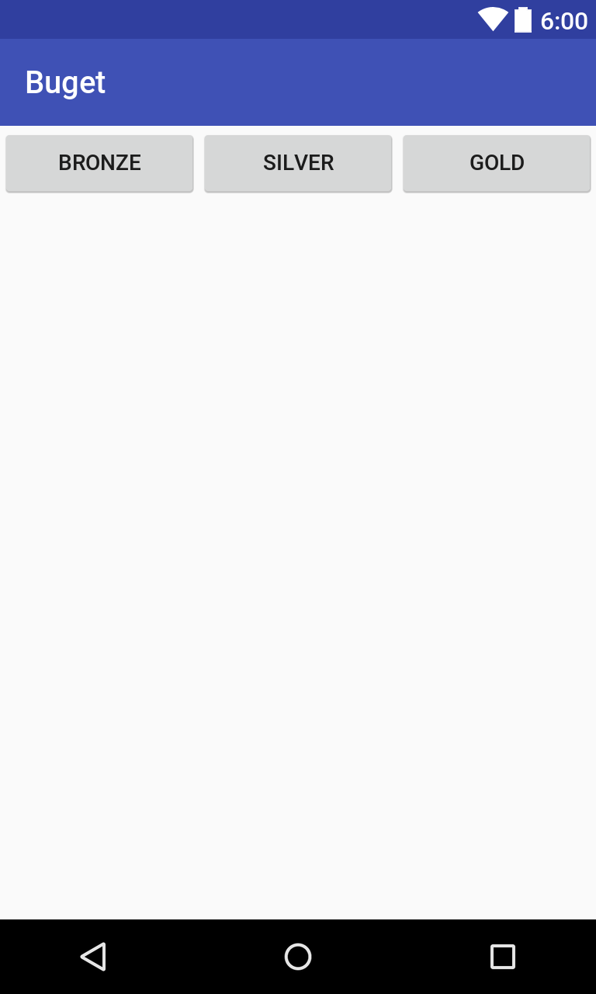
PremiumActivity
Button

Slide 5

IncomeInformationActivity
TextInputLayout
TextView
Button

Slide 6
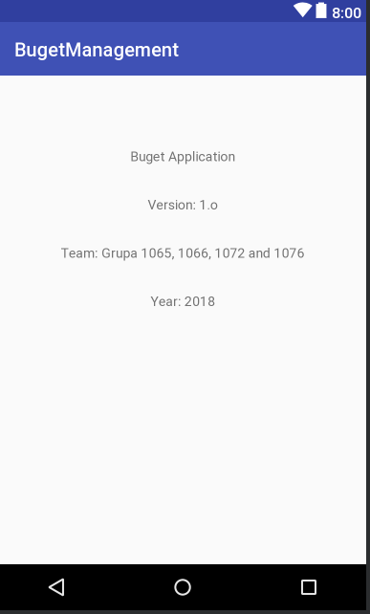
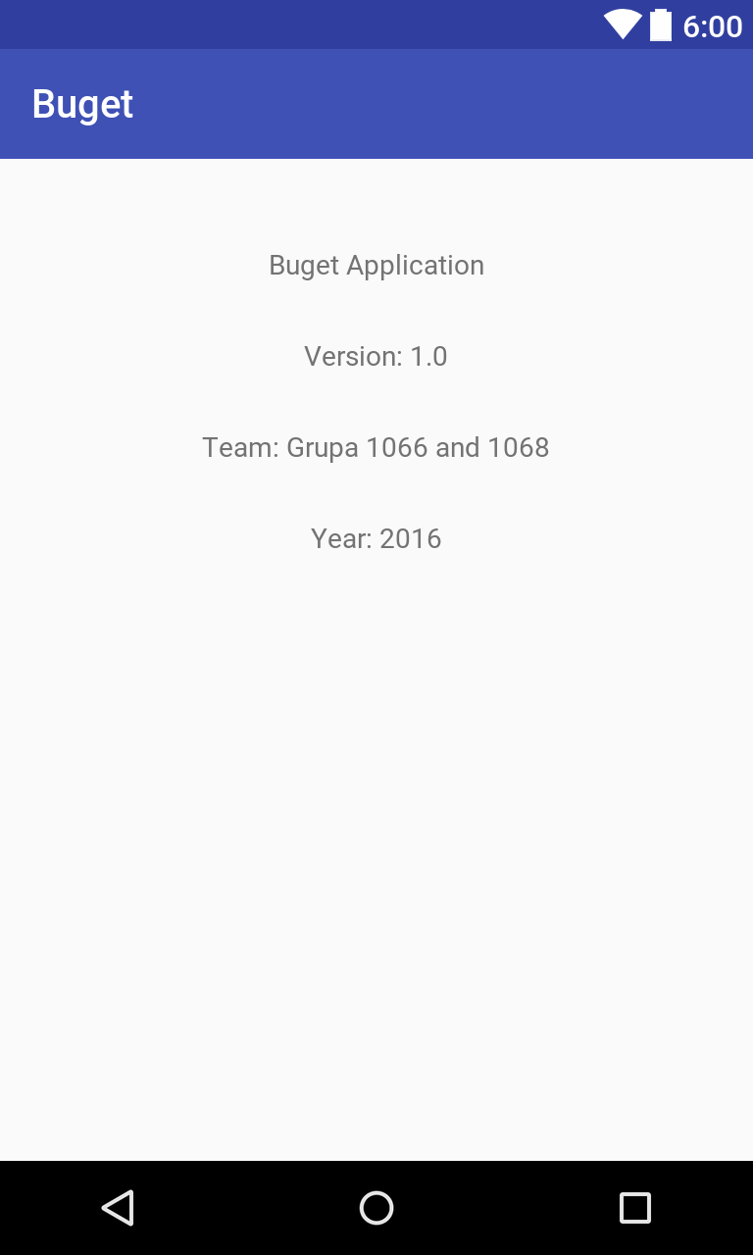
AboutActivity
TextView

