Slide 1
Sistema de Autenticación Externa
OBJETIVO:
1 . Registrar usuarios
2 . Iniciar sesión

Slide 2
OIDC
+ OAUTH Authorization Code Flow
+ PKCE
SPA
SAE
IDP
1
2
Sistema de Autenticación Externa
Proveedor de Identidad Externo
Aplicación Blazor Web Assembly
OIDC + OAUTH Authorization Code Flow + PKCE
OIDC + OAUTH Authorization Code Flow + PKCE

Slide 3
Authorization Code Flow + PKCE
El Cliente es redireccionado al IDP para solicitar un Código de Autorización.
El IDP solicita la autorización del usuario.
El IDP envía al cliente el código de autorización.
El cliente solicita el Id token/Access token proporcionando un código de autorización a través de una petición POST.
El IDP envía el Id token/Access token.

Slide 4







Register
State
code_challege_method
Code verifier
Code challenge
Nonce
AppOptions
Api Authorization_Endpoint
SPA Client_Id
SPA Redirect_uri
oogle
Clic
Facebook
1
BuildUrl(IdProvider)
Microsoft
Url_Web_Api
Api Authorization_endpoint?
response_type = code
client_id = <SPA clientId>
redirect_uri = <SPA Redirect_uri>
State =<State>
Scope = register_<IdProvider>
Code_challenge = <code challenge>
Code_Challenge_Method =
<Code_Chellenge_Method>
nonce
Web API
Authorization_Endpoint
Navigate To
State
Code verifier
Nonce
scope
2
QueryString:
response_type: code
client_Id
scope: register_<Provider>
State
Redirect_uri
Code_Challenge
Code_Challenge_Method
Nonce
Notes:
NOTA: Al validar al cliente, se valida Client Id y Redirect_Uri
Single-Page Apps
https://www.oauth.com/oauth2-servers/single-page-apps/
Authorization Code Grant
https://www.oauth.com/oauth2-servers/server-side-apps/authorization-code/
Example Flow
https://www.oauth.com/oauth2-servers/server-side-apps/example-flow/
v
Protecting Apps with PKCE
https://www.oauth.com/oauth2-servers/pkce/
Authorization Request
https://www.oauth.com/oauth2-servers/pkce/authorization-request/

Slide 5

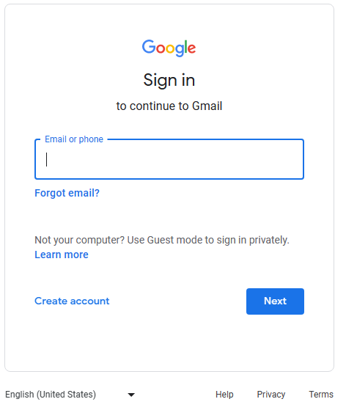

Web API
Authorize_Endpoint
2
QueryString:
response_type: code
client_Id
scope: register_<Provider>
State
Redirect_uri
Code_Challenge
Code_Challenge_Method
Nonce
Validate client
IdState
code_challege_method
Code verifier
Code challenge
Nonce
IdState
Code verifier
Nonce
IdProvider
ClientData
Client_Id
Redirect_Uri
Scope
State
Code challenge
Code challenge method
Nonce
Url_External_Provider
Provider Authorization_Endpoint?
response_type = code
client_id = <Api clientId>
redirect_uri = <Api Callback_Endpoint>
State =<IdState>
Scope = openid profile email
Code_challenge = <code challenge>
Code_Challenge_Method =
<Code_Chellenge_Method>
nonce
IdProvider
Scope.Provider
QS
3
IdProvider
Authorization_endpoint
Api Client_Id
Api Callback_Endpoint
HTTP 302
Location:
Url_External_Provider
Notes:
NOTA: Al validar al cliente, se valida Client Id y Redirect_Uri
Single-Page Apps
https://www.oauth.com/oauth2-servers/single-page-apps/
Authorization Code Grant
https://www.oauth.com/oauth2-servers/server-side-apps/authorization-code/
Example Flow
https://www.oauth.com/oauth2-servers/server-side-apps/example-flow/
v
Protecting Apps with PKCE
https://www.oauth.com/oauth2-servers/pkce/
Authorization Request
https://www.oauth.com/oauth2-servers/pkce/authorization-request/

Slide 6

4
HTTP 302
Location:
<redirect_uri>?state=<state>&code=<code>
QueryString
state=<state>&code=<code>
IDP
Token_Endpoint
Web API
Callback_Endpoint
HTTP POST: IDP Token_Endpoint
Request body
State => IdState
Code
5
QS
Request Body (FormUrlEncodedContent)
grant_type = authorization_code
code = <Code>
redirect_uri = <Api Callback_Endpoint>
client_id = <Api clientId>
Scope = openid profile email
code_verifier = <codeVerifier>
client_secret = <Api clientSecret>
Valid IdState exists
IdProvider
Token_Endpoint
Api Callback_Endpoint
Api Client_Id
Api Client secret
IdState
Code verifier
IdProveedor
Notes:
Authorization Code Request
https://www.oauth.com/oauth2-servers/access-tokens/authorization-code-request/
Authorization Code Exchange
https://www.oauth.com/oauth2-servers/pkce/authorization-code-exchange/

Slide 7
6
JSON Response
access_token = <Access token>
Id_token = <Id token>
Expires = <expires>
Id Token
JSON
Nonce
Id Token
IdState
Nonce
Validate Nonces
HTTP 302
Location:
<redirect_uri>?state=<state>&code=<IdState>
IdState
+ Id Token
IdState.Clientdata
Redirect_Uri
7
Notes:
Single-Page Apps
https://www.oauth.com/oauth2-servers/single-page-apps/

Slide 8
7
HTTP 302
Location:
<redirect_uri>?state=<state>&code=<code>
State
Code
Web API
Token_Endpoint
QS
IdState
Valid IdState
HTTP POST: Api Token_Endpoint
Request body
Code verifier
scope
Request Body (FormUrlEncodedContent)
grant_type = authorization_code
code = <Code>
redirect_uri = <Spa Callback_Endpoint>
client_id = <Spa clientId>
Scope = <scope>
code_verifier = <codeVerifier>
AppOptions
Api Token_Endpoint
SPA Callback_Endpoint
SPA Client_Id
8
Notes:
Authorization Code Request
https://www.oauth.com/oauth2-servers/access-tokens/authorization-code-request/
Authorization Code Exchange
https://www.oauth.com/oauth2-servers/pkce/authorization-code-exchange/

Slide 9
Web API
Token_Endpoint
8
HTTP POST: Api Token_Endpoint
Request body
grant_type = authorization_code
code = <Code>
redirect_uri = <Spa Callback_Endpoint>
client_id = <Spa clientId>
Scope = <scope>
code_verifier = <codeVerifier>
Code => Id State
Request
JSON Response
Access Token
Refresh Token
Valid IdState exists
IdState.IdProvider
9
Access_Token
UserName
EMail
First Name
Last Name
nonce
Refresh_Token
IdState.ClientData
Redirect_uri => c_redirect_Uri
Client_Id => c_client_Id
Scope => c_scope
Code challenge => c_cch
Code challenge method => c_cm
Nonce => nonce
Id_token => id_token
Validate:
Grant_type == authorization code
Redirect_uri == c_Redirect_uri
Client_id == c_client_id
Scope == c_scope
Hash(code_verifier) == c_cch
GetTokens(c_scope, id_token, Idprovider, nonce)

