Slide 1




Creation of an embedding alignment program by dynamic programming
Adriana Lecourieux
M2 BI
LSYIKIMD-VGQSY-V-VNR---VADHIQSRIVYYLMNIH------V-TPR
LAK--VRTDLPL--E-V-DFAKRR-EPDRERLRAFLERLEFGSLLHEF---

Slide 2
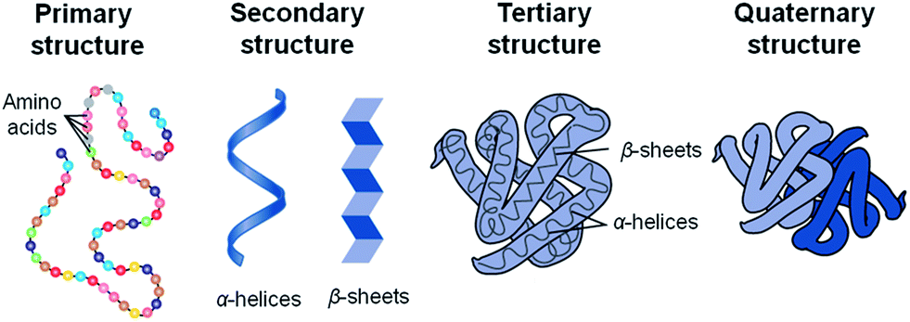
Introduction
Sequence alignment
https://www.toppr.com/ask/content/concept/levels-of-protein-organization-200359/
Embedding
1 protein sequence = 1 embedding
= X vectors of 1024 dimensions where X = number of amino acids in sequence
Sequence : L S Y
Embedding : vector 1 vector 2 vector3
(dim1, dim2, …, dim1024)
(dim1, dim2, …, dim1024)
(dim1, dim2, …, dim1024)

Slide 3
Material and methods
1033 embeddings (T5 ProtTrans mehtod) and fasta files
TMscore file :
- Similarites between protein structures
- Score between 0 and 1
arch_histone_1a7w compared to histone_1aoic : 0.85442
6PF2K_1bif compared to 5_3_exonuclease_1bgxt : 0.30667
3 algorithms :
Global (Needleman and Wunsch) : evaluation of the overall resemblance between two sequences
Local: (Smith and Waterman) : regions of strong similarity
Semi-Global (based on Needleman and Wunsch method) : global for one sequence and local for the other

Slide 4
Workflow
Input : Python main.py embedding1 + embedding2 + fasta1 + fasta2 + method (optional) + gap penalty (optional)
Pre-processing
pre_process_emb.py
fasta_sequences.py
semi_global.py
gap penalty fixe or affine
Dot product matrix
score_fonction.py
smith_waterman.py
gap penalty fixe or affine
needleman_wunsch.py
gap penalty fixe or affine
Transformed matrix + backtracing
save_output.py
Output : pairwise alignment as an amino acid sequence

Slide 5
arch_histone_1a7w compared to histone_1aoic : alignment results
Global alignment
Interaction with DNA (source : Uniprot)
MEL------------PIAPIGRIIK-D-A-G-AERVSDDARIT-LAKILEEMGRDIASE-A-IKLA-RHAGRKT-I-KAEDIELAVRRFK---------------
RAKAKTRSSRAGLQFPVGRVHRLLRK-G-N-YAERVGAGAPV-YLAAVLEYLTAEILE-L-AGNA-ARDNKKT-R-IIPRHLQLAVRNDEELNKLLGRVTIAQGG
Local alignment
MEL------------PIAPIGRIIK-D-A-G-AERVSDDARIT-LAKILEEMGRDIASE-A-IKLA-RHAGRKT-I-KAEDIELAVRRFK---------------
RAKAKTRSSRAGLQFPVGRVHRLLRK-G-N-YAERVGAGAPV-YLAAVLEYLTAEILE-L-AGNA-ARDNKKT-R-IIPRHLQLAVRNDEELNKLLGRVTIAQGG
Semi-global alignment
MEL------------PIAPIGRIIK-D-A-G-AERVSDDARIT-LAKILEEMGRDIASE-A-IKLA-RHAGRKT-I-KAEDIELAVRRFK---------------
RAKAKTRSSRAGLQFPVGRVHRLLRK-G-N-YAERVGAGAPV-YLAAVLEYLTAEILE-L-AGNA-ARDNKKT-R-IIPRHLQLAVRNDEELNKLLGRVTIAQGG
Histone-Fold Superfamily (source : InterPro)
The histone-fold consists of a core of three helices, where the long middle helix is flanked at each end by shorter ones.

Slide 6
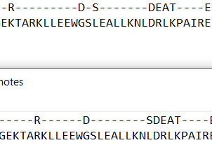
6PF2K_1bif compared to 5_3_exonuclease_1bgxt : alignment results
Global alignment
LSYIKIMD-VGQSY-V-VNR---VADHIQSRIVYYLMNIH------V-TPR
LAK--VRTDLPL--E-V-DFAKRR-EPDRERLRAFLERLEFGSLLHEF---
Local alignment
LSYIKIMD-VGQSY-V-VNR---VADHIQSRIVYYLMNIH------V-TPR
LAK--VRTDLPL--E-V-DFAKRR-EPDRERLRAFLERLEFGSLLHEF---
Semi-global alignment
LSYIKIM-DVGQSYV-VNRVA-D--HIQSRIVYYLMNIH------V-TPR
LAKVR--TDLPLE--V-DF-AKRREPDRERLRAFLERLEFGSLLHEF---
Alignement global avec pénalité de gap fixe à 0
Alignement global avec pénalité de gap affine (-1, 0)
arch_histone_1a7w
histone_1aoic

Slide 7
Discussion and conclusion
Change gap penalty
Check maximum score
Embeddings improve the alignment quality

Slide 8
Thank you for your attention !

Slide 9
A
arch_histone_1a7w par rapport à histone_1aoic
Alignement global
MEL------------PIAPIGRIIK-D-A-G-AERVSDDARIT-LAKILEEMGRDIASE-A-IKLA-RHAGRKT-I-KAEDIELAVRRFK---------------
RAKAKTRSSRAGLQFPVGRVHRLLRK-G-N-YAERVGAGAPV-YLAAVLEYLTAEILE-L-AGNA-ARDNKKT-R-IIPRHLQLAVRNDEELNKLLGRVTIAQGG
Alignement local
MEL------------PIAPIGRIIK-D-A-G-AERVSDDARIT-LAKILEEMGRDIASE-A-IKLA-RHAGRKT-I-KAEDIELAVRRFK---------------
RAKAKTRSSRAGLQFPVGRVHRLLRK-G-N-YAERVGAGAPV-YLAAVLEYLTAEILE-L-AGNA-ARDNKKT-R-IIPRHLQLAVRNDEELNKLLGRVTIAQGG
Alignement semi-global
MEL------------PIAPIGRIIK-D-A-G-AERVSDDARIT-LAKILEEMGRDIASE-A-IKLA-RHAGRKT-I-KAEDIELAVRRFK---------------
RAKAKTRSSRAGLQFPVGRVHRLLRK-G-N-YAERVGAGAPV-YLAAVLEYLTAEILE-L-AGNA-ARDNKKT-R-IIPRHLQLAVRNDEELNKLLGRVTIAQGG
6PF2K_1bif par rapport à 5_3_exonuclease_1bgxt
Alignement global avec pénalité de gap fixe à 0
Alignement global avec pénalité de gap affine (-1, 0)
-1-
-2-

Slide 10
arch_histone_1a7w par rapport à histone_1aoic
Alignement global
MEL------------PIAPIGRIIK-D-A-G-AERVSDDARIT-LAKILEEMGRDIASE-A-IKLA-RHAGRKT-I-KAEDIELAVRRFK---------------
RAKAKTRSSRAGLQFPVGRVHRLLRK-G-N-YAERVGAGAPV-YLAAVLEYLTAEILE-L-AGNA-ARDNKKT-R-IIPRHLQLAVRNDEELNKLLGRVTIAQGG
A
Alignement local
MEL------------PIAPIGRIIK-D-A-G-AERVSDDARIT-LAKILEEMGRDIASE-A-IKLA-RHAGRKT-I-KAEDIELAVRRFK---------------
RAKAKTRSSRAGLQFPVGRVHRLLRK-G-N-YAERVGAGAPV-YLAAVLEYLTAEILE-L-AGNA-ARDNKKT-R-IIPRHLQLAVRNDEELNKLLGRVTIAQGG
Alignement semi-global
MEL------------PIAPIGRIIK-D-A-G-AERVSDDARIT-LAKILEEMGRDIASE-A-IKLA-RHAGRKT-I-KAEDIELAVRRFK---------------
RAKAKTRSSRAGLQFPVGRVHRLLRK-G-N-YAERVGAGAPV-YLAAVLEYLTAEILE-L-AGNA-ARDNKKT-R-IIPRHLQLAVRNDEELNKLLGRVTIAQGG
B
6PF2K_1bif par rapport à 5_3_exonuclease_1bgxt
Alignement global
LSYIKIMD-VGQSY-V-VNR---VADHIQSRIVYYLMNIH------V-TPR
LAK--VRTDLPL--E-V-DFAKRR-EPDRERLRAFLERLEFGSLLHEF---
Alignement local
LSYIKIMD-VGQSY-V-VNR---VADHIQSRIVYYLMNIH------V-TPR
LAK--VRTDLPL--E-V-DFAKRR-EPDRERLRAFLERLEFGSLLHEF---
Alignement semi-global
LSYIKIM-DVGQSYV-VNRVA-D--HIQSRIVYYLMNIH------V-TPR
LAKVR--TDLPLE--V-DF-AKRREPDRERLRAFLERLEFGSLLHEF---

Slide 11
H------V-T
LEFGSLLHEF-

