Slide 1

Work Assignment
Advanced Architectures
Adriana Meireles a82582
Shahzod Yusupov a82617

Slide 2
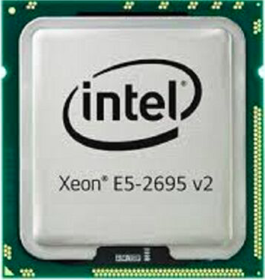
Cluster 662-node
#Cores = 12
#of Threads = 24
Processor Base Frequency = 2.40 GHz
Cache = 30MiB Intel® Smart Cache
Max Memory Bandwidth = 59.7 GB/s Intel® Xeon® Processor E5-2695 v2
Instruction Set = 64-bit

Slide 3
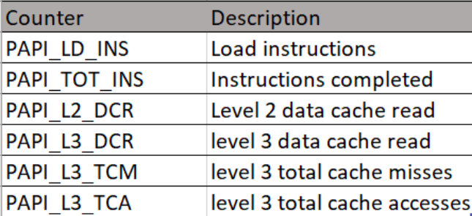
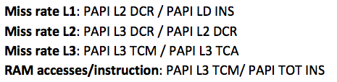
Papi Performance Counters

Slide 4
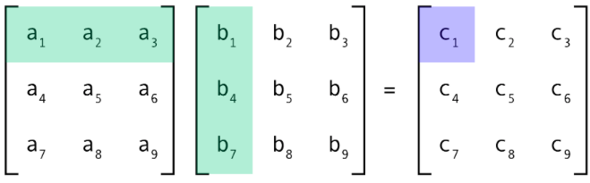
Case Study
Matrix – Matrix Multiplication

Slide 5
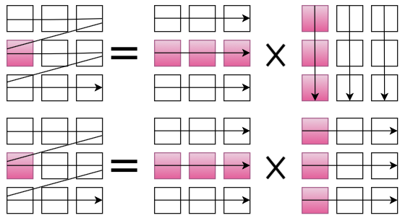
Algorithm IJK
IJK
IJK Transposed

Slide 6
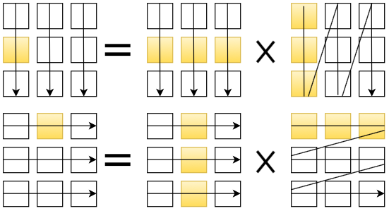
Algorithms JKI
JKI
JKI Transposed

Slide 7
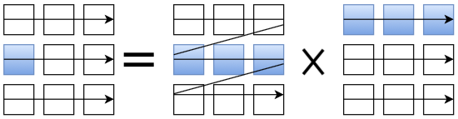
Algorithms IKJ

Slide 8
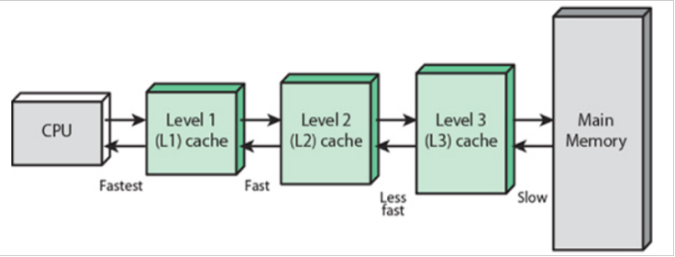
How to choose data set size
Size * Size *3(matrices) * 4(float size) <= Cache Level Size
Cache L1 (32 KiB) -> Size = 32
Cache L2 (256 KiB) -> Size = 128
Cache L3 (30 MiB) -> Size = 1024
RAM ( at least 4*L3 ~ 120MiB ) -> Size = 2048

Slide 9
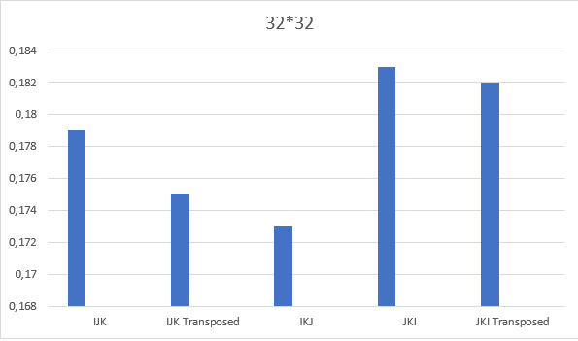
Execution times (milliseconds)

Slide 10
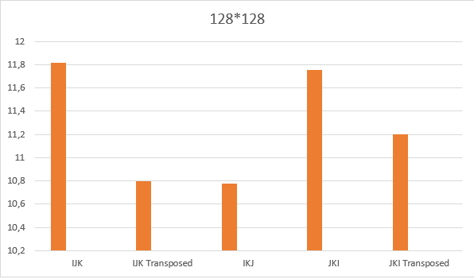
Execution times ( milliseconds)

Slide 11
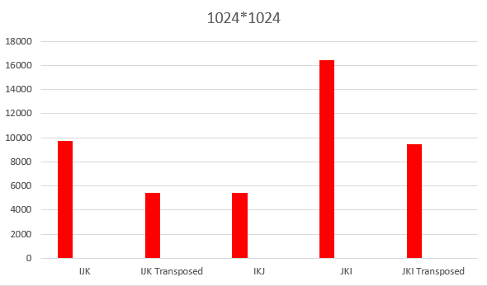
Execution times ( milliseconds)

Slide 12
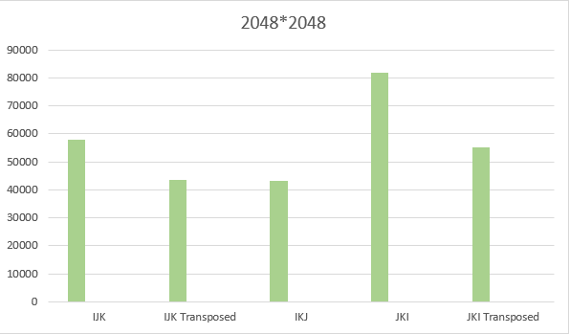
Execution times (milliseconds)

Slide 13
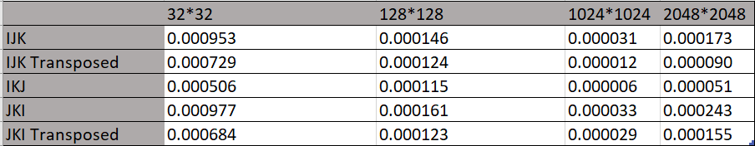
RAM accesses/ instruction

Slide 14
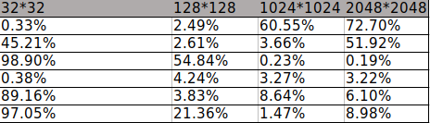
Miss rates
L1
L2
L3
L1
L2
L3
IJK
IJK_T

Slide 15
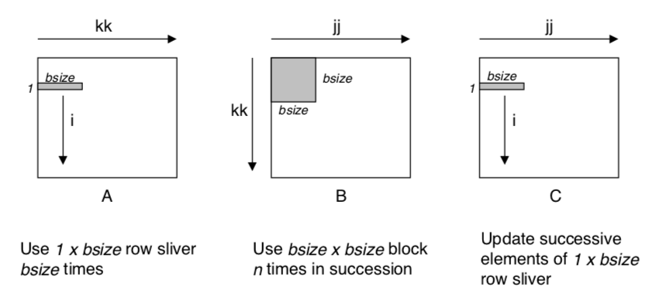
Blocking Optimization

Slide 16
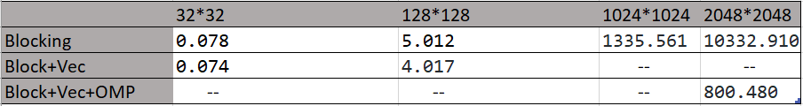
Time Measurements

Slide 17

Knights Landing many-core server

Slide 18
Work Assignment
Advanced Architectures
Adriana Meireles a82582
Shahzod Yusupov a82617

